Slide 1

OpenMP

Slide 2
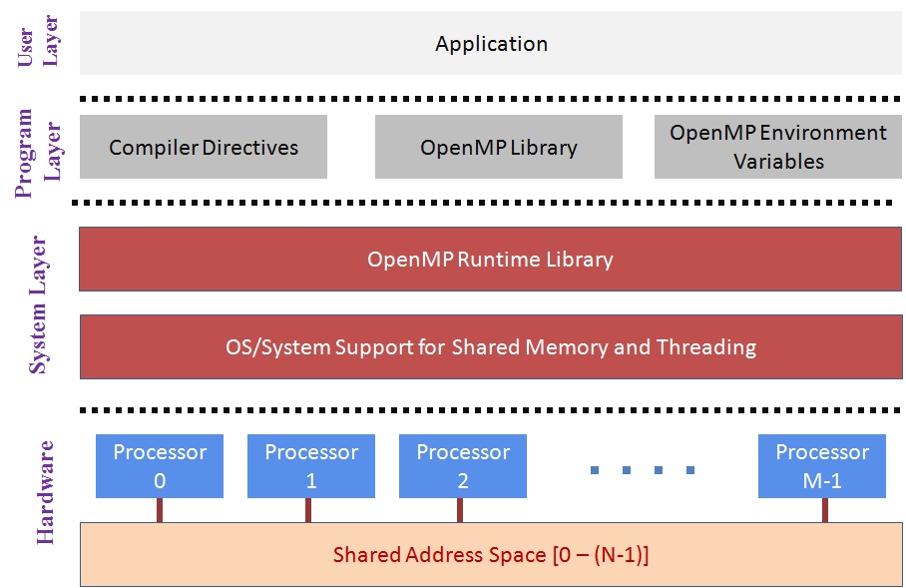
OpenMP Overview
OpenMP is an API for developing multi threaded Applications
collection of compiler directives and library routines
Available for C, C++ and Fortran

Slide 3
OpenMP Syntax
Most OpenMP constructs are compiler directives
#pragma omp construct [clause[clause]…]
Example:
OpenMP Constructs apply to a Structured Block.
One or more Statements with a point of entry at top and point of exit at bottom.
Can use exit() at bottom
Prototypes and types are defined in omp.h
#include <omp.h>
#pragma omp parallel num_threads(4)
{
…Structured Block…
}

Slide 4
Example 1
#include<stdio.h>
#include<omp.h>
void main()
{
#pragma omp parallel
{
int tid;
tid= omp_get_thread_num();
printf(“Thread %d:Hello World\n”,tid);
}//end of parallel section
}//end of main
#include<stdio.h>
void main()
{
printf(“Hello World\n”);
}

Slide 5

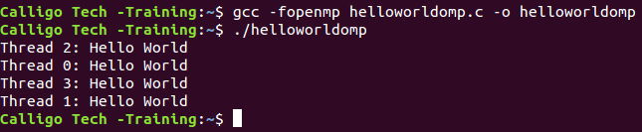
Example 1 - Solution
#include<stdio.h>
void main()
{
printf(“Hello World\n”);
}
#include<stdio.h>
#include<omp.h>
void main()
{
#pragma omp parallel
{
int tid;
tid= omp_get_thread_num();
printf(“Thread %d:Hello World \n” ,tid);
}//end of parallel section
}//end of main

Slide 6
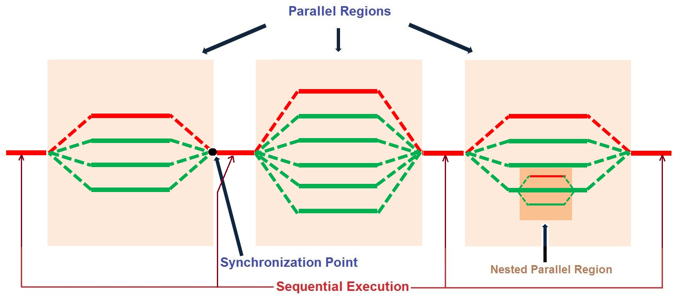
OpenMP Programming Model
Sequential Primary Thread spawns a number of threads.
A sequential program, adds threads where parallelism is permissible (Eg. Loops) to enhance performance and evolve as a parallel program.
Threads can be nested. The maximum number of threads depends on the underlying operating system.
Number of threads can also be set by Environment variable.

Slide 7
OpenMP Programming Model
int array[20];
#pragma omp parallel num_threads(5)
{
int threadID = omp_get_thread_num();
foo(threadID, array);
}//end of parallel region
printf(“End of threads\n”);
Function foo() is executed by each of the 5 threads redundantly.
Variable array is shared/common to all the 5 threads.
Variable threadID has a different value for each thread, 0-4.

Slide 8
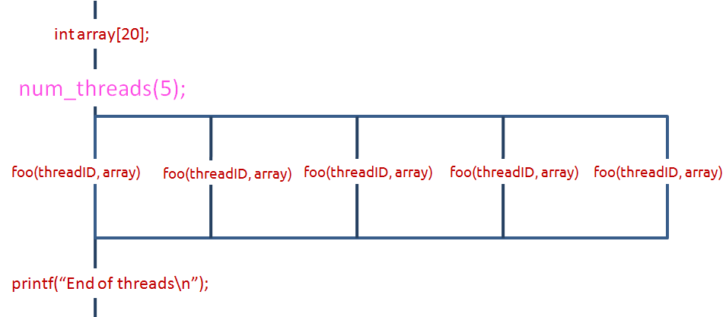
OpenMP Programming Model
void foo(int id, int a[])
{
int i;
printf(“Thread %d\n”,id);
for(i=0;i<20;i++)
printf(“a[%d]=%d”,i,a[i]);
}//end of foo()

Slide 9
OpenMP Programming Model
Threads communicate with Shared variables, within a Shared address space
Unintended sharing of variables are reasons for Race Conditions ( When the program outcome is different/unpredictable with changes in thread scheduling, implies Race Condition)
Synchronization is used to prevent race conditions and data conflicts
Synchronization leads to performance loss, rethinking data usage is better.

Slide 10
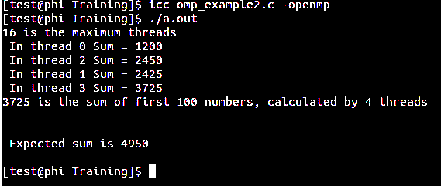
Example 2
//Header files
void main()
{
long *array,index,sum=0,expected_sum;
int max_threads, nthreads;
//Allocate memory and initialize
omp_set_num_threads(4);
#pragma omp parallel
{
int cnt, tid=omp_get_thread_num();
int nthreads=omp_get_num_threads();
for(cnt=tid;cnt<size;cnt+=nthreads)
sum+=array[cnt];
printf(" In thread %d Sum = %ld\n",tid,sum);
}
expected_sum=((size)*(size-1))/2;
printf("%ld is the sum of first %d numbers, calculated by %d threads\n",sum,size,nthreads);
printf("\n\n Expected sum is %ld\n\n",expected_sum);
}
Race condition

Slide 11
Synchronization
Synchronization constructs impose order and restrict/protect access to shared variables in the program.
Atomic
Critical
Barrier
Ordered
Flush
Locks
Notes:
While parallel programming helps achieve higher performance we have to handle the synchronization of code, data or both to make sure program results are consistent. OpenMP supports synchronization primitives that can be used to write parallel programs that deliver correct/consistent results.

Slide 12
Synchronization - Atomic
Atomic provides mutual exclusion and applies to read/update of a single shared variable (memory location).
//Include Header files
#define size 100
void main()
{
//Declare, Allocate and Intialize
omp_set_num_threads(4);
#pragma omp parallel
{
int cnt, tid=omp_get_thread_num();
int nthreads=omp_get_num_threads();
for(cnt=tid;cnt<size;cnt+=nthreads)
#pragma omp atomic
sum+=array[cnt];
printf(" In thread %d Sum = %ld\n", tid, sum );
}
expected_sum=((size)*(size-1))/2;
printf("%ld is the sum of first %d numbers, calculated by %d threads\n",sum,size,nthreads);
printf("\n\n Expected sum is %ld\n\n",expected_sum);
}
Avoid Race
condition
using atomic
Notes:
Declare Sum and array variables.

Slide 13
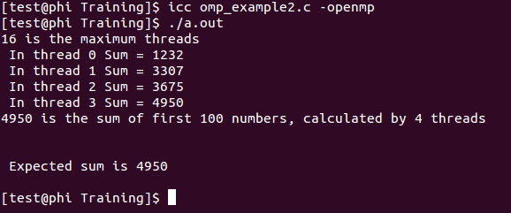
Synchronization – Atomic Example
©2015 Calligo Technologies Pvt. Ltd., All rights reserved. All other trademarks or registered trademarks are the property of their respective owners

Slide 14
Synchronization (Contd..)
atomic | Atomic provides mutual exclusion and applies to read/update of a single shared variable (memory location).
critical | Critical provides mutual exclusion for a region. Only one thread enters a critical region.
barrier | Barrier provides a mechanism to get all threads to a point, before continuing further.
ordered | Ordered region is executed in a sequential order.
flush | Flush forces variable to be updated in memory for other threads to see an updated value.
locks | Protects resources for a thread. A thread can lock a resource and release it for others.
Notes:
Here is a summary of synchronization constructs supported in OpenMP. One has to be careful in choosing the correct synchronization method with minimal performance impact

Slide 15
Useful Functions
int omp_get_num_threads() | Returns total number of active threads
int omp_get_thread_num() | Returns thread number
num_threads(int) | Sets the total number of threads to spawn
omp_set_num_threads(int) | Sets the maximum number of threads at runtime.
double omp_get_wtime() | Returns current time of the machine
int omp_num_procs() | Returns number of logical processors
float omp_wtime() | Returns current time
Notes:
Here is a list of useful functions that parallel programs may use. We have seen some of these functions used in previous examples.

Slide 16
Work Sharing
Work-Sharing constructs enable in dividing of a task among threads, where each thread executes its portion of code.
Sequential Code:
int cnt;
int a[N], b[N];
for(cnt = 0; cnt < N; cnt++)
{ a[cnt] = a[cnt] + b[cnt]; }
Parallel Code (Explicit Work-Sharing):
int i, a[N], b[N];
#pragma omp parallel
{ int id, totalTh, I, startCnt, endCnt;
id = omp_get_thread_num();
totalTh = omp_get_num_threads();
startCnt = id * N/totalTh;
endCnt = (id + 1) *N/totalTh;
if (id == (totalTh-1)) endCnt = N;
for(i=startCnt; i<endCnt; i++)
{a[i] = a[i] + b[i];} }
SPMD: Basically its Single Program, Multiple Data construct. Same program being executed redundantly.
Notes:
We have looked at some examples that must have given you an idea of the structure of a parallel program. The parallelization is achieved by sharing a workload across multiple CPUs or cores

Slide 17
Work Sharing(cont..)
Parallel code work-sharing for construct:
#pragma omp parallel
{
#pragma omp for
for(i=0; i<N; i++)
{
a[i] = a[i] + b[i];
}
}//end of parallel region
Parallel code work-sharing for construct with parallel construct:
#pragma omp parallel for
{
for(i=0; i<N; i++)
{
a[i] = a[i] + b[i];
}
}//end of parallel region

Slide 18
Work Sharing(cont..)
section | Denotes consecutive but independent code blocks to different threads
single | Denotes a structured block which is executed by one thread only (not necessarily by master/primary thread)
master | Denotes a structured block which is executed only by the master/primary thread.

Slide 19
Data Sharing
#include<stdio.h>
#include<omp.h>
#include<malloc.h>
#define size 100000000
long add_array(long int *arr,int length);
void main()
{
long int *array,sum[omp_get_max_threads()],index, total=0;
array=(long int *)malloc(size*sizeof(*array));
for(index=0;index<size;index++)
array[index]=index;
for(index=0;index<omp_get_max_threads();index++)
sum[index]=0;
#pragma omp parallel
{
int tid = omp_get_thread_num();
sum[tid]+=add_array(array,size);
printf(" In thread %d Sum[%d] = %ld\n",tid,tid,sum[tid]);
}//end of parallel region
total=add_array(sum,omp_get_max_threads());
printf("%ld is the sum of first %d numbers\n",total, size);
}//main()
Variables
array, sum[], index, total are
Shared by
all threads
Private to
each thread
Notes:
We have looked at some of the work sharing constructs. OpenMP also supports Data sharing mechanisms

Slide 20
Data Sharing(Cont..)
long add_array(long int *arr,int length)
{ long count,add=0;
#pragma omp for
for(count=0;count<length;count++)
add+=arr[count];
return add;
}
Private to each thread

Slide 21
Data Sharing Attributes
PRIVATE | Used to make variables in the list private to each thread
FIRST PRIVATE | Behaves same as PRIVATE attribute but with automatic initialization of the variables in the list
LAST PRIVATE | Behaves same as PRIVATE attribute but value of variable from last loop iteration or section is copied back to original variable
THREAD PRIVATE | It is used to make global variables local and persistent across threads and parallel regions
SHARED | It is used to share the variables in the list among all the threads
COPYIN | It is used to initialize the THREAD PRIVATE variables while entering parallel region
COPYPRIVATE | It is used to broadcast the values of private variables to the private instances of the variables in other threads
REDUCTION | It is used to maintain a private copy of shared global variable for each thread, apply reduction variable on the private copies and copy the final reduced value to the global shared variable.a

Slide 22
Environment variables
Variable | Value | Description
OMP_SCHEDULE | “guided, 4” “dynamic” | set schedule clause of omp for
OMP_NUM_THREADS | positive integer | Set number of threads to use
OMP_DYNAMIC | TRUE, FALSE | Dynamically adjust number of threads to be used
OMP_PROC_BIND | TRUE, FALSE | Thread binding to processor
OMP_NESTED | TRUE, FALSE | nested parallelism
OMP_STACKSIZE | Memory in Bytes | Controls the size of the stack for created (non-Master) threads
OMP_THREAD_LIMIT | positive integer | Sets the number of OpenMP threads to use for the whole OpenMP program.
Notes:
Here is a list of environment variables that control the behavior of the OMP execution

Slide 23
OpenMP Summary
OpenMP Summary
OpenMP(Open specifications for Multi-Processing) is Application Program Interface(API) that can be used to explicitly direct multi-threaded, shared memory parallelism.
It comprises of Compiler directives, Environment variables and Runtime routines .
It is specified for both C/C++ and Fortran.
It provides different data sharing constructs to share/restrict access to data variables among the threads.
It also provides different synchronization constructs to provide mutual exclusion, avoid race condition.

Slide 24
<Blank>

Slide 25
<Blank>

Slide 26
<Blank>

