Slide 1

OpenMP Part II

Slide 2
OpenMP History
Till 2005 OpenMP Architecture Review Board(ARB) published API specifications separately for C and Fortran.
Month/Year | Version
Oct 1997 | Fortran 1.0
Oct 1998 | C/C++ 1.0
Nov 1999 | Fortran 1.1
Nov 2000 | Fortran 2.0
Mar 2002 | C/C++ 2.0
May 2005 | OpenMP 2.5
May 2008 | OpenMP 3.0
Jul 2011 | OpenMP 3.1
Jul 2013 | OpenMP 4.0

Slide 3
OpenMP History (contd..)
OpenMP 2.5
Combined Fortran 2.0 and C/C++ 2.0 OpenMP features
OpenMP 3.0
Tasks and the task construct
OpenMP 4.0
Addition or improvement in the following
Support for accelerators, atomic, error handling, thread affinity, tasking and extensions, user defined reduction, SIMD support, Fortran 2003 support

Slide 4
OpenMP (contd..)
Synchronization
Notes:
We have discussed an overview of synchronization capabilities supported in OPenMP. We will discuss more details here.

Slide 5
Synchronization
Synchronization constructs impose order and restrict/protect access to shared variables in the program.
Atomic
Critical
Barrier
Ordered
Flush
Locks

Slide 6
Critical
Critical enforces mutual exclusion. Only one thread enters the critical block at a time
//Add header files
#define size 40 //size of array
long update_sum(int tid);
int max_threads;
void main()
{ //Declare & Initialize
max_threads=omp_get_max_threads();
// omp_set_num_threads(max_threads);
#pragma omp parallel
{ int tid=omp_get_thread_num();
#pragma omp critical
{ update_sum(tid);
printf("After thread %d entering critical section, total = %ld\n",tid,total);
}
}// End of Parallel Region
printf("%ld is the sum of first %d numbers, calculated by %d threads\n",total,size, max_threads);
printf("Expected sum=%d\n", (size-1)*size/2); }//End of main
//Subroutine to add array elements
long update_sum(int tid)
{
for(count = tid; count < size; count = count+max_threads)
total+=array[count];
}
Critical Region
Notes:
We had already discuss atomic in earlier session. Atomic is used to synchronize access to a variable. Critical synchronization construct enforces mutual exclusion for a code segment. Only one thread enters the critical block

Slide 7
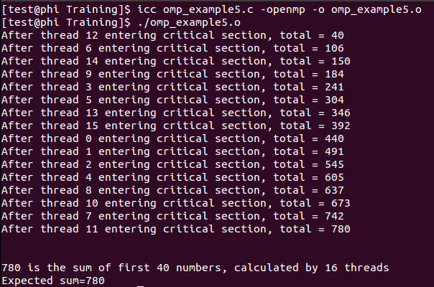
Critical Example

Slide 8
Barrier
Barrier – an explicit construct to create a barrier for all threads to arrive before proceeding further
Nowait – overrides the implicit barrier at end of parallel block
#pragma omp parallel {
.
.
#pragma omp barrier
.
.
#pragma omp for
for(int i=0……) { … }
.
.
#pragma omp for nowait
for(int i=0……) { … }
.
.
}
Explicit barrier among threads
Implicit barrier, end of parallel for block
No Implicit barrier,
end of parallel block due to nowait
Implicit barrier, end of parallel block

Slide 9
Barrier Example
Program to Find sum and product of N numbers stored in array.
//Header files
#define size 40 //size of array
void main()
{ //declare and intialize
#pragma omp parallel
{ int cnt, tid=omp_get_thread_num();
sum[tid]=0; prod[tid]=1; //Array sum
#pragma omp for
for(cnt=1;cnt<=size;cnt++)
sum[tid]+=array[cnt];
#pragma omp nowait
#pragma omp for //Factorial
for(cnt=1;cnt<=size;cnt++)
prod[tid]*=array[cnt];
printf(" In thread %d, Sum = %ld\t product = %ld\n",tid, sum[tid], prod[tid] );
}
}

Slide 10
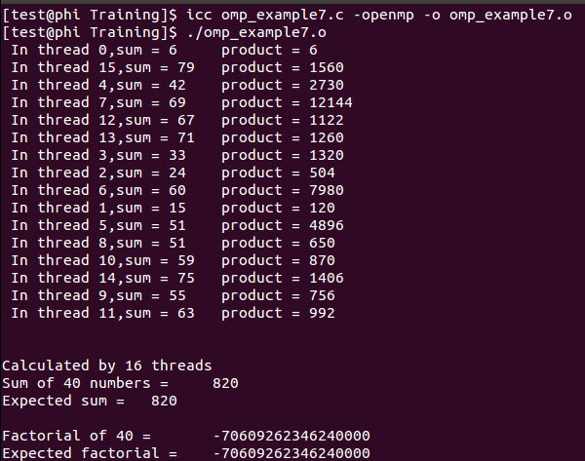
Barrier Example (contd..)
//Integrate
for(index=0;index<max_threads;index++)
{
total_sum+=sum[index];
factorial*=prod[index];
}
//Verify
unsigned long expected_factorial=1;
long expected_sum=0;
for(index=1;index<=size;index++)
expected_factorial*=array[index];
expected_sum=((size)*(size+1))/2;
printf("\n\nCalculated by %d threads\n",max_threads);
printf("Sum of %d numbers =\t%ld\n",size,total_sum);
printf("Expected sum =\t %ld\n\n",expected_sum);
printf("Factorial of %d =\t%ld\n",size,factorial);
printf("Expected factorial =\t%ld\n\n",expected_factorial);
}

Slide 11
Ordered
Threads execute concurrently till they encounter the order block
The order block will be executed sequentially, in the same sequence as a serial loop
#pragma omp for ordered
for(int cnt=0; cnt<=N; cnt++)
{
. PARALLEL AREA
.
#pragma ordered
{ .
AREA THAT IS SAME AS SERIAL LOOP
.
}
. PARALLEL AREA
.
}

Slide 12
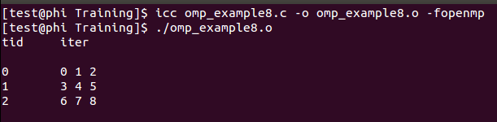
Ordered Example
//Header files
#define size 9
#define chunk 3
void main()
{
omp_set_num_threads(3);
int count;
printf("tid\titer\n");
#pragma omp parallel
{ int tid=omp_get_thread_num();
#pragma omp for schedule(static,chunk) ordered for(count=0;count<size;count++)
{
#pragma omp ordered
{ if((count%chunk)==0)
printf("\n%d\t",tid);
printf("%d ",count);}
}
}
printf("\n\n");
}

Slide 13
Flush
Flush - forces update of data in memory
Enables all threads to see an updated value of variable
float example_var;
.
.
#pragma omp parallel
{
.
example_var = foo();
.
.
#pragma omp flush(example_var);
.
.
}
All Threads see this value now

Slide 14
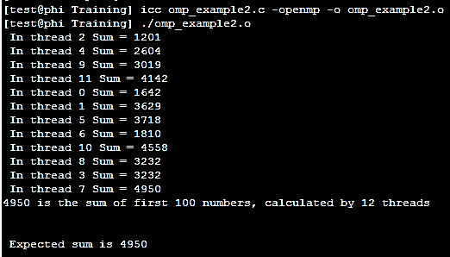
Flush Example
//Header files
#define size 100 //size of array
void main()
{ //Declare and Initialize
#pragma omp parallel
{ int cnt;
int tid=omp_get_thread_num();
for(cnt=tid;cnt<size;cnt+=nthreads)
{
#pragma omp atomic
sum+=array[cnt];
#pragma omp flush(sum)
}
printf(" In thread %d Sum = %ld\n",tid,sum);
}
printf("%ld is the sum of first %d numbers, calculated by %d threads\n", sum, size, max_threads);
printf("\n\n Expected sum is %ld\n\n", ((size)*(size-1))/2);
}

Slide 15
LOCK
Omp_set_lock(omp_lock_t *) and omp_unset_lock(omp_lock_t *) provide a mechanism to exclude all other threads and let only one
The thread always finds the latest copy of lock variable (does not need flush)
Omp_lock_t
Omp_lock_init(omp_lock_t *)
Omp_set_lock(omp_lock_t *)
Omp_unset_lock(omp_lock_t *)
Omp_test_lock(omp_lock_t *)
Omp_destroy_lock(omp_lock_t *)
omp_lock_t writeFileLock;
omp_init_lock(&writeFileLock);
#pragma omp parallel for
for ( i = 0; i < x; i++ )
{
// Common to all threads
omp_set_lock(&writeFileLock);
// one thread at a time updates file
omp_unset_lock(&writeFileLock);
// Common to all threads
}
omp_destroy_lock(&writeFileLock);

Slide 16
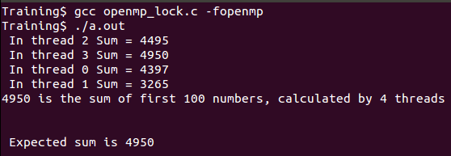
LOCK
//Header file
#define size 100 //size of array
void main()
{
//Declare and Initialize
omp_set_num_threads(4);
omp_lock_t updatelock; //Declaring lock variable
omp_init_lock(&updatelock); //Initializing lock
#pragma omp parallel
{ int cnt;
int tid=omp_get_thread_num();
int nthreads=omp_get_num_threads();
for(cnt=tid;cnt<size;cnt+=nthreads)
{
omp_set_lock(&updatelock);
sum+=array[cnt];
omp_unset_lock(&updatelock);
}
printf(" In thread %d Sum = %ld\n",tid,sum);
omp_destroy_lock(&updatelock);
}
//Print
}//end of main

Slide 17
NESTED LOCK
Nested Lock, locks several times. The number of set and unset locks should match.
Omp_nest_lock_t
Omp_init_nest_lock(Omp_nest_lock_t *)
Omp_set_nest_lock(Omp_nest_lock_t *)
Omp_unset_nest_lock(Omp_nest_lock_t *)
Omp_test_nest_lock(Omp_nest_lock_t *)
Omp_destroy_nest_lock(Omp_nest_lock_t *)

Slide 18
OpenMP (Cont…)
DATA ENVIRONMENT

Slide 19
Data Environment
Paradigm is Shared Memory
Most Variables are shared by default
Global Variables are shared among threads.
Static Variables
File Scope variables
Dynamically allocated variables
Variables not shared among threads
Local variables in functions called within a thread
Automatic variables within the thread block
Dynamic variables within thread blocks

Slide 20
Data Environment
int fileGlobal[100];
static int staticGlobal;
void main()
{
int progGlobal[20];
int abc, def;
.
#pragma omp parallel {
int threadLocal;
foo(abc, def, threadLocal);
.
.
}
// End threads
}
void foo(int a, int b, int c)
{
int fooLocal;
static int staticLocal;
.
.
}
Common to all threads
Only seen within each thread

Slide 21
Data Environment
Storage attributes can be changed within OpenMP
SHARED
PRIVATE
FIRSTPRIVATE
LASTPRIVATE
SHARED applies only to parallel constructs
PRIVATE, FIRSTPRIVATE, LASTPRIVATE apply to parallel and worksharing constructs

Slide 22
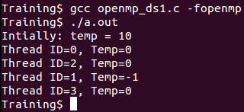
PRIVATE
PRIVATE(var) creates a new local copy of variable for each thread
Value is uninitialized
Access to Private Variable outside the construct is implementation dependent, best avoided
#include<stdio.h>
#include<omp.h>
void main()
{
int temp = 10,cnt = 23;
printf("Intially: temp = %d\n",temp);
#pragma omp parallel private(temp)
{
int threadID =omp_get_thread_num();
printf("Thread ID=%d, Temp=%d\n", threadID, temp);
}
}

Slide 23

FIRST PRIVATE
FIRSTPRIVATE(var) special case of private
Value in each thread is initialized to the one in master thread
#include<stdio.h>
#include<omp.h>
void main()
{
int temp = 10,cnt;
printf("Intially, temp = %d\n",temp);
#pragma omp parallel firstprivate(temp)
{
int threadID = omp_get_thread_num();
printf("Thread ID=%d Temp=%d\n", threadID, temp);
}
}

Slide 24
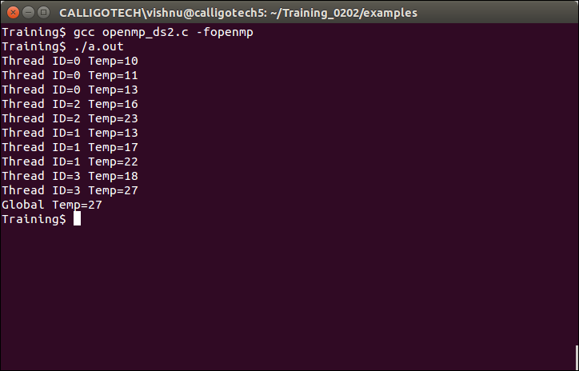
LAST PRIVATE
LASTPRIVATE(var) special case of private
The value of the last iteration is passed on to the global variable
#include<stdio.h>
#include<omp.h>
void main()
{
int cnt,temp = 10;
#pragma omp parallel for firstprivate(temp) lastprivate(temp)
for ( cnt=0; cnt<10; cnt++)
{
int threadID =omp_get_thread_num();
temp += cnt;
printf("Thread ID=%d Temp=%d\n",threadID, temp);
fflush(0);
}
printf("Global Temp=%d\n", temp);
}

Slide 25
PRIVATE,FIRST & LAST PRIVATE
//Header files
void main()
{
int cnt,tid,fpriv=10,lpriv=20,priv=30;
omp_set_num_threads(2);
printf("Intially: \nprivate=%d\tfirstprivate=%d\tlastprivate=%d\n“ ,priv,fpriv,lpriv);
#pragma omp parallel private(priv,tid) firstprivate(fpriv)
{
tid=omp_get_thread_num();
if (tid==0)
printf("After Entering parallel region: \n ");
printf("%d thread ==> private=%d\tfirstprivate=%d\tlastprivate=%d\n",tid,priv,fpriv,lpriv);
#pragma omp parallel for lastprivate(lpriv)
for(cnt=1;cnt<=10;cnt++)
lpriv=cnt*cnt;
if (tid==0)
printf("Before exiting parallel region: \n”);
printf("%d thread ==> private=%d\tfirstprivate=%d\tlastprivate=%d\n",tid,priv,fpriv,lpriv);
}
printf("Finally:\nprivate=%d\tfirstprivate=%d\tlastprivate=%d\n",priv,fpriv,lpriv);
fflush(0);
}

Slide 26
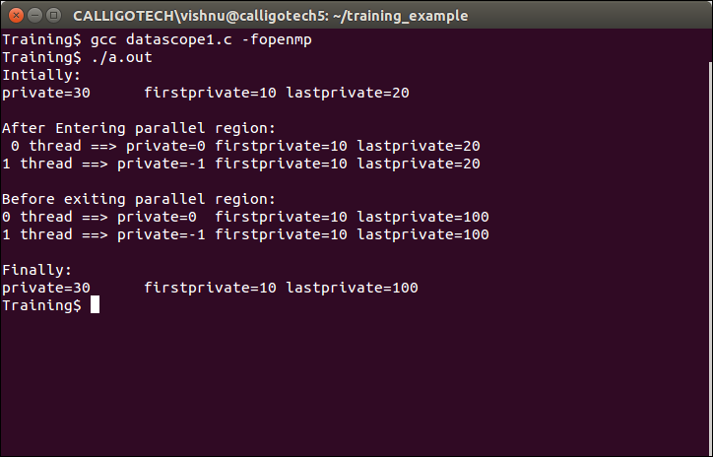
PRIVATE,FIRST & LAST PRIVATE
Private, unintialized in parallel
region
Firstprivate, initialized
Lastprivate, value updated
by last thread

Slide 27
SHARED
SHARED clause declares variables in its list to be shared among all the threads in the team (ie accessing same memory location)
Programmer’s responsibility to avoid race condition

Slide 28
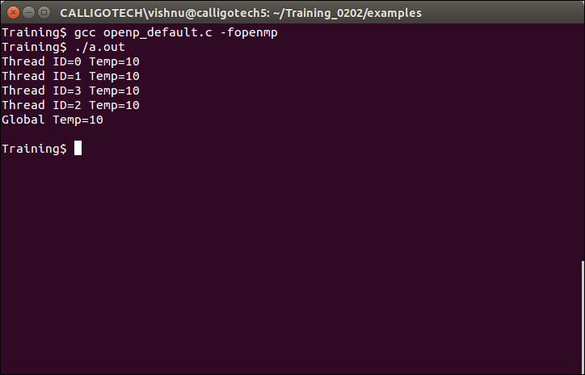
DEFAULT
DEFAULT(shared|none) is used to change the attribute of variables for threads
C/C++ allows shared or none where as FORTRAN supports PRIVATE and FIRSTPRIVATE .
void foo()
{
int temp = 10;
#pragma omp for default(shared) firstprivate(temp) lastprivate(temp)
for (int cnt=0; cnt<100; cnt++) {
int threadID = omp_get_thread_num();
temp += cnt;
printf(“Thread ID=%d Temp=%d”,threadID, temp);
}
printf(“Global Temp=%d\n”, temp);
}

Slide 29
SHARED & DEFAULT
//Header files
#define size 100
void main()
{ //Declare and Initialize
printf("Intially ==> Address of shared sum %p\t private tid %p\n",&sum,&tid);
printf("In parallel region:\n");
#pragma omp parallel default(none) private(tid) shared(sum,array)
{ int cnt;
tid=omp_get_thread_num();
printf("%d thread ==> Address of shared sum %p\t private tid %p\n",tid,&sum,&tid);
#pragma omp for
for(cnt=0;cnt<size;cnt++)
#pragma omp atomic
sum+=array[cnt];
}
//Prints
}

Slide 30
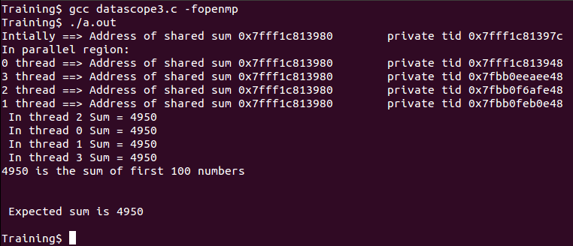
SHARED & DEFAULT (contd..)
Threads access same memory location (Share)
Threads access different memory location (local copy, private)

Slide 31
THREAD PRIVATE
THREADPRIVATE(var) is used to make given global file scope variable local
Values are persistent through out all the parallel regions (Different from private)
Must appear after the declaration of variables
Dynamic thread mechanism has to be turned off and number of threads through out parallel regions must be constant.
Outside parallel regions and in MASTER directives variables refer to the master thread’s copy.

Slide 32
THREAD PRIVATE
#include<omp.h>
#include<stdio.h>
int var1, var2, threadID;
#pragma omp threadprivate(var1, threadID)
void main()
{
➔ #pragma omp parallel private(var2) { threadID=omp_get_thread_num(); var1=12; var2=32; printf("First region:\n\tTid: %d var1 =%d var2=%d\n",threadID,var1, var2); fflush(0);
} printf("\n***************___**********\n");
➔ #pragma omp parallel private(var2)
{ printf("Second region:\n\tTid: %d var1 =%d var2 =%d\n",threadID,var1,var2); fflush(0);
}
}

Slide 33
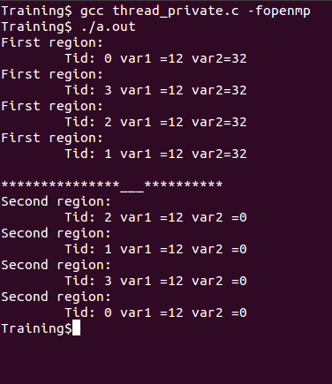
THREAD PRIVATE
private
threadprivate

Slide 34
COPYIN
COPYIN copies value to THREADPRIVATE variables
The master thread variable is used as the copy source.
The team threads are initialized with its value upon entry into the parallel construct.

Slide 35
COPYPRIVATE
COPYPRIVATE is used to broadcast values from a single thread to all instances of the private variables in the other threads
Associated with the SINGLE directive
Syntax: #pragma omp single copyprivate(list)

Slide 36
COPYIN & COPYPRIVATE
//Header files
int var1, var2, threadID;
#pragma omp threadprivate(var1, threadID)
void main()
{
#pragma omp parallel private(var2)
{
threadID=omp_get_thread_num();
var1=12;
var2=32;
if(threadID==0)
printf("Intially in first parallel region:\n");
printf("\tthreadID: %d var1 =%d var2=%d\n",threadID,var1, var2);
#pragma omp single copyprivate(var2)
var2=omp_get_num_threads();
var1=12+threadID;
if(threadID==0)
printf("Finally in first parallel region:\n");
printf("\tthreadID: %d var1 =%d var2 =%d\n",threadID,var1,var2);
}
#pragma omp parallel copyin(var1)
{
if(threadID==0)
printf("In second parallel region:\n");
printf("\tthreadID: %d var1 =%d var2=%d\n",threadID,var1, var2);
}
}

Slide 37
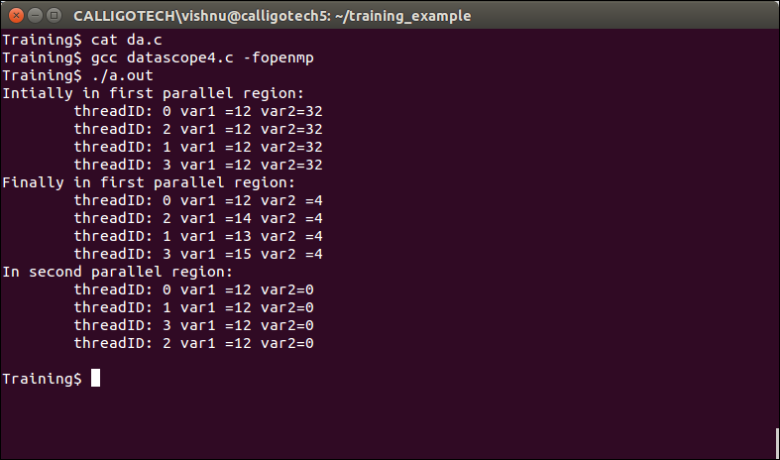
COPYIN & COPYPRIVATE
Var2 value has been broadcasted (copyprivate)
Var1 value has been copied from thread 0 to other threads (copyin)

Slide 38
REDUCTION
Private copy for each thread will be created and given reduction operation is performed at the end of parallel region
Final results is written to global shared variable
Format : reduction (operator : list)
Variables in the list must be scalar variables and SHARED

Slide 39
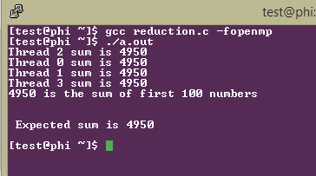
REDUCTION
//Header file
#define size 100 //size of array
void main()
{
//Initialize & Declare
#pragma omp parallel
{ int tid = omp_get_thread_num();
#pragma omp for reduction (+ : sum)
for(index=0;index<size;index++)
sum+=array[index];
printf ("Thread %d sum is %ld\n",tid,sum);
}
expected_sum=((size)*(size-1))/2;
printf("%ld is the sum of first %d numbers\n",sum,size);
printf("\n\n Expected sum is %ld\n\n",expected_sum);
}

Slide 40
Note
➔

Slide 41
<Blank>

Slide 42
<Blank>

Slide 43
<Blank>

