Slide 1
OpenMP Lab

Slide 2
Lab 1
Write a OpenMP program to print “hello world” by multiple threads with it threads ID.
Complete openmp_lab2.c (Finds sum of array elements using atomic for synchronization).
Hint : Use atomic for Synchronization

Slide 3
Lab 1 - Solutions
openmp_lab1.c ➔ ~/examples/openmp_example1.c
openmp_lab2.c ➔ ~/examples/openmp_example2.c

Slide 4
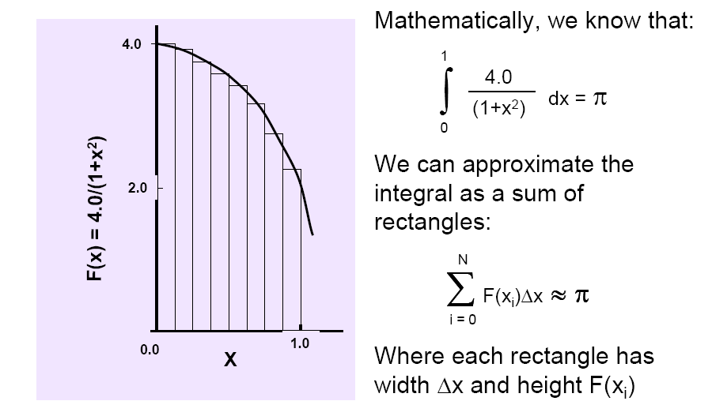
Lab 2
Rewrite array sum program to use partial sum array instead of atomic for synchronization
Write a program to compute value of pi using area under the curve

Slide 5
Lab 2- Solutions
Array sum using partial sum➔ ~/examples/openmp_example3.c
openmp_lab3.c ➔ ~/examples/openmp_pi.c

Slide 6
<Blank>

Slide 7
<Blank>

Slide 8
<Blank>

