Slide 1

Message Passing Interface
(MPI)
Notes:
We have seen the OpenmMP programming model for shared memory systems where two or more CPUs/Cores share the memory. The workload is shared across two or more CPUs or cores or, the workload is parallely executed on two or more CPUs to achieve higher performance. The OPenMP APIs for C/C++ and Fortran would enable programmer to explicitly or implicitly distribute the load across CPUs or cores for parallel execution. Conceptually the workload can also be shared across independent computers through the paradigm of message passing. MPI is a standards specification. There are MPI libraries that enable programmers to develop parallel programs across computers.

Slide 2
MPI Overview
MPI (Message Passing Interface) is an API standard.
It enables message-passing among a wide variety of heterogeneous interconnected machines.
Communication is essentially between processes
Available for Fortran, C, C++ and Java
Support for Point-to-point and collective communication
Defines the syntax and semantics of the core library routines
Fairly large standard with over 125 functions

Slide 3
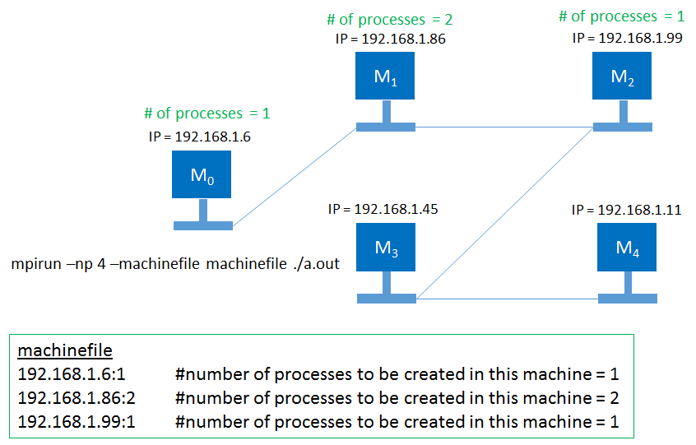
MPI Overview
MPI programs are compiled with mpicc/mpiicc
Compiled programs are run using mpirun/mpiexec
mpirun/mpiexec launches the program as process on each of the machines
mpirun creates the necessary runtime environment for program execution, one process per machine

Slide 4
Example 1
Example 1
#include <stdio.h>
#include <mpi.h> //mpi.h provides MPI definitions and types
int main (int argc, char *argv[])
{
int rank, size, namelen;
char name[100];
MPI_Init (&argc, &argv); //MPI_Init() starts MPI
MPI_Comm_size (MPI_COMM_WORLD,&size);
MPI_Comm_rank (MPI_COMM_WORLD,&rank);
MPI_Get_processor_name (name, &namelen);
printf ("Hello World from rank %d out of %d running on %s!\n", rank, size, name);
MPI_Finalize (); //MPI_Finalize() exits MPI
return 0;
}
All non-MPI statements are local and run on all the process

Slide 5
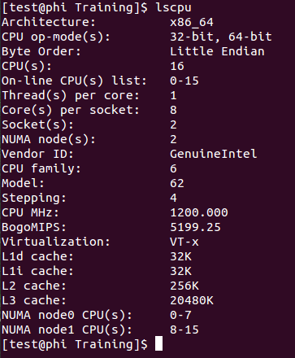
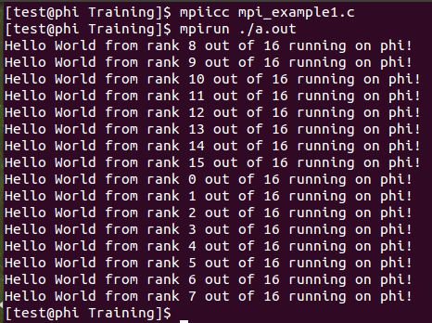
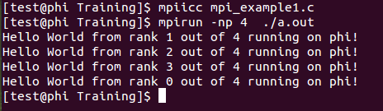
Example run

Slide 6
Rank, Group and Communicator
MPI_COMM_WORLD is a universal inter-communicator for all processes, available immediately after MPI_init()
Communicator is a mechanism through which scope of process communication is determined
Communicator is a dynamic object that is created, used and destroyed
Group is an ordered set of processes
Processes that are part of a group have a rank 0 to N-1 (N total process in a group)
Group is within a communicator and is a dynamic object
There are various Routines to handle Communicators and Groups. (MPI_Comm_* and MPI_Group_*)

Slide 7
Example 2
Problem Statement
Add elements of an array of (N-1)*10 elements
Lets say we use 1 Master and (N-1) Workers
Master is chosen randomly among 0 to N-1 Ranks (N=6 and N=11)
Broadcast master Rank
All workers add a set of 10 numbers and send the partial-sum to master
Master adds the partial-sums and obtains the final sum

Slide 8
Example 2
Example 2
#include <stdio.h>
#include <mpi.h>
int main (int argc, char *argv[])
{
int rank, size;
MPI_Init (&argc, &argv);
MPI_Comm_size (MPI_COMM_WORLD, &size);
MPI_Comm_rank (MPI_COMM_WORLD, &rank);
int arr_size=10*(size-1);
int master, worker, row=0;
if (rank == 0) //Select the master and broadcast
{
master = rand() % size;
printf("%d is Master\n", master);
}
MPI_Bcast(&master, 1, MPI_INT,0, MPI_COMM_WORLD);

Slide 9
Example 2 (contd..)
Example 2
//Distribute the work and get the work done by workers
if(rank==master)
{ int array[arr_size],total=0,total1=0;
for(row=0;row<=arr_size;row++)
array[row]=row;
for(worker=0;worker<size;worker++)
if(worker!=master)
{ MPI_Send (&array[row*10], 10, MPI_INT, worker, \ master, MPI_COMM_WORLD );
row++;
}
for(worker=0;worker<size;worker++)
if(worker!=master)
{ MPI_Recv(&total, 1, MPI_INT, worker, worker, \ MPI_COMM_WORLD, MPI_STATUS_IGNORE);
total1+=total;
}
printf("%d is the sum of first %d numbers\n",total1,arr_size);
}

Slide 10
Example 2 (contd..)
Example 2
//Workers task, compute and send local sum to master
else
{ int array[10],total=0;
MPI_Recv(&array[0], 10, MPI_INT, master, master, \ MPI_COMM_WORLD, MPI_STATUS_IGNORE );
for(row=0;row<10;row++)
total+=array[row];
MPI_Send(&total,1,MPI_INT,master, rank, MPI_COMM_WORLD);
}
MPI_Finalize ();
return 0;
} //End of main

Slide 11
Broadcast(Collective Communication)
MPI_BCAST(buffer, count, type, root, comm)
Buffer (INOUT) – Starting address of data to be sent or received
Count (IN) – Number of Items
Type (IN) – Data Type / Buffer Type
Root (IN) – Broadcaster Rank
Comm (IN) – Communicator whose ranks get the broadcast
Ierror (INOUT) – Optional argument to gather tx/rx status
Broadcasts a message from the root-rank to all other ranks in the communicator-group.
Type-Count need to match in all ranks of the group.
Blocking call, with participation from all ranks of the group
Note: Using MPI Data types enables program being machine independent and easy portability

Slide 12
Send (Blocking Co-operative communication)
MPI_SEND(buffer, count, type, dest, tag, comm)
Buffer (IN) – Starting address of data to be sent
Count (IN) – Number of Items
Type (IN) – Data Type / Buffer Type
Dest (IN) – Destination Rank
Tag (IN) – Message Tag
Comm (IN) – Communicator
Ierror (OUT) – Optional
Sends message from called rank to destination rank within the communicator-group.
Blocking

Slide 13
Receive(Blocking co-operative communication)
MPI_RECV(buffer, count, type, source, tag, comm)
Buffer (OUT) – Starting address of data to be received
Count (IN) – Number of Items
Type (IN) – Data Type / Buffer Type
Source (IN) – Destination Rank
Tag (IN) – Message Tag
Comm (IN) – Communicator
Ierror (OUT) – Optional
Receives message from source rank to called rank within the communicator-group and saves data in buffer.
Blocking
Note: Type has to be same between send and receive. No Type conversion allowed.

Slide 14
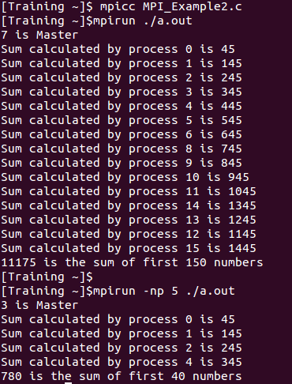
Example 2 – run outputs

Slide 15
MPI Communication
MPI allows for various types of communication.
Point-to-point co-operative
Send/receive – blocking
Send-receive – nonblocking
Point-to-point one-sided
Put/get
Collective
Broadcast
Scatter/gather

Slide 16
MPI Data Types
MPI has pre-defined data types for effective communication
MPI_Datatype | C datatype | Fortran datatype
MPI_CHAR | signed char | CHARACTER
MPI_SHORT | signed short int | INTEGER*2
MPI_INT | signed int | INTEGER
MPI_LONG | signed long int
MPI_UNSIGNED_CHAR | unsigned char
MPI_UNSIGNED_SHORT | unsigned short
MPI_UNSIGNED | unsigned int
MPI_UNSIGNED_LONG | unsigned long int
MPI_FLOAT | float | REAL
MPI_DOUBLE | double | DOUBLE PRECISION
MPI_LONG_DOUBLE | long double | DOUBLE PRECISION*8

Slide 17
<Blank>

Slide 18
<Blank>

Slide 19
<Blank>

