Slide 1


${Intel}^{®}$Tools
©2015 Calligo Technologies Pvt. Ltd., All rights reserved. All other trademarks or registered trademarks are the property of their respective owners

Slide 2
${Intel}^{®}$ Tools
Tools
Compilers | Intel® C++ Composer XE (icc , icpc ) (With its own OpenMP library)
 | Intel® Fortran Composer XE
Performance Libraries | Intel® Math Kernel Library (MKL) (Mathematic Operations)
 | Intel® Threading Building Blocks (Intel® TBB)
 | Intel® Integrated Performance Primitive (Intel® IPP)
 | Intel® MPI (can specify which compiler to use)
 | Intel® Cilk Plus
 | Intel® SDK for OpenCL* Applications XE
Debugger | GDB enhanced with Intel® features (gdb-ia, gdb-mic)
Profiling | Intel® Advisor XE (Threading Advisor)
 | Intel® Inspector XE (Memory and threading Debugger)
 | Intel® VTune™ Amplifier XE (Performance Analzer)
 | Intel® Trace Collector and Analyzer (Graphical tool for MPI calls)
Notes:
2

Slide 3
${Intel}^{®}$ Parallel Studio XE (cont..)
Professional Edition
Cluster edition
Intel® Advisor XE
Intel® Inspector XE
Intel® Vtune Amplifier XE
Intel® MPI Library
Intel® Trace Analyzer and Collector
Composer Edition
C/C++ Compiler
Fortran Compiler
Intel® MKL Math library
Intel® TBB Threading Library
Intel® IPP media and data library
Notes:
3

Slide 4
${Intel}^{®}$ Parallel Studio XE
Intel Parallel Studio is a software development suite for parallel programming.
suite is a C/C++ and Fortran tool suite supports Linux and Windows OS.
It is helpful in development, debugging and tuning of code to utilize parallel processing capabilities of compatible Intel processors and coprocessors.
Currently Parallel Studio is provided in variants
Composer Edition: includes compilers, performance libraries, and parallel models optimized to build fast parallel code.
Professional Edition: includes everything in the Composer edition. It adds performance profiler, threading design/prototyping, and memory & thread debugger to design, build, debug and tune fast parallel code.
Cluster Edition: includes everything in the Professional edition. It adds a MPI cluster communications library, along with MPI error checking and tuning to design, build, debug and tune fast parallel code that includes MPI.
Notes:
4

Slide 5
Components of Parallel Studio XE
Compilers
C++ and Fortran Compiler for Linux and Windows OS (MIC also supported)
Performance Libraries
MKL (Math Kernel Library) adds the boost with math routines for applications that solve large computational problems.
TBB (Thread Building Blocks) Library that supports scalable parallel programming using standard ISO C++ code.
IPP (Integrated Performance Primitives) is an extensive library of software functions to help you develop multimedia, data processing, and communications applications.
Cilk Plus is an extension to the C and C++ languages to support data and task parallelism.
MPI Library is a multi-fabric message passing library based on ANL MPICH3 and OSU MVAPICH2, Implements MPI 3 specifications.
Notes:
OSU Ohio State University
ANL Argonne National Labs
5

Slide 6
Components of Parallel Studio XE (Cont..)
Advisor XE Is a thread prototyping tool for C, C++ and Fortran programs.
Inspector XE memory and threading error debugger.
Vtune Amplifier XE Performance profiling tool to understand CPU utilization with.
less over head
Trace Analyzer and Collector graphical tool to visualize MPI application behaviour
to identify bottlenecks.
Notes:
6

Slide 7
${Intel}^{®}$ C/C++ Compiler
Supports 32 and 64 bits Intel or compatible architecture
Optimized for Intel Processor
Levels of optimizations are available.
Instruction set has evolved with processor and compiler is capable of generating generic or architecture specific code.

Slide 8
${Intel}^{®}$ C/C++ Compiler (contd…)
Levels of optimization
-O0 : No optimization
-O1 : Optimization for speed over size of the code
-O2: (default) Along with basic optimization performs basic loop optimizations, inlining of intrinsic, Intra-file interprocedural optimization
-O3: Performs O2 optimizations and enables more aggressive loop transformations. Recommended for applications that have loops that heavily use floating-point calculations and process large data sets.

Slide 9
${Intel}^{®}$C/C++ Compiler
Performance of GNU C Compiler vs Intel® C Compiler for multiplying two matrix of size 1500.

Slide 10
${Intel}^{®}$ Math Kernel Library(MKL)
Math Kernel Library (MKL) is library of optimized math routines for science, engineering, and financial applications.
Supports 32-bit, 64-bit Intel® or compatible processor and Intel® MIC.
Fortran and C/C++ are broadly supported language.
Automatically offloads if Intel® Xeon Phi™ is available.
Optimized for Intel® Architecture.
MKL uses OpenMP for threading.

Slide 11
${Intel}^{®}$ MKL Contents
BLAS
Basic Linear Algebra subroutines
Vector-vector, matrix vector and matrix operations
LAPACK
Linear Algebra Package
Solvers and Eigen solvers.
DFTs
Discrete Fourier transforms
Mixed radix, multi-dimensional transforms
Multithreaded
VML
Vector Math Library
Set of vectorized transcendental functions
Most of libm functions, but faster
VSL
Vector Statistical Library
Set of vectorized random number generators

Slide 12
${Intel}^{®}$ MKL Vs OpenBLAS

Slide 13
${Intel}^{®}$ Threading Building Blocks(TBB)
The library consists of data structures and algorithms that allow a programmer to avoid some complications arising from the use of native threading packages in which individual threads of execution are created, synchronized, and terminated manually.
Supports 32 and 64 bit architecture and also android OS.
Supports C and C++
Higher level task based parallelism
Also available as open source

Slide 14
${Intel}^{®}$ Threading Building Blocks(TBB) (contd..)
Dynamic memory functions are replaced by TBB library functions by loading proxy library at run-time or by linking with the proxy library.
These functions include:
C library: malloc, calloc, realloc, free
Standard POSIX* function: posix_memalign
Obsolete functions: valloc, memalign, pvalloc, mallopt
Global C++ operators new and delete.

Slide 15
${Intel}^{®}$ MPI Library
Low latency MPI implementation up to 2 times as fast as alternative MPI libraries
Enable optimized shared memory dynamic connection mode for large SMP nodes
Increase performance with improved various fabric support
Accelerate applications using the enhanced tuning utility for MPI

Slide 16
${Intel}^{®}$ Integrated Performance Primitives (Intel® IPP)
An extensive library of software functions to help you develop multimedia, data processing, and communications applications.
Highly optimized using Intel® Streaming SIMD Extensions (Intel® SSE) and Intel® Advanced Vector Extensions (Intel® AVX) instruction sets.
Performance Building - Optimized building blocks perform faster
Supports Windows, Linux, Android and OS X environments
Natively supports C/C++ and OpenCL development.

Slide 17
Intel® Vtune Amplifier
Intel® Vtune Amplifier is a hotspots analysis tool, used to analyze most time-consuming program units, and detect how they were called.
Basic Hotspots analysis is useful to analyze the performance of both serial and parallel applications.
Supports profiler for C, C++, Fortran, Assembly and Java.
User can identify hardware issues that have significant impact on the performance of their application
Notes:
SSE Streaming SIMD Extensions
AVX Advanced Vector Extensions

Slide 18
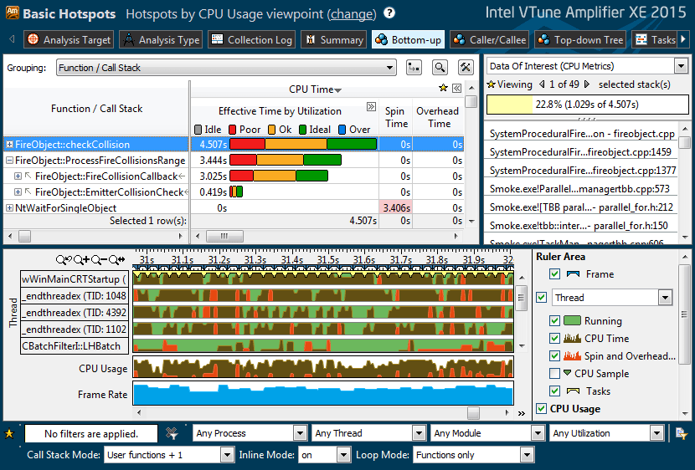
Intel® Vtune Amplifier
Notes:
SSE Streaming SIMD Extensions
AVX Advanced Vector Extensions

Slide 19
Intel® Trace Analyzer and Collector (ITAC)
Intel Trace Analyzer and Collector (ITAC) enables programmer to understand MPI application behaviour and quickly find bottlenecks to achieve high performance for parallel cluster applications.
Programmer can use the ITAC to evaluate profiling statistics and load balancing, identify communication hotspots, and increase application efficiency.
Benefits:
Visualize and understand parallel application behavior
Evaluate profiling statistics and load balancing
Analyze performance of subroutines or code blocks
Learn about communication patterns, parameters, and performance data
Identify communication hotspots
Decrease time to solution and increase application efficiency
Notes:
SSE Streaming SIMD Extensions
AVX Advanced Vector Extensions

Slide 20
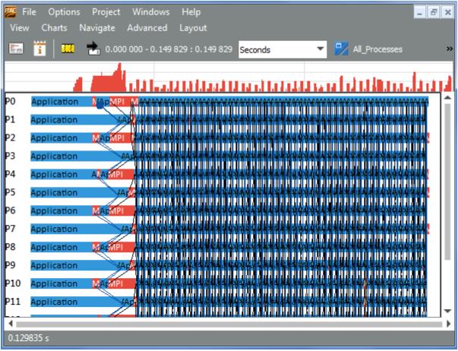
Intel® Trace Analyzer and Collector (ITAC) (contd..)
Event Time Line
Notes:
SSE Streaming SIMD Extensions
AVX Advanced Vector Extensions

Slide 21
Setting up Environment
The following paths has to be sourced:
$INTEL_PATH=<Installed Path, Eg:/opt/apps/intel/>
Tool | Paths
Intel® Advisor XE | {$INTEL_PATH}/advisor_xe/advixe-vars.sh
Intel® C++ Composer XE | {$INTEL_PATH}/composerxe/bin/compilervars.sh intel64
Intel® MPI | {$INTEL_PATH}/impi/5.0.1.035/bin64/mpivars.sh
Intel® Inspector XE | {$INTEL_PATH}/inspector_xe/inspxe-vars.sh
Intel® Trace Collector and Analyzer | {$INTEL_PATH}/itac/9.0.1.033/bin/itacvars.sh
Intel® Math Kernel Library (MKL) | {$INTEL_PATH}/mkl/bin/mklvars.sh intel64
Intel® VTune™ Amplifier XE | {$INTEL_PATH}/vtune_amplifier_xe/amplxe-vars.sh

Slide 22
${Intel}^{®}$Environment Variables
Offload | MIC_ENV_PREFIX=<Char> | Facilitates differentiation between the host and coprocessor environment
 | OFFLOAD_REPORT=[1|2|3] | Reports => 1:Time 2:Time and bytes taken 3:Add details of offload activity
 | MIC_LD_LIBRARY_PATH | Specifies the location for a target-shared object on the host.
 | MIC_PROXY_IO=[1|0] | Enables(1) or disables(0) the proxy server of stderr and stdout to the coprocessor.
Threads | OMP_NUM_THREADS | Number of threads
 | KMP_AFFINITY | Controls thread binding; Affinity policy :verbose, scatter, compact etc
 | MIC_KMP_PLACE_THREADS | Control the thread placement, works with KMP affinity
MPI | I_MPI_PIN=<arg> | Turn on/off process pinning feature. <arg>:{1/enable/yes/on}, {disable,no,off,0}
 | I_MPI_PIN_PROCESSOR_LIST / I_MPI_PIN_PROCS | Define a processor subset and mapping rules for MPI process within subset.
MPI + OpenMP | I_MPI_PIN_DOMAIN | Define number of non-overlapping subsets of logical processors on a node and set of rules on how MPI processes are bound.
 | I_MPI_PIN_ORDER | Set this environment variable to define the mapping order for MPI processes to domains as specified by the I_MPI_PIN_DOMAIN Environment variable.

Slide 23
<Blank>

Slide 24
<Blank>

Slide 25
<Blank>

