Slide 1
What is Hybridization?
Combining two inherent programming models to achieve some benefit.
Using different models of parallelization in a way that takes advantage of the good points of each.

Slide 2
Why Hybridization?
Architectural challenge:
Only MPI:
Distributed memory can not be accessed readily from other nodes.
Computation and communication can not be done parallel thus overhead.
Only OMP:
For a program requirement of memory may exceed more than available memory on the node.
Cannot be scaled for higher needs thus load imbalance.
Can’t share data among processes (except maybe via file I/O).
Hybridization provides solutions to the above challenges.

Slide 3
MPI
Provides a familiar and explicit means to use message passing on distributed memory clusters.
Can be implemented on many architectures and topologies.
Standard for distributed memory communications.
Synchronization must be handled explicitly due to the nature of distributed memory.
Data is distributed among the process.

Slide 4
OMP
Allows for implicit intra-node communication, by using shared memory.
Efficient utilization of shared memory SMP systems.
Facilitates relatively easy threaded programming.
No overhead as communication among threads is implicit.
Standard and also supported by most major compilers (Intel, IBM, gcc, etc).
Data is readily available for computation.

Slide 5
MPI + OMP
MPI allows for inter-node communication.
MPI facilitates efficient inter-node reductions and sending of complex data structures.
Program state synchronization is explicit.
A Common Execution Scenario.
A single MPI process is launched on each SMP node in the cluster.
Each process spawns N threads on each SMP node.
at some global sync point, the master thread on each SMP communicate with one another.
The threads belonging to each process continue until another sync point or completion.

Slide 6
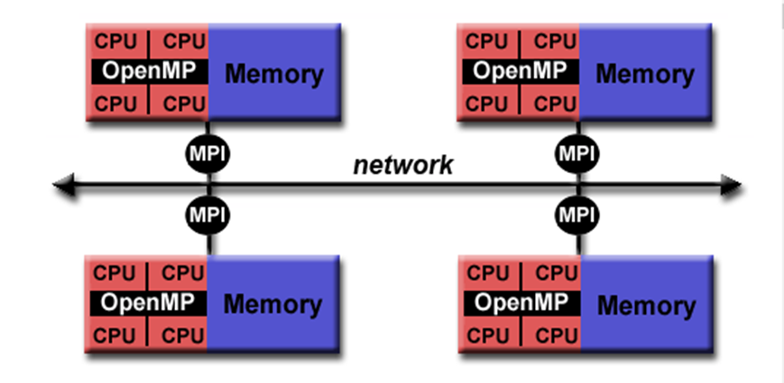
How to Approach
Use MPI to communicate (distribute work) with other nodes or processes (Outer loop).
Discover hot loops in each process and parallelize it using OMP(Inner loop).

Slide 7
Designing Hybrid Program
Redesigning an application, whether originally using OpenMP or MPI, is the ideal situation; although, this is not always possible or desired.
Benefits are greatest when considering the introduction of MPI into shared memory programs.
Great care should be taken to find the right balance of MPI computation and OMP “work”; it is the shared memory parts that do the work; MPI is used to simply keep everyone on the same page.

Slide 8
Designing Hybrid Program (contd)
Prioritized list of some considerations
the ratio of communication among nodes and time spend keeping the processors on a single node should be minimized in order to maximize scaling;
the shared memory computations on each node should utilize as many threads as possible during the computation parts;
MPI is most efficient at communicating a small number of larger data structures; therefore, many small messages will introduce a communication overhead unnecessarily;

Slide 9
Hybrid Programming Model
Parallel Programming models on Hybrid Platform
Pure MPI
One MPI process on each core
OMP only
Distributed virtual shared memory
Hybrid MPI + OpenMP MPI : inter-node communication
OMP: Inside each core
Hybrid MPI+MPI MPI for internode communication.MPI shared memory programming
Overlapping Communication
Few threads Communicate and others compute.
Non overlapping Communications
MPI parallel only outside computation
Within shared nodes:
Direct data copy
Within shared nodes: Access to neighbor data

Slide 10
Hybrid: MPI+OMP
Start with MPI initialization
Create OMP parallel regions within MPI task (process).
Serial regions are the master thread or MPI task.
MPI rank is known to all threads
Call MPI library in serial and parallel regions.
Finalize MPI
MPI_Init
Get rank
OMP Parallel
Compute
End Parallel
MPI_Finalize
MPI_Call
MPI_Call

Slide 11
Hybrid: MPI+OMP Example
Code
Screen shot

Slide 12
Hybrid: OMP+MPI
MPI_Init_thread is used to determine thread level support and it is supported in MPI2
Thread safety is controlled by single, funneled, serialized and multiple.
Types | Protocol | Description
Single | MPI_THREAD_SINGLE | Only one thread will execute
Funneled (Default) | MPI_THREAD_FUNNELED | Multi threaded process but one thread can make MPI calls.
Serialized | MPI_THREAD_SERIALIZE | Multi threaded process and MPI calls can be made by all the threads concurrently.
Multiple | MPI_THREAD_MULTIPLE | No restrictions over all the threads in multi threaded process.

Slide 13
<Blank>

Slide 14
<Blank>

Slide 15
<Blank>

