Slide 1
REVISION

Slide 2
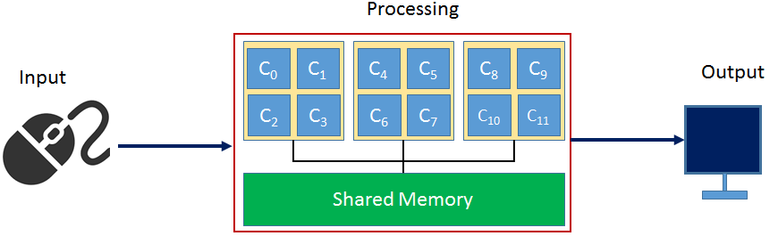
Computer Architecture

Slide 3
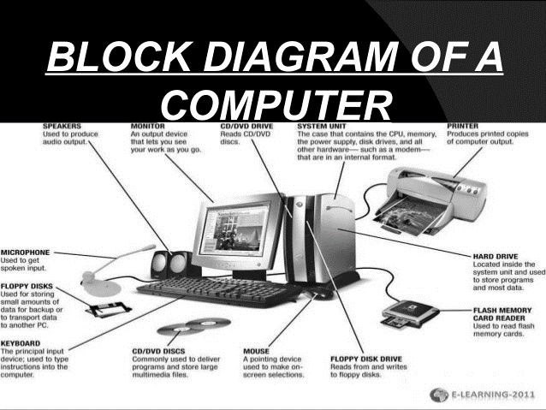
Components of Computer

Slide 4
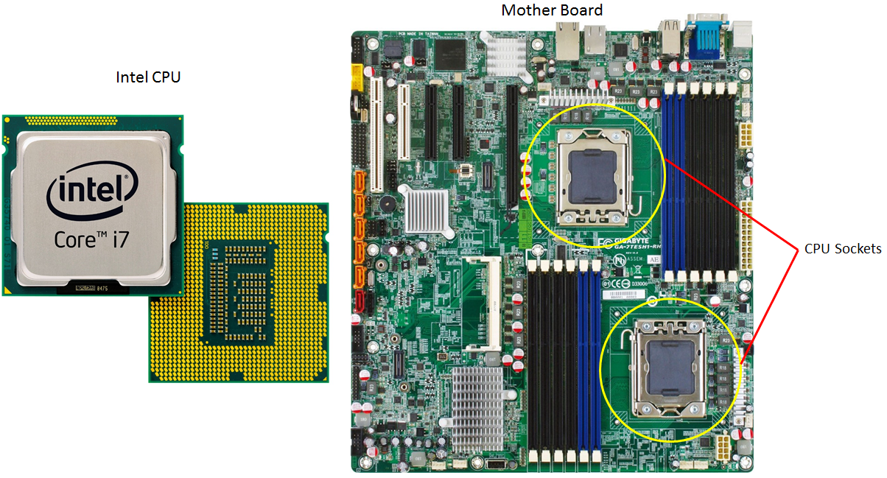
Mother Board

