Slide 1

IILM
UNIVERSITY
IILM UNIVERSITY, GREATER NOIDA
SQL AND DATABASE MANAGEMENT SYSTEMS
VIRTUAL INTERNSHIP PRESENTATION
Submitted by: Sachin Raj
Class: 3CSE21 | Roll No.: 2410030656
Internship Provider: EduSkills Academy
Duration: April – June 2026 | 8 Weeks

Slide 2
Internship Overview
Internship Title: SQL and Database Management Systems Virtual Internship (Hindi)
Mode: Virtual Internship
Duration: 8 weeks
Internship Period: April – June 2026
Supported by: EduSkills Academy
Academic Institution: IILM University, Greater Noida
IILM University, Greater Noida | SQL and Database Management Systems Virtual Internship

Slide 3
Abstract
The virtual internship provided structured exposure to the domain of SQL and Database Management Systems.
The learning focus was centered on understanding how structured data is organized, managed, and queried through database systems.
The internship strengthened academic familiarity with core database concepts and the role of SQL in working with relational data.
This experience supports further learning in data management, software development, and database-oriented applications.
IILM University, Greater Noida | SQL and Database Management Systems Virtual Internship

Slide 4
Learning Focus
Fundamental understanding of database management systems
Introduction to structured and relational data
Role of SQL in querying and managing data
Conceptual understanding of database operations
Importance of organized data storage and retrieval
IILM University, Greater Noida | SQL and Database Management Systems Virtual Internship

Slide 5
SQL and Database Management Systems
DATA
DATABASE
SQL QUERIES
RESULTS
Conceptual flow: structured data is stored in databases, SQL is used to interact with the data, and queries produce meaningful results.
IILM University, Greater Noida | SQL and Database Management Systems Virtual Internship

Slide 6
Key Skills Developed
Database concepts and terminology
Structured data understanding
SQL-oriented thinking
Data organization and retrieval concepts
Analytical approach to working with stored information
IILM University, Greater Noida | SQL and Database Management Systems Virtual Internship

Slide 7
Internship Outcome
Completed the 8-week virtual internship during April – June 2026.
Gained academic exposure to the SQL and Database Management Systems domain.
Developed a stronger foundation for continued learning in databases and data-driven software systems.
Received a Certificate of Virtual Internship for successful completion.
IILM University, Greater Noida | SQL and Database Management Systems Virtual Internship

Slide 8
Certification Summary
Student
Sachin Raj
Program
SQL and Database Management Systems Virtual Internship (Hindi)
Duration
8 Weeks
Period
April – June 2026
Support
EduSkills Academy
IILM University, Greater Noida | SQL and Database Management Systems Virtual Internship

Slide 9
Student Declaration
I, Sachin Raj, hereby declare that the information presented in this internship presentation is true to the best of my knowledge and is based on my academic details and the internship certificate provided for the SQL and Database Management Systems Virtual Internship (Hindi).
Sachin Raj
B.Tech CSE | 3CSE21
IILM University, Greater Noida | SQL and Database Management Systems Virtual Internship

Slide 10
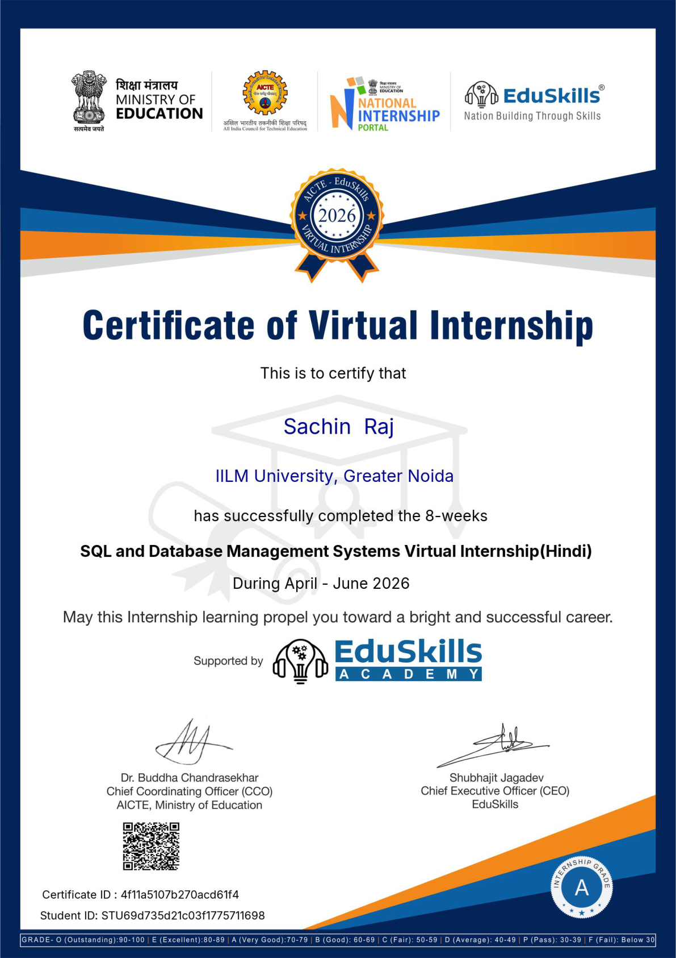

Slide 11
THANK YOU
SQL and Database Management Systems Virtual Internship
EduSkills Academy | IILM University, Greater Noida

