Slide 1
Secure data hiding in image using steganography
CAPSTONE PROJECT
Presented By: Sachin Rokde
Student Name : Sachin Rokde
College Name & Department : JEC Jabalpur , AI & Data Science

Slide 2
OUTLINE
Problem Statement
Technology used
Wow factor
End users
Result
Conclusion
Git-hub Link
Future scope

Slide 3
Problem Statement
This project aims to develop a secure data hiding technique using image steganography that ensures: ✔ High data embedding capacity without noticeable distortion. ✔ Enhanced security using encryption before embedding. ✔ Resistance to steganalysis attacks for better confidentiality. ✔ Minimal impact on image quality after embedding data.

Slide 4
Technology used
Python – Programming language
OpenCV – Image processing
NumPy – Array manipulation
PyQt6 – Graphical User Interface (GUI)
VS Code - Compiler

Slide 5
Wow factors
✅ Enhanced Security
✅ High Data Capacity ✅ Robust Against Attacks ✅ Quality Preservation ✅ Custom Encryption ✅ User-Friendly Interface ✅ Versatile Applications

Slide 6
End users
💻 Software Developers – To integrate secure data hiding in applications. 🔐 Cybersecurity Experts – For enhancing digital security and encryption. 📡 Network Security Teams – To protect sensitive communication over networks. 🖥️ Cloud Service Providers – To secure stored and transmitted data.

Slide 7
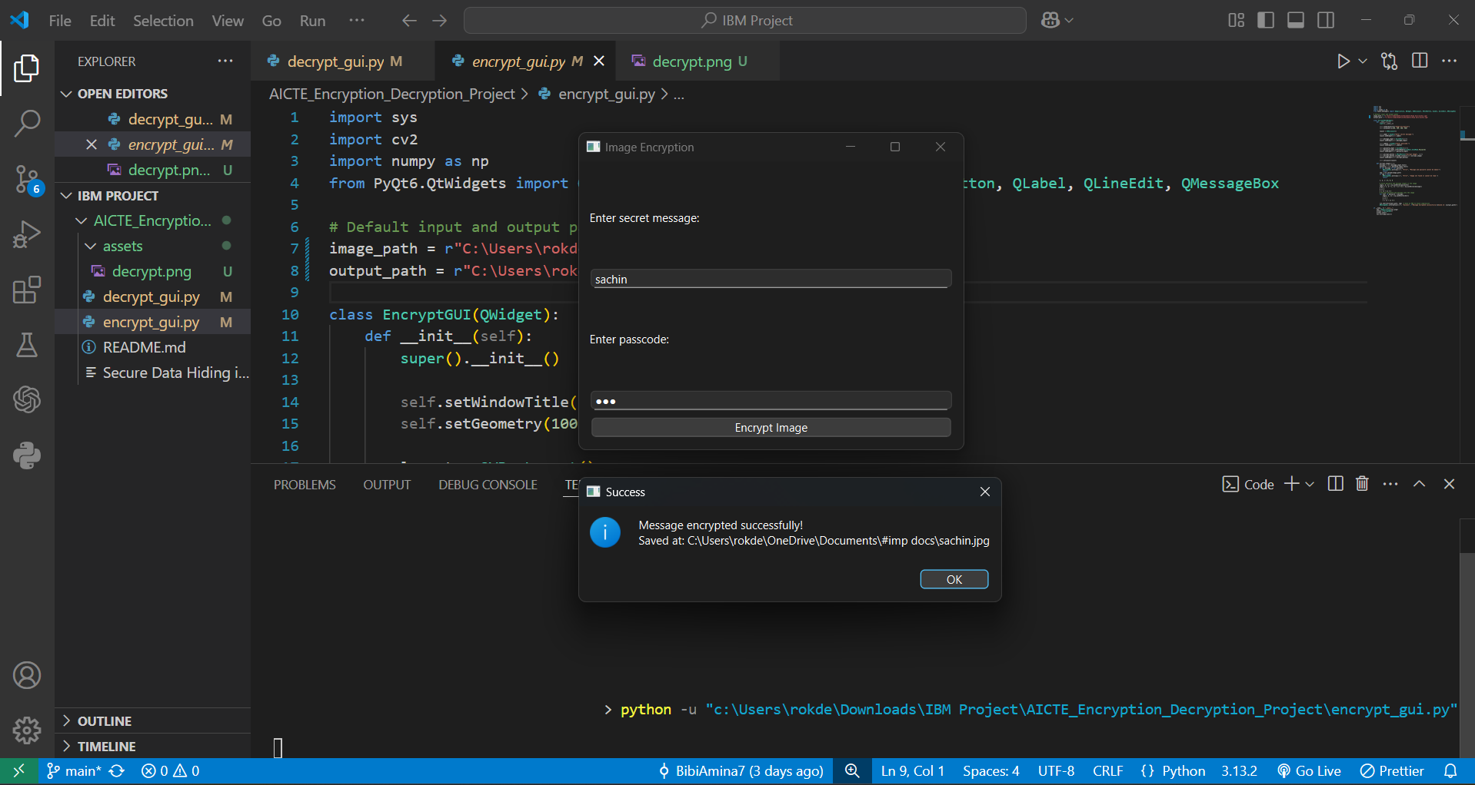
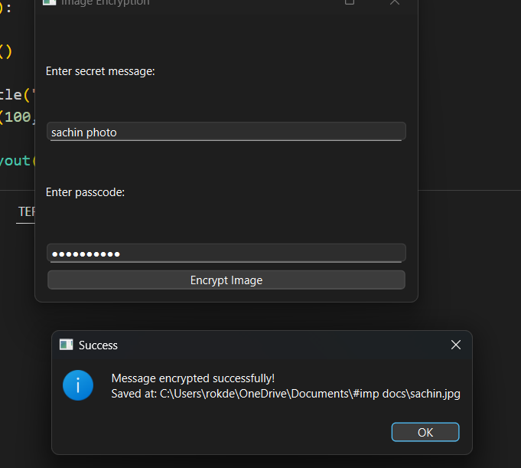
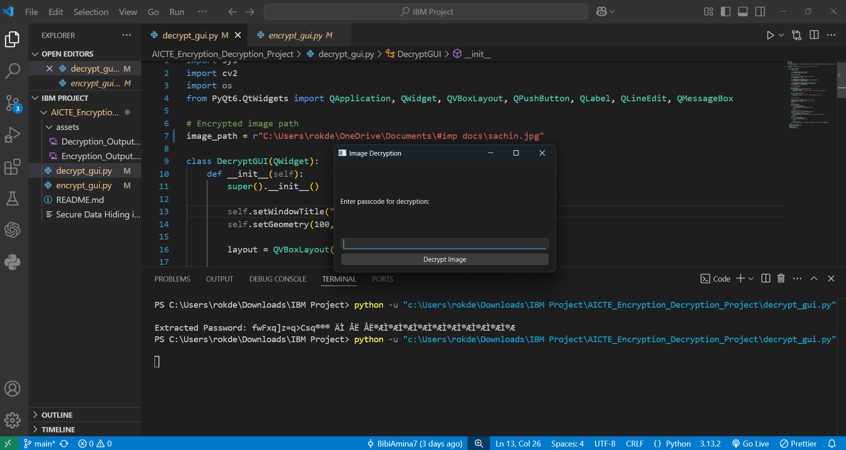
Results

Slide 8
Conclusion
This project successfully addresses the challenges of secure data transmission and privacy by implementing image steganography. By embedding encrypted data within images, the project ensures high security, improved data capacity, and resistance to steganalysis while maintaining image quality.

Slide 9
GitHub Link
https://github.com/sachinrokde/project-aicte-internship

Slide 10
Future scope(optional)
✅ Support for multiple image formats (JPG, BMP, etc.) ✅ Implementation of AES encryption for extra security ✅ Development of a mobile and web application ✅ AI-based image security and tampering detection

Slide 11
THANK YOU

