Slide 1
Acceleration of software package "R" using GPU's

Slide 2
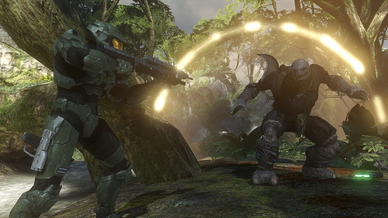
Introduction to Graphic Processing Units (GPU)

Slide 3
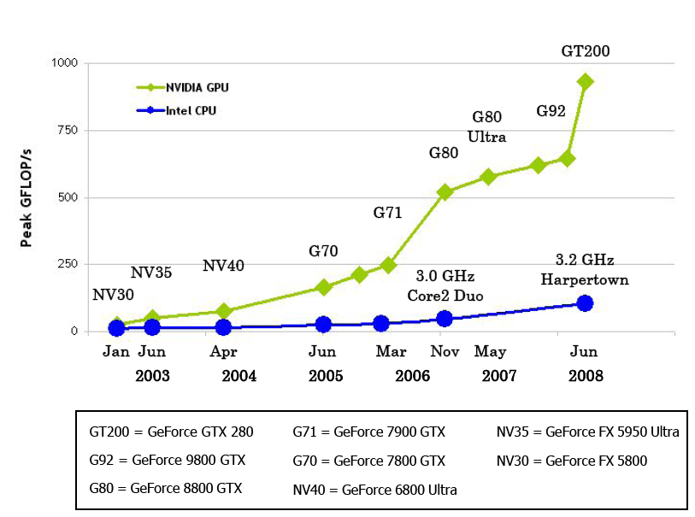
Introduction to GPU contd.

Slide 4

Introduction to R and BLAS
R
  Statistical Package
  Graphics
BLAS (Basic Linear Algebra Subprograms)
  Vector-Vector Addition/Multiplication etc.
  Vector-Matrix Addition/Multiplication etc.
  Matrix-Matrix Addition/Multiplication etc.
LAPack (Linear Algebra Package)

Slide 5
Results for 1000 x 1000 Matrices
 | CPU Average (s)
3.2 * A %*% B + 4.1 * A (3.2 A x B + 4.1 B) | 1.9335
A%*%B (Matrix A x matrix B) | 1.8855
t(A)%*%B (Transpose matrix A x Matrix B) | 1.9135
GPU Average (s) Single Precision | GPU Average (s) Double Precision
0.2375 | 0.123
0.176 | 0.092
0.207 | 0.089
solve(A) (Invert Matrix A) | 2.227 | 4.69 | 5.288

Slide 6
Improvements
 | Single Precision (%) | Double Precision (%)
3.2 * A %*% B + 4.1 * A | 814.1052632 | 1571.95122
A%*%B | 1071.306818 | 2049.456522
t(A)%*%B | 924.3961353 | 2150
solve(A) | -210.597216 | -237.4494836

Slide 7
Who to Blame
Simply random?
Me???
Stupid Computer?
Memory allocation.

Slide 8
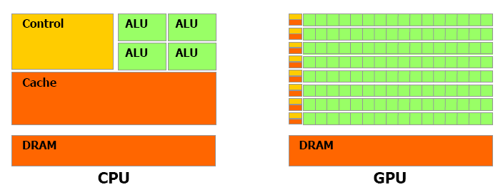
Nvidia GPU Architecture

Slide 9
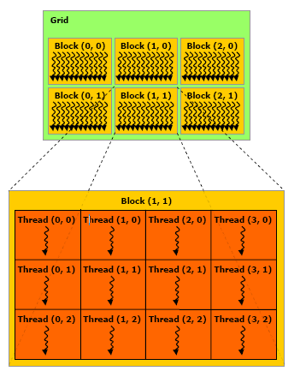
Nvidia GPU Architecture contd.

Slide 10
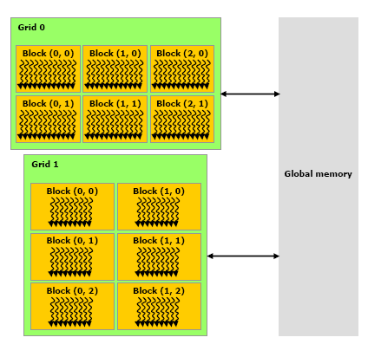
Nvidia GPU Architecture contd.

Slide 11
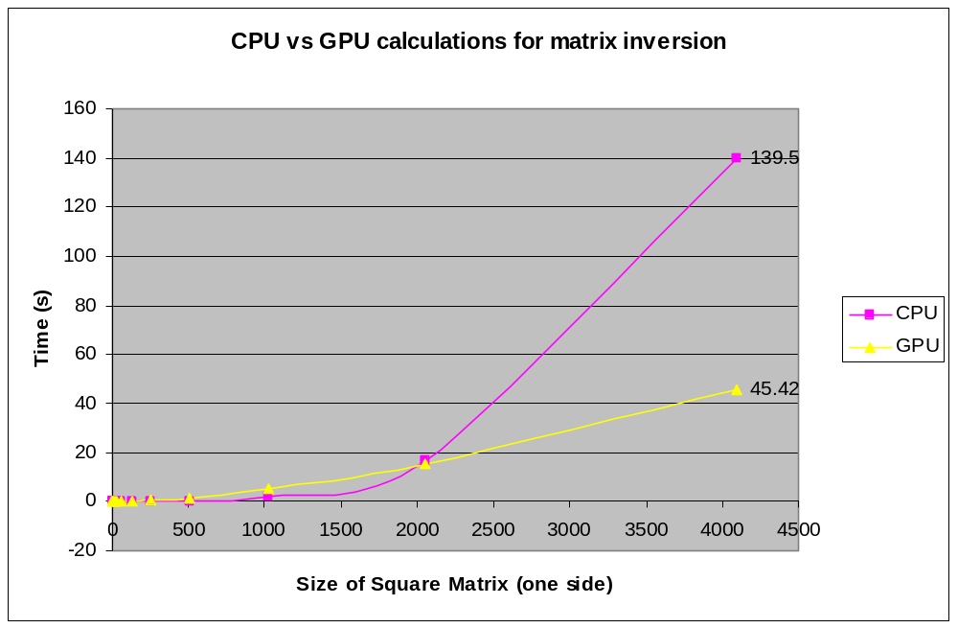

Slide 12
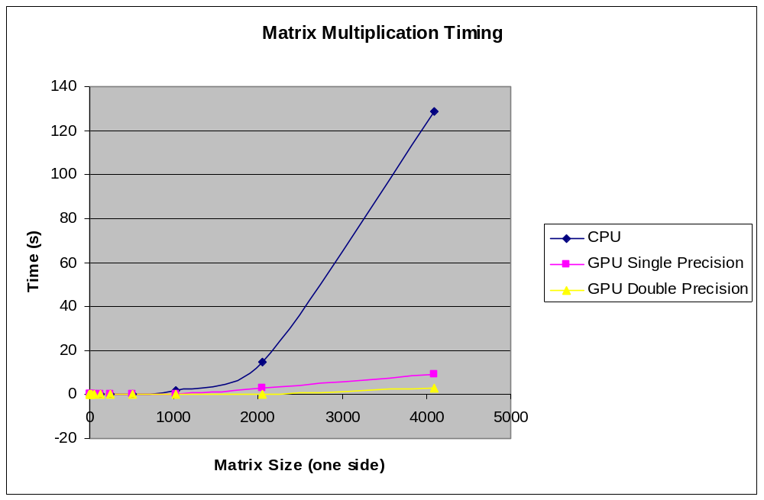

Slide 13
Comparison with Atlas RBlas
Improvement on multiplication : A%*%B 319%
Improvement on inverting matrix: solve(A) 281%
  (source:http://www.stat.columbia.edu/~cook/movabletype/archives/2008/06/a-trick-to-spee.html)
  Limitations on Atlas:
Latest version is for pentium 4 only

Slide 14
Limitations of this Project
Specific Card
Cost
  $1899.00 1.5Gb Leadtek nVidia Tesla GPU C870 Computer Board (Source: www.staticice.com.au)
  GeForce GTX 280 $582 (Source: http://www.msy.com.au/Parts/PARTS.pdf)
Precision?
  RMS of 6.350072e-06 for inverting a 1024 x 1024 matrix for the single precision cards.
  IEEE 754 deviations

Slide 15

BUGS

Slide 16
Where can I get this from
https://wiki.csiro.au/confluence/display/terabyte/GPU+Accelerated+R

Slide 17
Where to from now?
Implementation of more Blas functions
Getting rid of overhead
  Adjusting LAPack
  Double precision to Single Precision and Single to Double Conversion
Parallel Extensions (CPU)

Slide 18
Thank You
Luke Domanski
Dadong Wang
Pascal Valotton
Glenn Stone
Robert
CMIS/ CSIRO staff

Slide 19
