Slide 1
Sales Analysis
USA 2014 - 2017

Slide 2
Market Analysis: Sales analysis involves evaluating market trends and competitors to understand the broader market dynamics.
Sales analysis provides valuable information about the overall sales performance, including identifying patterns, trends, and areas of improvement. By analyzing sales data, businesses can gain a deeper understanding of their customer base, market dynamics, and sales strategies. This enables them to make data-driven decisions to optimize sales processes, improve customer satisfaction, and increase revenue.
Sales Analysis is process examine, evaluating sales data to gain insights into the performance and effectiveness of company sales efforts. It involves various aspects of sales such as revenue, quantity, marker trend, profit by region, state with sales details. So we can easily identify sales and profit about what ever wants in improve business growth.
Identify Sales Performance: Analyze sales data helps evaluate the overall sales performance of a business. This include examine sales revenue, sales growth, sales conversation rate.
Market Analysis are sales analysis evaluating market trend products and competitors to understand the broader market dynamics.

Slide 3
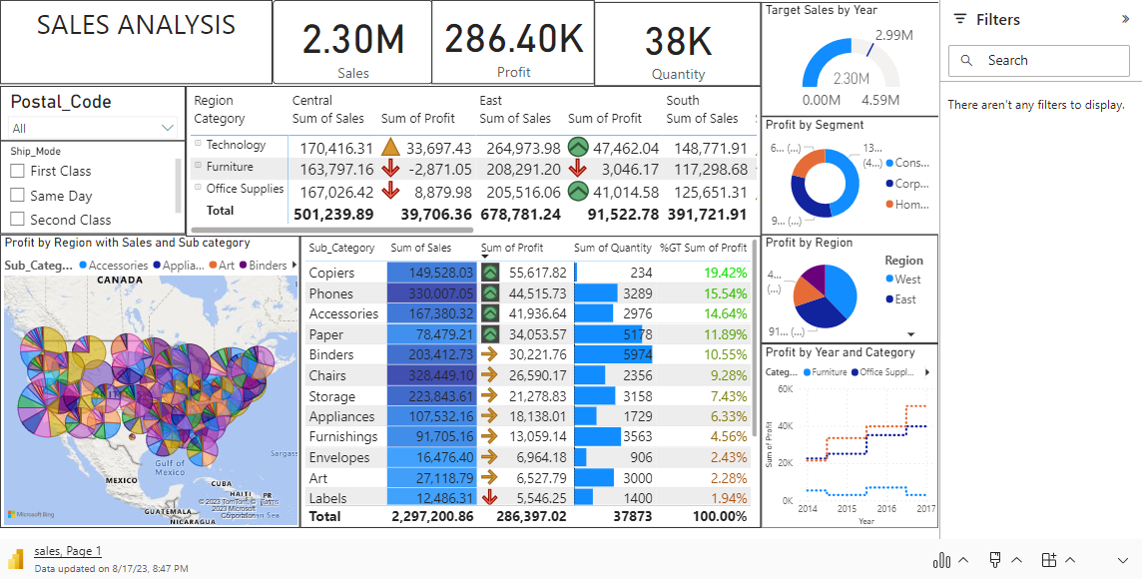

Slide 4
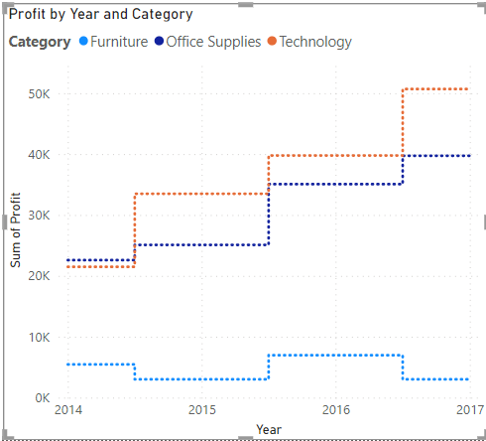
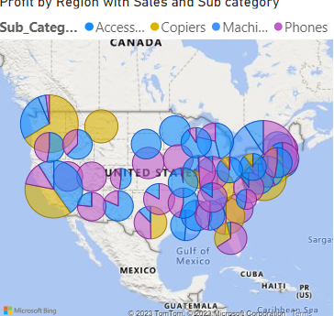
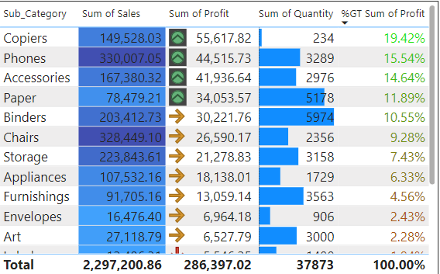
Between 2014 to 2017, Technology had the largest increase in sum of Profit (135.82%) while Furniture has the largest decrease (44.70 %). The most recent Sum of Profit anomaly was in 201, when had a high of 6,959.95.
Across Technology had the most interesting recent trend and starts trending up on 2014, rising by 135.82 % in 3 Years.
New York in Sub Category like Phones, Accessories, Machines, Copiers are made 3.00% Profit of Month in April
Texas in Sub Category made 6.36% Profit Office products are office suppliers
West had the highest profit at 52,609.85 followed by East, South, Central. West accounted for 42.95% of profit.
Chairs had the highest total profit at 6,592.72, followed by Bookcases tables and furnishing Illinois in Sub category made 11.92%. Chairs had the highest average profit at 599.34, followed by Bookcases, Furnishings and Tables.

