Slide 1
SQL Funnel & Retention Analysis of e commerce events history in electronic store
Funnel → tells who converted
Retention → tells who came back
By Sachin shanbhogue k

Slide 2
Project Objective
To analyze user behavior in an e-commerce platform by evaluating the conversion funnel, identifying category-level purchase patterns, and measuring short-term customer retention, in order to uncover key drop-off points and actionable opportunities to improve conversions and early repeat purchases.
Steps followed -
Data preparation
Imported raw e-commerce events data
Identified:
  Scientific-notation IDs (handled correctly)
  Blank category_code vs real NULLs
  Duplicate event rows
  Made event_time column to datetime and also made ne columns from it.
Removed duplicates using window functions
Created a clean working table (events_d)

Slide 3
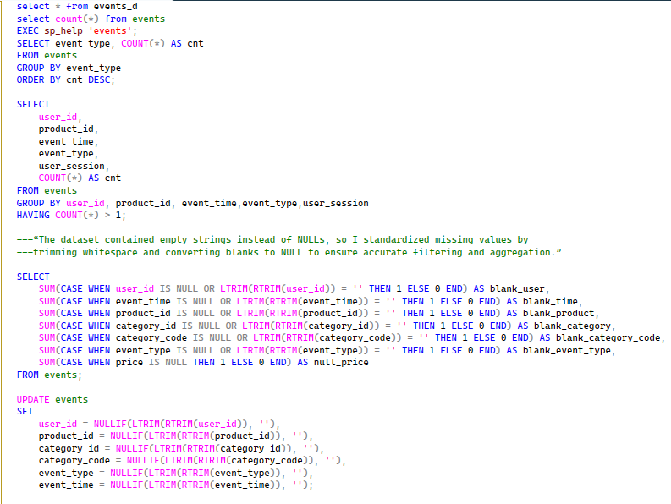
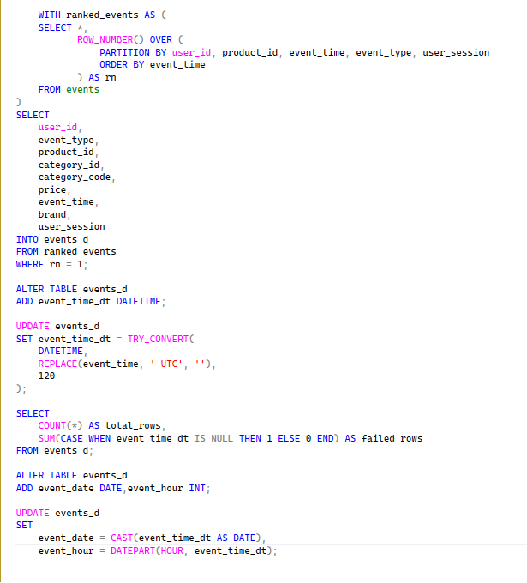
You now have:
events_d → deduped, time cleaned, analysis-ready
Next phase = Funnel Analysis.

Slide 4
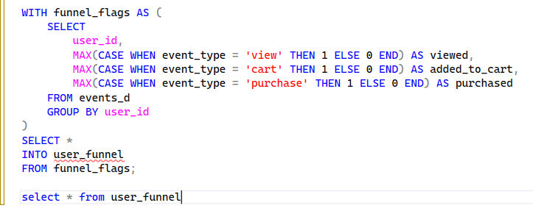
FUNNEL DEFINITION & CONVERSION ANALYSIS
🎯 Business Question
Where do users drop off in the purchase journey?
We’ll build a clean, defensible funnel.
Level 1 → Core funnel
🔹 STEP 1: Define Funnel Steps
For this dataset, use:
Step | event_type
Step 1 | view
Step 2 | cart
Step 3 | purchase
🔹 STEP 2: Create User-Level Funnel Table
We want one row per user, showing if they reached each step.

Slide 5
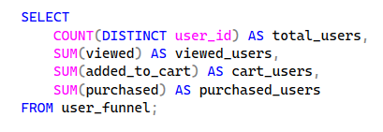
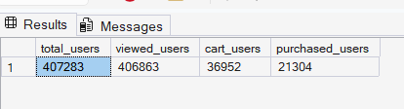

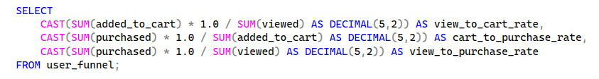
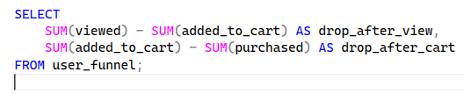

🔹 STEP 3: Funnel Counts
Stage | Users
Total Users | 407,283
Viewed | 406,863
Added to Cart | 36,952
Purchased | 21,304
🔹 STEP 4: Funnel Conversion Rates
Conversion Rates
View → Cart: 9%
Cart → Purchase: 58%
View → Purchase: 5%
🔹 STEP 5: Drop-Off Analysis
Drop-Off Point | Users Lost
After View | 369,911
After Cart | 15,648
I built a user-level funnel using event data to measure drop-offs between view, cart, and purchase stages, helping identify where conversion losses were highest.”

Slide 6
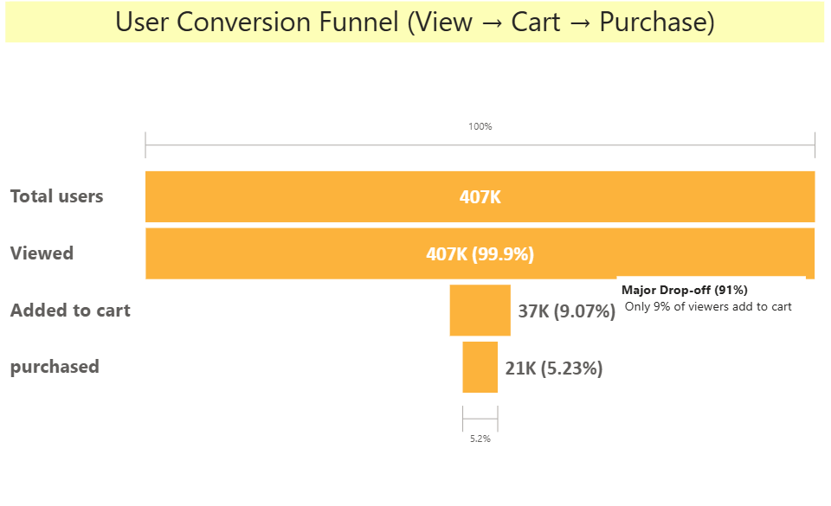
Business Interpretation
Primary Bottleneck: View → Cart
~91% of users drop off before adding to cart
Indicates:
  Browsing / comparison behavior
  Price sensitivity
  Insufficient product detail or value signaling
2. Checkout Is Strong
58% cart → purchase is a healthy conversion
Suggests:
  Low checkout friction
  High intent once users commit
“Funnel analysis showed that the largest user drop-off occurs before the cart stage, with only 9% of viewers adding items to cart. However, once users add products to cart, conversion to purchase is strong at 58%, indicating that optimization efforts should focus on pre-cart engagement rather than checkout flow.”

Slide 7
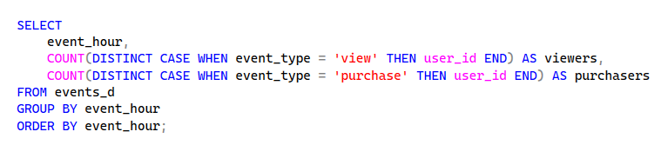
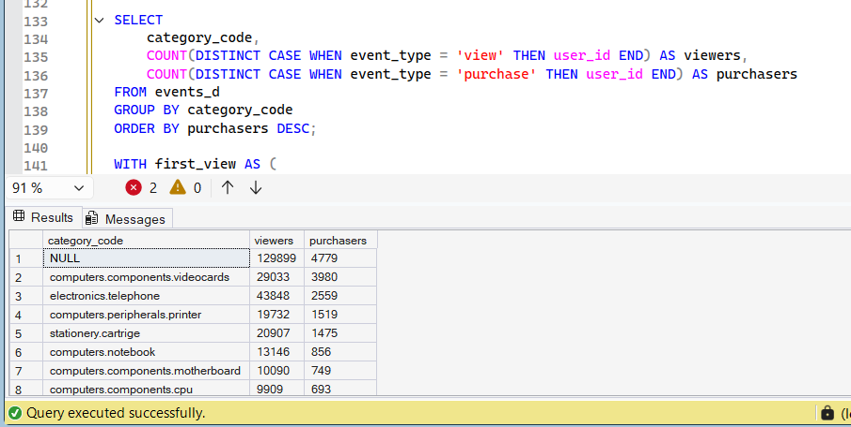
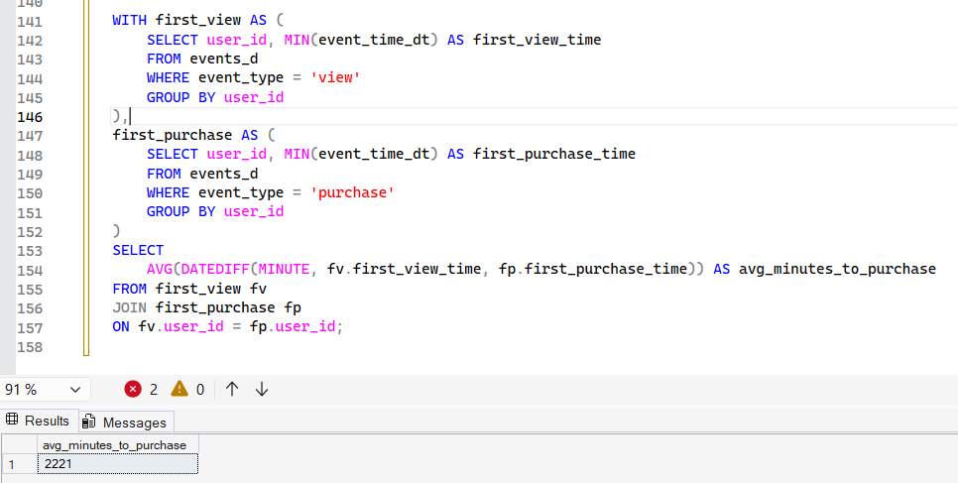
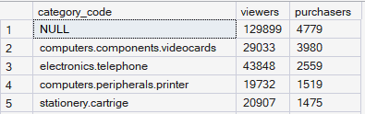
LEVEL 2 FUNNEL Segmentation
Event Hour | Viewers | Purchasers | Conversion Rate (%)
00:00 (12 AM) | 6,021 | 224 | 3.72%
01:00 | 6,086 | 232 | 3.81%
02:00 | 6,677 | 274 | 4.10%
03:00 | 8,939 | 388 | 4.34%
04:00 | 12,496 | 533 | 4.27%
05:00 | 17,062 | 830 | 4.86%
06:00 | 22,514 | 1,203 | 5.34%
07:00 | 26,380 | 1,385 | 5.25%
08:00 | 28,366 | 1,559 | 5.50%
09:00 | 29,415 | 1,651 | 5.61%
10:00 (Peak Viewers) | 29,899 | 1,700 | 5.69%
11:00 | 30,227 | 1,691 | 5.59%
12:00 (Noon) | 29,639 | 1,566 | 5.28%
13:00 | 28,709 | 1,485 | 5.17%
14:00 | 27,670 | 1,403 | 5.07%
15:00 | 26,913 | 1,339 | 4.98%
16:00 | 27,391 | 1,351 | 4.93%
17:00 | 28,130 | 1,381 | 4.91%
18:00 | 27,636 | 1,334 | 4.83%
19:00 | 24,652 | 1,269 | 5.15%
20:00 | 19,951 | 985 | 4.94%
21:00 | 14,115 | 662 | 4.69%
22:00 | 9,474 | 439 | 4.63%
23:00 | 7,188 | 305 | 4.24%
1️⃣ Funnel by Time
2️⃣ Funnel by Category
3️⃣ Time-to-Purchase Analysis
Top 5 categories (by purchase)

Slide 8
1️⃣ FUNNEL BY HOUR
What the data shows
Traffic steadily increases from early morning (5–6 AM)
Peak activity: 10 AM – 1 PM
Purchases closely follow traffic pattern
Night-time (0–4 AM) has very low intent
Although raw counts are higher mid-day:
Evening hours (7–9 PM) show strong purchase intent per viewer
Early morning viewers are low-intent browsers
2️⃣ FUNNEL BY CATEGORY
High-performing categories (conversion-friendly)
These categories convert well:
Cameras ,computer components.videocards ,telephone,cartridge,computers peripherals.printer
High-need
Specification-driven
Low impulse uncertainty
Browsing-heavy, low-conversion categories
electronics.video.tv ,electronics.audio.acoustic, electronics.audio.headphone
These are:
High comparison
Price-sensitive
Often bought offline

Slide 9
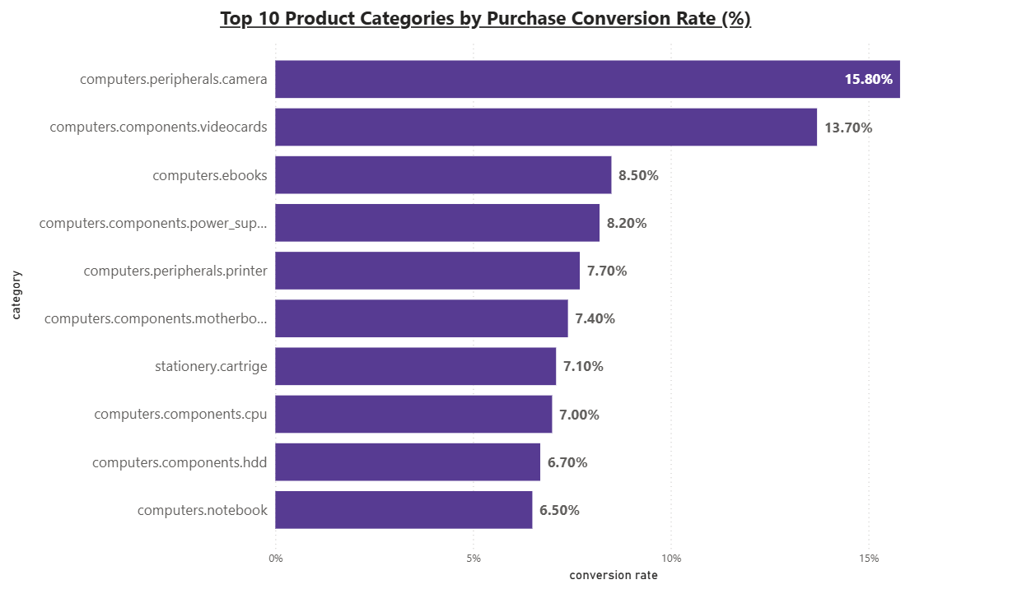

Slide 10
Important insight: NULL category
Highest traffic
Moderate purchases
Interpretation:
Many products lack category mapping; treating them as a separate group avoids data loss but requires cleanup for better merchandising insights.
3️⃣ TIME TO PURCHASE INSIGHT
⏱ Average time to purchase
2221 minutes ≈ 37 hours
What this means:
Users do not purchase immediately
Indicates:
  Research-driven behavior
  Multi-session journey
  Price comparison
Overall insight
Funnel analysis shows that the largest user drop-off occurs before the cart stage, with only 9% of viewers adding items to cart. However, once users add products to cart, conversion to purchase is strong at 58%, indicating that optimization efforts should focus on pre-cart engagement rather than checkout flow.
Purchase activity peaks between hours 9–13 based on the recorded event timestamp, indicating consistent intra-day activity patterns.
High-involvement categories such as notebooks and videocards show lower conversion compared to accessory items, suggesting longer decision cycles.
The average time from first product view to purchase is ~37 hours, indicating comparison-driven buying behavior rather than impulse purchases.

Slide 11
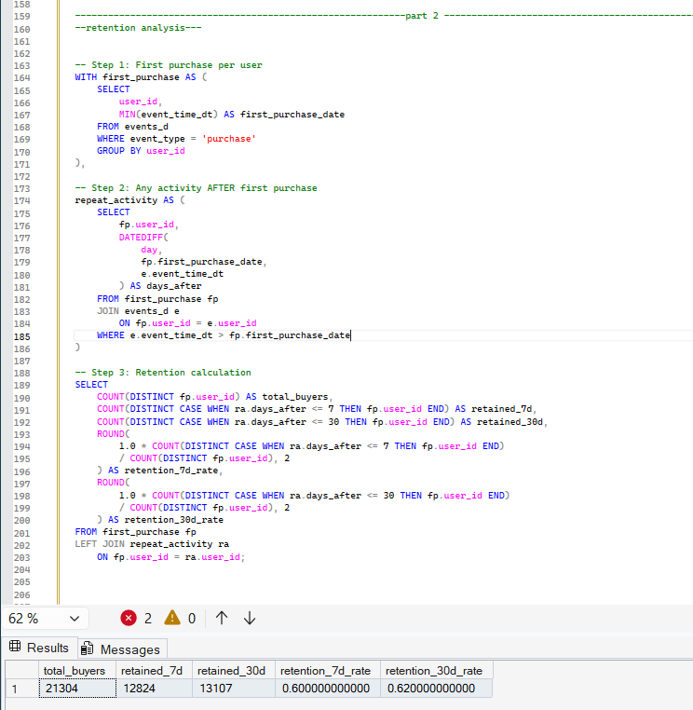
PART 2: RETENTION ANALYSIS
🎯 Objective
Understand:
Do users return after first purchase?
How many come back within 7 / 30 days?

Slide 12
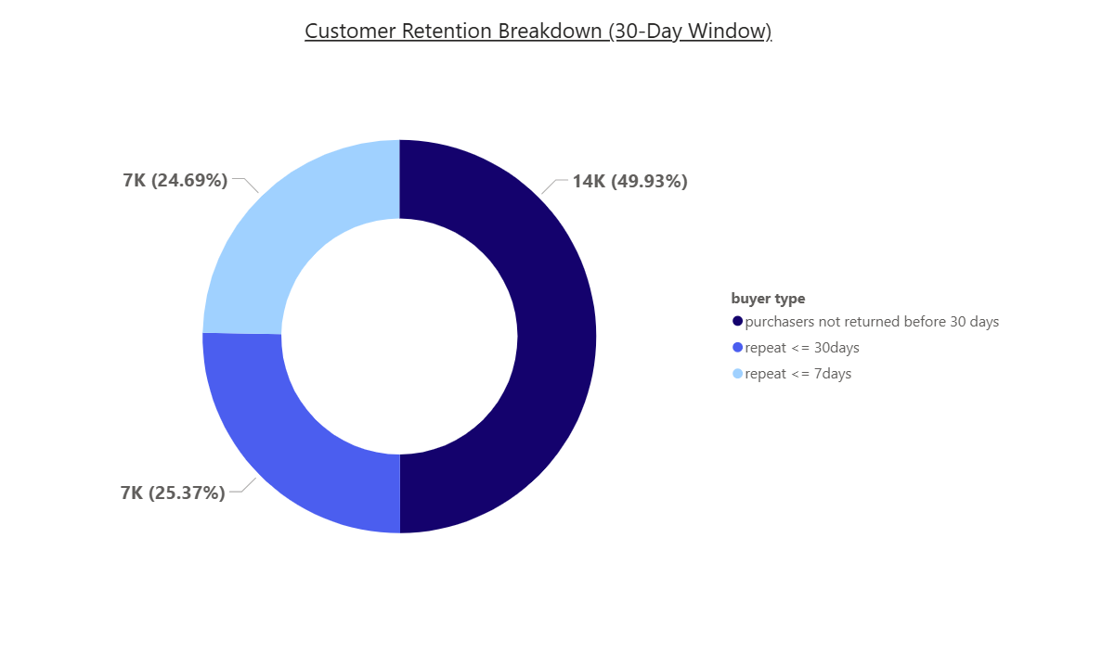
Retention Results and insights
Retention Results (Final)
Total buyers: 21,304
7-day repeat buyers: 6,985 (33%)
30-day repeat buyers: 7,178 (34%)
Out of 21,304 buyers, 34% made a repeat purchase within 30 days, while 66% did not return within the 30-day window.
Repeat purchases are heavily concentrated in the first 7 days, with very limited additional returns between days 8–30.
This indicates that short-term repeat behavior happens quickly, and buyers who do not return early are less likely to repurchase in the near term.

Slide 13
OVERALL INSIGHT
The main conversion bottleneck lies in the pre-cart stage, where most users drop off during product evaluation.
Buyers who do convert exhibit deliberate purchasing behavior, taking ~37 hours to complete a purchase.
Short-term retention is time-sensitive: customers who repurchase typically do so within the first week, while delayed repeat behavior is rare within 30 days.
Business efforts should therefore focus on:
  Improving pre-cart engagement to increase first-time conversion
  Activating early post-purchase nudges within 7 days, rather than assuming long-term loyalty patterns

Slide 14
Actionable Business Recommendations
1️⃣ Fix the biggest funnel leak: View → Cart (91% drop-off)
What the business should do
Improve product evaluation at the moment of browsing:
  Add clear specs comparison for similar products
  Show price breakdown & discounts upfront
  Display delivery timelines early (before cart)
Introduce “Add to cart nudges”:
  “Low stock” or “Price changed recently” indicators
  Quick-add buttons for accessories
📊 Why (data-backed):
Only 9% of viewers add to cart, but 58% of those convert.
So every improvement in view → cart directly multiplies revenue.
2️⃣ Time post-purchase engagement around the 37-hour decision cycle
What the business should do
Within 24–48 hours of first purchase:
  Send personalized follow-up emails / push notifications
  Recommend complementary or accessory products
  Example:
    Laptop → mouse, keyboard, adapter
    Videocard → power supply, cooling fan
don’t wait a week — the window is 1–2 days.

Slide 15
3️⃣ Exploit the 7-day retention window (most critical)
What the business should do
Day 2–3: Reminder / cross-sell message
Day 5–7: Limited-time incentive (small discount, free delivery)
Stop aggressive nudging after Day 7
📊 Why:
33% repeat within 7 days
Almost no additional users return after that
ROI drops sharply after Week 1
This is classic short-term retention behavior.
4️⃣ Different strategies by product type
High-involvement products (notebooks, videocards)
Add:
  Buying guides
  Comparison tables
  Extended warranty visibility
Avoid aggressive discounts immediately
Low-cost accessories
Push bundles and add-ons
Use urgency messaging
Target for fast repeat purchases

Slide 16
CONCLUSION
“The data shows that revenue impact is driven by improving pre-cart engagement and activating buyers quickly after purchase. Most repeat purchases happen within 7 days, and the average decision cycle is ~37 hours, so retention strategies should focus on timely post-purchase nudges rather than long-term loyalty campaigns.”

