Slide 1
TRANSCRIPT INTELLIGENCE
What 100 calls tell us about the outage
Findings from call transcripts, Feb 3 to Apr 28, 2026
27 support calls · 43 external calls · 30 internal calls

Slide 2
Customers turned negative after the outage, and churn signals followed
61%
4.25 → 3.42
20%
of external calls after March 10 contained a churn signal. Before the outage it was 27%.
Average external sentiment score, before and after the outage. The largest drop of any call type.
of customer sentences on external calls are negative. Our own staff: 4%.
Source: outputs/sentiment_before_after_outage.csv, outputs/sentiment_by_side.csv, outputs/churn_early_warning.csv

Slide 3
Outage touches half of all calls; billing and compliance follow
Theme | Primary calls | External | Internal | Support
Outage & reliability | 22 | 6 | 10 | 6
Billing & renewals | 19 | 14 | 0 | 5
Compliance & audit | 18 | 11 | 4 | 3
Product & roadmap | 11 | 2 | 8 | 1
Identity & access | 11 | 4 | 2 | 5
Backup & recovery | 7 | 1 | 2 | 4
Onboarding & deployment | 5 | 4 | 1 | 0
Competitive intelligence | 4 | 1 | 3 | 0
Integrations & API | 3 | 0 | 0 | 3
Each call has one primary theme. Outage appears as primary or secondary in 48 of 100 calls. Source: outputs/theme_by_call_type.csv

Slide 4
Rules first, because a panel has to be able to audit them
What we did
How much to trust it
• Keyword taxonomy of nine themes, scored on title, summary and tags. A title hit counts three times.
• One primary theme per call, plus secondary themes, so an outage inside a renewal call is counted in both.
• Call type comes from attendee emails: any outside address makes the call external.
• Clustering agrees only partly: TF-IDF with KMeans gives an adjusted Rand index of 0.25. The primary theme is a label, not ground truth.
• Meeting scores hold up: shipped sentiment scores correlate with VADER at r = 0.83.
• Sentence labels are rough: VADER agrees with them at kappa 0.11, so shares use the shipped labels.
Code: src/categorize.py, src/sentiment.py. Full notes: README.md

Slide 5
Customers are the negative voice, not our own staff
Speaker side | Negative | Neutral | Positive
External calls: customer | 20% | 41% | 39%
External calls: Aegis staff | 4% | 53% | 43%
Support calls: customer | 39% | 52% | 9%
Support calls: Aegis staff | 8% | 81% | 11%
Support is the most negative channel: 23% of all sentences are negative, against 13% on external calls and 17% on internal calls.
Our staff stay mostly neutral: 53% of their external sentences are neutral, against 41% for customers. The spread is on the customer side, so customer sentiment is the better health signal.
Source: outputs/sentiment_by_side.csv, outputs/sentiment_by_call_type.csv. Speaker side is inferred from attendee emails.

Slide 6
The outage moved external sentiment down the most
Call type | Before March 10 | After March 10 | Change
External | 4.25 (15 calls) | 3.42 (28 calls) | −0.83
Internal | 3.80 (9 calls) | 3.26 (21 calls) | −0.54
Support | 3.07 (10 calls) | 2.86 (17 calls) | −0.21
68%
17 of 28
of external calls after the outage discuss outage topics. Before, 13%.
post-outage external calls contain a churn signal. Before the outage: 4 of 15.
The before and after groups have different sizes, so read these as directional. Source: outputs/sentiment_before_after_outage.csv

Slide 7
Outage and integrations score lowest
Mean meeting sentiment score by primary theme, on a 1 to 5 scale
Integrations & API
2.40
Outage & reliability
2.43
Competitive intelligence
3.00
Identity & access
3.31
Backup & recovery
3.40
Billing & renewals
3.60
Product & roadmap
3.67
Compliance & audit
4.27
Onboarding & deployment
4.62
Source: outputs/sentiment_by_theme.csv

Slide 8
Four insights beyond the brief
Churn early warning
Feature demand
24 accounts show churn signals, and 22 of them after the outage. Brightpath Commerce, Summit Trust and Cobalt Software each have three.
Compliance has 13 feature-gap moments and billing has 8. Customers ask for proactive seat-overage alerts and for compliance report formats.
For: account managers and CS leads
For: product managers
Competitor pressure
Repeat support accounts
SentinelShield came up in 61.5% of calls in the outage week. Since then it has appeared in 0% to 33% of calls each week.
Eight accounts have more than one support case. Silverline Brands has three, and its average sentiment is 2.9.
For: sales leadership and product marketing
For: support leadership
Source: outputs/churn_early_warning.csv, feature_demand.csv, competitor_pressure_weekly.csv, support_repeat_accounts.csv

Slide 9
What I would do next
1.
Give account managers the churn list this week, starting with the 24 accounts that show churn signals.
2.
Track external sentiment and outage mentions weekly by call type, so the next incident shows up in the data within days.
3.
Put proactive overage alerts and compliance report formats at the top of the roadmap, backed by the feature-gap evidence.
4.
Link action items to the tracker, so follow-through after incidents can be measured. The dataset has no completion data today.
Limits: 100 calls, call type and speaker side inferred from emails, no renewal or resolution outcomes.

Slide 10
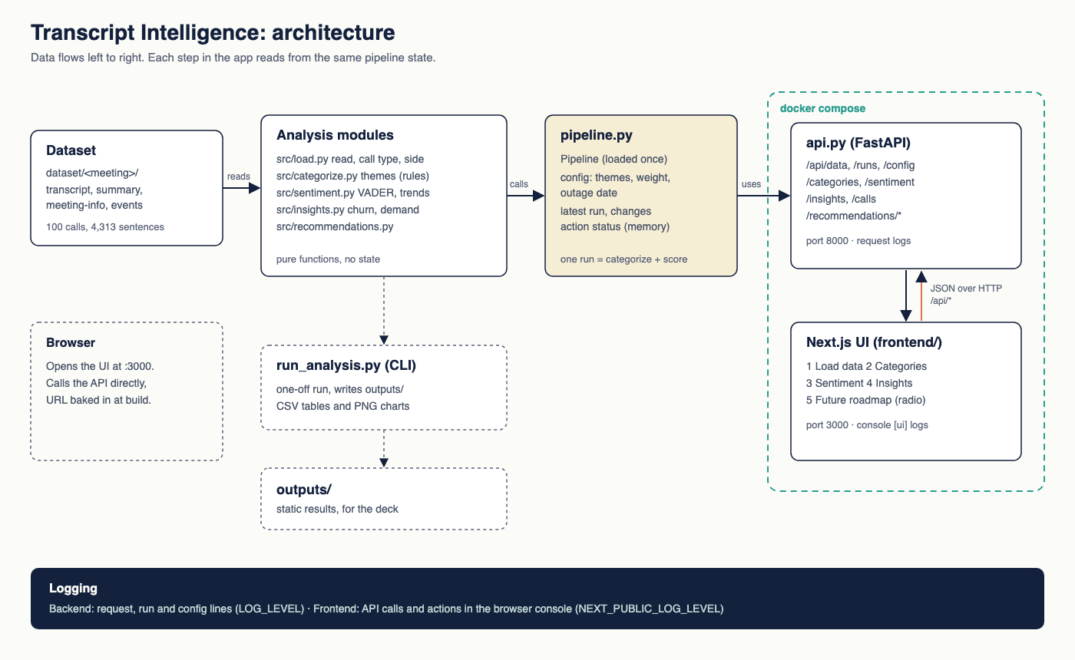
Architecture: one pipeline, two ways to reach it

