Slide 1
BASICS OF NLP
Sachin Shivakalimath
sachin.smath@gmail.com
9449764697

Slide 2
Tokenization
Tokenization is the process of breaking down text into smaller units, or "tokens," which can then be processed by machine learning or natural language processing (NLP) models.
There are various levels of tokenization, depending on how granular you want the analysis to be, including character-level, word-level, sentence-level, and paragraph-level tokenization.
Character-Level Tokenization
Word-Level Tokenization
Sentence-Level Tokenization
Paragraph-Level Tokenization
Subword Tokenization
Morphological Tokenization
N-Gram Tokenization
Syllable-Level Tokenization
Entity-Level Tokenization
Regex-Based Tokenization

Slide 3
Character-Level Tokenization
Definition: Each individual character in the text becomes a token.
Example:
For the word "Hello", character-level tokens would be ['H', 'e', 'l', 'l', 'o’].
Use Cases: Useful for languages with complex character structures, such as Chinese or Arabic, where characters carry semantic meaning. It’s also helpful in text generation, spelling correction, and applications where minor textual variations (e.g., typos) need to be considered.
Pros: Captures details at the finest level, making it adaptable to handling unknown words or spelling variations.
Cons: Results in a large number of tokens, which can increase computational complexity and lead to issues like long sequence lengths in deep learning models.

Slide 4
Word-Level Tokenization
Definition: The text is split into tokens based on words. Typically, words are separated by whitespace or punctuation.
Example:
For the sentence "The quick brown fox," word-level tokens would be ['The', 'quick', 'brown', 'fox’].
Use Cases: Commonly used in NLP tasks like sentiment analysis, machine translation, and text classification. Most word embeddings (like Word2Vec and GloVe) are designed for word-level tokens.
Pros: Captures semantic meaning more effectively than character-level tokenization, making it efficient and interpretable.
Cons: Cannot handle out-of-vocabulary (OOV) words, misspellings, or variations effectively. Models trained on word-level tokens may struggle with unseen words in new text.

Slide 5
Sentence-Level Tokenization
Definition: The text is split into individual sentences, which are treated as tokens.
Example:
For the text "Hello world! How are you?", sentence-level tokens would be ['Hello world!', 'How are you?’].
Use Cases: Useful for tasks requiring context within a sentence, such as summarization, sentence classification, or text segmentation. Sentence-level tokenization can help retain contextual information that spans multiple words.
Pros: Preserves sentence structure, which is beneficial for tasks requiring an understanding of complete thoughts or ideas.
Cons: Sentence boundaries can be challenging to identify in certain languages or informal writing styles. Additionally, it may overlook finer details within each sentence.

Slide 6
Paragraph-Level Tokenization
Definition: The text is divided into paragraphs, often separated by newlines or indentation.
Example:
For a text with two paragraphs, "Hello world! This is the first paragraph.\nAnd here’s the second paragraph," the tokens would be:
['Hello world! This is the first paragraph.', 'And here’s the second paragraph.’]
Use Cases: Used in applications like document summarization, topic modeling, and legal or medical text analysis, where entire paragraphs may hold unique, contextually complete thoughts.
Pros: Retains the highest level of context, making it suitable for analyses that rely on larger portions of text or where paragraph structure has meaning.
Cons: This approach is less granular, so it may overlook important details within sentences or words. Additionally, it’s less suitable for tasks that require detailed text analysis at a finer level.

Slide 7
N-Gram Tokenization
Definition: Breaks text into continuous sequences of n words or characters, known as n-grams. Common values are bigrams (2 words), trigrams (3 words), etc.
Example:
For the sentence "I love NLP," bigram tokenization produces ['I love', 'love NLP’].
Use Cases: Useful in text classification, sentiment analysis, and language modeling, as it captures context within neighboring tokens.
Pros: Captures local context and word associations, making it effective for analyzing phrases or short sequences.
Cons: Large n-grams can lead to very large feature spaces, which increases computational cost.

Slide 8
Regex-Based Tokenization
Definition: Uses regular expressions to define custom patterns for tokenization, often for domain-specific applications.
Example:
Splitting text based on dates or URLs, like turning "See more at https://example.com on 12/12/2023" into ['https://example.com', '12/12/2023’].
Use Cases: Useful in text preprocessing for cleaning or splitting based on specific patterns.
Pros: Highly customizable for specific tokenization needs, especially in preprocessing.
Cons: Requires expertise in regular expressions and can be error-prone if patterns are not defined carefully.

Slide 9
Vectorization

Slide 10
Vectorization
Vectorization is the process of converting textual data into numerical vectors so that machine learning models can process and learn from it. Different vectorization methods are used depending on the complexity, context requirements, and applications.
Count Vectorization (Term Frequency)
Term Frequency-Inverse Document Frequency (TF-IDF)
Word Embeddings (e.g., Word2Vec, GloVe)
FastText
Contextualized Embeddings (ELMo, BERT)
Transformer-Based Models and Beyond (GPT, T5)
Sentence Embeddings (Sentence-BERT, Universal Sentence Encoder)

Slide 11
Method | Level | Contextual? | Handles Polysemy | Common Use Cases
Common Use Cases | Word-level | No | No | Simple text classification
 | Word-level | No | No | Text classification, relevance ranking
Word2Vec / GloVe | Word embeddings | No | No | Sentiment analysis, word similarity
FastText | Subword embeddings | No | Partial | Text classification, languages with complex morphology
ELMo | Contextual word embeddings | Yes | Yes | Named entity recognition, part-of-speech tagging
BERT | Contextual word embeddings | Yes | Yes | QA systems, language inference, translation
Sentence-BERT / USE | Sentence embeddings | Yes | Yes | Semantic similarity, document clustering

Slide 12
Count Vectorization (Term Frequency)
Count Vectorization converts text to vectors by counting the occurrences of each word in a document. Each unique word becomes a feature, and its value is the number of times it appears in the document.
Example: For two documents, "I love NLP" and "NLP is great," the count vector might look like:
Limitations: High dimensionality and inability to capture semantic relationships. It only tells you if a word appears and how often, not its importance.
I | love | NLP | is | great
1 | 1 | 1 | 0 | 0
0 | 0 | 1 | 1 | 1

Slide 13
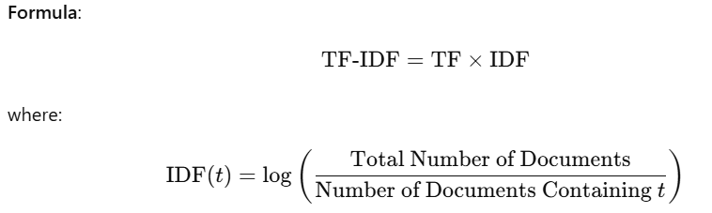
TF-IDF
TF-IDF improves on raw counts by weighing words according to their importance. It combines two metrics:
Term Frequency (TF): How frequently a word appears in a document.
Inverse Document Frequency (IDF): The inverse frequency of the word across all documents, reducing the weight of commonly occurring words (e.g., "the," "and").
Advantages:
Amplifies rare words, panelizes frequent words
Highlights important words and reduces the influence of commonly used words.
Limitations: Still treats each word independently, losing the context of word sequences.

Slide 14
Word2Vec / GloVe
Word embeddings capture semantic relationships by mapping words into a continuous vector space. Word2Vec and GloVe are two popular word embedding techniques that use context to understand word relationships.
Word2Vec: Uses neural networks to learn word representations based on neighboring words. It has two approaches:
CBOW (Continuous Bag of Words): Predicts a word given its surrounding words.
Skip-gram: Predicts the surrounding words given a specific word.
Word2Vec learns word relationships like king - man + woman ≈ queen.
GloVe (Global Vectors for Word Representation): Learns embeddings by factorizing word co-occurrence matrices, capturing both global and local contexts.
Advantages: Captures semantic and syntactic relationships, e.g., similar words are closer in the vector space.
Limitations: Fixed embeddings, so it can't handle polysemy (words with multiple meanings).

Slide 15
FastText
FastText, developed by Facebook, is an extension of Word2Vec that breaks words into character n-grams and then generates word embeddings by aggregating these n-grams. This allows subword information to be included, which is particularly useful for morphologically rich languages and for handling out-of-vocabulary words.
Example: The word "playing" might be broken down into subword tokens like "pla," "lay," "ayi," etc., and then represented as the sum of these subword embeddings.
Advantages: Improves on Word2Vec by handling rare words and morphologically complex languages better.

Slide 16
Contextualized Embeddings (ELMo, BERT)
Contextualized embeddings consider the surrounding words dynamically, providing different embeddings for the same word based on its context. These embeddings are generated by large language models (LLMs).
ELMo (Embeddings from Language Models):
ELMo embeddings are generated using a two-layer bi-directional LSTM trained on a language modeling task.
Each word’s embedding is generated based on the entire sentence, allowing different embeddings for the same word depending on its context.
Example: The word "bank" will have different embeddings in "river bank" and "money bank."
BERT (Bidirectional Encoder Representations from Transformers):
BERT is based on the Transformer architecture, using self-attention to capture context from both left and right sides of each word.
BERT embeddings are contextualized at a deeper level, as it’s trained on a masked language model objective, where some words are randomly masked and predicted from the context.
Advantage: BERT embeddings capture deeper context and handle polysemy better than ELMo and Word2Vec.
Limitation: BERT embeddings are computationally expensive and require fine-tuning for specific tasks.

Slide 17
Transformer-Based Models and Beyond (GPT, T5)
Advanced transformer-based models like GPT and T5 generate embeddings for both words and entire sentences by understanding context bidirectionally (BERT-style) or autoregressively (GPT-style). These models create embeddings not only for individual words but also for sentences and even documents.
GPT (Generative Pre-trained Transformer):
GPT is an autoregressive model, generating text by predicting the next word based on prior context.
Use case: Mainly used for generating coherent and contextually relevant text.
T5 (Text-To-Text Transfer Transformer):
T5 is designed as a text-to-text framework, meaning that it reformulates NLP tasks as text generation.
This allows T5 to learn generalized embeddings across tasks like summarization, translation, and question answering.

Slide 18
Sentence Embeddings (Sentence-BERT, Universal Sentence Encoder)
Sentence embeddings provide fixed-size vector representations for entire sentences rather than individual words. These embeddings are useful for sentence-level tasks such as semantic similarity and text classification.
Sentence-BERT: A variant of BERT fine-tuned on sentence pairs to create embeddings that capture semantic similarity.
Universal Sentence Encoder: Developed by Google, it generates sentence embeddings that are easy to use in various applications, especially in semantic search and clustering.

Slide 19
Vector Database

Slide 20
VectorDB
A vector database is a specialized type of database designed to handle high-dimensional data in the form of vectors. Vectors are mathematical representations of data points in a multidimensional space, commonly used in machine learning, natural language processing, and computer vision. In these applications, vector databases are essential for efficiently storing, retrieving, and searching for vectors, enabling tasks like similarity search and recommendation.

Slide 21
Key Concepts in Vector Databases
Vectors:
Vectors represent features or embeddings derived from raw data like text, images, audio, or any structured or unstructured data. For example, words in a document can be converted into vectors using models like Word2Vec, BERT, or GPT. Similarly, images can be represented as vectors by passing them through a convolutional neural network (CNN).
Each vector is a list of numerical values representing the data in a high-dimensional space.
Similarity Search:
One of the main applications of vector databases is similarity search, where the goal is to find vectors (data points) that are similar to a given query vector.
Similarity is often measured using metrics like cosine similarity, Euclidean distance, or Manhattan distance. Vector databases are optimized to perform these calculations quickly on large datasets.
Indexing:
Vector databases use specialized indexing methods, such as Approximate Nearest Neighbor (ANN) techniques, to efficiently search through vast amounts of high-dimensional data.
Popular indexing algorithms include FAISS (Facebook AI Similarity Search), HNSW (Hierarchical Navigable Small World), and ANNOY (Approximate Nearest Neighbors Oh Yeah).
Scalability and Speed:
Vector databases are built to handle large volumes of data with low latency. This makes them suitable for real-time applications, such as recommendation systems, chatbots, image search, and voice recognition.
Traditional relational databases are not efficient for high-dimensional vector data due to their inability to perform rapid vector similarity searches.

Slide 22
Why Use a Vector Database?
Efficient Similarity Search:
Vector databases are optimized to retrieve the most similar data points (nearest neighbors) for a given vector, making them ideal for recommendation systems, search engines, and personalized content delivery.
Real-time Recommendations:
E-commerce platforms, social media sites, and streaming services use vector databases to recommend items based on user behavior, preferences, and past interactions.
Handling Unstructured Data:
Unstructured data like text, images, and audio can be transformed into vector representations, which vector databases can store and retrieve. This makes vector databases suitable for tasks involving natural language processing, image recognition, and more.
Flexibility with Machine Learning Models:
With pre-trained models available for tasks like NLP and computer vision, developers can quickly generate embeddings for their data, store them in a vector database, and start performing similarity searches without additional model training.

Slide 23
Popular Vector Databases
Pinecone:
A fully managed vector database that integrates with machine learning models and provides API-based access for similarity search.
Weaviate:
An open-source, schema-based vector database with built-in support for various machine learning models, including text and image embeddings.
Milvus:
Another open-source vector database, optimized for scalability, and frequently used in large-scale AI and data analytics projects.
FAISS (Facebook AI Similarity Search):
Not strictly a database, FAISS is a library for efficient similarity search and clustering of dense vectors, often integrated into vector databases.

Slide 24
Transfer Learning

Slide 25
Transfer learning
Transfer learning is a machine learning technique where a model developed for a specific task is reused as the starting point for a model on a second, related task.
Instead of training a model from scratch on a large dataset, transfer learning allows the use of a pre-trained model as a foundation, which is then fine-tuned for the specific requirements of a new task.

Slide 26
Benefits of transfer Learning
Reduced Training Time: By leveraging pre-trained models, you can significantly reduce the time required to train a new model from scratch. This is particularly beneficial for complex models like deep neural networks.
Improved Performance: Pre-trained models often achieve better performance than models trained from scratch, especially when dealing with limited data. The knowledge captured in the pre-trained model can help the new model generalize better to unseen data.
Lower Data Requirements: Transfer learning can be effective even with small datasets. The pre-trained model provides a strong foundation, allowing the new model to learn from a smaller amount of data.
Increased Accessibility: Transfer learning makes advanced machine learning techniques more accessible to researchers and developers with limited resources. By using pre-trained models, you can build complex models without the need for extensive data or computational power.
Enhanced Generalization: Pre-trained models often have a broader understanding of the underlying features and patterns in the data. This can help the new model generalize better to unseen data, leading to improved performance on new tasks.

Slide 27
Representation Learning

Slide 28
Representation Learning
Representation learning, also known as feature learning, is a type of machine learning technique where the system automatically discovers the representations needed for a task.
Instead of relying on manually engineered features, representation learning algorithms learn to transform raw data into the representations that make it easier to perform the desired task, such as classification, regression, clustering, etc.
Basic Concepts
Raw Data: The initial form of data that hasn't been transformed or processed, such as pixels in an image or words in a sentence.
Features: A feature is an individual measurable property or characteristic of a phenomenon being observed. In representation learning, the features are learned automatically from the data.

Slide 29
Latent Space
Representation learning is a field within machine learning that focuses on learning efficient, meaningful, and often lower-dimensional representations of data, which can then be used for various tasks such as classification, clustering, or generation. These representations often reside in what we refer to as a "latent space."
Feature Space vs. Latent Space
Feature Space: The feature space refers to the original space where the raw data is represented by its features or attributes. For instance, in image data, each pixel is a feature, so an image is represented by a vector of pixel values. This space can be very high-dimensional, especially for complex data like images, text, or audio.
Latent Space: Latent space, on the other hand, is the transformed version of this feature space, typically lower-dimensional, where the model encodes the essential information needed to describe the data. It captures the underlying patterns or structures in the data, often in a way that is more efficient or more interpretable than the original feature space.

Slide 30
RNN

Slide 31
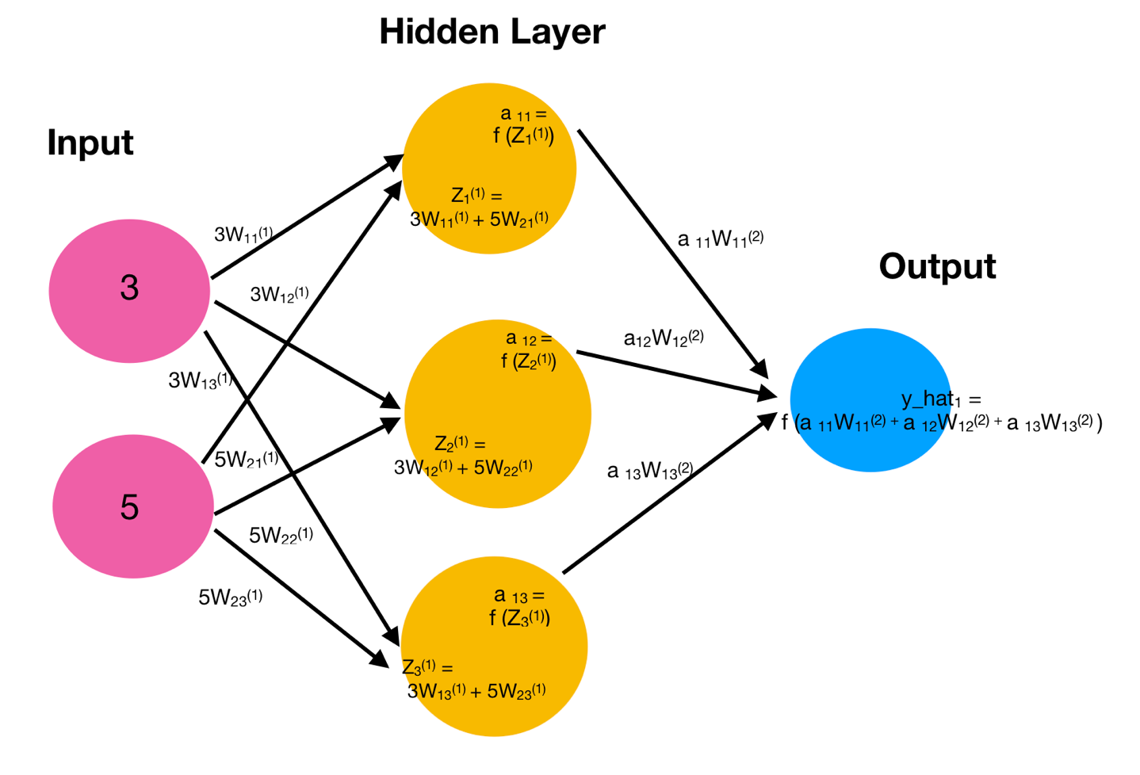
NN with Hidden Layer

Slide 32
RNN architecture – Forward Network
Y_{Predicted}
T₁
T₂
T₃
T₄
F
O₀
O₁
O₂
O₃
O₄
Y_{Predicted}
O_{t}
W₁
W₁
W₁
W₁
W¹¹
Softmax
W
W
W
W
X₁₁
X₁₂
X₁₃
Y_{Predicted}
-
Y
X₁₄
Loss =
X_{1t}
X_{s} = < X₁₁, X₁₂, X₁₃, X₁₄ > Y_{i}

Slide 33
Problem with this Simple RNN
Suffers vanishing gradient and exploding gradient problem.
Vanishing gradient problems when the weight updating is negligible
Sigmoid 0 to 1
Hyperbolic tangent(tanh) -1 to 1
ReLu 0 to infinity
Softmax 0 to 1
Exploding gradient problem when weight updating is so large
ELU negative infinity to positive infinity
SELU negative infinity to positive infinity

Slide 34
LSTM example
Today, due to my current job and family condition, I need to take a loan
Last year, due to my current job and family condition, I had to take a loan

Slide 35
RNN - LSTM
To solve vanishing and exploding gradients in RNN we need LSTM
LSTM is designed to solve vanishing gradient problem with the help of bellow mentioned gates
Memory Cell
Forget gate
Input Gate
Output Gate

Slide 36
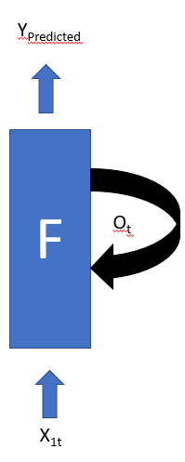
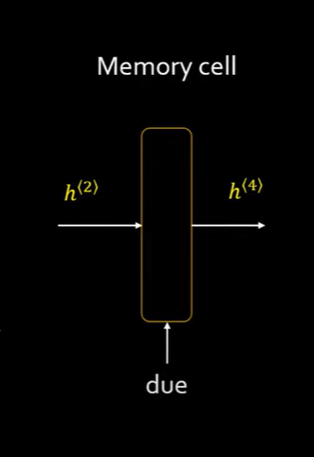
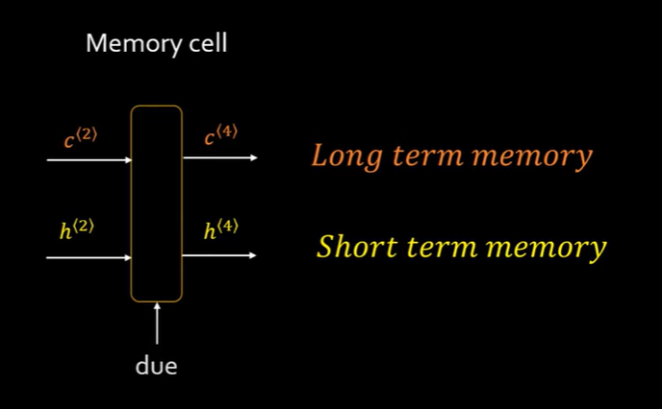
Memory Cell

Slide 37
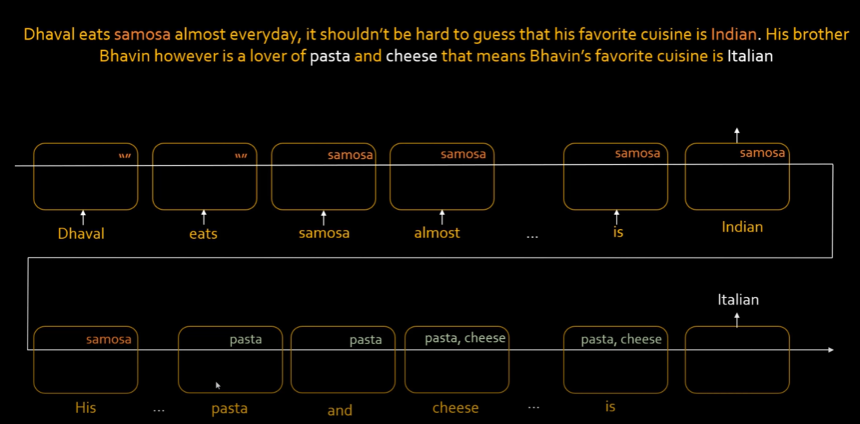
Forget gate

Slide 38
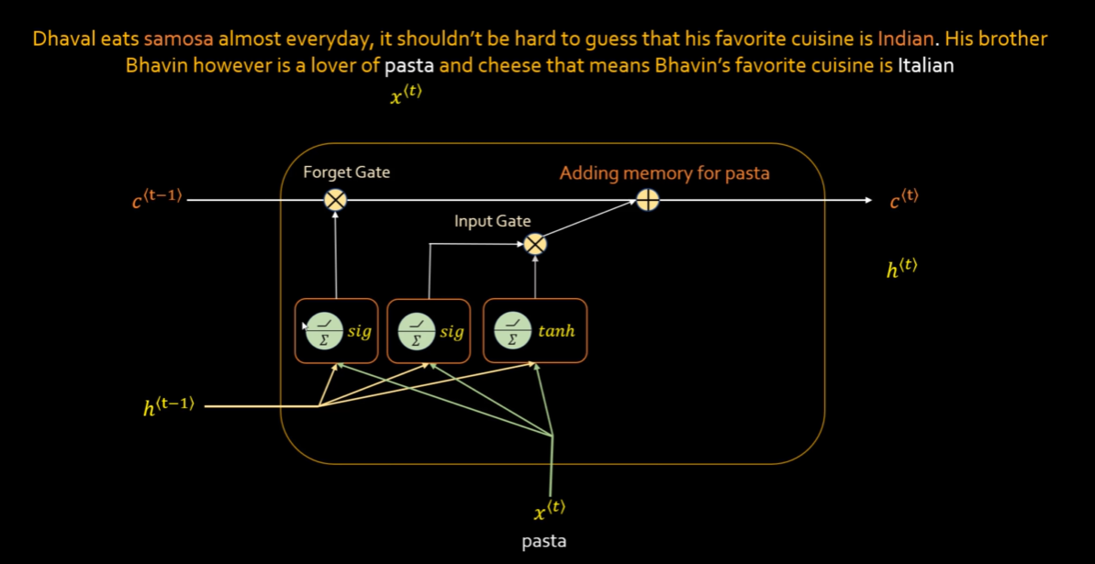
Input Gate

Slide 39
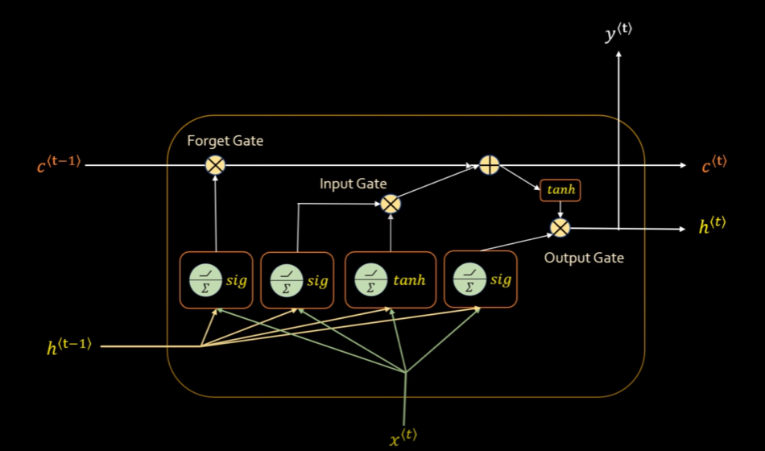
Output Gate

Slide 40
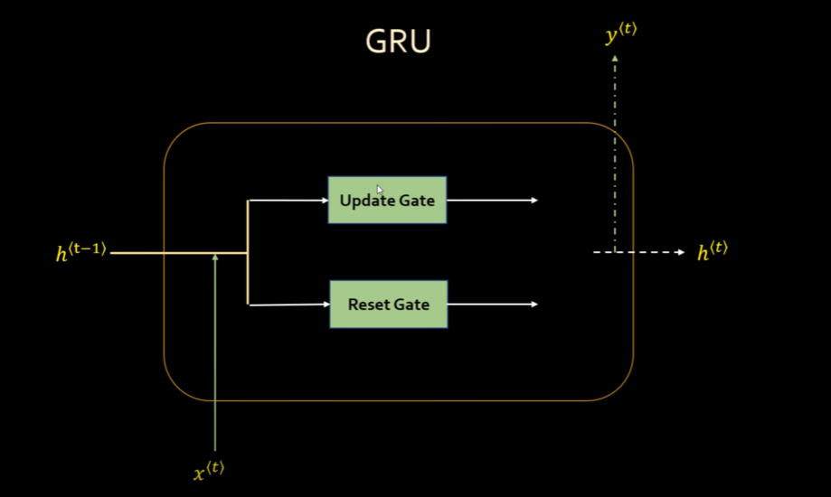
GRU Gates
Update Gate
How much past memory to retain
Reset Gate
How much past memory to forget

Slide 41
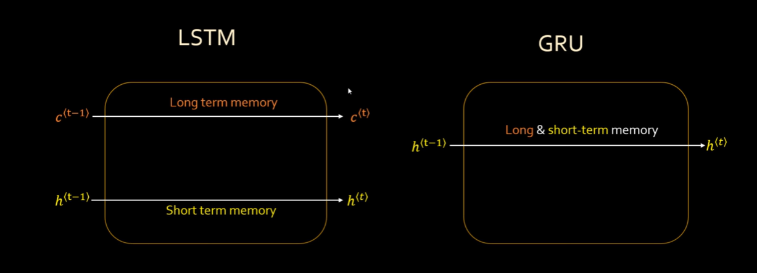
GRUs – Gated Recurrent Units

Slide 42
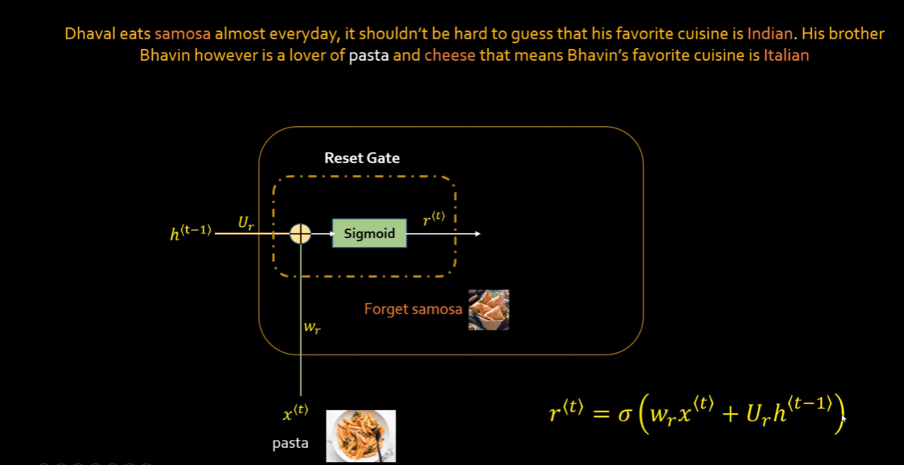
Reset Gate

Slide 43
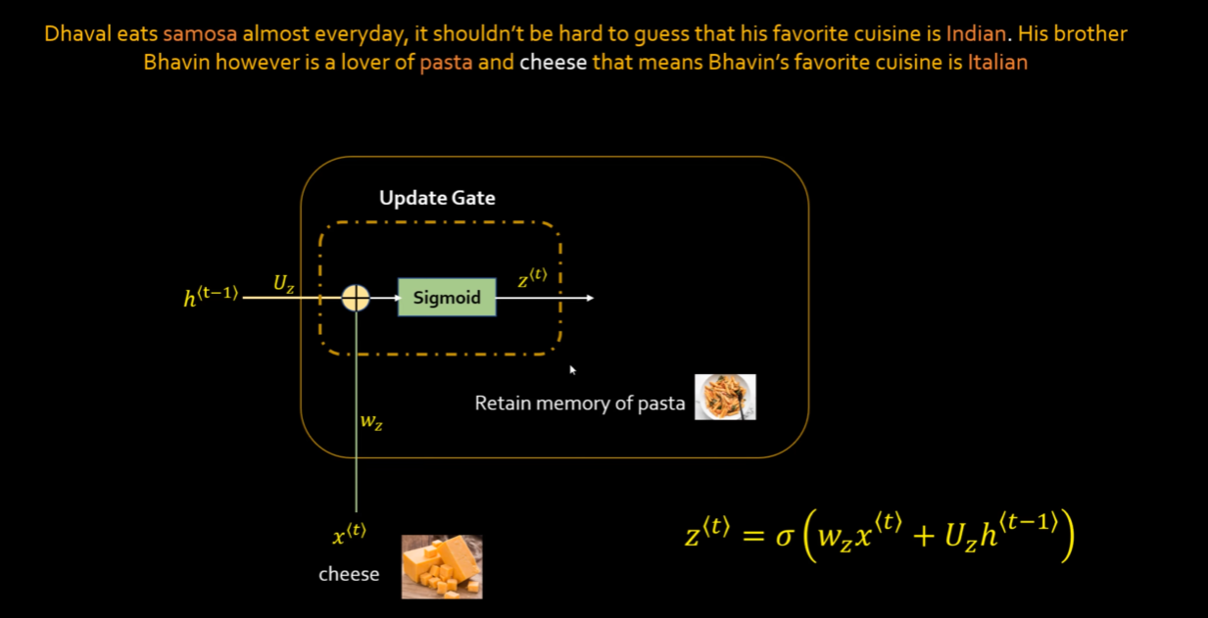
Update Gate

