Slide 1
MLOps Introduction

Slide 2
Logistics
Git
Github account
3. Docker
4. Docker hub account
5. VSCode

Slide 3
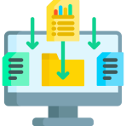

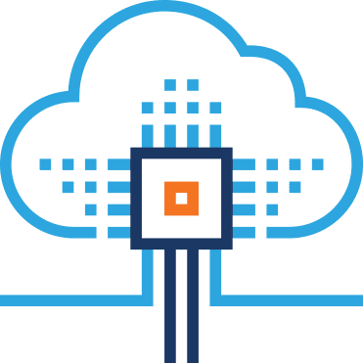
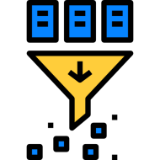

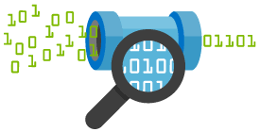

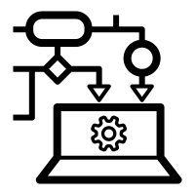

Machine Learning Life Cycle
Gathering Data
Deployment
Data preparation
Test the model
Data Wrangling
Train the model
Analyse Data

Slide 4
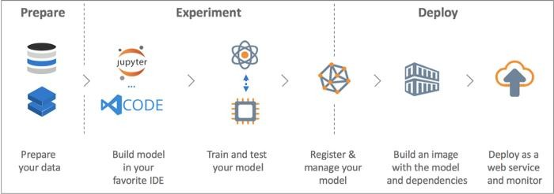






Typical workflow for creating a machine learning model:

Slide 5
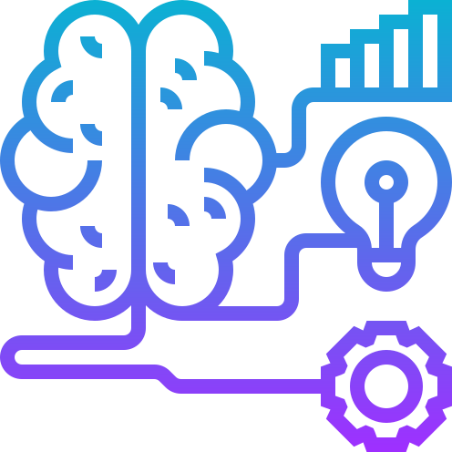
Machine learning
Machine learning (ML) is the study of algorithms and mathematical models that computer systems use to progressively improve their performance on a specific task.

Slide 6
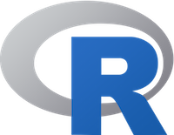


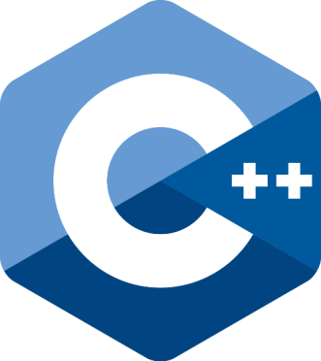
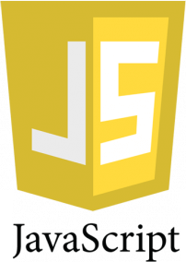
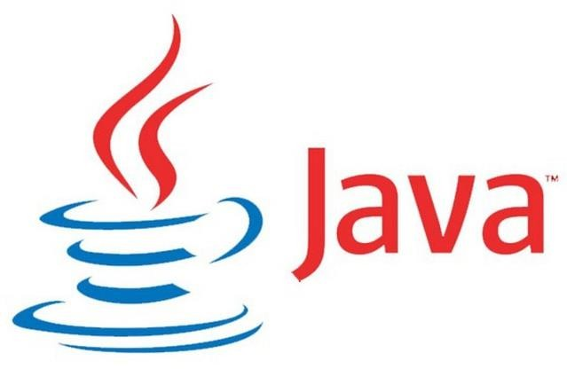
Programming Languages

Slide 7
Machine Learning Operations(MLOps)
Introduction

Slide 8
What is MLOps?
MLOps is a set of practices for collaboration and communication between data scientists and operations professionals.
Applying these practices increases the quality, simplifies the management process, and automates the deployment of Machine Learning and Deep Learning models in large-scale production environments.

Slide 9
State of machine learning
Last decade
By end of 2024
75% of organizations will shift from piloting to operationalizing AI
Focusing mostly on building ML model
Operationalization was an
afterthought
Today
53% of POC make it into production
Average 9 months
Source AWS AI conclave 2023, Bangalore, India

Slide 10
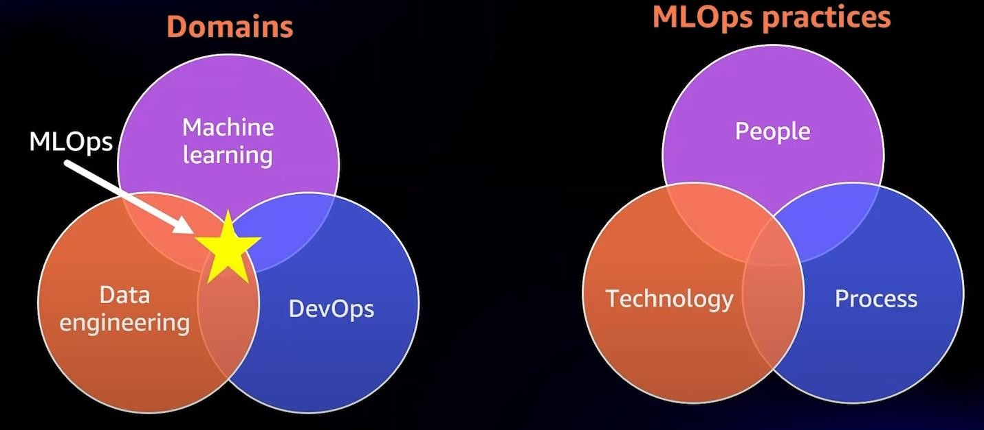
MLOps Motivation: High-level view
MLOps is the discipline that sits at the intersection between the domains of Machine Learning, Data engineering & DevOps.
MLOps as a discipline is enabled by core set of practices that span people, process & technology

Slide 11









MLOps Components
Use Case Discovery
Data Engineering
Machine Learning
Pipeline
Production Deployment
Production Monitoring
Business Understanding
Data
preparation
Deploy
Learning Algorithms
Model Serving
Optimize
Feasibility Study
Use Case
Identification
Automate
Model
Evaluation
Model Building
/Training
Monitor
Data
Understanding
Model
Experimentation
Operate

Slide 12

Machine learning industrialization challenges
Data availability and quality:
Machine learning models require large amounts of high-qualit data
Model deployment and maintenance
Deploying models to production ready environment to generat predictions
Requires careful planning and ongoing maintenance.
Model performance and accuracy
Continuously monitoring the performance and accuracy of deployed machine learning model
Challenging when data distribution or underlying business processes are constantly changing
y
e

Slide 13
Machine learning industrialization challenges
Explainability and interpretability:
Important to understand how a machine learning model is making predictions
Many machine learning models are difficult to interpret
Bias and fairness
Machine learning models can sometimes reflect the biases
present in the data they are trained on

Slide 14
AI Industrialization Challenges
AI Adoption:
Poor AI strategy makes startups, enterprises fail today
AI adoption with strategy drives the AI into production
AI Strategy
Your beginning of the AI model results looks good
Then changes or improvements of multiple dimensions
Feature additions/attributes
Regularization
Standardization of models
..may back propagate to the original state

Slide 15
Training and retraining
Scale issues will be seen only after moving the models into production
Managing and securing data
AI systems often rely on large amounts of data
Must be managed and secured in order to protect sensitive information
Ensure compliance with relevant regulations
Scaling Issues
Running AI at Scale is also one of the major challenges
Running model at scale needs
Robust orchestration
Load balancing
Model scale building using deep learning techniques with GPU's

Slide 16
Technology and People
Technology and people with right skills may be able to build the model to run in scale.
Challenges after moving model to production
Real time data pattern changes
Data volume changes
Load issues for the model
Right skills to address scaling issues
Stats
Data science skills
Analytical skills
DevOps skills

Slide 17
Platforms
Platforms for AI models is one of the key challenges now a
days enterprises facing
Tools in this platform may address the issue the issue of
model outages or monitoring model issues etc
Consider using ML Pipeline tools and techniques in orchestrating the models

Slide 18
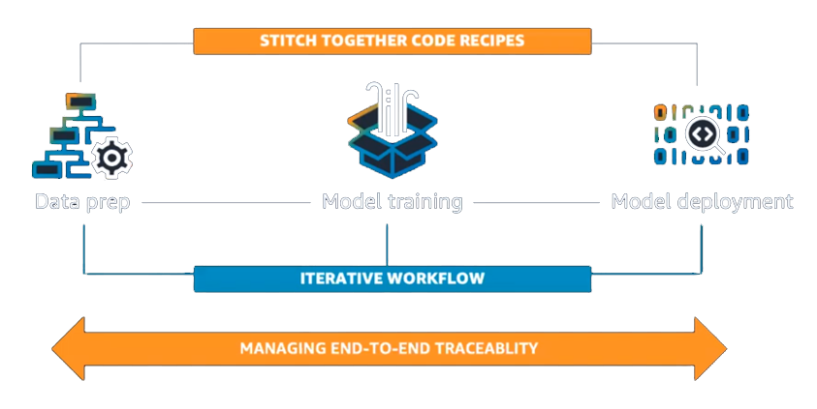
MLOps challenges
Creating & managing Machine Learning workflows involves lot of challenges
Data Preparation
Model Training
Model Deployment
Model Training
Data Prep
Model deployment

Slide 19
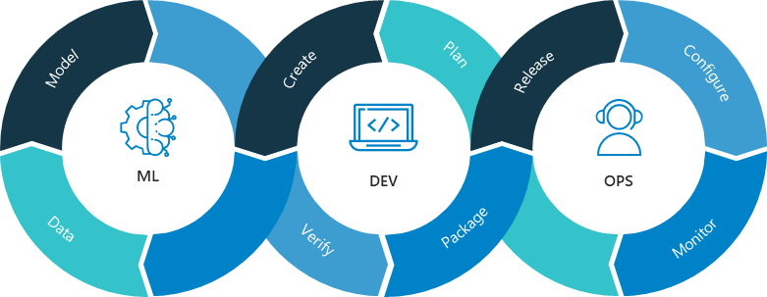
MLOps challenges similar to DevOps
Challenges in operationalizing ML models have lot common with software production. Incorporating CI/CD practices on top of all of this like Source & version control.
Source code versioning
Track & versioning data
Model artifacts versioning
Model versioning

Slide 20
Use case discovery:
Collaboration between business and data scientists to define a business problem and translate that into a
problem statement
Objectives solvable by ML with associated relevant KPIs (Key Performance Indicator).
Data Engineering:
Collaboration between data engineers and data scientists to acquire data from various sources
Prepare the data (processing/validation) for modeling.
Machine Learning pipeline:
This stage is designing and deploying a pipeline integrated with CI/CD.
Data scientists use pipelines for multiple experimentation and testing.
The platform keeps track of data and model lineage and associated KPIs across the experiments.

Slide 21
Production deployment:
This stage accounts for secure and seamless deployment into a production server of choice, be it public cloud, on-premise, or hybrid.
Production monitoring:
This stage includes both model and infrastructure monitoring.
Models are continuously monitored using configured KPIs like changes in input data distribution or changes in model performance.

Slide 22
How does it relate to DevOps, AIOps, ModelOps, and GitOps?

Slide 23
How does it relate to DevOps, AIOps, ModelOps, and GitOps?
DevOps
DevOps is a set of practices and principles that emphasizes collaboration and automation to improve the speed, reliability, and security of software delivery.
Life cycle
Involves multiple phases, from development and testing to deployment and
monitoring

Slide 24
Tools & Platforms
Configuration Management Tools: Ansible, Chef, and Puppet
Containerization and Orchestration Tools: Docker and Kubernetes
Continuous Integration and Continuous Deployment (CI/CD) Tools: Jenkins, Travis CI, CircleCI, and GitLab CI/CD
Monitoring and Logging Tools: Prometheus, Grafana, and Elasticsearch/Kibana
Collaboration and Communication Tools: Slack, Microsoft Teams and JIRA
AIOps Tools: Moogsoft and Big Panda

Slide 25
DevOps Aim
DevOps aims to improve the speed and reliability of software delivery, and to increase collaboration and communication between development and operations teams
Deliver software faster
Increase reliability and reduce errors
Improve collaboration and communication
Achieve better visibility and control
Enhance Security
Achieve better scalability

Slide 26
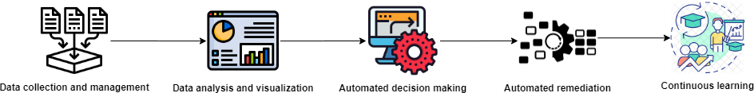
AIOps
AIOps (Artificial Intelligence for IT Operations) is the use of machine learning and other AI technologies to automate many processes that are currently done manually in an organization.
AIOps is also different from MLOps because it uses AI to automate many
processes, not just one or two tasks like MLOps does.
The organizations planning to implement AIOps will need to have in place
MLOps
Life cycle

Slide 27

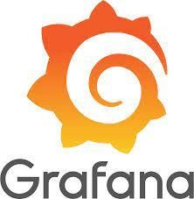



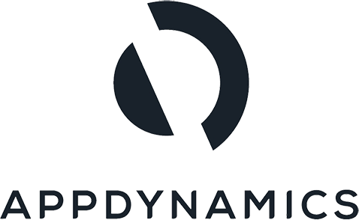

Tools & Platforms
ELK Stack
Prometheus
Grafana
Splunk
AppDynamics
IBM Netcool Operations Insight
ServiceNow AIOps

Slide 28
AIOps Aim
The main aim of AIOps is to improve the efficiency and effectiveness of IT operations by using artificial intelligence and machine learning to automate and optimize various tasks.
Improved incident management
Increased automation
Reduced mean time to repair (MTTR)
Increased visibility
Improved Root Cause Analysis
Predictive maintenance

Slide 29
ModelOps
ModelOps (Model Operations) is the practice of managing and deploying machine learning models in a production environment.
It includes the processes, tools, and best practices
Developing
Testing
Deploying
Monitoring
Maintaining machine learning models in a production environment.
key components of ModelOps
Model development
Model deployment
Model monitoring
Model maintenance
Model Governance

Slide 30

Life cycle
Tools & Platforms
TensorFlow Extended (TFX)
MLflow
Amazon SageMaker
DataRobot
Algoworks AI-ML Platform
Google Cloud AI Platform
RapidMiner
ModelOps Aim
The goal of ModelOps is to ensure that machine learning models are reliable, accurate, and maintainable, so that they can be used effectively in real-world applications.

Slide 31
GitOps
GitOps is a practice that uses Git as a single source of truth for declaratively managing
infrastructure and application deployments.
It uses Git as a central repository to store configuration files and use them to drive the state of the systems
It's based on the idea that the version-controlled configuration files that describe the
desired state of the systems should be treated as the single source of truth
key components of GitOps
Centralized repository
Declarative configuration
Automated deployment
Continuous integration and delivery (CI/CD) pipelines
Continuous monitoring
Collaboration

Slide 32
Tools & Platforms
Code is committed to a version control repository
CI/CD system listens for changes to the repository and automatically builds and tests the code
If test passed the code is deployed to a staging environment for further testing
Once the code is deemed ready, it is deployed to the production environment
Any updates or rollbacks to the production environment are done by committing changes to the version control repository.
Triggers the CI/CD pipeline to redeploy the changes.

Slide 33
GitOps Aim
GitOps uses Git as a single source of truth for declaratively managing distributed systems, such as Kubernetes clusters
All desired states of the system are stored in Git
Changes to the system are made by committing new versions of these manifests to the Git repository
GitOps allows for version control, review, and rollback of infrastructure changes, and also allows for easy collaboration and auditing
Allows you to use tools you are already familiar with, like git and CI/CD pipelines.

Slide 34

Major Phases - what it takes to master MLOps
Mastering MLOps (Machine Learning Operations) can be a complex and multifaceted
endeavor, as it involves both machine learning expertise and operations experience.
key areas that are important to master in MLOps:
Machine Learning
Cloud Computing and Infrastructure
CI/CD and Automation
Monitoring and Evaluation
Security and Compliance
Data Engineering and Operations

Slide 35
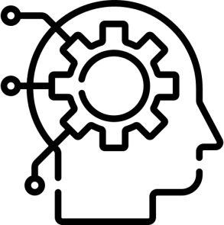

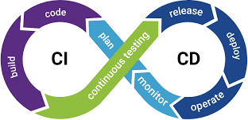
Major Phases - what it takes to master MLOps
Machine Learning
To master MLOps, you should have a solid understanding of machine learning concepts, algorithms, and frameworks.
This will allow you to develop, train, and deploy machine learning models effectively.
Cloud Computing and Infrastructure
Experience with cloud computing platforms, such as AWS, Azure, or GCP.
Experience with container orchestration tools like Kubernetes.
These are crucial for MLOps as they are often used to deploy and manage machine learning models in production.
CI/CD and Automation
To be effective in MLOps, you should be proficient in using continuous integration and continuous delivery (CI/CD) tools
Automation frameworks to build, test, and deploy machine learning models and
infrastructure.

Slide 36


Major Phases - what it takes to master MLOps
Monitoring and Evaluation
MLOps also require being able to monitor the performance and behavior of machine learning models in production
Including logging, alerting and tracking of the models performance over time to measure their effectiveness.
Security and Compliance
Machine learning models can process sensitive data
Important to have a solid understanding of data security and compliance best practices
To ensure that the models are deployed and managed securely.

Slide 37
Major Phases - what it takes to master MLOps
Data Engineering and Operations
Considering data is the lifeblood of machine learning models
A solid understanding of data engineering and operations is crucial in MLOps
Strong data pipeline and storage skills will be very beneficial in this regard

Slide 38
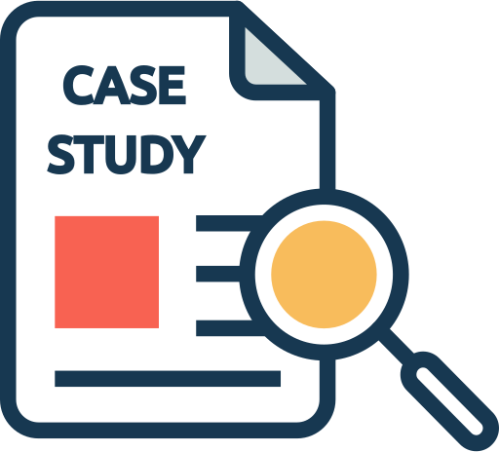
CI/CD in Production Case Study

Slide 39
CI/CD in Production Case Study
One of the core concepts in DevOps that is now making its way to machine learning operations (MLOps) is → CI/CD—Continuous Integration and Continuous Delivery or Continuous Deployment.
Continuous integration (CI) is the practice of automating the building and testing of code every time it is committed with version control and pushed to a code repository (to build the application).
Continuous delivery (CD) is the practice of deploying every build to a production-like environment and performing automated integration and testing of the application before it is deployed.
Continuous deployment (CD) compliments continuous integration with additional steps by automating the configuration and deployment of the application to a production environment.

Slide 40


CI/CD for Machine Learning (ML) with Azure DevOps
Industry: Retail and consumer goods.
Use case:
This team helps a retail client to resolve tickets in an automated way using machine learning
This tickets are raised by users or raised by maintenance problems
Machine learning is used to classify the tickets into different categories, helping in the faster resolution of the tickets.

Slide 41
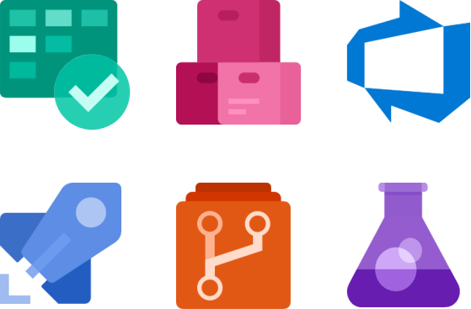
Core CI/CD tools:
Azure DevOps Pipeline
Git
Overview:
To orchestrate their CI/CD workflow, the team used the Azure DevOps suite
of products.
They also configured development and production environments for their ML workloads.
These workflows consist of all CI/CD processes that happen before deploying the model to production and after deployment.

Slide 42
CI/CD workflow before deploying the model to production
Step 1:
To automate the dev-to-production cycle, the team set up build and release tasks
with Azure DevOps Pipelines.
The build pipeline generates the model artifacts from a candidate source code and
after model serialization (mostly using ONNX).
Step 2:
The artifacts are deployed to infrastructure targets using the release pipelines
The release pipelines move the artifacts to the quality assurance (or QA) stage after they have been tested in the development environment.

Slide 43
Step 3:
Model testing happens in the QA stage where A/B tests and stress tests are performed on the model
To ensure model is ready to be deployed to the production environment.
Step 4:
A human validator, usually the product owner, ensures the model passes the tests, has been validated
And then approves the model to be deployed to the production environment using
the release pipelines.

Slide 44

CI/CD workflow after deploying the model to production
Step 1:
After deploying the model to production
Team sets up cron jobs that monitor model metrics for data drift and concept drift on a weekly basis
So that the pipeline can be triggered when an unacceptable drift occurs that requires retraining the model.
Step 2:
They also monitor the performance of their CI/CD pipeline in production
The purpose of the inspection is to ensure their CI/CD pipeline is healthy and in a robust state

Slide 45



CI/CD for ML with GitOps using Jenkins and Argo workflows
Industry
Computer software
Use case
GreenSteam – An i4 Insight Company provides software solutions for the marine industry that help reduce fuel usage
Excess fuel usage is both costly and bad for the environment, and vessel operators are obliged to get more green by the International Maritime Organization and reduce the CO2 emissions by 50 percent by 2050
Core CI/CD tools
Argo
Jenkins

Slide 46
Overview:
The team used Jenkins and GitOps to automatically check and test their code before deploying it to production, by simulating production-like conditions in a test environment.
The team had a single pipeline for model code where every pull request was going
through code reviews and automated unit tests.
Pull requests were checked using automated tests that trained models, made predictions, and ran the whole process on small pieces of real data to ensure everything worked correctly and nothing was broken
Models were continuously delivered and reviewed by a domain expert after training, and were deployed manually after getting approved by the expert and passing all checks.

Slide 47
Code quality checks and using Jenkins to manage the CI pipeline
Jenkins is one of the most popular tools used for continuous integration among developers for tests, checks, and reviews
Step: 1
They put all code quality checks in a Docker container to keep consistency and unify the tools and configurations used locally and on Jenkins.
So versioning & config tools required like flake8, black, mypy, pytest all are unified
Step: 2
Docker eliminated issues caused by different versions of dependencies on
local, Jenkins, and production environments.

Slide 48
Step: 3
For local development, they had a Makefile to build the Docker image and
run all the checks and tests on the code.
Step: 4
For code reviews, they set up Jenkins and it was running the same checks as
a part of the CI pipeline.
Using Argo to manage CI/CD pipelines
Argo Workflows is a tool that runs parallel jobs on Kubernetes
Allows the team to run heavy computational jobs like machine learning and
data processing on Amazon EKS clusters.
The pipeline includes:
Retraining models
Testing
Expert review before deployment
© 2022 Psitíon ľechnologies Pvt.Ltd

Slide 49
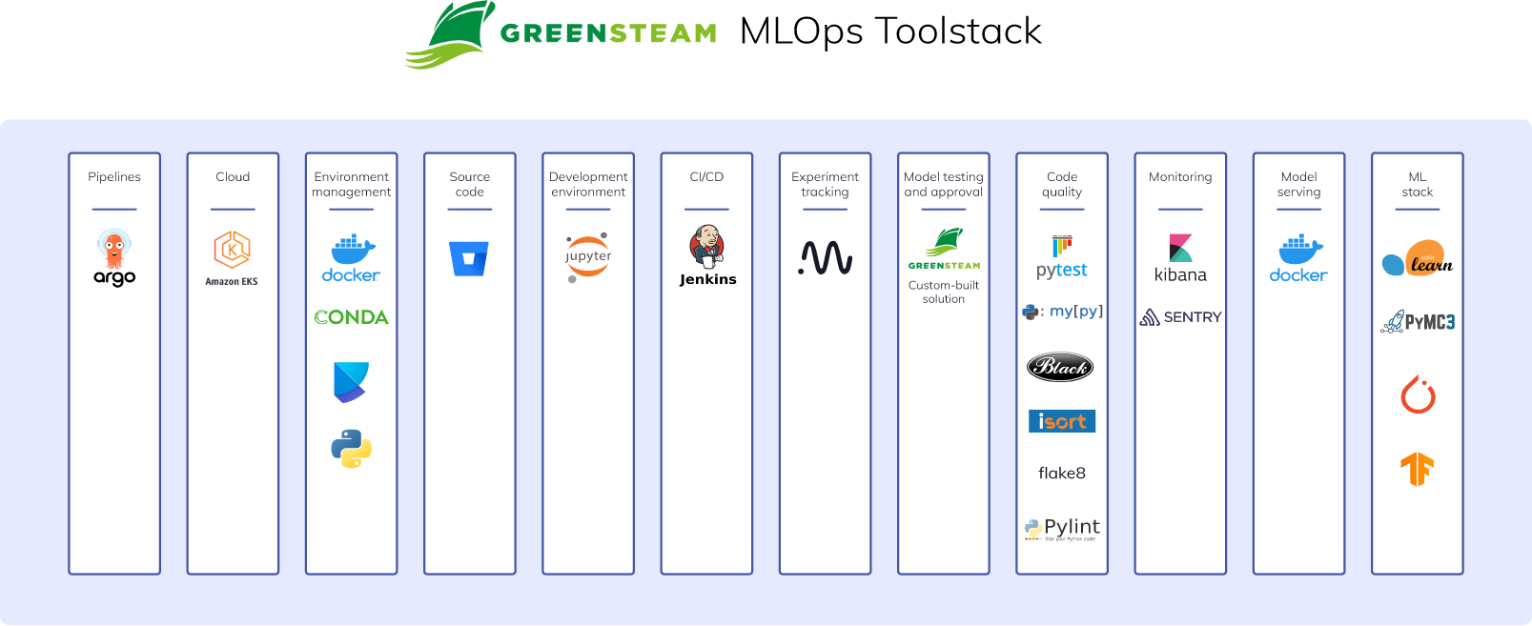
Team’s entire stack for ML workloads:

Slide 50

CI/CD for ML with AWS CodePipeline and Step Functions
Industry
Transportation and logistics.
Use case
For this use case, the team is from a consulting and professional services company that worked on a public project. Specifically, they built machine learning applications that solved problems like:
Predicting how long it will take to deliver a parcel
Predicting a location, based on unstructured address data and resolving it to a coordinate system (latitude/longitude).
Core CI/CD tools
AWS CodeBuild – A fully managed continuous integration service that compiles source code, runs tests, and produces software packages that are ready to deploy.
AWS CodePipeline – A fully managed continuous delivery service that helps you automate your
release pipelines.
AWS Step Functions – A serverless function orchestrator that makes it easy to sequence AWS Lambda functions and multiple AWS services.
© 2022 Psitíon ľechnologies Pvt.Ltd

Slide 51
Overview:
AWS Cloud provides managed CI/CD workflow tools like AWS CodePipeline and AWS Step Functions to carry out continuous integration and continuous delivery for their machine learning projects.
For continuous integration, the team used git to make commits to
AWS CodeCommit
Commits trigger a build step in CodePipeline (through an AWS CodeBuild job)
AWS Step Functions handle the orchestration of the workflows for every action from CodePipeline.
© 2022 Psitíon ľechnologies Pvt.Ltd

Slide 52
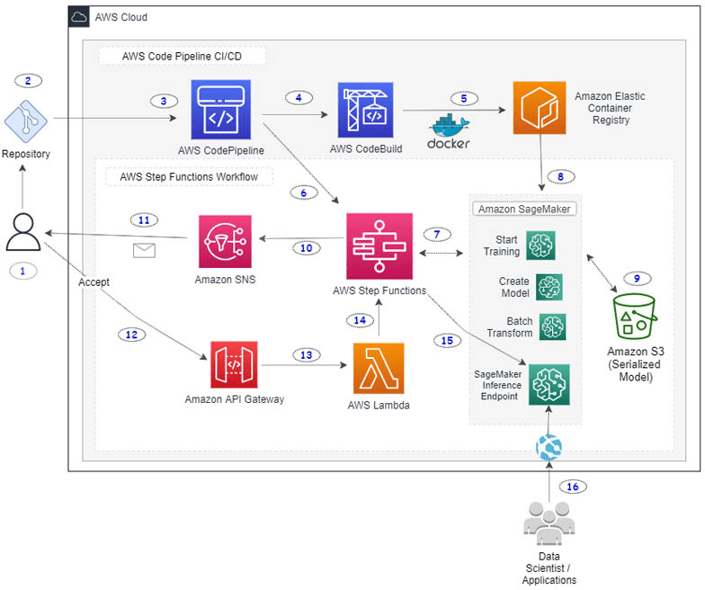
Understanding the architecture
© 2022 Psitíon ľechnologies Pvt.Ltd

Slide 53
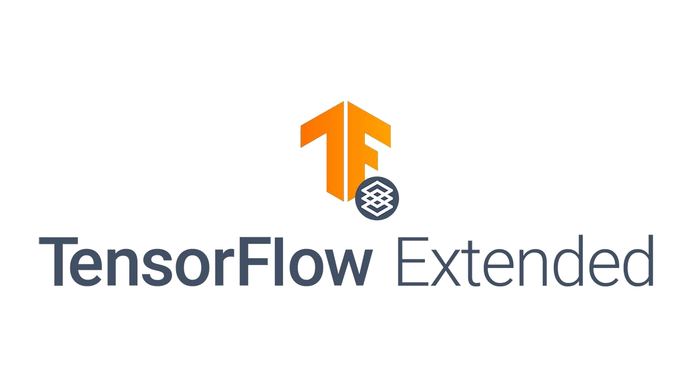
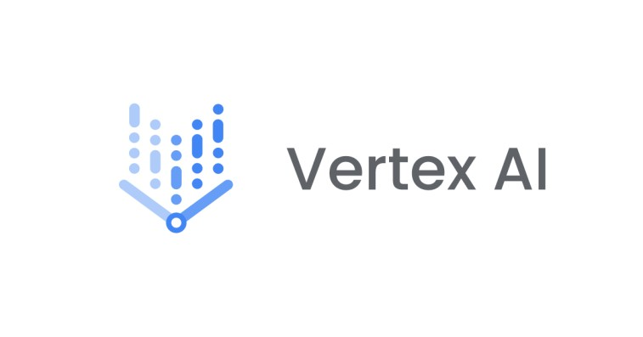
CI/CD for ML with Vertex AI and TFX on Google Cloud
Industry
Business intelligence and financial technology services.
Use case
Digits Financial, Inc. is a fin-tech company offering a visual, machine learning-powered expense monitoring dashboard for startups and small businesses.
Building a tool to turn a company's financial data into a real-time model.
Using unstructured data to predict future events for customers.
Grouping data to show what's most relevant for customers' businesses.
Core CI/CD tools
TensorFlow Extended
Vertex AI Pipelines
© 2022 Psitíon ľechnologies Pvt.Ltd

Slide 54
Overview
The team at Digits used a specialized tool called Vertex AI Pipelines and
TensorFlow Extended
They used this tool to manage and improve the process of implementing
machine learning models on Google Cloud
This approach helped to maintain consistency and quality in the models
created.
© 2022 Psitíon ľechnologies Pvt.Ltd

Slide 55
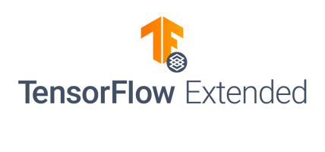
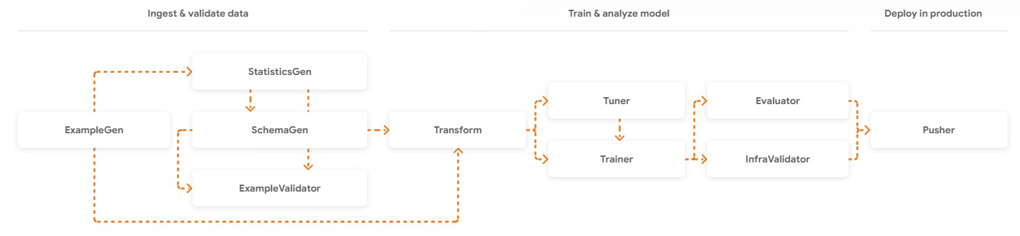
What is TensorFlow Extended (TFX) ?
It's a library for creating and deploying production
machine learning pipelines
Pipelines can be run using Apache Beam, Apache Airflow, or Kubeflow Pipelines
Provides a set of tools for building, deploying, and managing machine learning workflows
Deployed to a variety of environments, including
on-premises and cloud-based systems.
TFX pipeline is a set of reusable components
These components include data ingestion and
validation, model training, evaluation, and serving
As well as model monitoring and management.
© 2022 Psitíon ľechnologies Pvt.Ltd

Slide 56
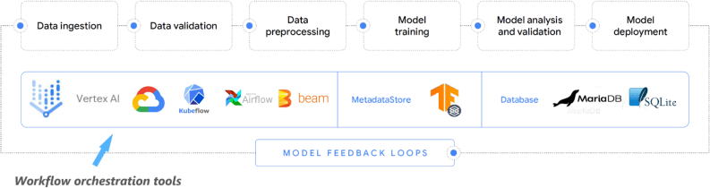
Machine learning pipelines with TFX
The team moved their ML pipelines from Kubeflow to
Vertex AI Pipeline from Google Cloud
This removed the need to maintain databases that store metadata, launch clusters to host and operate the build servers and pipelines
This helped them easily tie together model development (ML) and operations (Ops) into high- performance and reproducible steps
Vertex AI Pipeline service is a managed service, which reduces the maintenance required to self-hosted Kubeflow Pipelines.
One of the core advantages of using Vertex AI Pipelines is that it helped the team transition from managing their pipeline to leveraging the managed Vertex AI Pipeline service for workflow orchestration
© 2022 Psitíon ľechnologies Pvt.Ltd

Slide 57
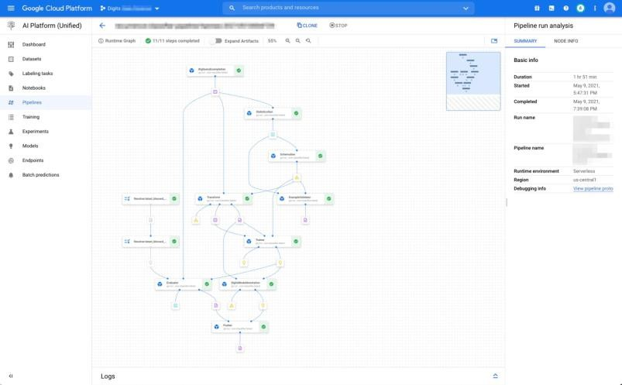
Orchestrating with Vertex AI Pipelines
Vertex AI is a platform that helps to speed up experimentation and deployment of machine learning models
It helps to automate, monitor, and govern the team's ML systems by organizing them in a serverless manner
It stores the workflow's artifacts
By storing these artifacts, the team can trace the origin of the models, including the training data, hyperparameters and code used to create the model.
© 2022 Psitíon ľechnologies Pvt.Ltd

Slide 58

Benefits from using machine learning pipelines
Using ML pipelines reduced the DevOps requirements for the team
Migrating to managed ML pipelines reduced the expense of running 24/7 clusters
Model updates were easy to integrate and automated, freeing
up the team for other projects
Consistency across all ML projects because the teams could run
the same tests and reuse the pipeline or components
A centralized place for machine learning-related metadata and information
Models are automatically tracked and auditable.
© 2022 Psitíon ľechnologies Pvt.Ltd

