Slide 1
Promotions analysis to provide tangible Insights to sales Director
Done By – Sachin Sahadev Singh

Slide 2
Task to Achieve
Store Performance Analysis:
• Which are the top 10 and Bottom 10 stores in terms of Incremental Revenue (IR) and Incremental Sold Units (ISU) generated from the promotions?
• How does the performance of stores vary by city? Are there any common characteristics among the top-performing stores that could be leveraged across other stores?

Slide 3
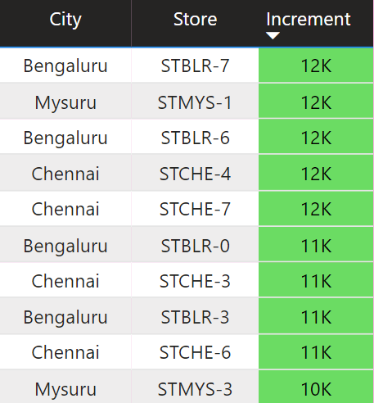
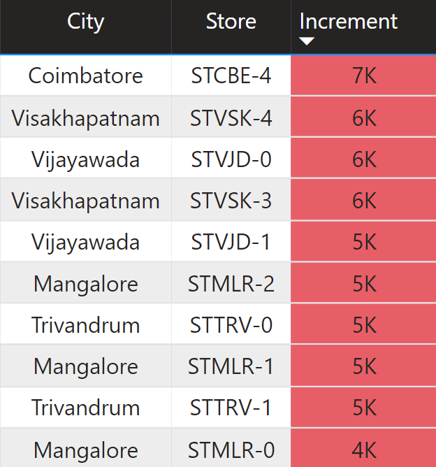
Top vs Bottom Stores

Slide 4
Store Insights
Chennai
Mysuru
Coimbatore
Mangalore
Visakhapatnam
Vijayawada
Trivandrum
Bengaluru

Slide 5
Why??
Factors | Top Cities | Bottom Cities
Geographical Location | Inland Cities | Coastal Cities
Economic Focus | IT hubs and industrial centers (technology, manufacturing, and services) | diverse economies (agriculture, fishing, manufacturing, and trade)
Geo Location
Profession of Majority People

Slide 6
Promotion Type Analysis:
• What are the top 2 and Bottom 2 promotion types that resulted in the highest Incremental Revenue and impact on Incremental Sold Units?
• Is there a significant difference in the performance of discount-based promotions versus BOGOF (Buy One Get One Free) or cashback promotions?
• Which promotions strike the best balance between Incremental Sold Units and maintaining healthy margins?

Slide 7
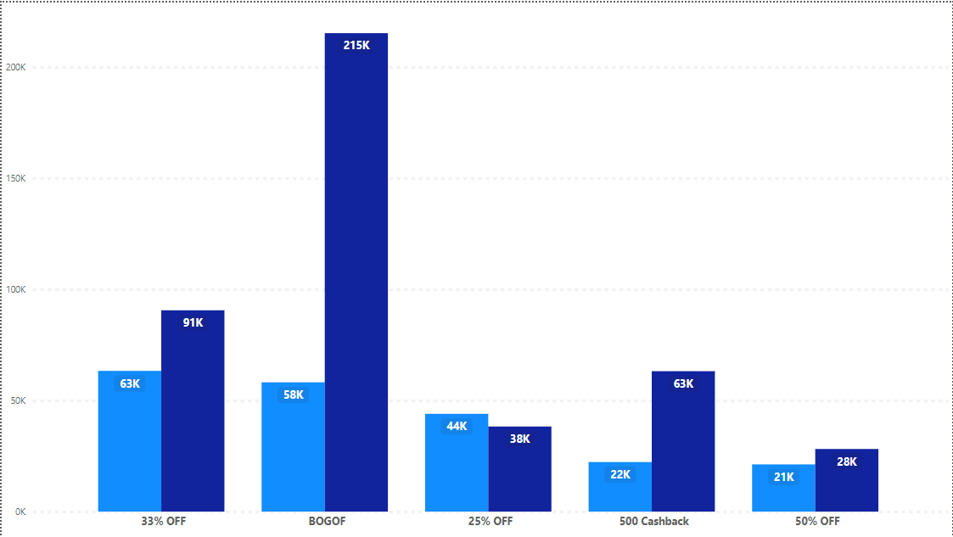
Quantity Impact
Quantity sold before promo
Quantity sold after promo

Slide 8


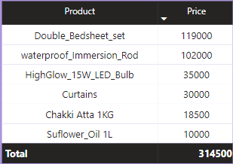



Top Promotions
3.5X
3X

Slide 9


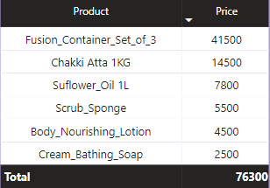


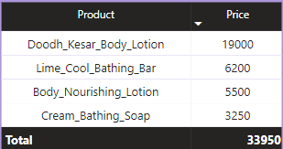
Bottom Promotions

Slide 10
Product and Category Analysis:
• Which product categories saw the most significant lift in sales from the promotions?
• Are there specific products that respond exceptionally well or poorly to promotions? What is the correlation between product category and promotion type effect

Slide 11
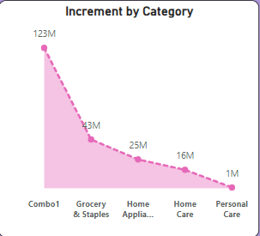
Best Category

Slide 12
Thank You

