Slide 1

Automotive ECU Communication Framework Using CAN Protocol
VECTOR INDIA PVT LTD
PROJECT MEMBERS:
V25BE4K8 Kammara Himasagarachari
V25BE4S1 Sachin Rawat
V25BE4S26 Shivani V

Slide 2
CONTENTS
Introduction
Problem and Objective
Literature Survey
Proposed System
Hardware/Software Used
Implementation
Results
Conclusion
References

Slide 3
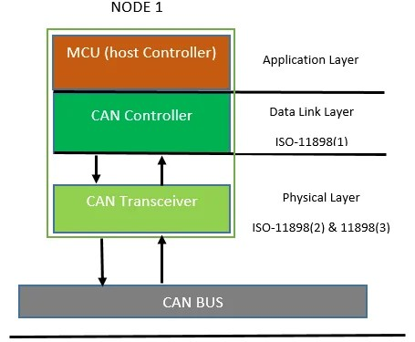
Introduction:
AN AUTOMOTIVE ECU COMMUNICATION SYSTEM USES THE CONTROLLER AREA NETWORK (CAN) PROTOCOL.
IT IS A MESSAGE-BASED & SERIAL COMMUNICATION SYSTEM.
IT ALLOWS MULTIPLE ECUS TO EXCHANGE DATA RELIABLY OVER A TWO-WIRE BUS WITHOUT A HOST COMPUTER.
CAN IS A BROADCAST AND ASYNCHRONOUS PROTOCOL.

Slide 4
PROBLEM STATEMENT & OBJECTIVE
PROBLEM STATEMENT:
INCREASING NUMBER OF ECUS IN MODERN VEHICLES.
POINT-TO-POINT WIRING IS COMPLEX, COSTLY, AND INEFFICIENT.
REAL-TIME COMMUNICATION BETWEEN ECU’S IS CHALLENGING.
NEED FOR A RELIABLE AND STANDARD COMMUNICATION SYSTEM.
OBJECTIVE:
TO UNDERSTAND AND IMPLEMENT THE CAN PROTOCOL FOR ECU COMMUNICATION.
TO SIMULATE REAL-TIME DATA EXCHANGE BETWEEN MULTIPLE ECUS.
TO REDUCE WIRING COMPLEXITY USING A TWO-WIRE CAN BUS.
TO MAKE INTERRUPT HANDLER BASED COMMUNICATION.

Slide 5
LITERATURE SURVEY
CAN protocol specifications are published in the Bosch CAN 2.0 documentation and later standardized as ISO 11898.
For this project, we referred to:
Bosch CAN Protocol Documentation – For understanding CAN message framing and arbitration.
NXP LPC2129 Datasheet – To configure CAN controller registers.
MCP2551 Transceiver Datasheet – For interfacing the LPC2129 with the CAN bus.
Keil uVision IDE Documentation – For compiling and debugging the project code.
Flash Magic User Manual – For programming the LPC2129 microcontroller using UART.

Slide 6
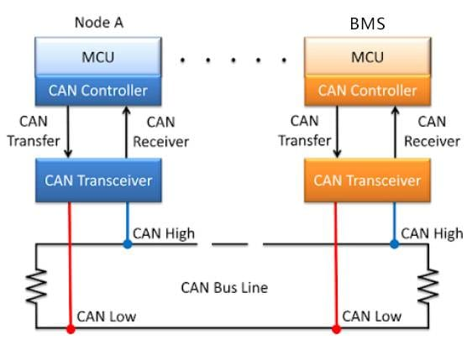
PROPOSED SYSTEM
SYSTEM DESCRIPTION:–
LPC21XX ECU WITH CAN1 PERIPHERAL.
ACCEPTANCE FILTER CONFIGURED FOR SPECIFIC IDS.
INTERRUPT-DRIVEN MESSAGE HANDLING.
LEDS USED FOR OUTPUT INDICATOR.
USED 16x2 LCD AND UART SERIAL TERMINAL TO DISPLAY SPEED AND HEADLIGHT AND LEFT AND RIGHT INDICATOR.
Node A
Node B

Slide 7
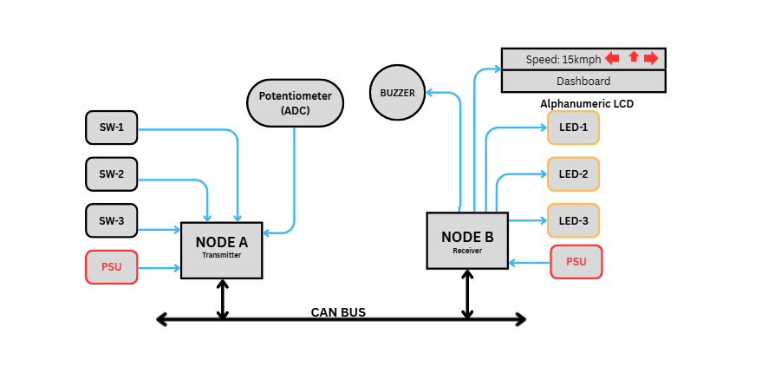
BLOCK DIAGRAM

Slide 8
HARDWARE / SOFTWARE USED
HARDWARE:-
LPC2129 Microcontroller(2 Boards).
MCP2551 CAN Transceiver.
3 LEDs & 3 Switches.
1 Buzzer
16x2 Alphanumeric LCD
Potentiometer(ADC).
Power Supply.
Connecting Wires.
SOFTWARE:-
Keil uVision IDE: Our coding environment.
Serial Terminal / Debug Tools: For testing and Troubleshooting.
Flash Magic: For flashing/Dumping a hex file into Microcontroller using UART0.

Slide 9
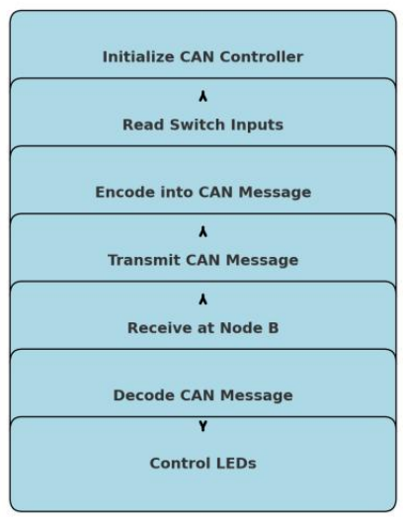
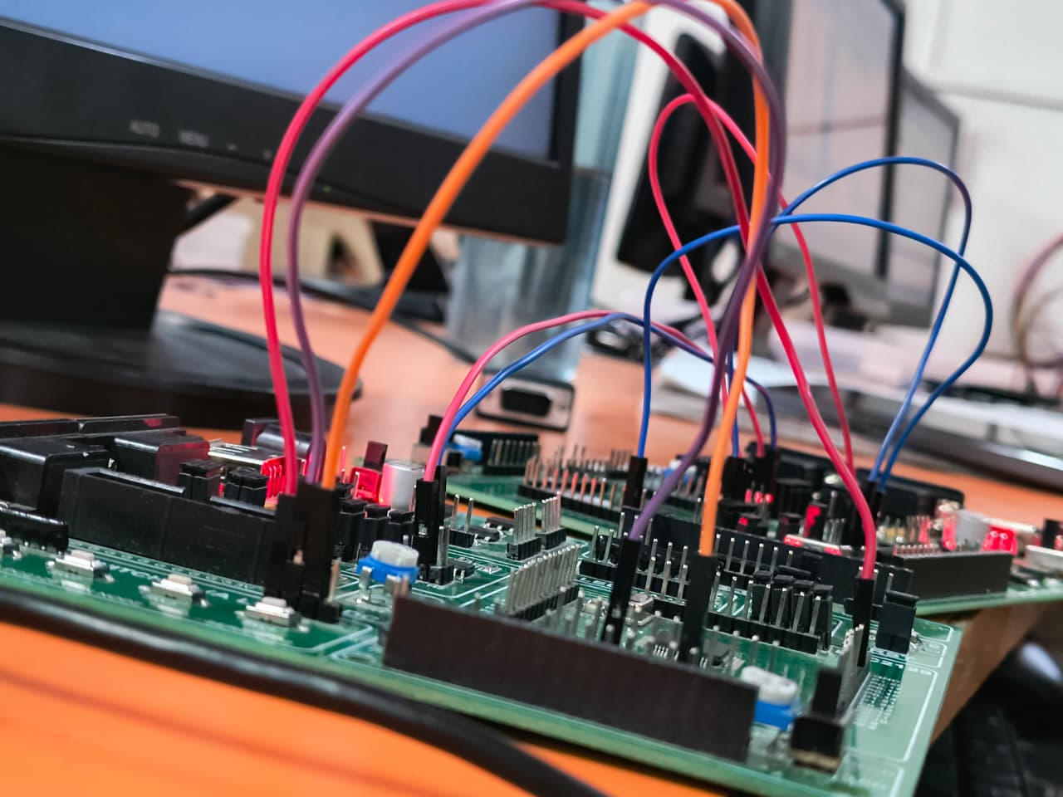
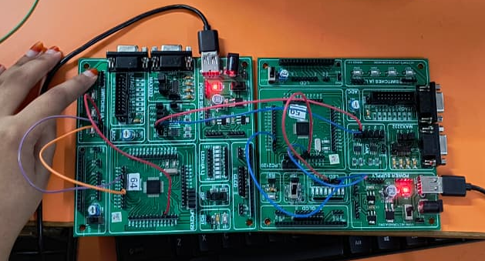
IMPLEMENTATION :

Slide 10
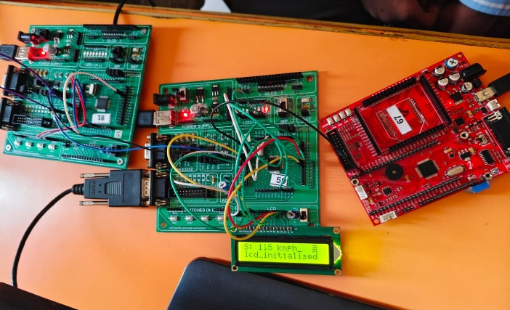
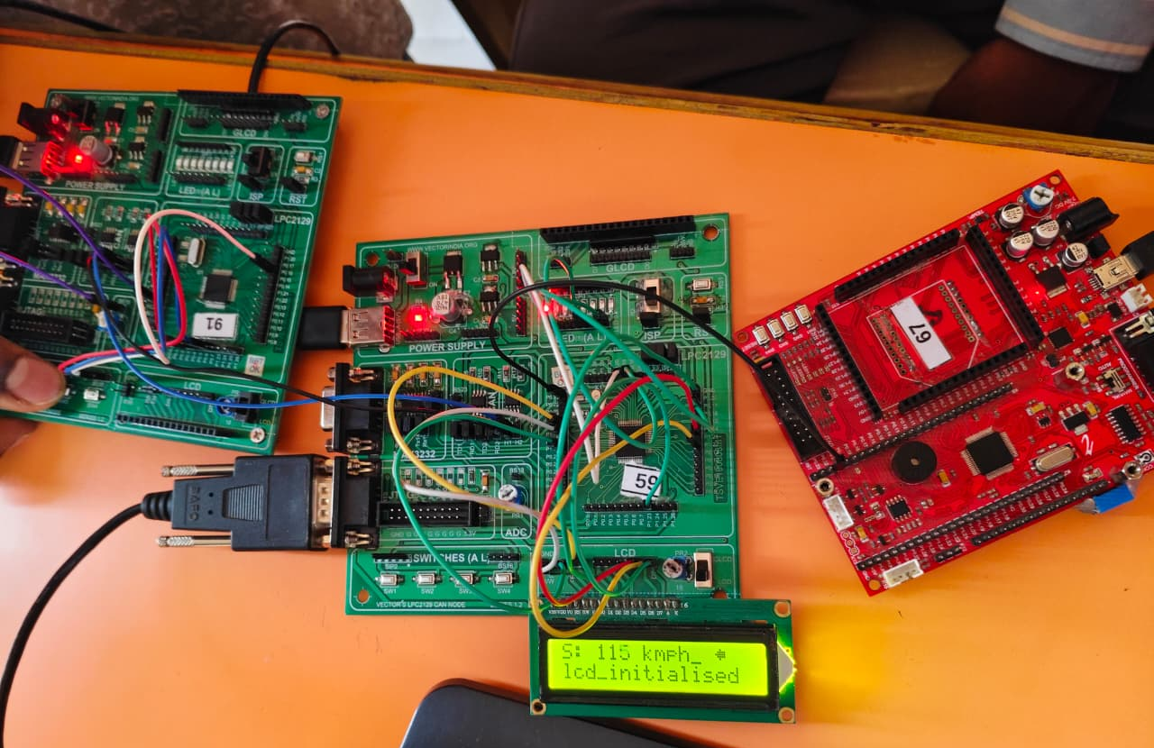
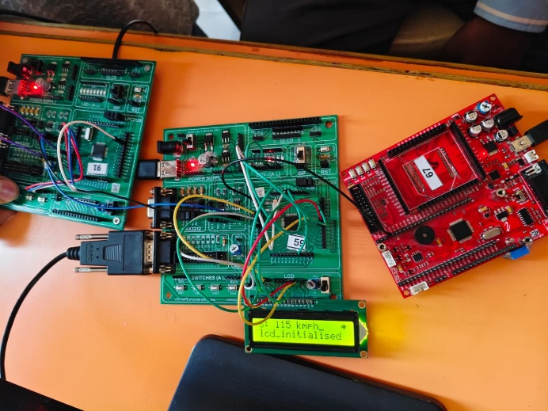
RESULTS
SUCCESFULLY CAN MESSAGES TRANSMISSION.
HEADLIGHT ON/OFF WORKING.
RIGHT/LEFT INDICATORS BLINKING AS PER COMMANDS.
Speed is showing as per the potentiometer.

Slide 11
CONCLUSION
IMPLEMENTED CAN COMMUNICATION WITH INTERRUPTS.
REDUCES WIRING COMPLEXITY IN AUTOMOTIVE SYSTEMS.
PROVIDES HANDS-ON UNDERSTANDING OF EMBEDDED SYSTEMS AND ECU COMMUNICATION.
CAN PROTOCOL ENABLES REAL-TIME, RELIABLE, AND EFFICIENT COMMUNICATION.

Slide 12
REFERENCES
USER MANUAL OF LPC2129
USER MANNUAL OF MCP2551
WEBSITES (https://www.vectror.com)

Slide 13



