Slide 1


GCP Virtual Machine Setup with Auto-Scaling and Security
Virtualization and Cloud Computing
Assignment 2
Step-by-step implementation & demonstration
By:
Sachin Singh
M24CSE033

Slide 2
Requirement
Set up a virtual machine in Google Cloud Platform (GCP), implement auto-scaling policies based on workload, and configure security measures like firewall rules and IAM.

Slide 3
Introduction
Google Cloud Platform (GCP) provides scalable cloud computing resources.
Compute Engine allows the creation of virtual machines.
Auto-scaling ensures efficient resource utilization.
Security configurations protect cloud resources.

Slide 4
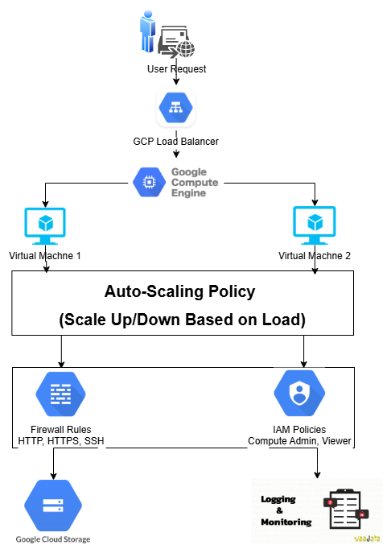
Architecture Diagram
Virtual Machine (VM) Instance
Managed Instance Group with Auto-Scaling
Load Balancer
Firewall & IAM Policies

Slide 5
Setting Up a Virtual Machine in GCP
Navigate to Compute Engine > VM Instances.
Click Create Instance.
Choose Machine Type (e.g., e2-medium).
Select Boot Disk (Ubuntu 20.04 LTS).
Enable Firewall Rules (Allow HTTP & HTTPS).
Click Create.

Slide 6
Implementing Auto-Scaling Policies
Create a Managed Instance Group.
Configure Autoscaling Policy:
Target CPU utilization: 60%.
Min instances: 1.
Max instances: 5.
Auto-scales based on workload.

Slide 7
Configuring Security Measures
IAM Roles & Policies:
Compute Viewer: Read-only access.
Compute Admin: Full control.
Firewall Rules:
Allow HTTP (port 80) & HTTPS (port 443).
Restrict SSH (port 22) to specific IPs.

Slide 8
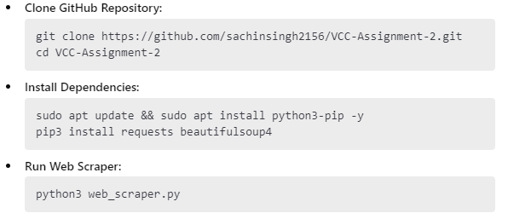
Cloning & Running Web Scraper Program

Slide 9
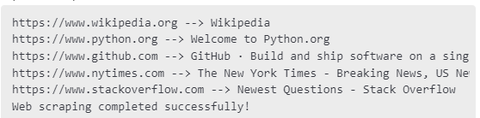
Expected Output of Web Scraper
Fetches webpage titles from multiple sites.
Demonstrates that the VM has network connectivity.
Expected Output:

Slide 10

Implementation

Slide 11
Sachin Singh M24CSE033
Thank You
m24cse033@iitj.ac.in

