Slide 1

LLoydsBankPOC
Android Mobile App
1.0v

Slide 2
Requirements
Index
Technology
Functionality
Unit Test
Source Code Git Repository

Slide 3
Requirements
This is mobile application integrated with public-api. This mobile app using This application using Clean Architecture with MVVM design pattern for the performance, readability, maintainability, testability, scalability and simplicity. Also this mobile application any third party library if there required.

Slide 4
Technology
This is mobile application developed in Android native with kotlin language. This application developed in Android Studio Hedgehog(IDE). This application run on Android 26 API and Above API Level. This application using Android Jetpack Architecture components like:Compose, LiveData,Lifecycle,Coroutines,RoomDataBase,HiltViewModel,navigation,dagger etc for the application performance,readability,maintainability testability,scalability and simplicity.

Slide 5
Functionality
This application used public-api, public-api like:
https://potterapi-fedeperin.vercel.app/en/books
https://potterapi-fedeperin.vercel.app/es/characters?search=Weasley
https://potterapi-fedeperin.vercel.app/en/spells
According to above apis contain Harry Potter related data,so there apps functionality :
Books
Weasley
Spells

Slide 6
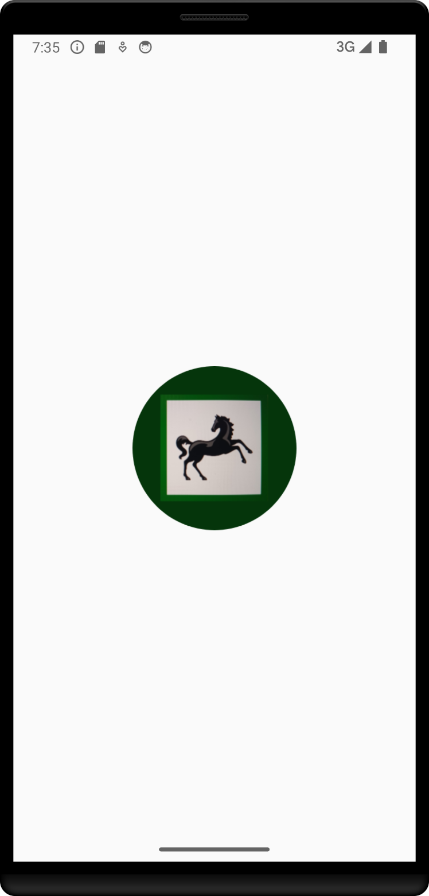
Splash Screen
This screen shown application logo

Slide 7
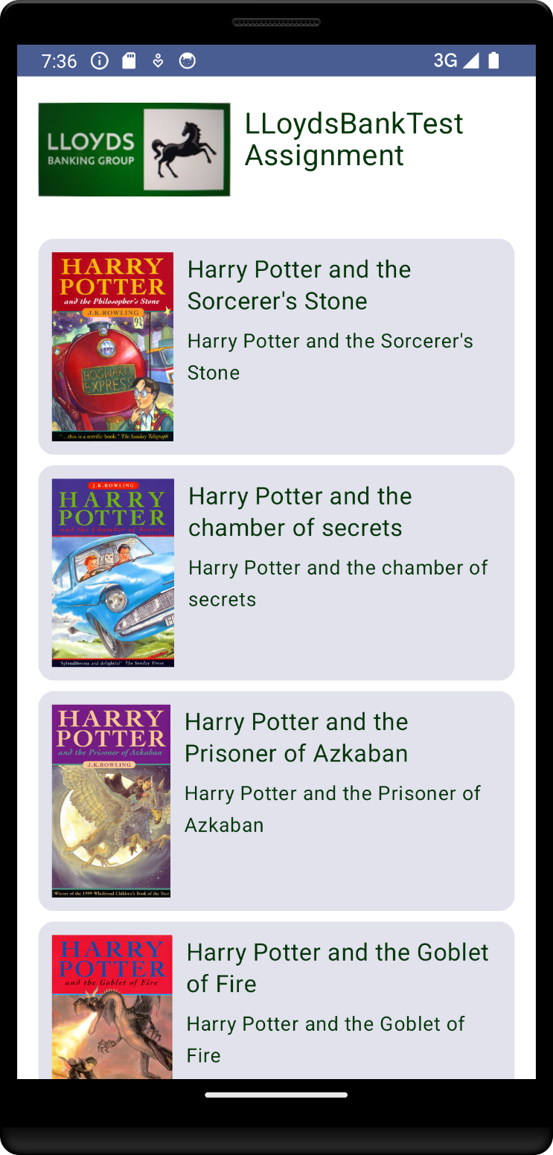
Books
Books page shown all list books related harry potter

Slide 8
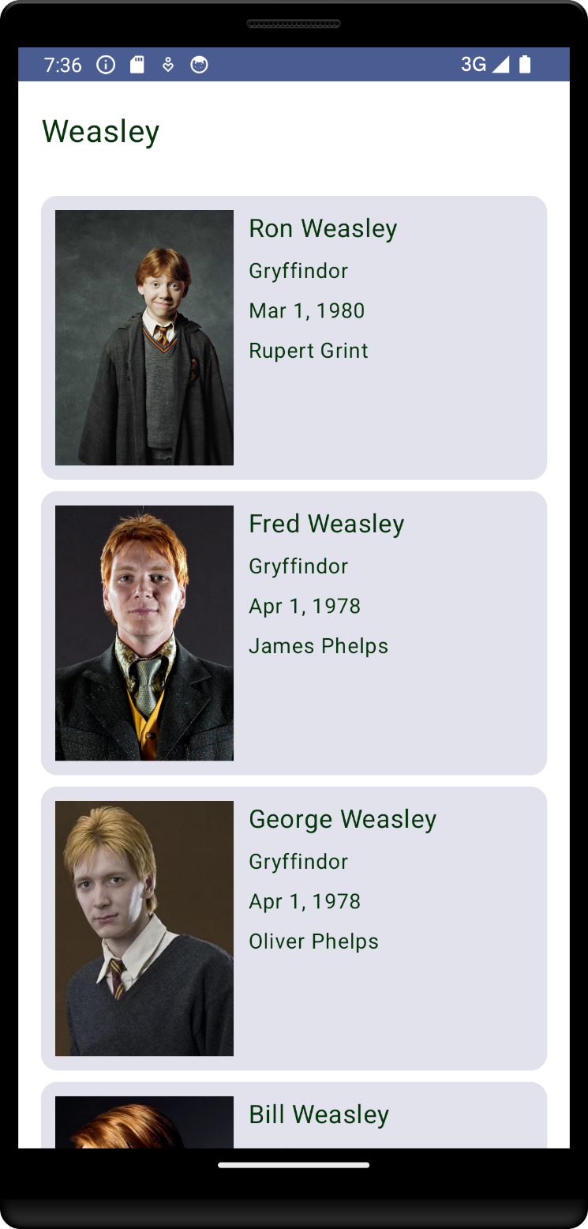
Weasley
Weasley page shown related data.

Slide 9
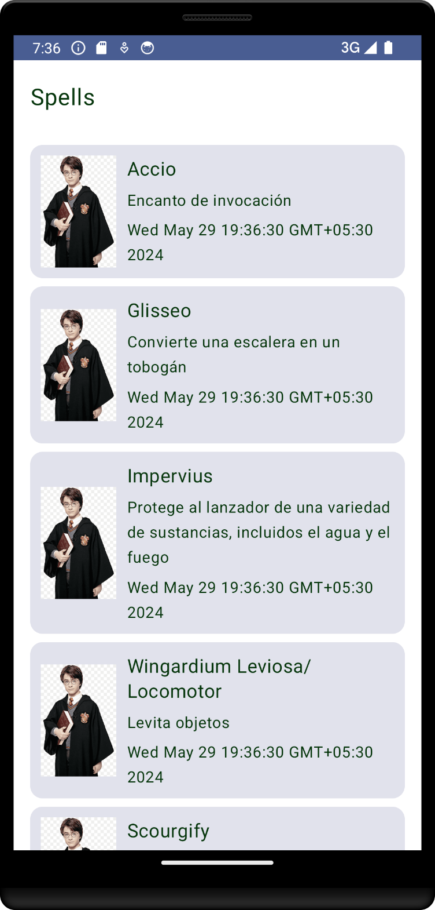
Spells
Spells page shown related data.

Slide 10
Unit Test
Unit Tests – For verifying a minimal unit of source code.
Integration Tests – For testing operations between different application modules.

Slide 11
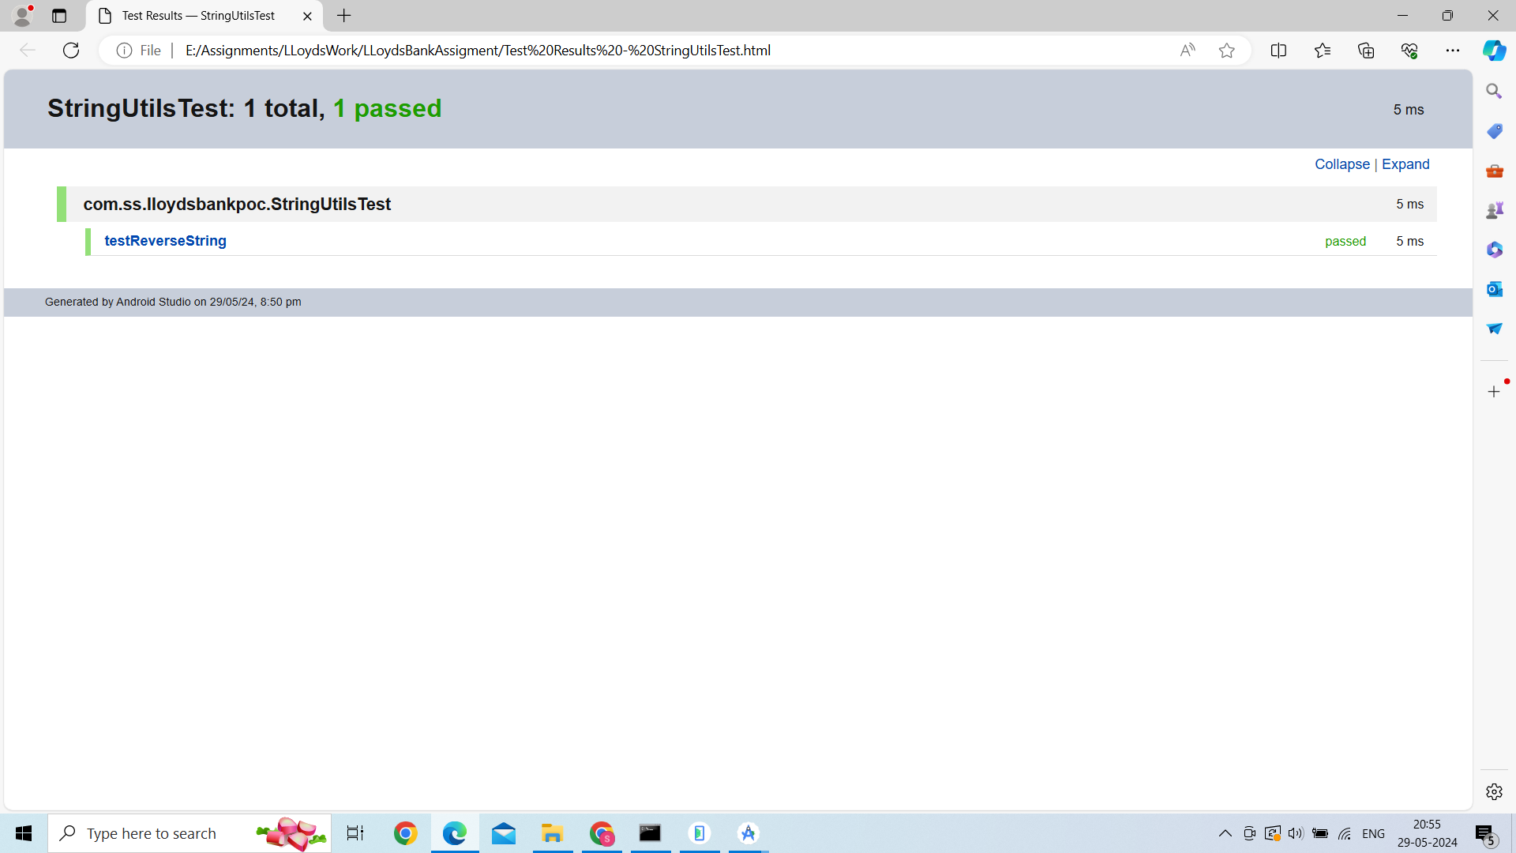

Slide 12
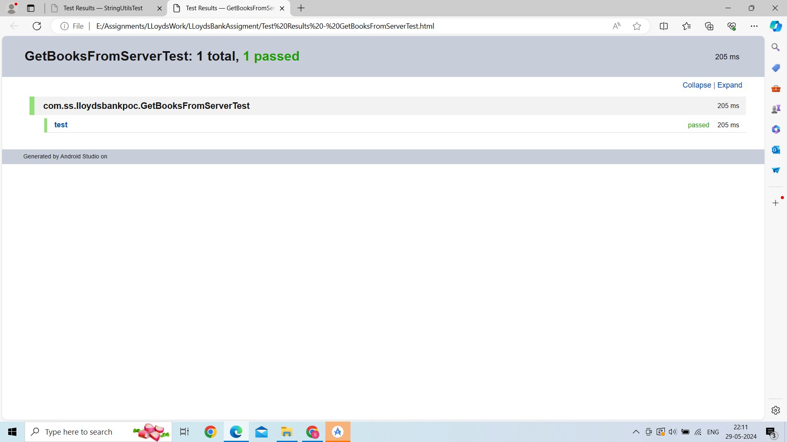

Slide 13
Source Code Git Repository
https://github.com/sachinsonvane/LLoydsBankAssigment

Slide 14
Thank You

