Slide 1

LLoydsBankTest
Android Mobile App
1.0v

Slide 2
Requirements
Index
Technology
Functionality
Unit Test

Slide 3
Requirements
This is mobile application integrated with public-api. This mobile app using MVVM design pattern for the performance, readability, maintainability, testability, scalability and simplicity. Also this mobile application any third party library if there required.

Slide 4
Technology
This is mobile application developed in Android native with kotlin language. This application developed in Android Studio Hedgehog(IDE). This application run on Android 26 API and Above API Level.

Slide 5
Functionality
This application used public-api, public-api like:
https://potterapi-fedeperin.vercel.app/en/books
https://potterapi-fedeperin.vercel.app/es/characters?search=Weasley
https://potterapi-fedeperin.vercel.app/en/spells
According to above apis contain Harry Potter related data,so there apps functionality :
Home Page
Books
Weasley
Spells

Slide 6
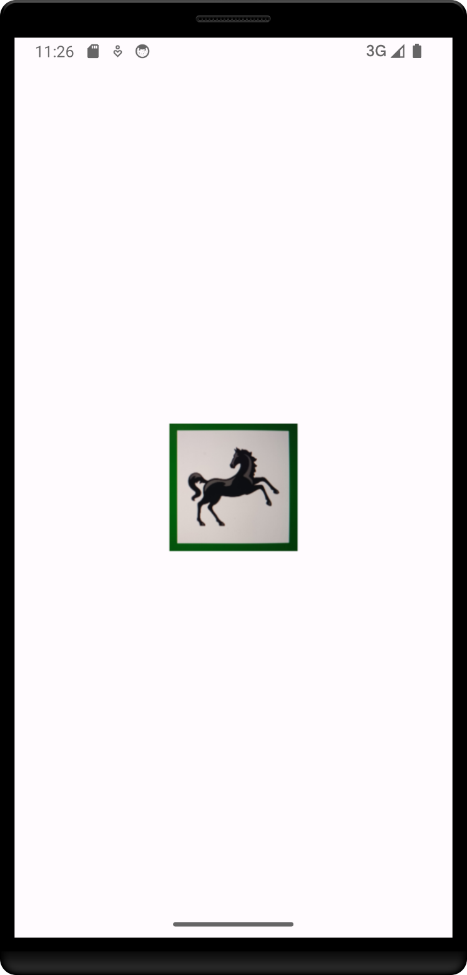
Splash Screen
This screen shown application logo

Slide 7
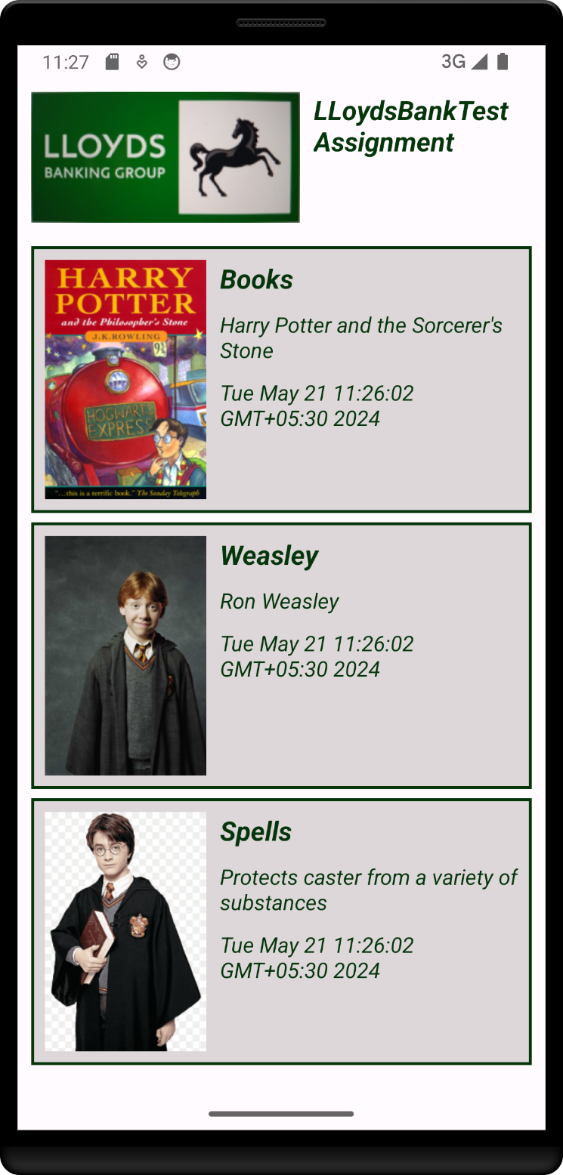
Home
Home page contain menus options like a Books, Weasley and Spells etc.
If there want to get more details then please click that particular option, so that go to next page.

Slide 8
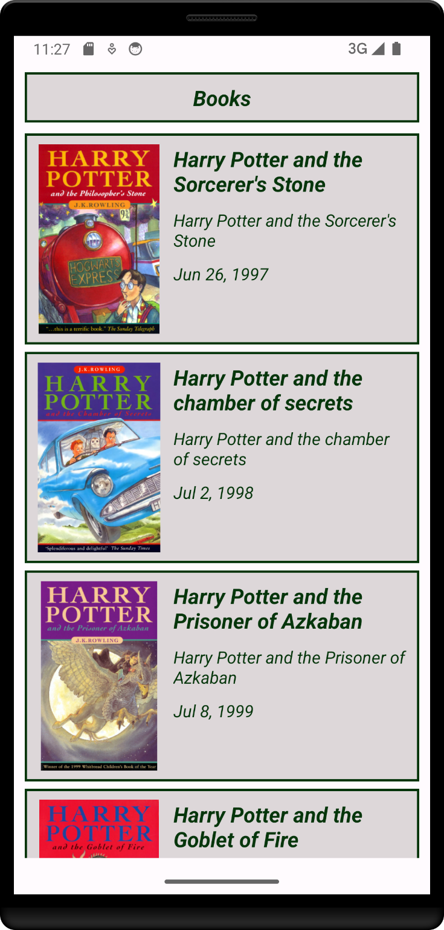
Books
Books page shown all list books related harry potter

Slide 9
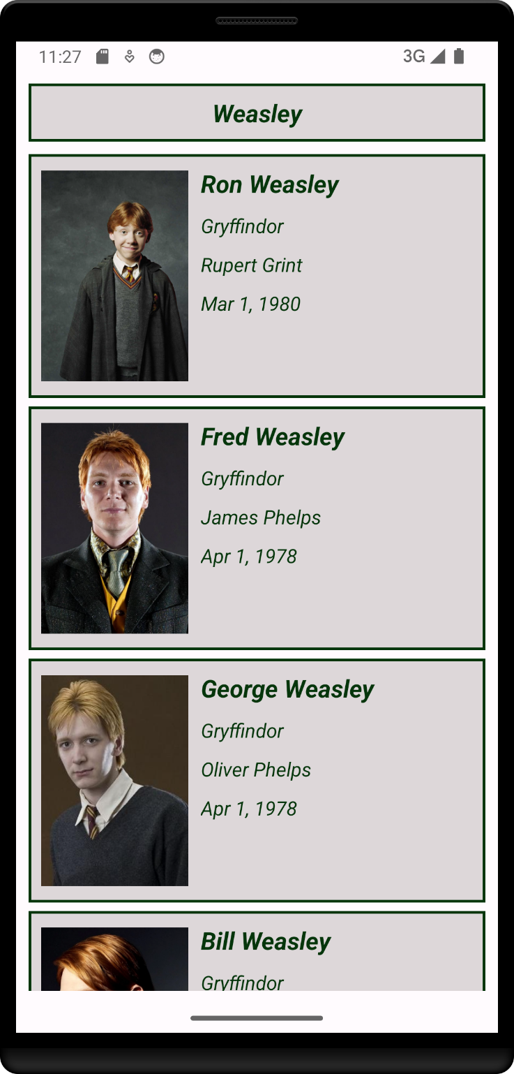
Weasley
Weasley page shown related data.

Slide 10
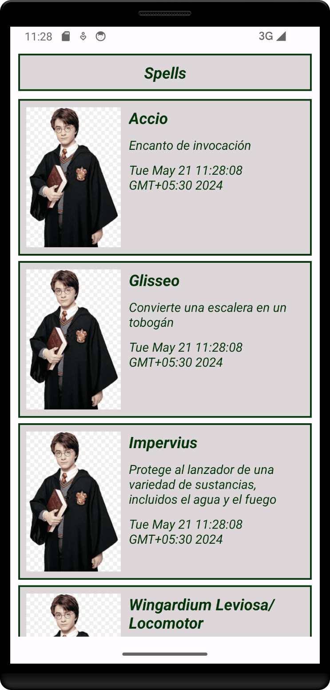
Spells
Spells page shown related data.

Slide 11
Unit Test
Unit Tests – For verifying a minimal unit of source code.
Integration Tests – For testing operations between different application modules.

Slide 12
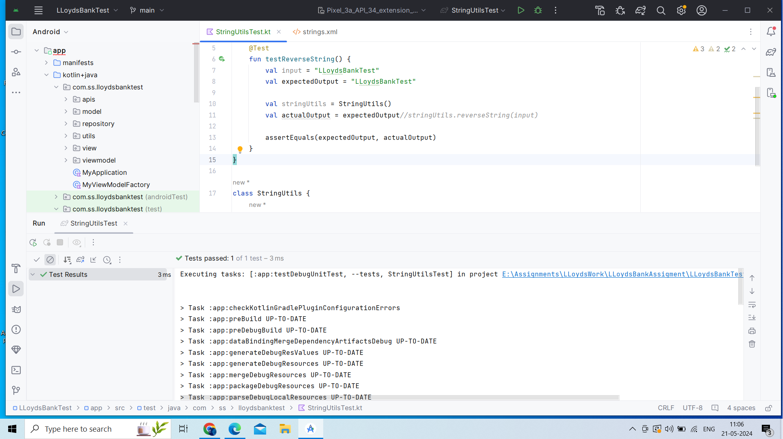

Slide 13
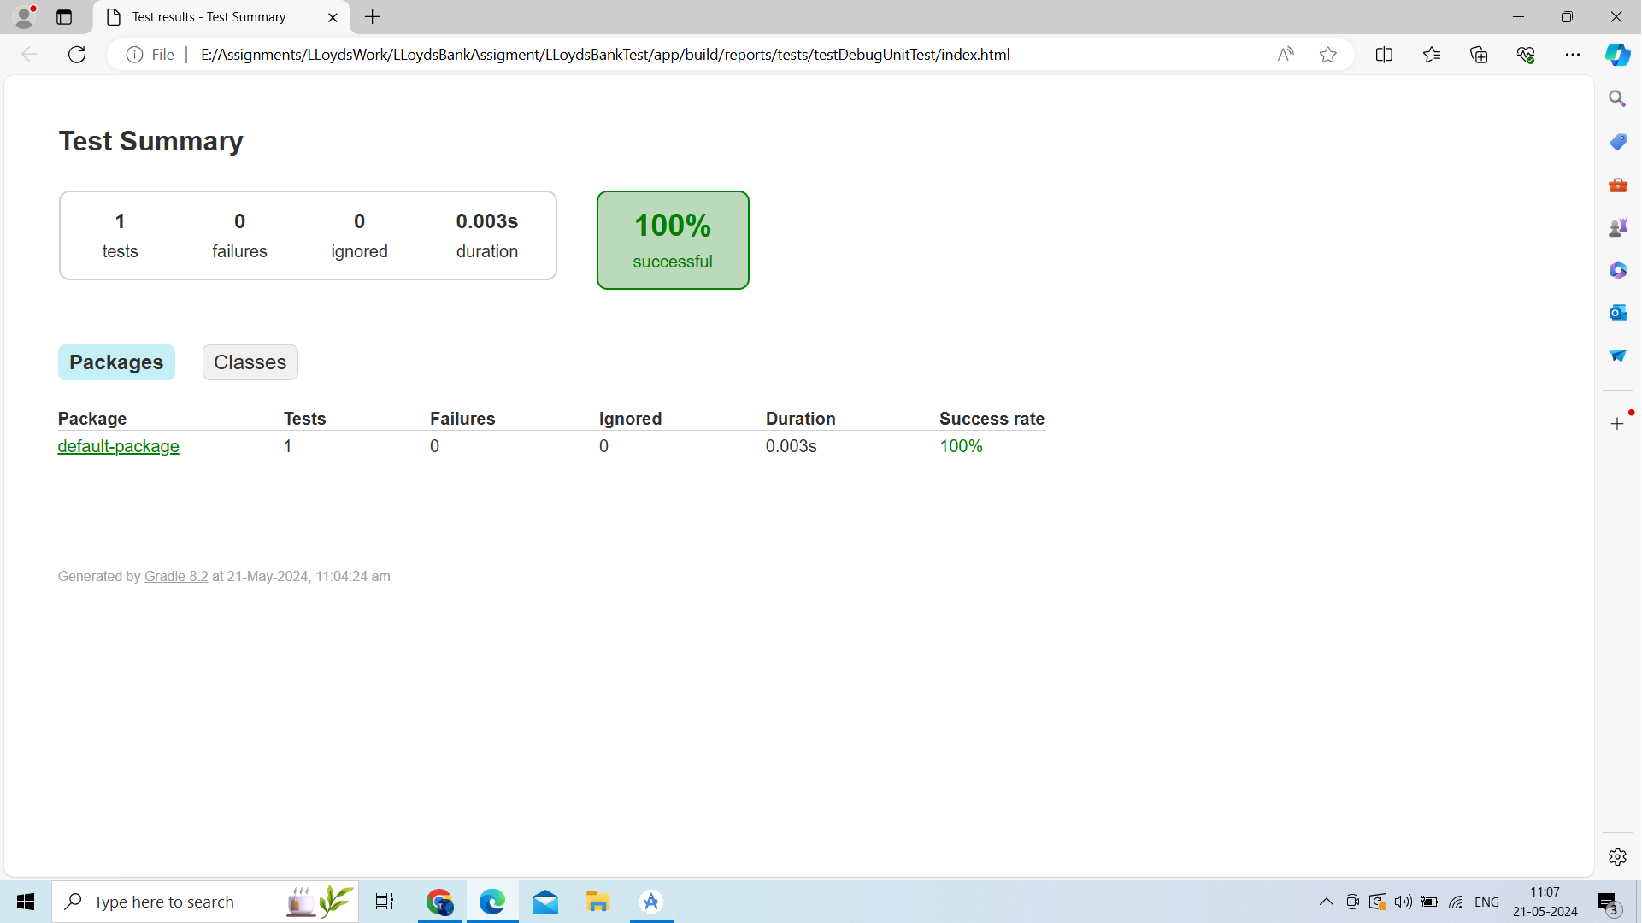

Slide 14
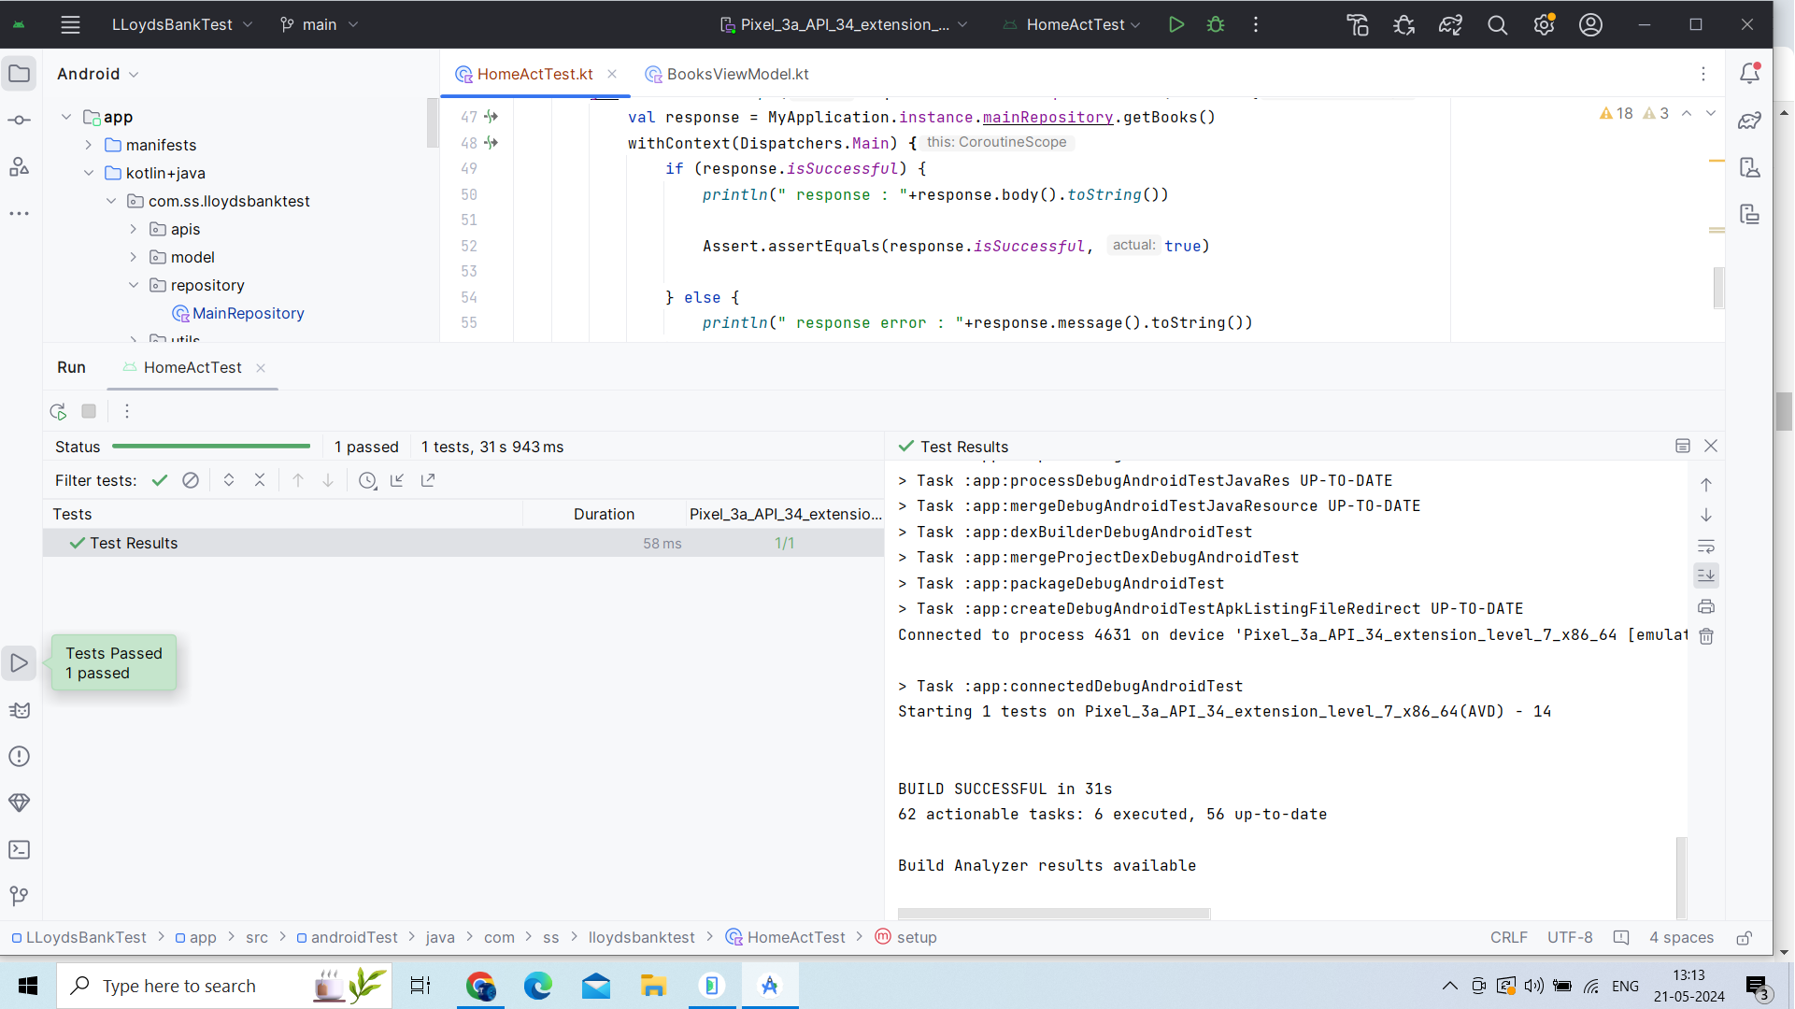

Slide 15
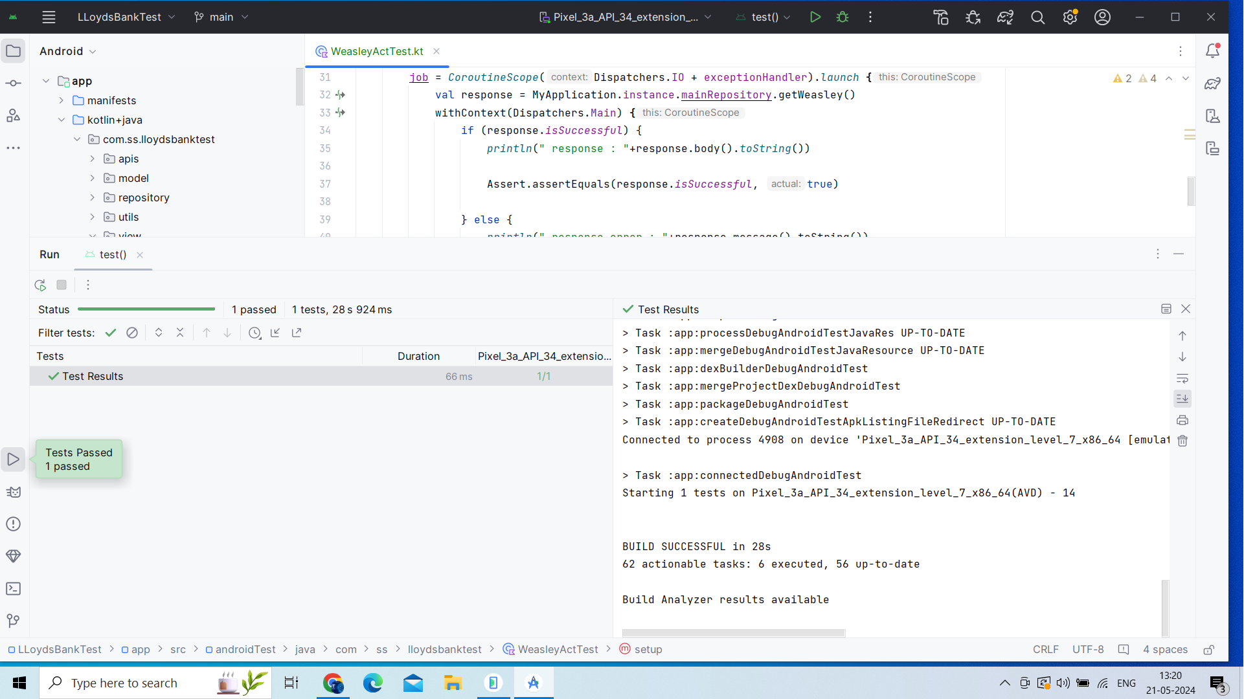

Slide 16
Source Code Git Repository
https://github.com/sachinsonvane/LLoydsBankAssigment

Slide 17
Thank You

