Slide 1

CARNIVAL CRUISES
Case Study: World Cruise 2025
Revenue Management
Chetana Mane
Kishore Rajendra
Manish Babu Satish Babu
Sachin Suresh
Shriraj Bagade
Umesh Uddar

Slide 2
Agenda
01
02
Introduction
Scenario Planning Demand in 2025
Objective of our Case study
Carnival corporation overview
Importance of Revenue Optimization
Dubai
San Francisco
Australia
Singapore
03
04
Optimal Passenger Allocation for Revenue Maximization
Estimating Cancellation Rates
Calculations
Planning
Old Demand
New Demand
Maximizing Revenue
Cabin type allocation
05
06
Overbooking Strategies
Recommendations & Conclusions
Calculations
Assumptions
Risk and Rewards

Slide 3

Introduction
Objective of our Case Study:
Uncover insights within WorldCruiseSummary2024.xlsx and WorldCruiseData2024.csv.
Carnival Corporation Overview:
A maritime powerhouse, Carnival Corporation commands a fleet of 100+ ships across 9 distinct cruise lines globally.
Renowned brands include AIDA, Carnival Cruise Lines, Costa, Cunard, Holland America Line, Princess Cruises, P&O Cruises Australia, P&O Cruises UK, and Seabourn.
Importance of Revenue Optimization:
Revenue optimization is pivotal for sustained success.
Tailoring strategies for each cruise line and its offerings is critical.
Focus on P&O Cruises UK's World Cruise demands precision in pricing, allocation, and marketing.

Slide 4





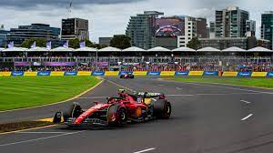
Scenario Planning for Demand in 2025
Singapore (20%)
Tourism : World Aquatics Championships
San Francisco (33%)
Tourism: San Francisco International Film Festival, San Francisco Fleet Week, Chinese New Year.
Dubai (28%)
Tourism: Hong Kong Arts Festival, Dragon Boat Festival, Dubai Expo and Dubai Shopping Festival.
Hub of Connectivity: Dubai's strategic location connects routes from Auckland, Sydney, Hong Kong, and more.
Efficient Travel Hub: Passengers experience smooth transitions, making Dubai a central point in our cruise journey.
Australia (BNE & SYD) - 22%
Tourism: Kangaroo Island, Woodford folk festival , Australian grand prix.

Slide 5

Optimal Passenger Allocation for Revenue Maximization
Increase in Tourism: With the anticipated increases in tourism demand for Singapore, Dubai, San Francisco, and Australia, based on the scenarios derived from the above slide, the revised demand table shows more passengers on key routes.
Code for Linear Programming Approach: Utilizes the PULP library to set up a linear programming problem to maximize revenue by defining decision variables for each route, formulating an objective function for total revenue maximization, and establishing constraints based on available passengers and projected increases.
Revenue Maximization Strategy: Utilizing linear programming in order to maximize revenue, the code dynamically adjusts passenger allocations across routes, taking historical data into account as well as projected tourism growth.
Comparison of Occupancy and Revenue: The revised demand table and Python code aim to boost occupancy rates and revenue over the previous year by efficiently allocating passengers across routes according to projected demand increases, ensuring optimal utilization of transportation resources for maximum revenue generation.

Slide 6
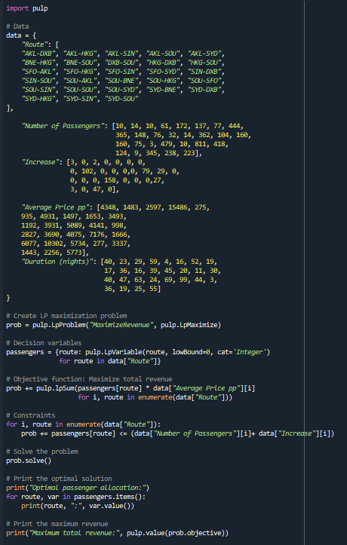
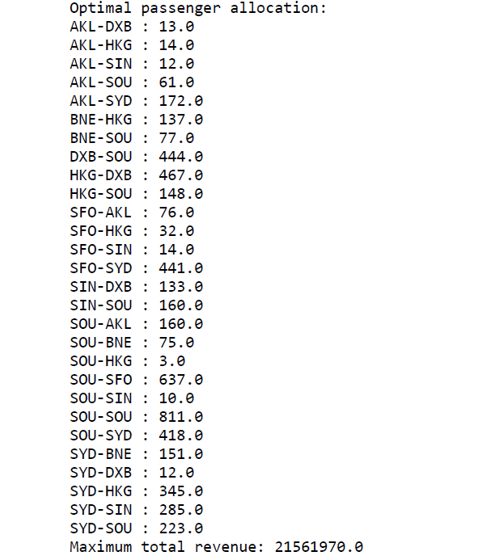
Optimal Passenger Allocation for Revenue Maximization
Code for Linear Programming and its Output

Slide 7
Old Demand
Provides historical data on routes, number of passengers, average price per passenger, and duration of the journey.

Slide 8
New Demand
Reflects the projected increase in tourism for different routes, along with updated numbers for passengers, average price per passenger, and duration of the journey.

Slide 9

Maximizing Revenue
20.6 M
21.5 M
93 – 100%
2022 Total Revenue
Predicted 2025 Total Revenue
Allocation Range
Revenue Increase: Overall, there is a noticeable increase in revenue from the old demand to the new demand. The total revenue has risen from £20,632,295 to £21,561,970, indicating a positive trend in revenue generation.
Occupancy Rates: The increase in occupancy rates across most routes in the new demand scenario has positively impacted revenue generation. The occupancy rates range from 92.3% to 100%, with the majority of routes experiencing an improvement in occupancy compared to the old demand.
Overall Performance: The analysis demonstrates a successful outcome in maximizing revenue and optimizing occupancy rates across multiple routes. By adjusting pricing strategies and effectively allocating passengers based on demand patterns, the cruise line has managed to enhance its financial performance and ensure better utilization of resources.

Slide 10
Cabin type Allocation strategy
Calculation of Booking Percentage : The booking percentage for each cabin type (Balcony, Suite, Oceanview, Inside) is calculated for each route based on historical data from WorldCruiseData2024.csv, representing the proportion of passengers booking each cabin type on a particular route.
Allocation of Passengers for 2025 Demand : The calculated booking percentages are used to allocate passengers for the demand in 2025 for each cabin type. Let's look at one route, for instance: SOU-SOU. Assuming that 811 passengers are allotted for this route in 2025, divided into 485 Balcony seats, 93 Suite seats, 108 Oceanview seats, and 125 Inside seats, these passengers are assigned to the appropriate cabin classes according to booking percentages determined from past statistics.
Example for Percentage Calculation for respective Cabin-Types

Slide 11
Cabin type Allocation strategy
Distribution of Passengers and Ensuring Full Occupancy : Once the allocation is complete for one route, similar calculations are performed for all other routes in the dataset. Each route's demand in 2025 is distributed among the available cabin types according to their booking percentages, ensuring that the overall demand is met while maintaining full occupancy for each route.

Slide 12
Estimating Cancellation Rates
Utilizing Historical Cancellation Rates for World Cruise Planning:
Forecasting: Predict expected cancellation rates for each sector in 2025 to anticipate revenue fluctuations and adjust pricing/marketing strategies.
Risk Management: Implement tailored risk management strategies, such as flexible booking policies or overbooking, based on past cancellation patterns to mitigate revenue loss.
Customer Engagement: Target marketing efforts towards sectors with lower historical cancellation rates to drive bookings and stabilize revenue streams.
Operational Planning: Optimize resource allocation and staffing levels by considering expected cancellation rates, enhancing operational efficiency and reducing costs.
Customer Service: Proactively address passenger concerns and offer personalized assistance to passengers booked on sectors with historically higher cancellation rates to improve satisfaction and retention.

Slide 13
Estimating Cancellation Rates
Calculation:
The cancellation ratios obtained from the 2022 booking data offer valuable insights into booking behaviors and trends. This calculation provides a clear understanding of the proportion of bookings that were canceled during that time frame. Furthermore, by analyzing cancellation ratios across different cabin types, routes, or booking periods, we can identify patterns and factors influencing cancellation rates. This analysis enables us to develop tailored strategies for managing cancellations, such as adjusting cancellation policies, offering incentives to prevent cancellations, or implementing dynamic pricing to fill canceled spaces. Ultimately, leveraging cancellation ratios allows us to optimize revenue management practices and enhance the overall profitability of Carnival Cruises.

Slide 14

Overbooking Strategies
Example:
To implement an overbooking strategy, we calculate the expected number of denied customers using the formula: Expected number of denied customers = (C/P) * p(deny)
C represents the capacity (in this case, 313), P is the probability that a customer shows up (assumed to be 0.75), and p(deny) is the probability of denial (set at 0.2 or 20%).
By applying this formula, we can estimate the number of customers expected to be denied boarding due to overbooking.
However, it's essential to consider potential consequences, such as customer dissatisfaction and reputational risks, when implementing overbooking strategies
SFO- SYD Balcony: 85 Ocean View: 23 Inside: 20 Suite: 2
HKG - DXB Balcony: 34 Ocean View: 22 Inside: 17 Suite: 1

Slide 15
Overbooking Strategies
Assumptions:
Consistency in cancellation patterns.
Stable booking patterns.
Customer preference for higher-priced cabins.
Adequate compensation for denied boarding.
Operational flexibility for last-minute changes.
Increased demand for SYD by 22% and DXB by 28%.
SOU-SYD Route:
Balcony: Moderate overbooking
Ocean View & Inside: Moderate overbooking (10%).
Suite: Minimal overbooking to preserve premium service reputation.
HKG-DXB Route:
Balcony & Ocean View: Moderate overbooking (10%).
Inside & Suite: Minimal overbooking for suites; moderate for inside cabins.
Risks and Rewards:
Rewards: Maximizing revenue, optimizing Cruise capacity, and profitability.
Risks: Potential denied boarding leading to customer dissatisfaction, negative publicity, and compensation costs.

Slide 16

Recommendations and Conclusions
Further Recommendations:
Cabin Configuration Optimization: Strategically configuring cabins with upper-beds alongside standard lower-beds expands bed capacity beyond the ship's standard limit, accommodating more passengers per voyage. This maximizes revenue potential by increasing occupancy rates and leveraging additional accommodation fees.
Comprehensive Water Activities Package: Introducing a comprehensive package that integrates scuba diving with various water activities and cultural experiences enhances revenue potential. By offering a diverse range of aquatic adventures alongside opportunities for cultural immersion, the ship attracts adventure-seekers and cultural enthusiasts alike, resulting in increased onboard spending and revenue generation.
Enhanced Tourism Revenue through Local Partnerships and Promotion: Local partnerships with businesses and tourism authorities along the cruise route can significantly boost tourism revenue. By collaborating with these entities, cruise lines can leverage brand-sponsored events, product placements, and co-branded experiences onboard. This not only diversifies revenue streams but also enhances the overall passenger experience.
Growing tech trends: Exciting technology trends, including wearable tech, VR, AR, AI chatbots, and AI/ML for predictive maintenance, are driving innovation in the cruise industry, enhancing passenger experiences, providing valuable insights, and improving operational efficiency.

Slide 17

Recommendations and Conclusions
Conclusion:
The primary hub and embarkation and disembarkation port is Southampton, however significant locations including Dubai, Australia, Singapore, and San Francisco make substantial contributions to the cruise network's overall earnings. Considering their various capacities and cost structures, it is essential to comprehend the preferences for various cabin types in order to maximize revenue. We have successfully achieved a total revenue of 21.5 million pounds for the year, which is approximately one million pounds more than that the previous year, by strategically applying various ways and taking the demand in 2025 into consideration. The accompanying spreadsheet contains detailed computations and income forecasts that were previously discussed. The detailed analysis and calculations are available in the spreadsheet at: https://docs.google.com/spreadsheets/d/1rN0GCs4Y_wWUwefNaTkJTgPD6Hf4g49QyasLJmF8JhA/edit?usp=sharing. This guarantees openness and access to the comprehensive data and techniques utilized to maximize Carnival Cruises' profits.
Overall, the comprehensive approach outlined above ensures a win-win situation for both the cruise line and the local communities visited. By optimizing revenue through strategic initiatives and enhancing the passenger experience with immersive cultural and recreational offerings, the cruise line can achieve sustainable growth and success in the competitive cruise tourism industry.

Slide 18


Slide 19


