Slide 1
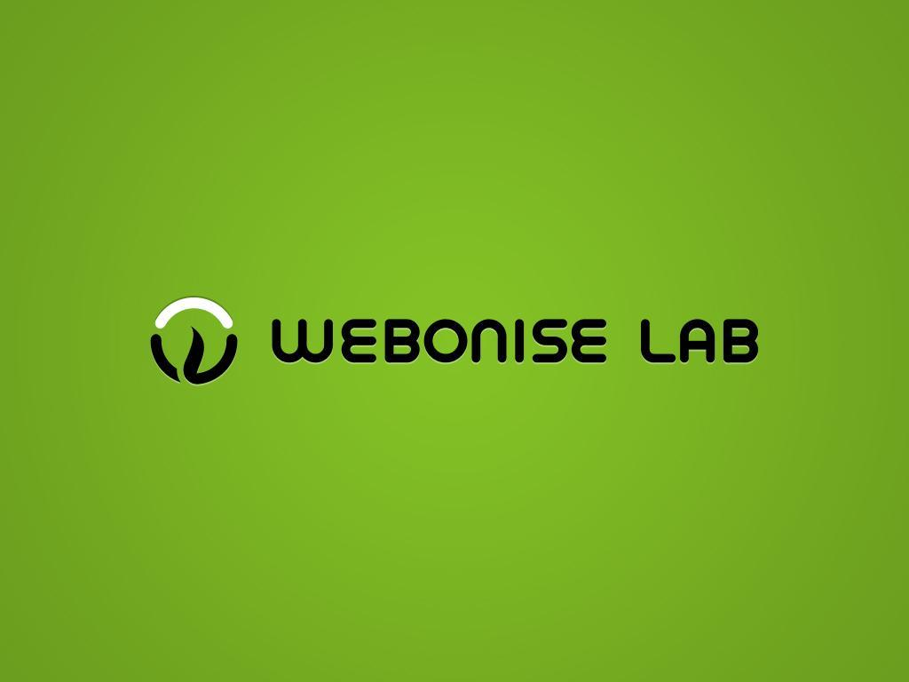

Slide 2


RMI in Java

Slide 3
Discussion
Definition.
Scenario.
Local Vs. Remote Object
Goals of RMI.
Architecture of RMI.
How it works?

Slide 4
Define
RMI (Remote Method Invocation) represents a distributed Object Application. It allows a java program running on one JVM ( i.e. client) to invoke methods on another JVM(i.e. Server).
Therefore RMI represents a Client and Server.
Java RMI is provided in the java.rmi package.

Slide 5
Scenario
Consider the follow scenario :
  Developer A writes a service that performs some useful function. He regularly updates this service, adding new features and improving existing ones.
  Developer B wishes to use the service provided by Developer A. However, it's inconvenient for A to supply B with an update every time.
Java RMI provides a very easy solution! Since RMI can dynamically load new classes, Developer B can let RMI handle updates automatically for him. Developer A places the new classes in a web directory, where RMI can fetch the new updates as they are required.

Slide 6
Scenario
Developer A
Remote method Invocation
S
E
R
V
E
R
Client
Developer B
JVM
JVM

Slide 7
Local Vs. Remote Object
Although we would like remote objects to behave exactly the same as local object, that is impossible for several reasons:
  Networks can be unreliable.
  Resources may not be accessible.
  References on one machine (memory addresses) have no meaning on another machine.

Slide 8
Goals of RMI
Minimize difference between working with local and remote Objects.
Minimize Complexity.
Preserve Type Safety.
Distributed Garbage Collection.

Slide 9
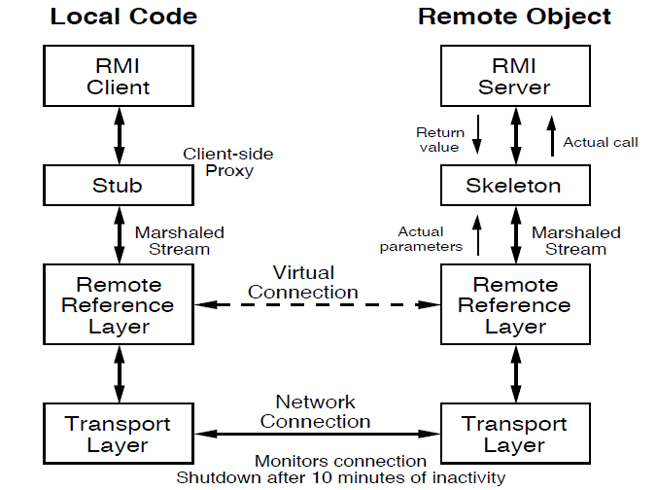
Architecture

Slide 10
Architecture
RMI architecture consists of:-
  Application layer.
  Proxy layer(Stub and skeleton).
  RRL(Remote Reference Layer).
  Transport layer.

Slide 11
Architecture
Application Layer
  It’s a responsible for the actual logic (implementation) of the client and server applications.
  Generally at the server side class contain implementation logic and also apply the reference to the appropriate object as per the requirement of the logic in application.
Proxy Layer
  It’s also called the “Stub/Skeleton layer”. A Stub class is a client side proxy handles the remote objects which are getting from the reference. A Skeleton class is a server side proxy that set the reference to the objects which are communicates with the Stub.

Slide 12
Architecture
Remote Reference Layer (RRL)
  It’s a responsible for manage the references made by the client to the remote object on the server so it is available on both JVM (Client and Server).
  The Client side RRL receives the request for methods from the Stub that is transferred into byte stream process called serialization (Marshaling) and then these data are send to the Server side RRL.
  The Server side RRL doing reverse process and convert the binary data into object. This process called deserialization (or Unmarshaling )and then sent to the Skeleton class.

Slide 13
Architecture
Transport Layer
  It’s also called the “Connection layer”. It’s a responsible for the managing the existing connection and also setting up new connections. So it is a work like a link between the RRL on the Client side and the RRL on the Server side.

Slide 14
How it works?
The RMI Registry is a naming service.
RMI server programs use this service to bind the remote java object with the names using “Naming.rebind()”.
Clients executing on local or remote machines retrieve the remote objects by their name registered with the RMI registry using “Naming.lookup()”and then execute methods on the objects.
1099 is the default RMI port.

Slide 15
How it works?
Communicate directly by invoking methods on the remote object
S
E
R
V
E
R
Client
Locate the object by Naming.lookup() and retrieve the remote object by name
RMI
Registry
Binds the object in the rmi registry using Naming.rebind()

Slide 16
Assignment
Client server chat application.
CRUD operation over chat server application

Slide 17

Thank You
Notes:
*

