Slide 1


Slide 2
JSP
Java Server Pages

Slide 3
What is JavaServer Pages?
JavaServer Pages (JSP) is a technology for developing web pages that support dynamic content which helps developers insert java code in HTML pages by making use of special JSP tags, most of which start with <% and end with %>.

Slide 4
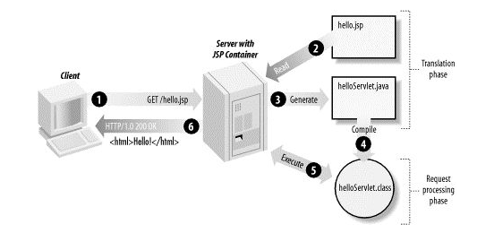
JSP Architecture :

Slide 5
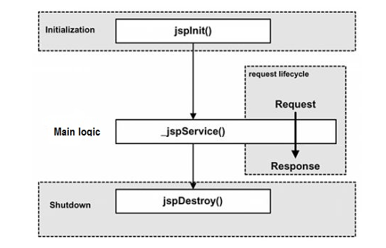
JSP Life Cycle :

Slide 6
A JSP life cycle can be defined as the entire process from its creation till the destruction which is similar to a servlet life cycle with an additional step which is required to compile a JSP into servlet.
Compilation
Initialization
Execution
Cleanup

Slide 7

JSP Compilation:
The compilation process involves three steps:
Parsing the JSP.
Turning the JSP into a servlet.
Compiling the servlet.
JSP Initialization:
When a container loads a JSP it invokes the jspInit() method before servicing any requests.

Slide 8

JSP Execution:
This phase of the JSP life cycle represents all interactions with requests until the JSP is destroyed.
Whenever a browser requests a JSP and the page has been loaded and initialized, the JSP engine invokes the _jspService() method in the JSP.
The _jspService() method of a JSP is invoked once per a request and is responsible for generating the response for that request

Slide 9

JSP Cleanup:
The destruction phase of the JSP life cycle represents when a JSP is being removed from use by a container.
The jspDestroy() method is the JSP equivalent of the destroy method for servlets.
Override jspDestroy when you need to perform any cleanup, such as releasing database connections or closing open files.

Slide 10
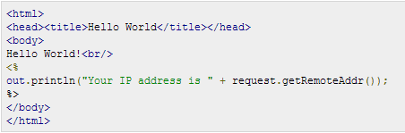
The Scriptlet:
A scriptlet can contain any number of JAVA language statements, variable or method declarations, or expressions that are valid in the page scripting language.
E.g :
<% code fragment %>

Slide 11

JSP Declarations:
A declaration declares one or more variables or methods that you can use in Java code later in the JSP file.
<%! declaration; [ declaration; ]+ ... %>

Slide 12
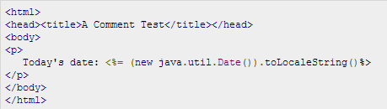
JSP Expression:
A JSP expression element contains a scripting language expression that is evaluated, converted to a String, and inserted where the expression appears in the JSP file.
<%= expression %>

Slide 13
JSP Comments:
JSP comment marks text or statements that the JSP container should ignore.
<%-- This is JSP comment --%>

Slide 14
JSP Directives:
A JSP directive affects the overall structure of the servlet class.
<%@ directive attribute="value" %>
There are three types of directive tag:
<%@ page ... %>
Defines page-dependent attributes, such as scripting language, error page, and buffering requirements.
<%@ include ... %>
Includes a file during the translation phase.
<%@ taglib ... %>
Declares a tag library, containing custom actions, used in the page

Slide 15
Directives
Buffer
Specifies a buffering model for the output stream.
autoFlush
Controls the behavior of the servlet output buffer.
contentType
Defines the character encoding scheme.
errorPage
Defines the URL of another JSP that reports on Java unchecked runtime exceptions.
isErrorPage
Indicates if this JSP page is a URL specified by another JSP page's errorPage attribute.
extends
Specifies a superclass that the generated servlet must extend
import
Specifies a list of packages or classes for use in the JSP as the Java import statement does for Java classes.
info
Defines a string that can be accessed with the servlet's getServletInfo() method.
isThreadSafe
Defines the threading model for the generated servlet.
language
Defines the programming language used in the JSP page.
session
Specifies whether or not the JSP page participates in HTTP sessions

Slide 16
JSP Actions:
JSP actions use constructs in XML syntax to control the behavior of the servlet engine.
<jsp:action_name attribute="value" />
jsp:include
Includes a file at the time the page is requested
jsp:useBean
Finds or instantiates a JavaBean
jsp:set
--- PropertySets the property of a JavaBean
jsp:getProperty
Inserts the property of a JavaBean into the outputjsp:forwardForwards the requester to a new page
jsp:plugin
Generates browser-specific code that makes an OBJECT or EMBED tag for the Java plugin
jsp:element
Defines XML elements dynamically.
jsp:attribute
Defines dynamically defined XML element's attribute.
jsp:body
Defines dynamically defined XML element's body.

Slide 17
JSP Action Example
Date.jsp
<p>
Today's date: <%= (new java.util.Date()).toLocaleString()%>
</p>
Main.jsp
<center>
<h2>The include action Example</h2>
<jsp:include page="date.jsp" flush="true" />
// <jsp:forward page="date.jsp" />
</center>

Slide 18
Actions Example
package action;
public class TestBean {
private String message = "No message specified";
public String getMessage() {
return(message);
}
public void setMessage(String message) {
this.message = message;
}
}
<body>
<center>
<jsp:useBean id="test" class="action.TestBean" />
<jsp:setProperty name="test"
property="message" value="Hello JSP..." />
<p>Got message....</p>
<jsp:getProperty name="test" property="message" />
</center>

Slide 19
JSP Implicit Objects:
JSP supports nine automatically defined variables, which are also called implicit objects.
request
response
out
session
application
config
pageContext
page
Exception

Slide 20
The request Object:
The request object is an instance of a javax.servlet.http.HttpServletRequest object. Each time a client requests a page the JSP engine creates a new object to represent that request.
The response Object:
The response object is an instance of a javax.servlet.http.HttpServletResponse object.
The response object also defines the interfaces that deal with creating new HTTP headers.

Slide 21
The out Object:
The out implicit object is an instance of a javax.servlet.jsp.JspWriter object and is used to send content in a response.
out.print(dataType dt)
out.flush()
The session Object:
The session object is an instance of javax.servlet.http.HttpSession and behaves exactly the same way that session objects behave under Java Servlets.
The session object is used to track client session between client requests.

Slide 22
The application Object:
The application object is direct wrapper around the ServletContext object for the generated Servlet and in reality an instance of a javax.servlet.ServletContext object.
This object is created when the JSP page is initialized and will be removed when the JSP page is removed by the jspDestroy() method.
The config Object:
The config object is an instantiation of javax.servlet.ServletConfig and is a direct wrapper around the ServletConfig object for the generated servlet.
e.g. config.getServletName();

Slide 23
The pageContext Object:
The pageContext object is an instance of a javax.servlet.jsp.PageContext object. The pageContext object is used to represent the entire JSP page.
The pageContext object also contains information about the directives issued to the JSP page, including the buffering information, the errorPageURL, and page scope.
e.g pageContext.removeAttribute("attrName", PAGE_SCOPE);

Slide 24
The page Object:
This object is an actual reference to the instance of the page.
The page object is really a direct synonym for the this object.
The exception Object:
The exception object is a wrapper containing the exception thrown from the previous page.

Slide 25

Page Redirection in JSP
Page redirection is generally used when a document moves to a new location and we need to send the client to this new location
The simplest way of redirecting a request to another page is using method sendRedirect()

Slide 26
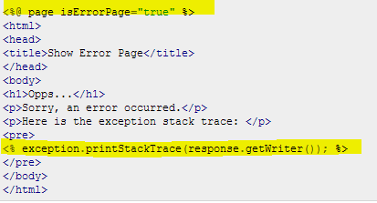
JSP Exception
JSP gives you an option to specify Error Page for each JSP.
Whenever the page throws an exception, the JSP container automatically invokes the error page.

Slide 27
JSP Exception Example
<%@ page errorPage="ShowError.jsp" %>
<html>
<head>
<title>Error Handling Example</title>
</head>
<body>
<%
// Throw an exception to invoke the error page
int x = 1;
if (x == 1)
{
throw new RuntimeException("Error condition!!!");
}
%>
</body>
</html>

Slide 28
Assignment :
Use JSP and Servlet and integrate the JDBC to have CRUD operations performed on EMployee and departments.
JDBC assignment with a broswer UI

Slide 29
Thank you.

