Slide 1

COLLEGE OF ENGINEERING AND MANAGEMENT Nepalgunj, Banke (Affiliated by Pokhara University)
A Presentation on
“ online food ordering system”
Project Members:
MILAN MAGRATI [21120146/BEIT/2020]
SACHIN CHAUDHARY THARU [21120148/BEIT/2020]
DeePAK CHAUDHARY [21120145/BEIT/2020]
may,2023

Slide 2
Table of Contents
Chapter 1: Introduction
1.1 Background
1.2 Problem Defination
1.3 Objective
1.4 Project Features
1.5 Scope
1.6 Requirement Study and Analysis
Chapter 2
2.1 Literature Review
2.2 Feasibility Analysis
2.3 Applications
2.4 System Design
a: Block diagram
b: Flowchart
2.5 Main Modules
2.6 Tools used
2.7 Limitations
2.8 Future work

Slide 3
INTRODUCTION
Online Food ordering system
The traditional food order method is not efficient to deal with crowded situation in their restaurant.
It is of two types.
Paper based order
Verbal based order
Paper based means that waiter has to record down foods that customers order
food serve not in sequence, missing of food order paper, mistake in record down the food name
Verbal based means that waiter remember all the customer’s food and order by relying on their memory verbally
This is the proposal written to propose an efficient food order system to enhance and improve the traditional food order management system
This is the solution for traditional food ordering system which is not efficient and doesn’t meet customer’s preferences

Slide 4
PROBLEM DEFINATION
Difficulties in food ordering
Hard to trace the cheating of employees
Loss of human time and energy
Difficult to store daily records

Slide 5
OBJECTIVE
To manage Smart Online Food ordering management system.

Slide 6
PROJECT FEATURES
Makes restaurant or café to do more with less and produce better result
Easy food ordering system
Easy billing system for cashier
Update menu without any fuss and in no time.

Slide 7
SCOPE
Restaurants
Cafe
Hotel
Bar

Slide 8
REQUIREMENT study and Analysis
Software Requirement
SQL Server
Operating System: Window 8/ Window 10 and Android 5.0 or above
Programming Language : JAVA, SQL,HTML,CSS,JS
Hardware Requirement
Monitor
Smartphone/Tablets
USB drive
Wireless Access Point

Slide 9
LITERATURE REVIEW
The development of “ online food ordering system” system seeks to solve the challenges that are experienced by the current manual system. Some of the challenges are too much paper work, data retrieval and inaccuracy. In an attempt to review existing literature, we came across a number of similar products that are in use in many hotels worldwide. Some of them are described below:
Wireless Food Ordering System
Smart Restaurant
RestroOrder

Slide 10
METHODOLOGY
We use prototype model to build this project system. The basic idea of prototyping model is that instead of freezing the requirements before design or coding, a throwaway prototype is built to understand the requirements. The goal is to provide a system with overall functionality. By using this prototype, the client can get an “actual feel” of the system. Since the interactions with prototype can enable the client to better understand the requirement of system .

Slide 11
FEASIBILITY ANALYSIS
Economic Feasibility
This application requires Desktop /computer and coding and compiling software. There is not much cost associated for using the system and software. Thus, the program is economically feasible.
Technical Feasibility
All the technology required by the application are available and can be accessed freely, hence it is determined technically feasible.
Operational Feasibility
This program is developed in such a way that it can be easily operated by a normal individual with little knowledge to operate it. Thus, the project is operationally feasible.

Slide 12
APPLICATIONS
ordering system
Add data to database
Modify the database

Slide 13
SYSTEM DESIGN
Block Diagram
Figure. Block diagram

Slide 14
SYSTEM DESIGN
Flowchart:
Figure. Flowchart

Slide 15
Main Modules
Admin section
Billing section
Chef section

Slide 17
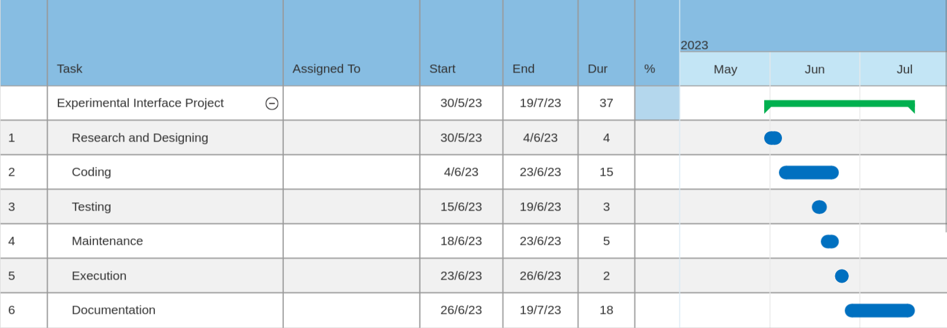
Work Schedule
Table 2. Gantt chart

Slide 18
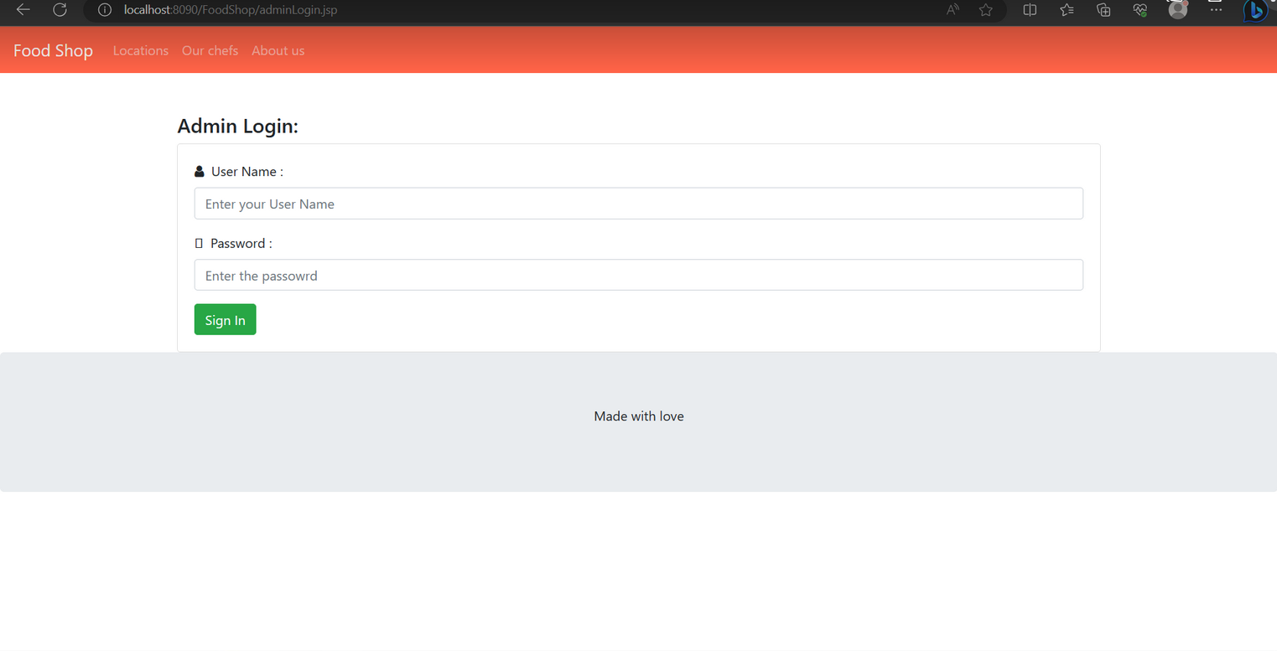

Slide 19
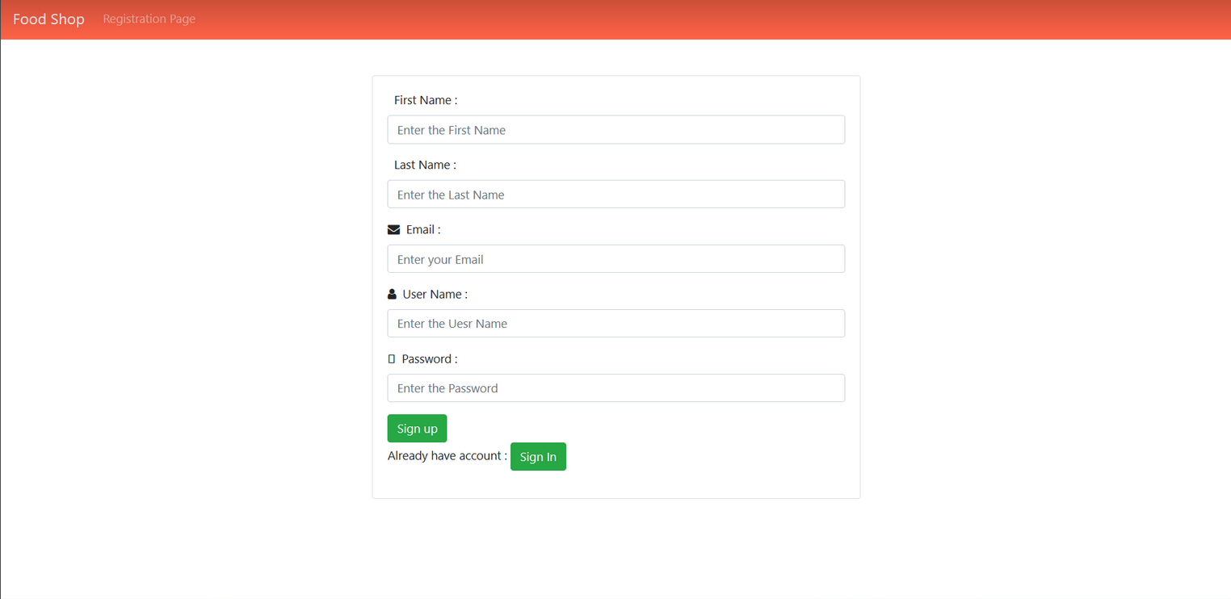

Slide 20
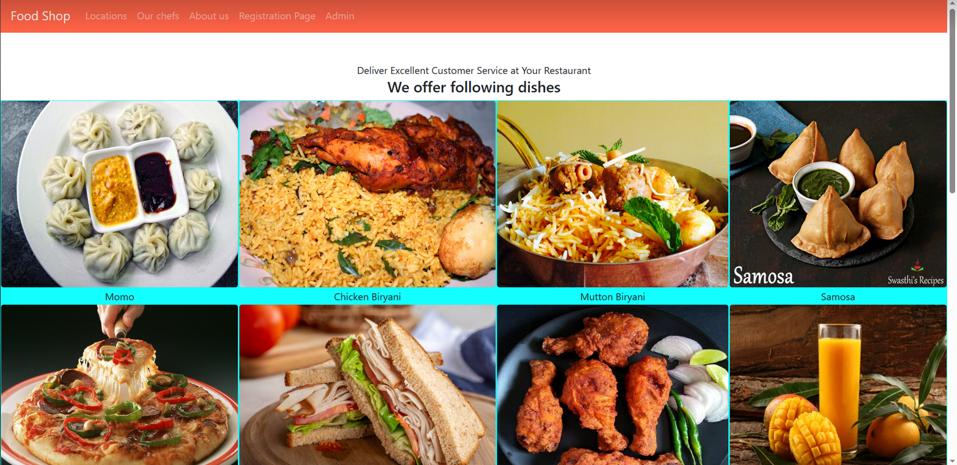

Slide 21
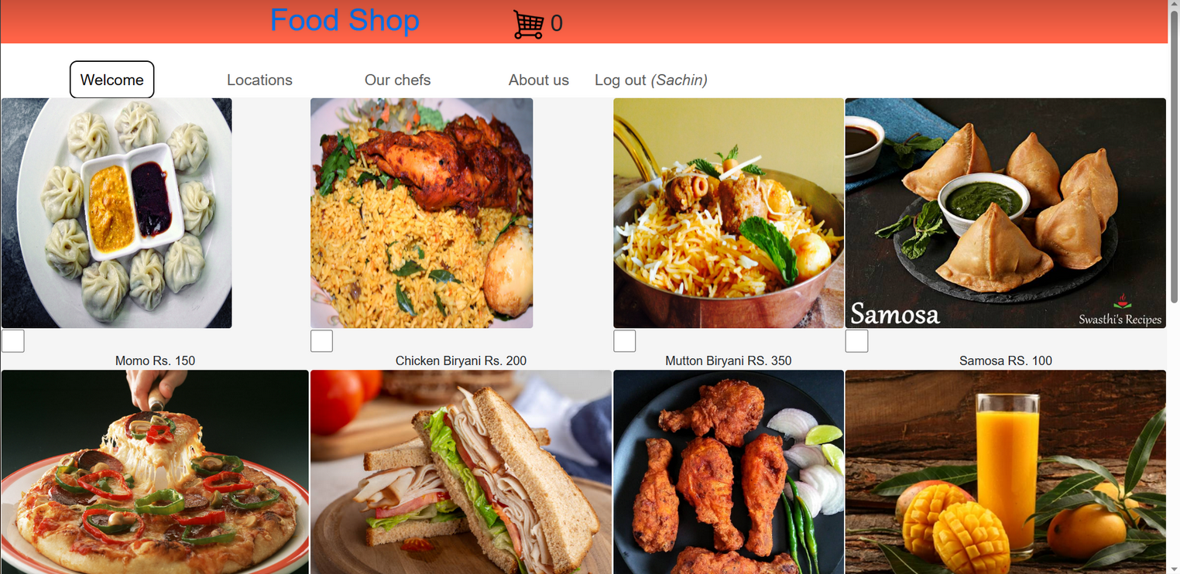

Slide 23
Tools used
ECLIPSE IDE
TOMCAT SERVER
SQL Server

Slide 24
LIMITATIONS
24
Food menu with rate is still paper based
Food description is unavailable
Bill printing is not available

Slide 25
FUTURE WORK
25
Food menu with rate can be included in app
Food description can be added
Bill printing can be made available
Options for employee record

Slide 26
REFERENCES
26
[1] Khairunnisa, K., Ayob, J., Mohd. Helmy, A., Erdi Ayob, M., Izwan Ayob, M. and Afif Ayob, M. (2009).The Application of Wireless Food Ordering System. [online] Available at: http://eprints.uthm.edu.my/5726/1/Wireless_Food_Ordering_System.PDF [Accessed 16 Nov. 2014].
[2] Shashikant Tanpure, S., R. Shidankar, P. and M. Joshi, M. (2013). Automated Food Ordering System with Real-Time Customer Feedback. [online]
[3] Wafula, K, R. (2014). ONLINE ORDERING SYSTEM PROJECT PROPOSAL. [online] Academia.edu. Available at: http://www.academia.edu/4935972/ONLINE_RDERING_SYSTEM_PROJECT_P ROPOSAL [Accessed 16 Nov. 2014].

