Slide 1
Food Delivery Analytics Dashboard
Using SQL, Python and Power BI
Presented by: Sachin Tiwari

Slide 2
PROJECT OBJECTIVE
Analyze food delivery orders.
Monitor total revenue.
Track customer ratings.
Identify top-performing restaurants.
Build an interactive Power BI dashboard.

Slide 3
TOOLS AND TECHNOLOGIES USED
SQL
Python
Pandas
Matplotlib
Power BI

Slide 4
PROJECT WORKFLOW
Raw Data
Data Cleaning
SQL Analysis
Python EDA
Power BI Dashboard

Slide 5
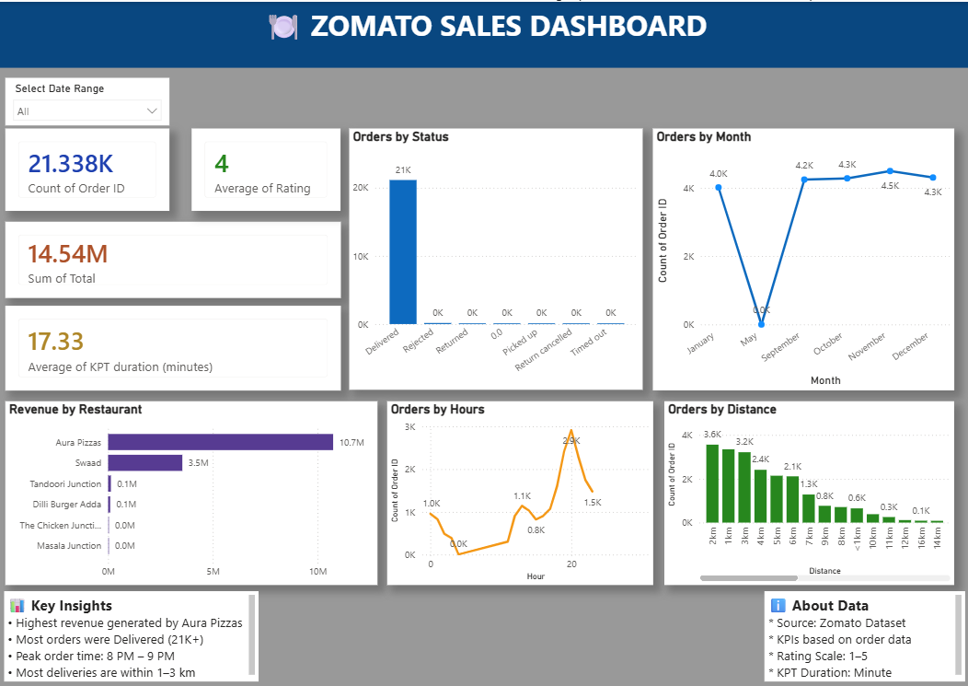
DASHBOARD OVERVIEW

Slide 6
Key insights
Highest revenue generated by Aura Pizzas
Most orders were Delivered (21K+)
Peak order time: 8 PM – 9 PM
Average customer rating: 4.0
Most deliveries are within 1–3 km

Slide 7
conclusion
Successfully analyzed food delivery data.
Built an interactive Power BI dashboard.
Generated meaningful business insights.
Improved decision-making through data visualization.

Slide 8
Thank you
Questions?

