Slide 1
Software

Slide 2

UNIVERSE

Slide 3
KEY MEMBER

Slide 4


Slide 5
REVIEW PROCESS

Slide 6
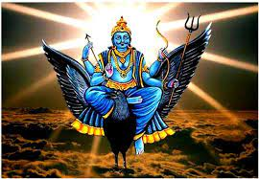

SHANI DEV
CHITRAGUPTA

Slide 7
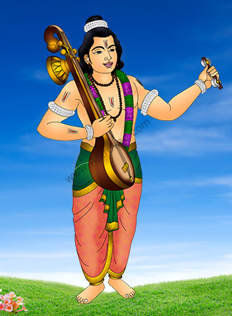
NARADA MUNI

Slide 8
SOFTWARE COMPANIES ON EARTH

Slide 9
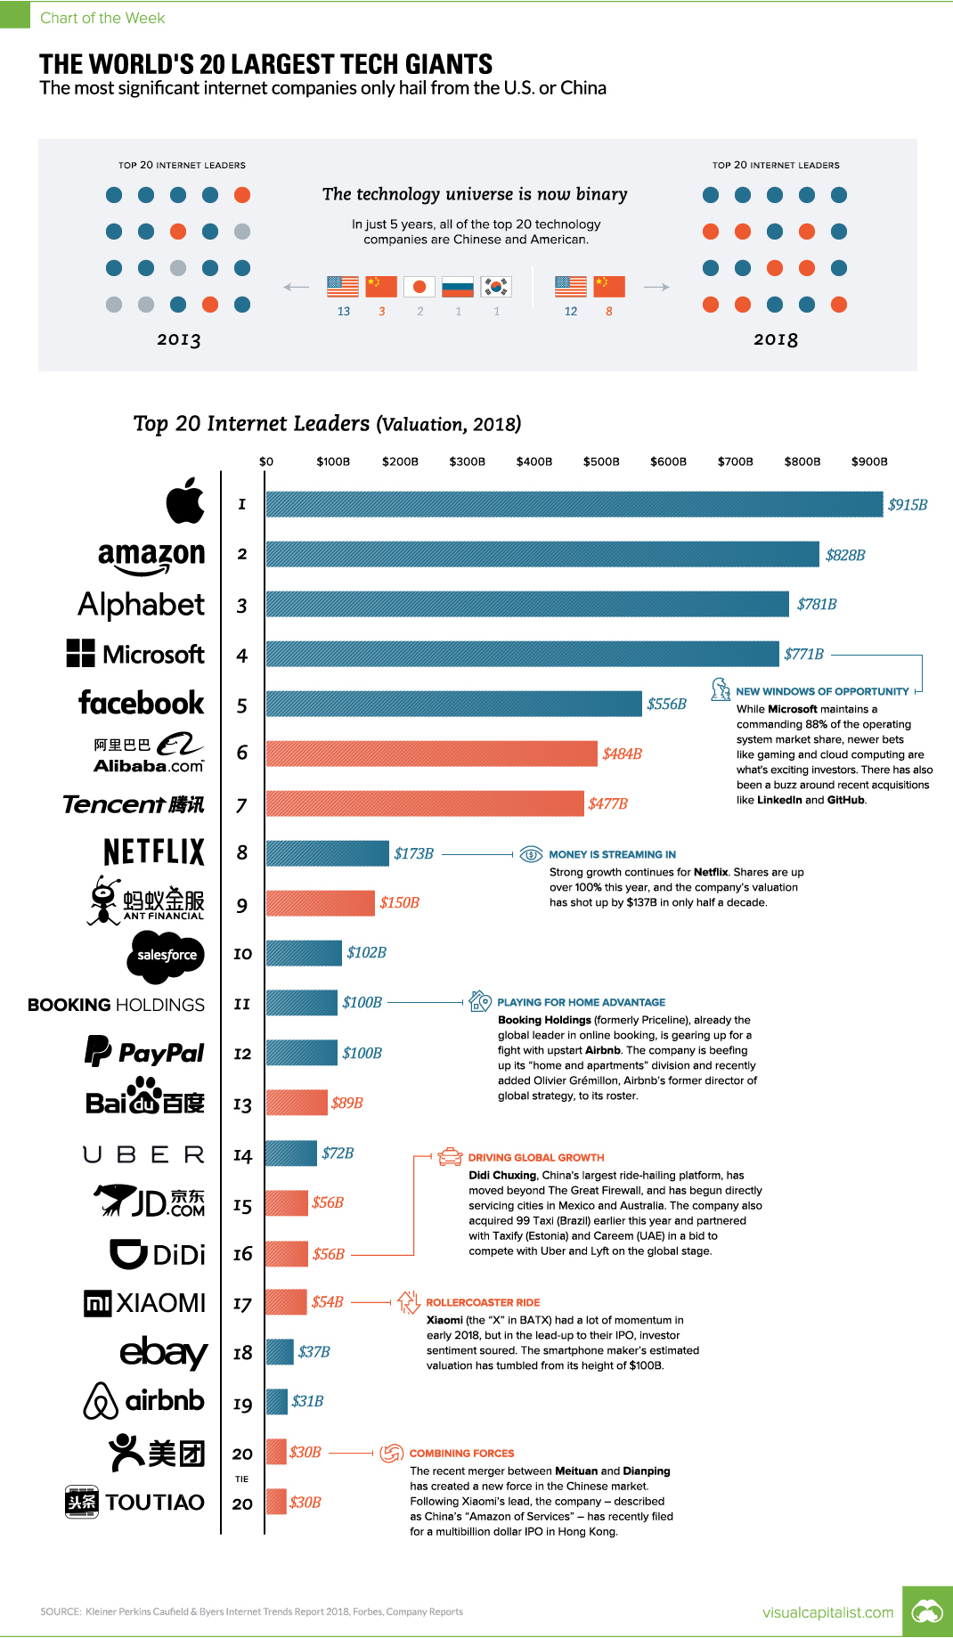

Slide 10
Hierarchy of Computer language

Slide 11
Mobile Software

Slide 12
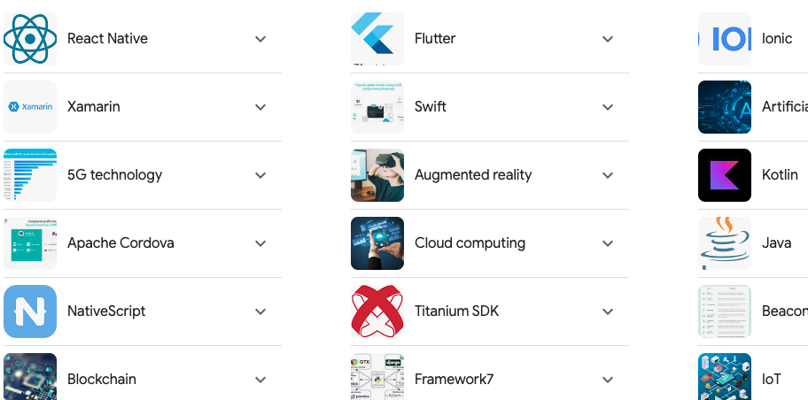

Slide 13
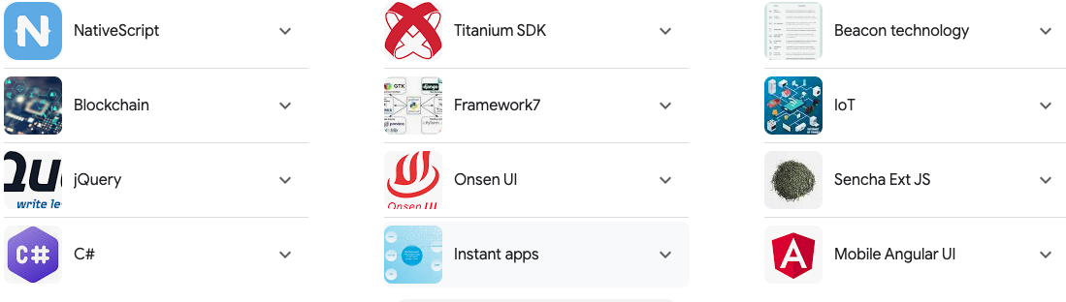

Slide 14
Bonus

Slide 15
Thank You

