Slide 1
Software
Notes:
1

Slide 2

UNIVERSE
Notes:
2

Slide 3
KEY MEMBER
Notes:
3

Slide 4

Notes:
4

Slide 5
REVIEW PROCESS

Slide 6
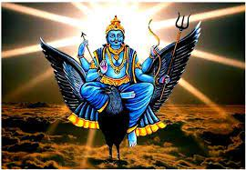

SHANI DEV
CHITRAGUPTA

Slide 7

NARAD MUNI

Slide 8
SOFTWARE COMPANIES ON EARTH

Slide 9
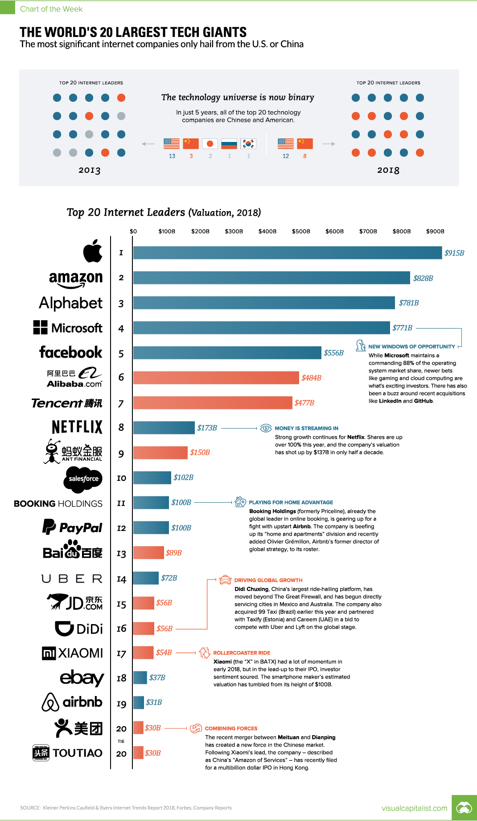

Slide 10
Hierarchy of Computer language

Slide 11
Mobile Software

Slide 12
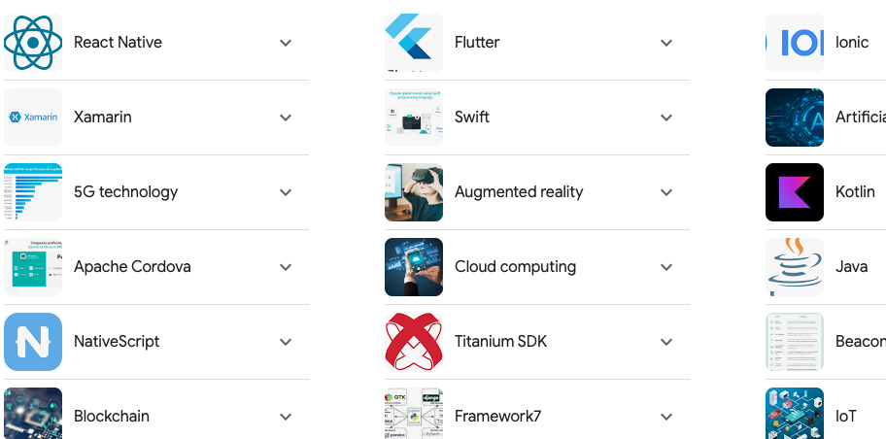

Slide 13
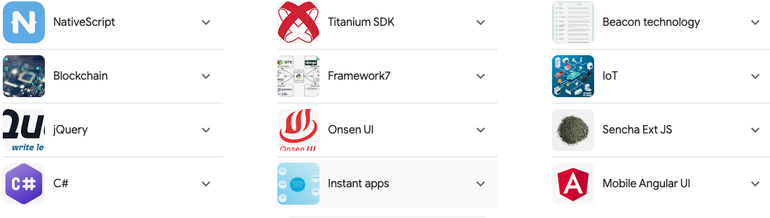

Slide 14
Bonus

Slide 15
Thank You

