Slide 1

Unlocking the Power of Python: Loading CSV Files and Making Graphs
Topic name: India: Unemployment, population, life expectancy and GDP. Men and women
By sachin vadhel

Slide 2

Index
Introduction to CSV File Loading in Python
Reading CSV Files in Python
Creating Graphs with CSV Data in Python
Exploring Pandas and Matplotlib
Example with code
Graphs and questions
Conclusion

Slide 3
Introduction to CSV File Loading in Python
exchanging data between applications and data stores.
plain text, such as a spreadsheet or database. In Python, it is easy to load data from any source, including CSV files.
Python provides an inbuilt module called csv to work with CSV files. This module provides a number of functions to work with CSV files, including reading and writing them.

Slide 4
Reading CSV Files in Python
the csv.reader() function. This function takes a file object and returns a reader object, which can be used to iterate over the rows of the CSV file. The csv.reader() function also has an optional parameter called dialect, which can be used to specify the format of the CSV file. The dialect parameter can be used to specify the delimiter, quote character, escape character, and other formatting options.

Slide 5
Creating Graphs with CSV Data in Python
Python provides a number of libraries for creating graphs, such as matplotlib, seaborn, and pandas. These libraries provide a number of functions to create graphs from CSV data.
For example, the matplotlib library provides a number of functions for creating line graphs, bar charts, histograms, scatter plots, and more from CSV data.

Slide 6
Introduction to Pandas and Matplotlib
Pandas is a library for data manipulation and analysis, while Matplotlib is a library for data visualization. Together, they provide a comprehensive suite of data analysis and visualization capabilities.
Pandas allows for easy manipulation and analysis of data, while Matplotlib provides a powerful and intuitive way to visualize data.

Slide 7
Example with code
# import necessary libraries
import pandas as pd
import matplotlib.pyplot as plt
# get input data
df = pd.read_csv('filename.csv')
df.plot(x='column 1', y='colomn 2')
plt.title('title name)
plt.xlabel("x axis lable")
plt.ylabel("y axis lable")
plt.show()

Slide 8
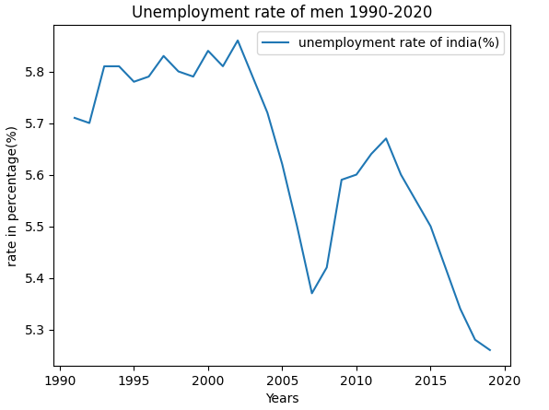
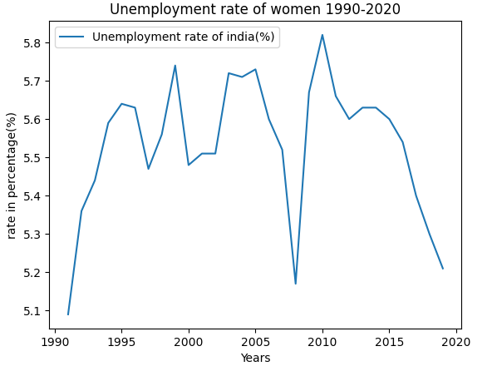
graphs
India unemployment rate(men)
India unemployment rate(women)

Slide 9
Question 1: Which gender is more likely to be unemployed?
the female unemployment rate in India was higher than the male unemployment rate in 2019
In 2019, the female unemployment rate in India was 5.21%, while the male unemployment rate was 3.8%.
Reasons :
women face significant social and cultural barriers
limited access to education and training
discrimination and harassment in the workplace.

Slide 10
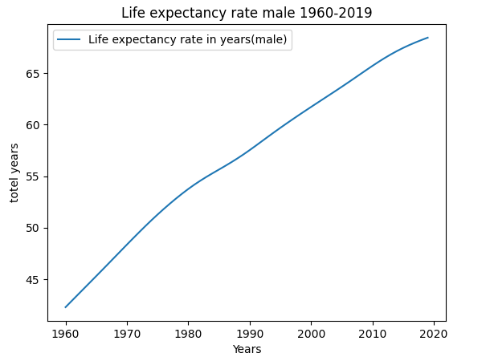
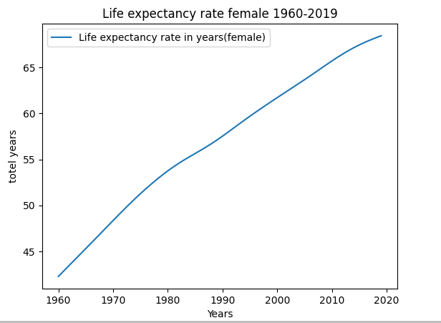
India life expectancy rate(male)
India life expectancy rate(female

Slide 11
Question 2: Which gender has a bigger life expectancy?
females have a slightly higher life expectancy than males in India.
the life expectancy in India is around 68.46 years for males and around 71 years for females
depending on factors : healthcare, socioeconomic status, and lifestyle choices

Slide 12
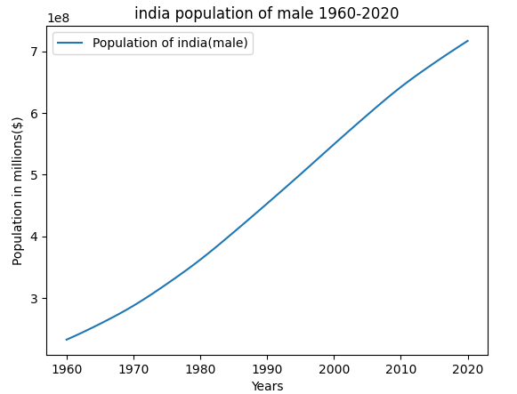

India population(male)
India population(female)

Slide 13
Question 3: Which gender forms the bigger part regarding India's population?
The population of India is approximately 1.21 billion
males comprising about 51.7% (623.7 million) of the population
females about 48.3% (586.5 million) of the population.

Slide 14
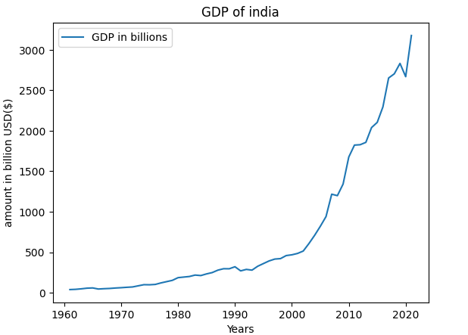
India GDP

Slide 15
Example of code
import pandas as pd
# Read the first CSV file into a pandas dataframe
df1 = pd.read_csv('file 1')
# Read the second CSV file into a pandas dataframe
df2 = pd.read_csv('file 2')
# Select the same two columns from each dataframe
col2_df1 = df1['colum of file 1']
col2_df2 = df2['colum of file 2']
# Calculate correlation coefficient between the two columns from each dataframe
corr_coef = col2_df1.corr(col2_df2)
# Print the result
print(f"Correlation coefficient between Life expectancy rate and population of india(male) is: {corr_coef}")
Output:
Output will be –0 to 0.99 where 0.99 means 1 it describe connection between data and –0 means there is no any connection.

Slide 16
Question 4: Is there any connection between GDP and unemployment?
Question 5: Is there any connection between GDP and life expectancy?
Direct job creation is not possible
changes in technology, government policies, and global economic conditions can also influence the relationship between GDP and unemployment.
higher GDP usually means that a country has more resources available for investing in healthcare, education, and other social services that can promote better health outcomes
higher GDP – higher economic development
higher GDP -- access to nutrition and better living standard
Output:
Correlation coefficient between GDP of india in and unemployment rate of india is: 0.8577721014361375
Output:
Correlation coefficient between GDP of india in and lifeexpectancy rate of india is: 0.8004102288221597

Slide 17
Question 6: Is there any connection between GDP and population?
Question 7: Is there any connection between unemployment and life expectancy?
that other factors, such as social and cultural factors, government policies, and access to education and healthcare, also play a significant role in determining population growth rates.
India has a large informal economy and a high level of poverty, which means that many people who are technically unemployed
access to healthcare, sanitation, and nutrition can have a greater impact on life expectancy than employment status alone.
Output:
Correlation coefficient between GDP of india in and Population of india(male) is: 0.8577721014361375
Output:
Correlation coefficient between unemployment rate and Life expectancy rate(male) is: -0.7770728194800688
The output clearly shows there is no any connection between unemployment rate and life expectancy in india

Slide 18
Question 8: Is there any connection between life expectancy and population?
the relationship between population and life expectancy in India is not straightforward
India has made significant progress in improving life expectancy
having one of the largest populations in the world.
This can be attributed to a range of factors such as improved access to healthcare, sanitation, and nutrition, as well as advancements in medical technology.
Output:
Correlation coefficient between Life expectancy rate and population of india(male) is: 0.988212033291134
This output define there is many similarities between life expectancy rate and population of india

Slide 19
Conclusion
In conclusion, it is easy to load CSV files in Python using the csv module. The csv module provides a number of functions to read and write CSV files. Once the CSV file has been read or written, it can be used to create graphs using a number of libraries, such as matplotlib, seaborn, and pandas. These libraries provide a number of functions to create graphs from CSV data.
If we talk about the data of india, there are complex and indirect connections between GDP, population, unemployment, and life expectancy in India. While these factors can have some impact on each other, other factors such as access to healthcare, sanitation, nutrition, education, and social and economic development can also play a significant role in determining health outcomes.

