Slide 1
GOV-TECHTHON 2020:VIRTUAL HACKATHON
Presentation on
Software Solution for Automation of Vehicle fitness test
Presented By
Sachin K. Vanjire
Aditya M. Mane
Abhiram S.Patil
Inspector/User

Slide 2
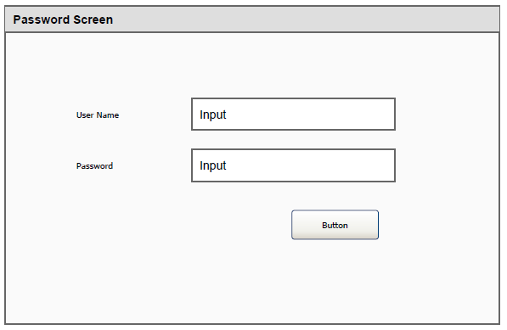
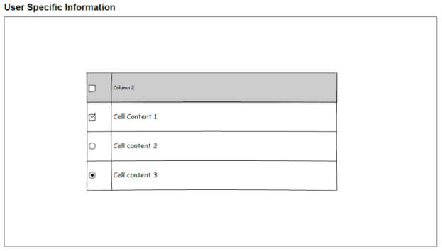
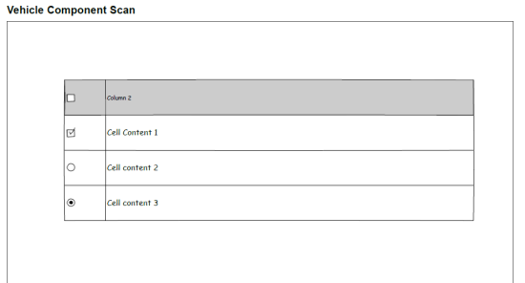
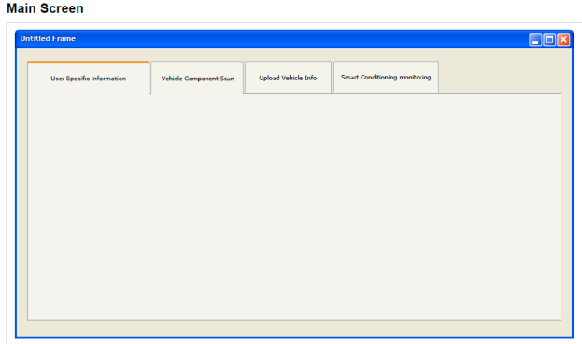
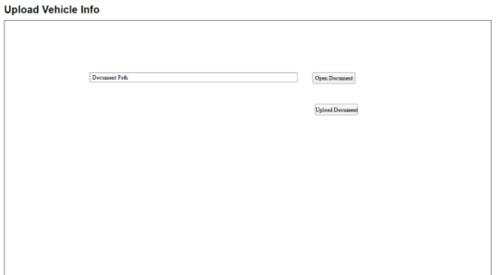
Requirement Gathering
Vehicle Fitness Inspection
Problem Statement -
Login
User Info/Vehicle Info/Component Scan/Upload document/Smart Inspect
Wire Diagram -

Slide 3

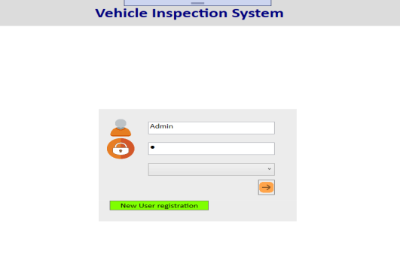

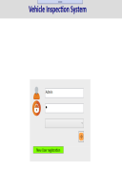


Software Infrastructure
Open CV library
Manufacturer owned database
Cloud base server
Multi platform Software development
Inspector/User

Slide 4
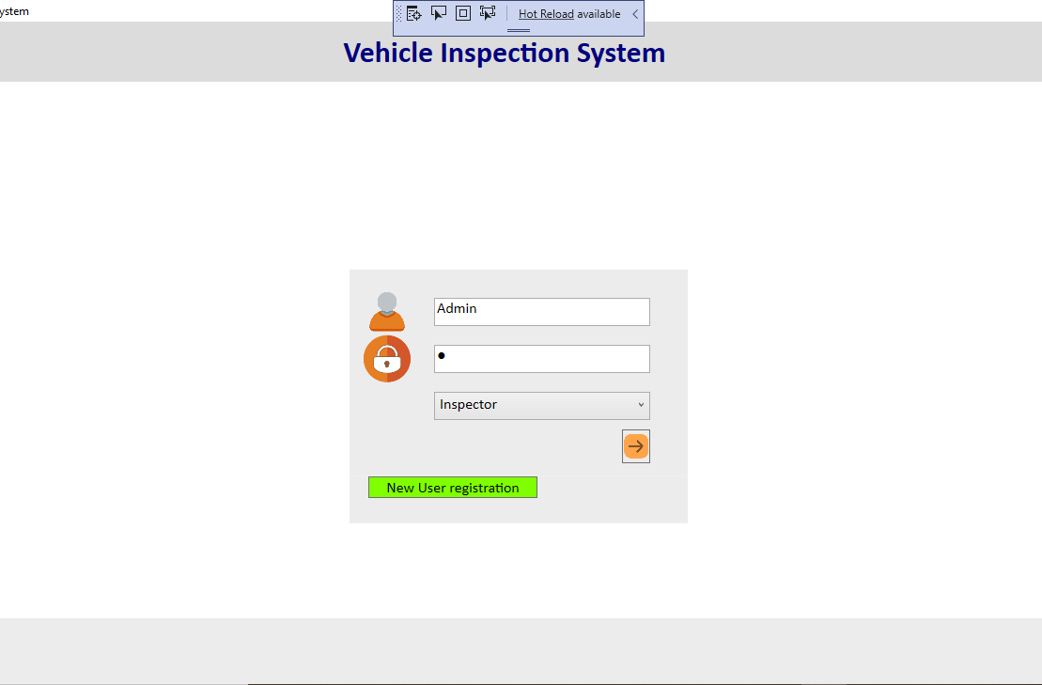
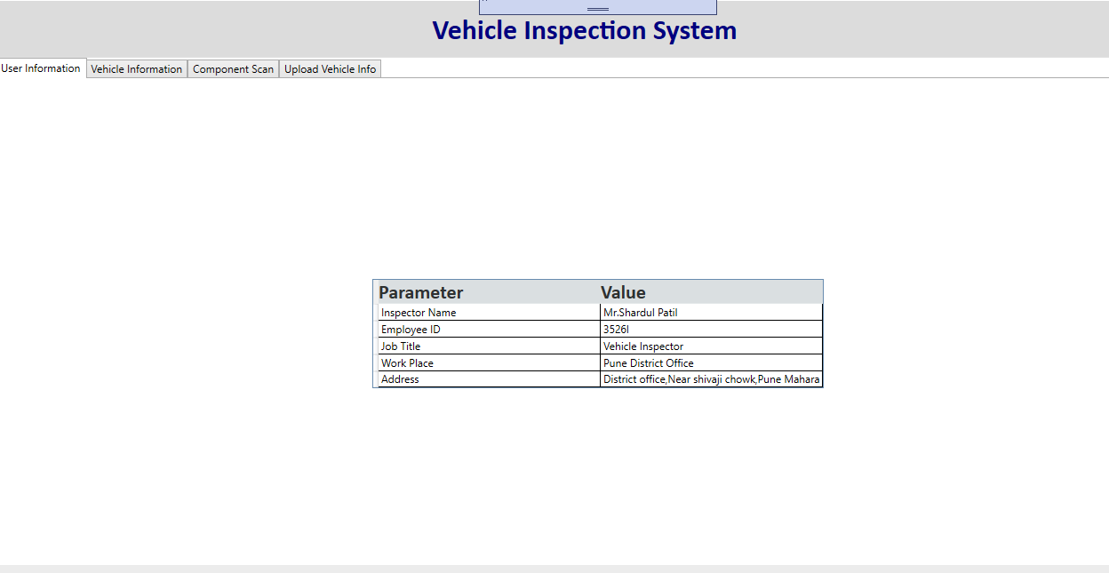
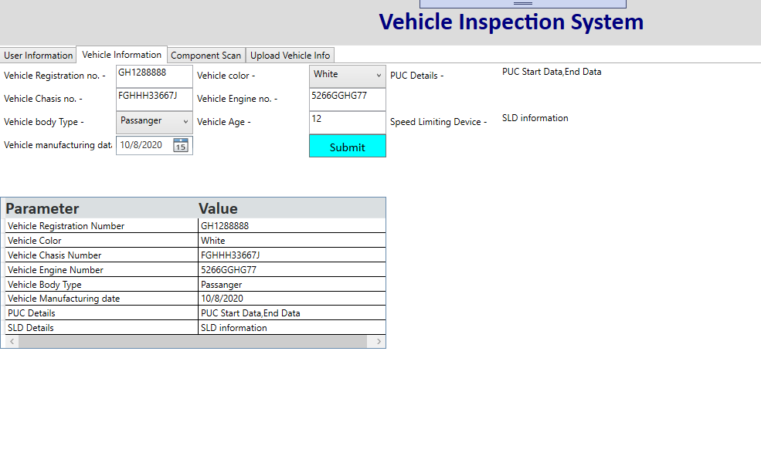
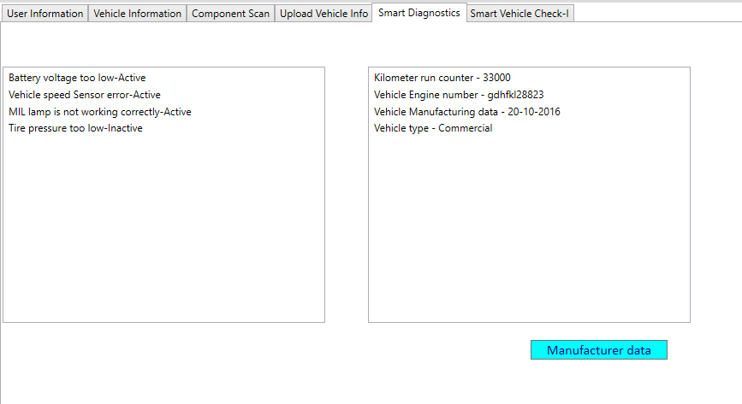
Tool UX Design development

Slide 5
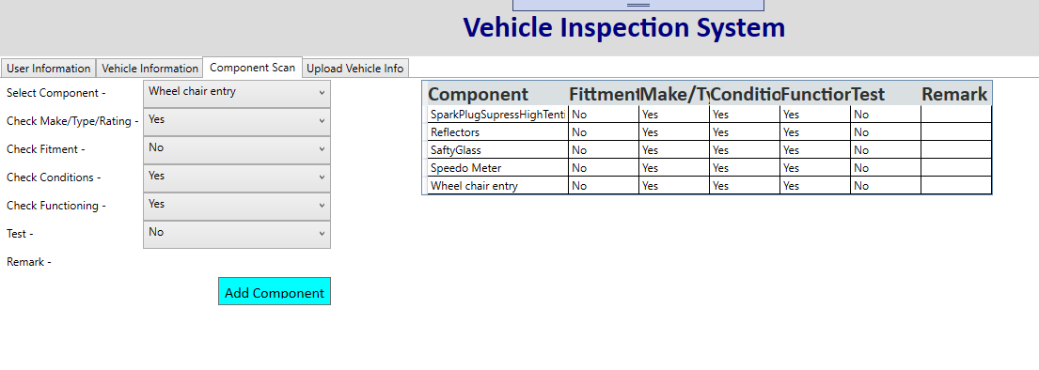
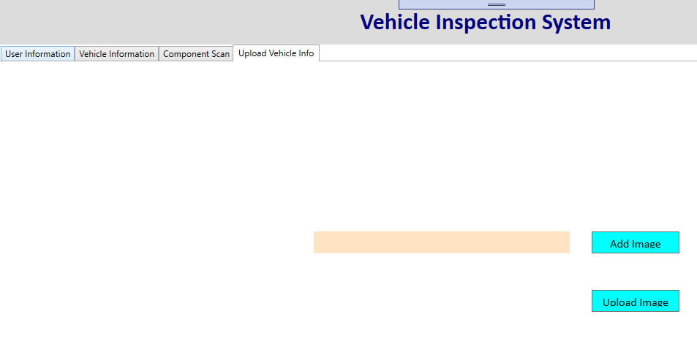
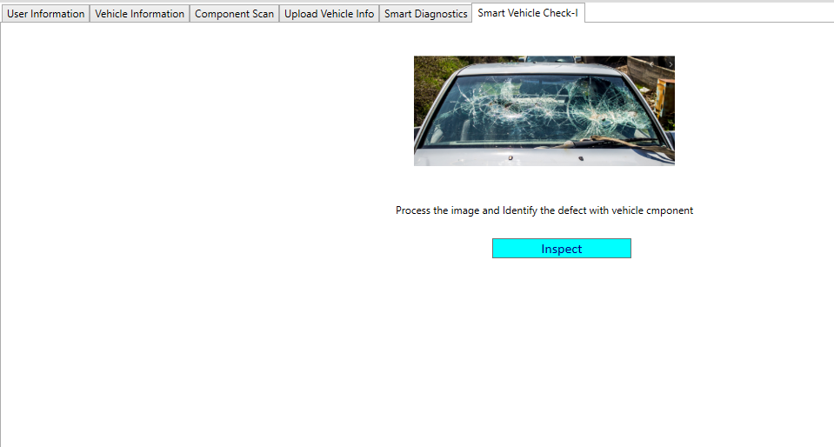
Tool UX Design development

Slide 6
Software Development Technology
Demonstration Tool -
Platform | Desktop Application
Language | C#.net,WPF XAML
Multiplatform Tool -
Platform | Windows, Mobile
Language | Microsoft XAMRIN
Cloud Server | Azure devops
Computer Vision | Open CV
Database | Microsoft SQL,Oracle
Wish List -
Multiplatform Tool development(Desktop,Tablet,Mobile)
Manufacturer Database connectivity to get the repair details .and design of smart dashboard
Vehicle prognostics Alert.
Smart Vehicle Inspection based on Computer Vision
Cloud base database server implementation
Vehicle Health Report and Alerts to the user with the help of web base service. Geo Fencing solution
Image compression techniques to upload the data
Security Implementation (Encryption. Decryption of data)

Slide 7
Thank you…
Inspector/User

