Slide 1
Introduction to Data Science
By: Sachin Yadav
Email: sachin@grras.com
Mobile: 9782131159
Git : https://github.com/sachinyadav3496

Slide 2
Content:
Prelude
The problem landscape
Defining Data Science
Demystifying Data Science, Decision Science, AI, ML and DL
Overview of Data Scientist's Toolbox
Notes:
Prelude – an action or event serving as an introduction to something more important
Demystifying → making a difficult subject easy

Slide 3
Prelude
It all starts with Decision Making and Business Strategy!
Historically, business strategies and decisions were backed by intuitions, experiences and heuristics. Research was very limited.
As time evolved, digital adoption was in place and data was readily available and naturally a new field BI i.e. Business Intelligence was born.
With the advent of time, computing and storage capabilities scaled to new heights and so did data volume and soon data driven techniques matured from B.I. to A.I.
(Illustrative) – Journey of Data Science Maturity
Data driven decisions maturity
Manually analyzing legers/documents etc.
Business Intelligence reports
BI 2.0/3.0
Artificial Intelligence
Before Digitization
Post Digital Adoption
Post Internet explosion
<--------------The data time line ----------------→

Slide 4
The problem landscape
Problems solved in the industry can be broadly defined using 2 dimensions; i.e. Impact & Frequency
We can further divide them into 4 logical blocks with high and low variations of Impact and Frequency, viz.
Low Impact – Low Frequency
Low Impact – High Frequency
High Impact – Low Frequency
High Impact – High Frequency
The middle layer highlighted is the area where solving problems become increasingly complex and ambiguous lack a structure
This highlighted area is where mainly data science started getting traction in several organizations.
Eventually, data driven decisions also resulted in the development of several data products and also the industry transitioned from BI to AI
Low impact
High Frequency
High impact
High Frequency
Frequency
High
Low
High impact
Low Frequency
Low impact
Low Frequency
Low
High
Impact

Slide 5
Defining Data Science
Math
Definition
Data Science can be defined as the art and science of making data driven decisions
The field is inter-disciplinary and requires a combination of skill sets that has never been leveraged earlier together.
Data Science is basically a combination of
Math i.e. Statistics, Linear Algebra, Probability etc.
Business – Domain knowledge of the system &
Technology – Programming and hacking skills
The modern definition of data science adds several more skills to the equation and thus making it truly interdisciplinary.
Design Thinking, Behavioral Science etc. are few to name.
Consulting
Products
Data Science
Business
Technology
IT Services

Slide 6
A closer look at the related terms
Data Science
Data wrangling
Data plumbing
There are several interlinked and similar names that arise along with the topic of Data science.
It gets increasingly difficult to distinguish between these ambiguous terms as there exists no standard definition for them.
Few terms that surface while exploring the field of Data Science and Machine Learning are
NLP (Natural Language Processing), Decision Science, Neural Networks, Deep Learning, Data mining, Data Analysis etc.
From the long never ending list, we can simplify the core content into 3 important topics nested within each other. And lastly, Data Science can be defined as a holistic collection of the different subfields orchestrated in a structure manner.
Artificial Intelligence
Machine Learning
Deep
Learning
Data visualization
Data Engineering

Slide 7
Demystifying Data Science, AI, ML and DL
Artificial Intelligence
A branch of computer science that deals with providing intelligence to machines artificially; and hence the name.
They could be simple rule based systems, knowledge driven databases etc.
Machine Learning
A subfield within AI that deals with making machines intelligent without explicit programing.
It is in fact the most successful branch of AI
Deep Learning
A subfield of machine learning that deals with making machine intelligent and are concerned with algorithms inspired by the structure and function of the brain called artificial neural networks.
Data Science
It deals with the entire journey of extracting, cleaning, transforming, visualizing, mining and developing AI/ML products from data.

Slide 8






Data Scientist’s Toolbox
This is not an exhaustive list though…
There are plenty of tools available in the market today that can ease the life of a data scientist.
Each tools comes with it’s own pros and cons and finalizing the best tool is a long debate with no clear winner.
Overall, R and Python are the most common tools used by the majority of the data science fraternity.
We will spend a little more time to understand R and Python a bit better.
Lastly, for the remaining modules and hand-on exercises, we will be leveraging Python.

Slide 9
A closer look at R Lang
The R language started getting a lot of traction with several packages released by Hadley
An open source programming language and software environment for statistical computing
Widely used by researchers, data miners
An implementation of the S language; created by Bell labs.
Named after the first letter of its creators Ross Ihaka and Robert Gentleman
The duo conceived the project at University of Auckland in 1992
Initial version was released in 1995
A stable version was finally released in 2000
The language was later revolutionized by Hadley Wickham from 2005 onwards when he launched several useful packages in R for visualizing, manipulating and engineering data.

Slide 10
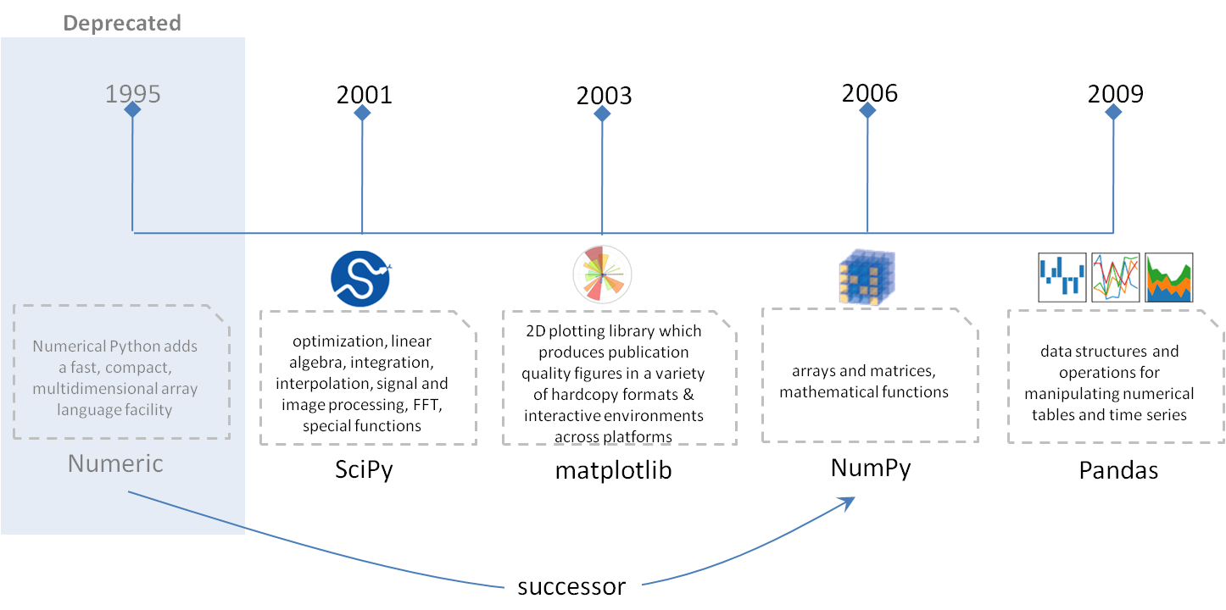
A closer look at Python
Python got a lot of traction with the launch of Pandas, Scipy and Scikit Learn
A highly popular open-source and general purpose programming language created by Guido van Rossum in 1991
Python incorporated several data science related tools in late 2005.
It attracted a lot of traction with the launch of Pandas (similar to R’s Data frame concept)
Python was more preferred to software engineers due to the shallow learning curve and production support tools
At present, Python is leading the race with R specifically for Deep Learning packages and frameworks.
It will most probably overtake R as the preferred language for a data scientist in the near future

Slide 11
Any Questions ?

Slide 12
Thank You

