Slide 1
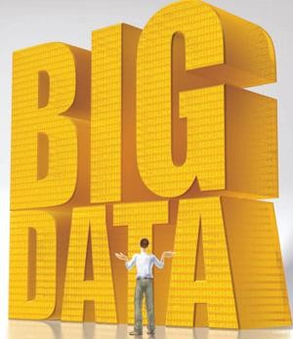
1

Slide 2
Outline
Big Data
Structured and Unstructured Data
What is Big Data?
Big Data Ecosystem and Life Cycle
Industries using Big Data
Big Data Applications
Challenges in Big Data
Hadoop
Hadoop Components
How Hadoop Works?
Hadoop Distributed File System (HDFS)
Hadoop MapReduce
Hadoop1 vs Hadoop2
2

Slide 3

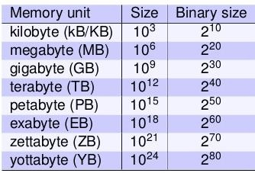
Simple to start
What is the maximum file size you have dealt so far?
Files
Movies
Streaming video
3

Slide 4
Structured & Unstructured Data
Structured Data
Any data that resides in a fixed field within a record or a file.
Includes data contained in relational databases and spreadsheets.
Unstructured Data
Information that doesn’t reside in a traditional row-column database.
Includes text and multimedia content like e-mail, word processing documents, videos, audios, ppts, webpages, etc.
4

Slide 5
Structured & Unstructured Data
Data Management
Structured | Unstructured
SQL - a programming language created for managing and querying data in relational database management systems. Libraries to process Spreadsheets | Big Data tools – Hadoop
 | Business Intelligence Software
 | Data Integration tools
 | Document Management Systems
 | Information Management solutions
 | Search & Indexing tools
5

Slide 6
Semi-Structured Data
Information that doesn't reside in a relational database but that does have some organizational properties that make it easier to analyze.
Examples include
of semi-structured XML documents
data might and NoSQL
databases.
6

Slide 7
What is Big Data?
Every day, we create 2.5 quintillion bytes of data and 90% of the data in the world today has been created in the recent years alone.
This data comes from everywhere:
sensors used to gather climate information,
posts to social media sites,
digital pictures and videos,
purchase transaction records, and
cell phone GPS signals
and many more ……
This data is
7

Slide 8
Big Data – A Growing Torrent
There are huge volumes of data in the world:
From the beginning of recorded time until 2003, we created 5 billion gigabytes (exabytes) of data.
In 2011, the same amount was created every two days.
In 2014, the same amount of data was created every 10 minutes.
8

Slide 9
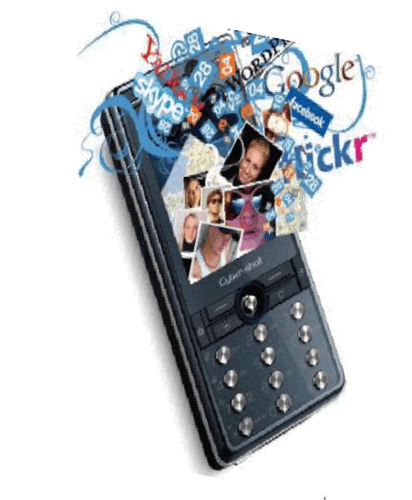


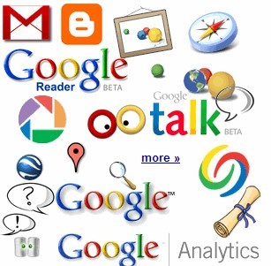

Why is “Big Data” a “Big Deal”?
5.5
billion +
camera phones world wide
40 billion RFID
tags today (1.3B in 2005)
12+ TBs
of tweet data every day
100s of millions of GPS enabled
devices
sold annually
? TBs of data every day
25+ TBs of log data every day
3.5 billion +
people on the Web by end
2016
76 million smart meters in 2009… 200M + Now
9

Slide 10
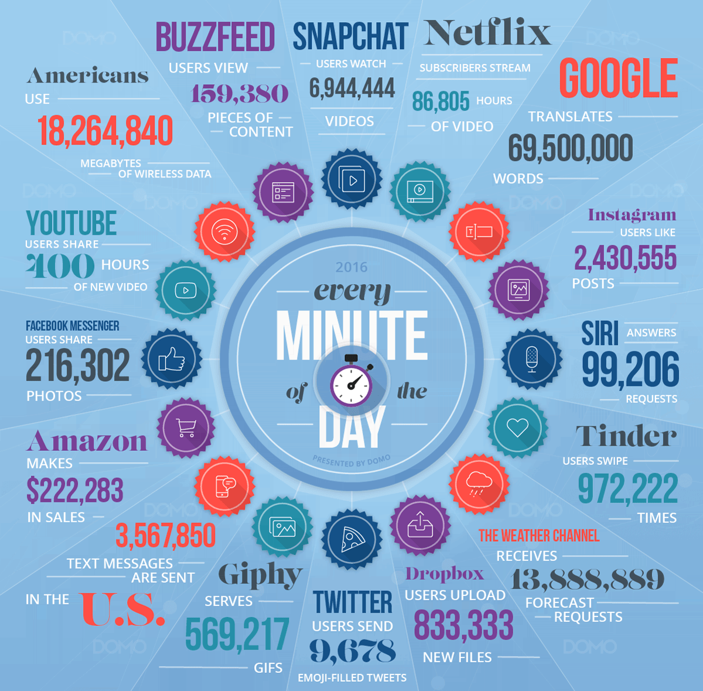

Data Never Sleeps
11

Slide 11
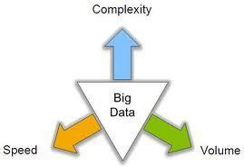
A Formal Definition
Big Data is high-volume, high-velocity and high- variety information that demands cost-effective, innovative forms of information processing for enhanced insight and decision making.
(http://www.gartner.com/)
12

Slide 12
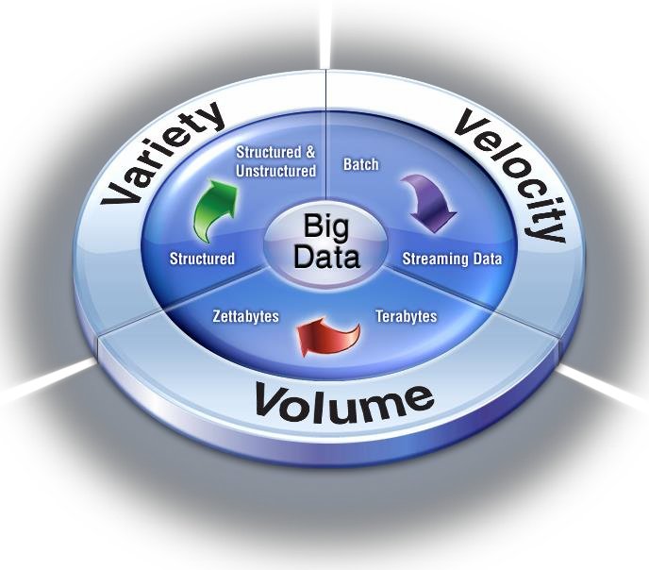
The Three V’s of Big Data
13

Slide 13
Volume, Velocity and Variety
Volume: Enterprises are awash with ever-growing data of all types, easily amassing terabytes—even petabytes—of information.
Turn 12 terabytes of Tweets created each day into improved product sentiment analysis
Convert 350 billion annual meter readings to better predict power consumption
Velocity: Sometimes 2 minutes is too late. For time-sensitive processes such as catching fraud, big data must be used as it streams into your enterprise in order to maximize its value.
Scrutinize 5 million trade events created each day to identify potential fraud
Analyze 500 million daily call detail records in real-time to predict customer churn faster
Variety: Big data is any type of data - structured and unstructured data such as text, sensor data, audio, video, click streams, log files and more. New insights are found when analyzing these data types together.
Monitor 100’s of live video feeds from surveillance cameras to target points of interest
Exploit the 80% data growth in images, video and documents to improve
customer satisfaction
14

Slide 14
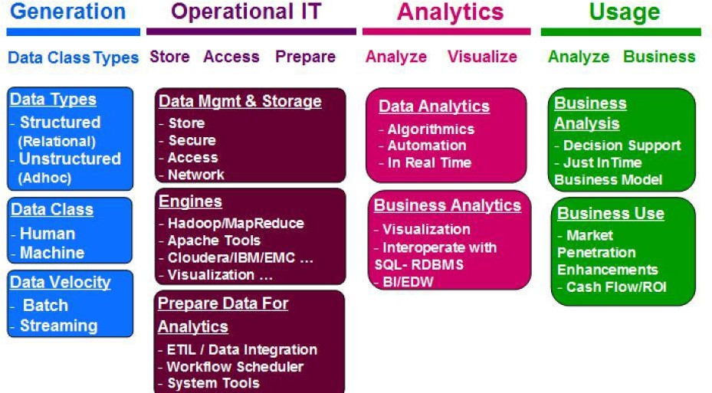
Big Data Ecosystem
Source : IMEX research-Big Data Industry Report
15

Slide 15


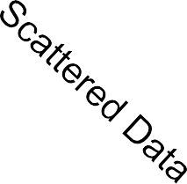






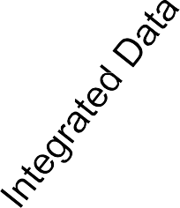

Life Cycle of Big Data
Acquisition
Big Data
Application
Aggregation
Analysis

Slide 16





Computational View of Big Data
Interpretation/
Evaluation
Data Mining
Knowledge
Preprocessing
Patterns
Selection
Preprocessed Data
Target Data
Big Data

Slide 17
Where Engineers fit?
Increasing potential to support business decisions
Making
Decisions
End User
Data Presentation
Visualization Techniques
Business Analyst
Data Mining
Information Discovery
Data Analyst
Data Exploration
Statistical Analysis, Querying and Reporting
Data Warehouses / Data Marts
OLAP
DBA
Data Sources
Paper, Files, Information Providers, Database Systems, OLTP

Slide 18
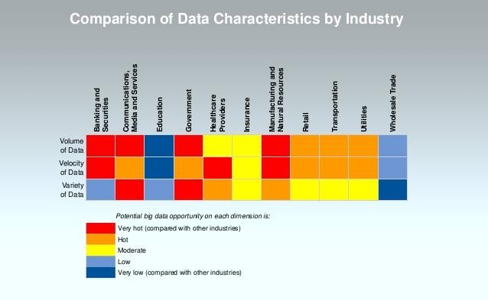
Industries using Big Data

Slide 19
Industries using Big Data
Banking and Securities
Securities fraud early warning
Card fraud detection and Audit Trails
Credit risk reporting
Customer data information and Analytics
Application
The Securities Exchange Commission (SEC) is using big data to monitor financial market activity. They are currently using network analytics and natural language processors to catch illegal trading activity in the financial markets.

Slide 20
Banking
Card marketing
By identifying
customer
segments,
card issuers
and acquirers can
improve profitability with more effective acquisition and retention
programs, targeted product development, and customized pricing.
Fraud detection
Fraud is enormously costly. By analyzing past transactions that were later determined to be fraudulent, banks can identify patterns.
Predictive life-cycle management
DM helps banks predict each customer’s lifetime value and to service each segment appropriately (for example, offering special deals and discounts).

Slide 21
Industries using Big Data
Communication, Media and Entertainment
Collecting, insights
Understanding content
analyzing and utilizing customer
patterns of real-time media
Application
Wimbledon
Championships leverages big data to
deliver detailed sentiment analysis on the tennis matches to TV, mobile and web users in real-time.

Slide 22
Telecommunication
Call detail record analysis
Telecommunication companies accumulate detailed call records. By identifying customer segments with similar use patterns, the companies can develop attractive pricing and feature promotions.
Customer loyalty
Some customers repeatedly switch providers, or “churn”, to take advantage of attractive incentives by competing companies. The companies can use DM to identify the characteristics of customers who are likely to remain loyal once they switch, thus enabling the companies to target their spending on customers who will produce the most profit.

Slide 23
Industries using Big Data
Retail and Wholesale Trade
Unutilized data derived from customer loyalty cards.
Data from PoS scanners, RFID, etc.
Application
Retail industries utilize Big Data for analytics and for other uses including:
Optimized staffing through data from shopping patterns, local events etc.
Reduced fraud and
Timely analysis of inventory

Slide 24
Retail
Performing basket analysis
Which items customers tend to purchase together? Improves stocking, store layout strategies, and promotions.
Sales forecasting
Examining time-based patterns helps retailers make stocking decisions. If a customer purchases an item today, when are they likely to purchase a complementary item?
Database marketing
Profiling of customers with certain behaviors, for example, those who purchase designer labels clothing or those who attend sales. To focus cost–effective promotions.
Merchandise planning and allocation
For new stores, merchandise planning and allocation by examining patterns in stores with similar demographic characteristics. Retailers can also use data mining to determine the ideal layout for a specific store.

Slide 25
Industries using Big Data
Healthcare Providers
Education
Manufacturing and Natural Resources
Government
Insurance
Transportation

Slide 26
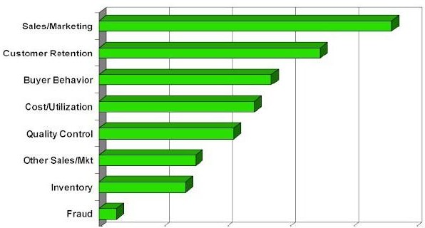
Big Data Applications

Slide 27
Fraud Detection
Applications: Health care, retail, credit card service, telecomm.
Auto insurance
Ring of collisions
Money laundering
Suspicious monetary transactions
Medical insurance
Professional patients
Unnecessary or correlated screening tests
Telecommunications: phone-call fraud
Phone call model: destination of the call, duration, time of day or week. Analyze patterns that deviate from an expected norm
Retail industry
Analysts estimate that 38% of retail shrink is due to dishonest employees
Anti-terrorism

Slide 28
Other Applications
Customer segmentation
All industries can take advantage of DM to discover discrete segments in their customer bases by considering additional variables beyond traditional analysis.
Manufacturing
Through choice boards, manufacturers can customize products for customers. Needs of customers.
Warranties
Manufacturers need to predict the number of customers who will submit warranty claims and the average cost of those claims.
Frequent flier incentives
Airlines can identify groups of customers that can be given
incentives to fly more.

Slide 29
Other Applications
Sports
IBM Advanced Scout analyzed NBA game statistics (shots blocked, assists, and fouls) to gain competitive advantage for New York Knicks and Miami Heat
Internet Web Surf-Aid
IBM Surf-Aid applies data mining algorithms to Web access logs for market-related pages to discover customer preferences and behavior pages, analyzing effectiveness of Web marketing, improving Web site organization, etc.

Slide 30
Large Dataset Challenges
Storing large VOLUMES (TB/PB/XB)
Processing In Timely Manner
Processing Variety of DATA (St/SS/US)
Costly High End Infrastructure
31

