Slide 1
Introduction to SQOOP

Slide 2
Agenda
◆ What is Sqoop?
◆ What Sqoop provides?
◆ Why Sqoop?
◆ How Sqoop Works?
◆ Sqoop Architecture
◆ Sqoop Processing
◆ Sqoop Import
◆ Sqoop Export
◆ Sqoop Jobs

Slide 3
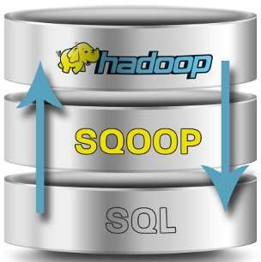
What is Sqoop?
Apache Sqoop is a tool designed for efficiently transferring bulk data between Apache Hadoop and
structured datastores such as relational databases.
This is how Sqoop got its name – “SQL to Hadoop & Hadoop to SQL”.
Sqoop can also be used to export data from Hadoop and export it to external structured datastores such as relational databases and enterprise data warehouses.
Transform data in Hadoop with Map-Reduce or hive.
Export data back to Relational Databases.

Slide 4
What Sqoop Provides?
Sqoop allows easy import and export of data from structured data stores.
Relational Database, Enterprise data warehouses, and NoSQL Systems
Provision data from external system on to HDFS
Once data is moved populate tables n Hive and HBase.
Sqoop integrates with Oozie, allowing you to schedule and automate import and export tasks.
Sqoop uses connector based architecture which supports plugins that provide connectivity to new external systems.

Slide 5
Why Sqoop?
As more organizations deploy Hadoop to analyse vast streams of information, they may find they need to transfer large amount of data between Hadoop and their existing databases, data warehouses and other data sources
Loading bulk data into Hadoop from production systems or accessing it from map- reduce applications running on a large cluster is a challenging task since transferring data using scripts is a inefficient and time-consuming task
Allows data imports from external datastores and enterprise data warehouses into Hadoop
Parallelizes data transfer for fast performance and optimal system utilization
Copies data quickly from external systems to Hadoop
Makes data analysis more efficient

Slide 6
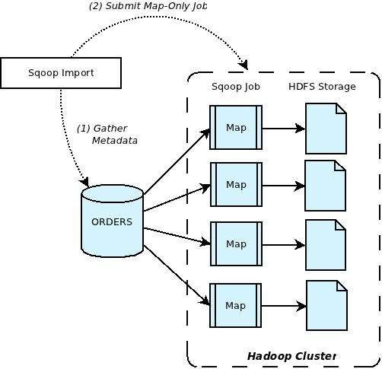
How Sqoop Works?

Slide 7
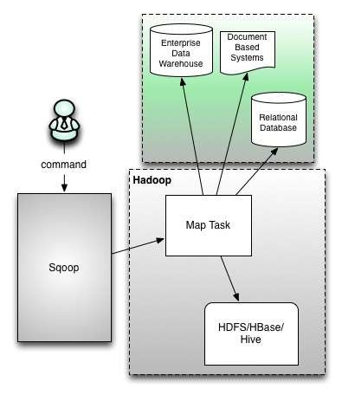
Sqoop Architecture

Slide 8
Sqoop Processing
Sqoop runs in Hadoop Cluster
Sqoop has access to Hadoop Core
Using Mappers to slice the incoming data
Data is placed to HDFS
Import
From RD/NoSQL to Hadoop
Export
From Hadoop to RD/NoSQL

Slide 9
SLICING THE DATA
The dataset being transferred is sliced up into different partitions.
A map-only job is launched with individual mappers responsible for transferring a slice of this dataset.
Each record of the data is handled in a type safe manner since Sqoop uses the database metadata to infer the data types.

Slide 10
Sqoop Import
Sqoop import: a tool for importing tables from RDBMS to HDFS.
each row in a table is considered as a record in HDFS.
must specify a connect string that describes how to connect to the DB.
communicated to Sqoop with the –connect argument
defines the server and database to connect to;
specify the port.

Slide 11
Syntax and Example
Sqoop Import Syntax-
$ sqoop import (generic-args) (import-args) $ sqoop-import (generic-args) (import-args)
For example: $ sqoop import –connect jdbc:mysql://database.example.com/employees

Slide 12
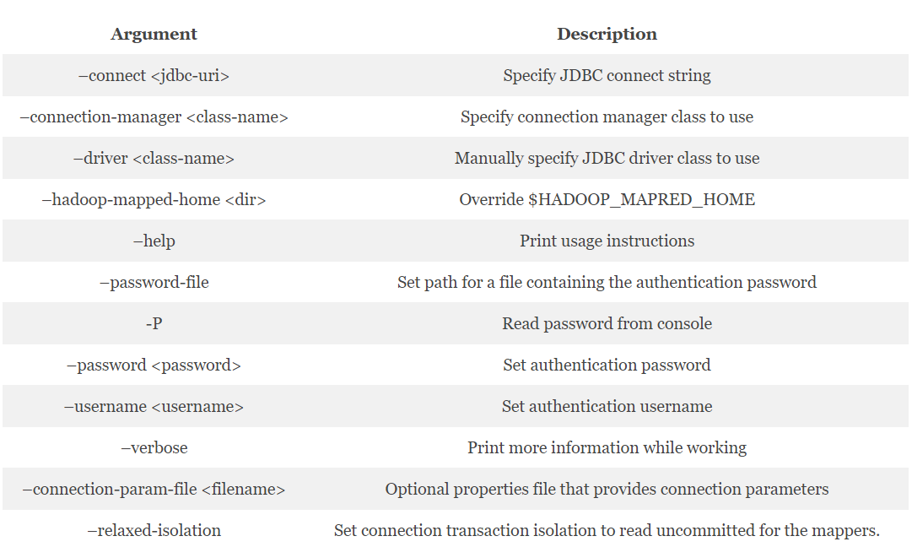
Sqoop Import table arguments

Slide 13
Import All Tables
Imports set of tables from RDBMS to HDFS.
Each table must have a single column primary key.
Imports all the columns of table
Non-default splitting of the columns or ocnditions mustn’t be used.
SYNTAX –
$ sqoop-import-all-tables (generic-args) (import-args)
$ sqoop import-all-tables (generic-args) (import-args)
EXAMPLE -
$ sqoop import-all-tables --connect jdbc:mysql://db.foo.com/corp
$ hdfs dfs -ls
Found 4 items
drwxr-xr-x - someuser somegrp 0 2010-04-27 17:15 /user/someuser/EMPLOYEES
drwxr-xr-x - someuser somegrp 0 2010-04-27 17:15 /user/someuser/PAYCHECKS
drwxr-xr-x - someuser somegrp 0 2010-04-27 17:15 /user/someuser/DEPARTMENTS
drwxr-xr-x - someuser somegrp 0 2010-04-27 17:15 /user/someuser/OFFICE_SUPPLIES

Slide 14
Selecting the data to import
Imports data in table centric fashion
To select the table : -- table
Example : --table employees
By default all columns are selected for import
To select subset of columns : --columns
Example : --columns "name,employee_id,jobtitle“
Control which rows to import by adding a SQL WHERE clause to the import statement.
By default, Sqoop generates statements of the form SELECT <column list> FROM <table name>.
For example: --where "id > 400".
Only rows where the id column has a value greater than 400 will be imported.

Slide 15
Free-form query imports
Instead of using the --table, --columns and --where arguments, specify a SQL statement with the --query argument.
must specify a destination directory with --target-dir.
to import the results of a query in parallel
each map task will need to execute a copy of the query
results partitioned by bounding conditions inferred by Sqoop.
query must include $CONDITIONS which each process will replace with a unique condition expression
select a splitting column with --split-by.
For example:
$ sqoop import \
--query 'SELECT a.*, b.* FROM a JOIN b on (a.id == b.id) WHERE $CONDITIONS' \
--split-by a.id --target-dir /user/foo/joinresults

Slide 16
Controlling Parallelism
Sqoop imports data in parallel from most database sources.
-m or --num-mappers argument : specify the number of map tasks (parallel processes)
Each of these arguments takes an integer value which corresponds to the degree of parallelism
By default, four tasks are used.
Do not increase the degree of parallelism -
greater than that available within your MapReduce cluster
higher than that which your database can reasonably support

Slide 17
Sqoop uses a splitting column to split the workload when performing parallel imports.
Set mappers: If the source table has a primary key, explicitly set the number of mappers using --num-mappers.
Split by: If primary keys are not evenly distributed, provide a split key using --split-by
Sequential: If you do not have a primary key or split key, import data sequentially using --num-mappers 1 or --autoreset-to-one-mapper in query.

Slide 18
By default, Sqoop will identify the primary key column is used as the splitting column.
For example
a table with a primary key column of id
minimum value - 0
maximum value - 1000,
Sqoop directed to use 4 tasks
Sqoop would run four processes which each execute SQL statements of the form
SELECT * FROM sometable WHERE id >= low AND id < high
with (low, high) set to (0, 250), (250, 500), (500, 750), and (750, 1001)
If the actual values for the primary key are not uniformly distributed across its range
Use the --split-by argument.
For example, --split-by employee_id.

Slide 19
Controlling the import process
By default, the import process will use JDBC
mysqldump tool : exports data from MySQL to other systems very quickly.
By default, Sqoop will import
>a table named foo
>to a directory named foo inside your home directory in HDFS.
For example - if your username is someuser, the import tool will write to /user/someuser/foo/(files).
--warehouse-dir : Adjust the parent directory of the import
For example:
$ sqoop import --connect <connect-str> --table foo --warehouse-dir /shared \
This command would write to a set of files in the /shared/foo/ directory.

Slide 20
You can also explicitly choose the target directory
$ sqoop import --connnect <connect-str> --table foo --target-dir /dest \
This will import the files into the /dest directory.
--target-dir is incompatible with --warehouse-dir.

Slide 21
Incremental Imports
Incremental import - to retrieve only newer rows than some previously-imported set of rows.
Arguments and Description
--check-column (col) : Specifies the column to be examined when determining which rows to import.
(the column should not be of type CHAR/NCHAR/VARCHAR/VARNCHAR/ LONGVARCHAR/LONGNVARCHAR)
--incremental (mode) : Specifies how Sqoop determines which rows are new. Legal values for mode include append and lastmodified.
--last-value (value) : Specifies the maximum value of the check column from the previous import.

Slide 22
Types of incremental import
Sqoop supports two types of incremental imports:
1. append :- used when rows in a source table in DB get inserted regularly
the table must have a numeric primary key
if not then a numeric –split-by column that is used in absence of numeric primary key.
For example :
$sqoop import –connect jdbc://mysql:/localhost/DB_name –user username –password pasword –table tablename –incremental append –check-column colname –last-value 100

Slide 23
2. lastmodified :-
used when rows in a source table in DB get updated regularly
the table must have a numeric primary key, if not then a numeric –split-by column that is used in absence of numeric primary key.
For example -
$sqoop import –connect jdbc://mysql:/localhost/DB_name –username username –password pasword –table tablename –incremental lastmodified –check-column colname –last-value “yyyy-mm–dd 0000:00:0”

Slide 24
File Formats
Data can be imported in one of two file formats: delimited text or SequenceFiles.
Delimited text
default import format. Specified explicitly by --as-textfile argument.
Example of text-based import:
1,here is a message,2019-01-01
2,happy new year!,2019-01-01
3,another message,2019-01-01
appropriate for most non-binary data types.
readily supports further manipulation by tools, such as Hive.
SequenceFiles –
binary format that store individual records in custom record-specific data types.
These data types are manifested as Java classes automatically generated by Sqoop.
Supports exact storage of all data in binary representations

Slide 25
Importing data into Hive
The import can include the following information :
For Example:
Database connection information: database URI, database name, and connection protocol, such as jdbc:mysql:
The data to import
Parallel processing directives for performant data transfer
Destination for imported data

Slide 26
To Connect and Login -
To enter a password for the data source on the command line, use the -P option in the connection string.
$ sqoop import --connect jdbc:mysql://db.foo.com:3306/bar \
<data to import> \
--username <username> \
-P
To specify a file where the password is stored, use the --password-file option.
$ sqoop import --connect jdbc:mysql://db.foo.com:3306/bar \
--table EMPLOYEES \
--username <username> \
--password-file ${user.home}/.password

Slide 27
Specify the data to import in the command.
Entire table:
$ sqoop import \
--connect jdbc:mysql://db.foo.com:3306/bar \
--table EMPLOYEES
Subset of columns:
$ sqoop import
--connect jdbc:mysql://db.foo.com:3306/bar \
--table EMPLOYEES \
--columns "employee_id,first_name,last_name,job_title"
Free-form query to import the latest data:
$ sqoop import \
--connect jdbc:mysql://db.foo.com:3306/bar \
--table EMPLOYEES \
--where "start_date > ‘2019-01-23'"

Slide 28
Optionally, control parallelism
Set mappers:
$sqoop import --connect jdbc:mysql://db.foo.com:3306/bar \
--table EMPLOYEES \
--num-mappers 8 \
Split by:
$sqoop import --connect jdbc:mysql://db.foo.com:3306/bar \
--table EMPLOYEES \
--split-by dept_id

Slide 29
--hive-import - Specify importing the data into Hive using Hive default delimiters by specifying the import option.
Specify the Hive destination of the data.
--hive-table - If the table does not already exist in Hive, name the table using <db>.<table_name> and use the --create-hive-table option.
To insert the imported data into an existing Hive external table,
name the table using --hive-table <db>.<table_name>.
Do not use the --create-hive-table option.

Slide 30
Command Example
To imports the MySQL EMPLOYEES table to a new Hive table
named in the default HDFS location /user/hive/warehouse.
$ sqoop import --connect jdbc:mysql://db.foo.com:3306/corp \
--table EMPLOYEES \
--hive-import \
--create-hive-table \
--hive-table mydb.newtable

Slide 31
Command example
To imports the MySQL EMPLOYEES table to an external table in HDFS.
$ sqoop import --connect jdbc:mysql://db.foo.com:3306/corp \
--table EMPLOYEES \
--hive-import \
--hive-table mydb.myexternaltable

Slide 32
Sqoop import in HBase
used to transform a relational database schema into an HBase schema.
import data from an RDBMS or data warehouse directly into Hbase.
Sqoop doesn’t now permit to import, all at once, a relational table directly into an HBase table having multiple column families.
To work around this limitation, create the HBase table first and then execute three Sqoop import operations to finish the task.

Slide 33
Create table into Hbase :
hbase(main):017:0> create 'customercontactinfo', 'CustomerName',
hbase(main):018:0* 'ContactInfo', 'ProductNums'
target HBase column family specified by the –column-family and corresponding MySQL columns specified by the –columns
customernum primary key also becomes the HBase row key, as specified by the –hbase-row-key

Slide 34
command
$ sqoop import
--connect jdbc:mysql://localhost/serviceorderdb
--username root -P
--table customercontactinfo
--columns "customernum,customername"
--hbase-table customercontactinfo
--column-family CustomerName
--hbase-row-key customernum -m 1
To see the table :
hbase(main):033:0> scan 'customercontactinfo'

Slide 35
SQOOP EXPORT
To export data back from the HDFS to the RDBMS database
The target table must exist in the target database.
Syntax -
$ sqoop export (generic-args) (export-args)
$ sqoop-export (generic-args) (export-args)

Slide 36
Common arguments
Argument Description
--connect <jdbc-uri> Specify JDBC connect string
--connection-manager <class-name> Specify connection manager class to use
--driver <class-name> Manually specify JDBC driver class to use
--hadoop-home <dir> Override $HADOOP_HOME
--help Print usage instructions
-P Read password from console
--password <password> Set authentication password
--username <username> Set authentication username
--verbose Print more information while working
--connection-param-file <filename> Optional properties file that provides connection parameters

Slide 37
Export Control Arguments
--direct Use direct export fast path
--export-dir <dir> HDFS source path for the export
-m,--num-mappers <n> Use n map tasks to export in parallel
--table <table-name> Table to populate
--update-key <col-name> Anchor column to use for updates. Use a comma separated list of columns if there are more than one column.
--update-mode <mode> Specify how updates are performed when new rows are found with non-matching keys in database.
--input-null-string <null-string> The string to be interpreted as null for string columns
--input-null-non-string <null-string> The string to be interpreted as null for non-string columns
NOTE THAT the --table and --export-dir arguments are required.

Slide 38
Example
A basic export to populate a table named bar:
This example takes the files in /results/bar_data and injects contents in to the bar table in the foo database on db.example.com.
$ sqoop export --connect jdbc:mysql://db.example.com/foo --table bar \
--export-dir /results/bar_data

Slide 39
Inserts v/s Updates
By default, sqoop-export appends new rows to a table;
Each input record is transformed into an INSERT statement that adds a row to the target database table.
Specifying the --update-key argument, it will instead modify an existing dataset in the database.
Each input record is treated as an UPDATE statement that modifies an existing row.

Slide 40
Example
Consider the table
CREATE TABLE foo(
id INT NOT NULL PRIMARY KEY,
msg VARCHAR(32),
bar INT);
Consider also a dataset in HDFS containing records like these:
0,this is a test,42
1,some more data,100
$ sqoop-export (generic args) --table foo --update-key id --export-dir /path/to/data
It will run an export job that executes SQL statements like :
UPDATE foo SET msg='this is a test', bar=42 WHERE id=0;
UPDATE foo SET msg='some more data', bar=100 WHERE id=1;

Slide 41
SQOOP JOBS
To create and work with saved jobs.
Saved jobs remember the parameters used, so they can be re-executed by invoking the job by its handle.
$ sqoop job (generic-args) (job-args) [-- [subtool-name] (subtool-args)]
$ sqoop-job (generic-args) (job-args) [-- [subtool-name] (subtool-args)]
--create <job-id> Define a new saved job with the specified job-id (name)
--delete <job-id> Delete a saved job.
--exec <job-id> Given a job defined with --create, run the saved job.
--show <job-id> Show the parameters for a saved job.
--list List all saved jobs

Slide 42
Command Usage and Example
Create a job named myjob which can be executed later.
$ sqoop job --create myjob -- import --connect jdbc:mysql://example.com/db \
--table mytable
To see the list of saved jobs:
$ sqoop job --list
Available jobs:
myjob

Slide 43
Inspection of Job
We can inspect the configuration of a job with the show action:
$ sqoop job --show myjob
Job: myjob
Tool: import
Options:
----------------------------
direct.import = false
codegen.input.delimiters.record = 0
hdfs.append.dir = false
db.table = mytable
...

Slide 44
Running the job
we can run the job with exec:
$ sqoop job --exec myjob
10/08/19 13:08:45 INFO tool.CodeGenTool: Beginning code generation
..
if the database were changed to require a username, we could specify the username and password with:
$ sqoop job --exec myjob -- --username someuser -P
Enter password:
...

Slide 45
THANK YOU

