Slide 1
EXPLORATORY DATA ANALYSIS GRAMENAR CASE STUDY SUBMISSION
Group Name:
Deepak Aneja
Suresh Balla
Merin Jose
Fayiz Mayam Veettil
28 Jan 2018

Slide 2
Business Objectives and Types of Risks
Business Objective
Identify the risk analytics in banking and financial services and understand how data is used to minimize the risk of losing money while lending to customers
Strategy
The company has to make a decision for loan approval based on the applicant’s profile
Types of Risks
If the applicant is likely to repay the loan, then not approving the loan results in a loss of business
If the applicant is not likely to repay the loan, then approving the loan may lead to a financial loss

Slide 3
Data Exploration
Dataset
Contains the information about past loan applicants whether they ‘defaulted’ or not
Approx. 40,000 loan applicants records from Jun ’07 to Dec ‘11
3 possible scenarios for accepted loans
Fully Paid: Applicant has fully paid the loan
Current: Applicant is in the process of paying the instalments
Charged-off: Defaulted applicant
Rejected loans not considered
The aim is to identify patterns which indicate if a person is likely to default, which may be used for taking actions such as denying the loan, reducing the amount of loan, lending (to risky applicants) at a higher interest rate, etc.

Slide 4
Step by Step Approach for Analysis
Cleaning and formatting data
Derive useful metrics out of data
Check the data density and correlations
Univariate Analysis
Bivariate Analysis
Conclusion

Slide 5
Data Cleaning and Manipulation
Check for possible data inconsistencies
Check for duplicate records
Check for NA values in the columns used for analysis
Status of data cleaning
No duplicate records found
Only 40 columns used out of 111 columns and the rest are removed
Uses the column ‘loan_status’ as targeted variable

Slide 6
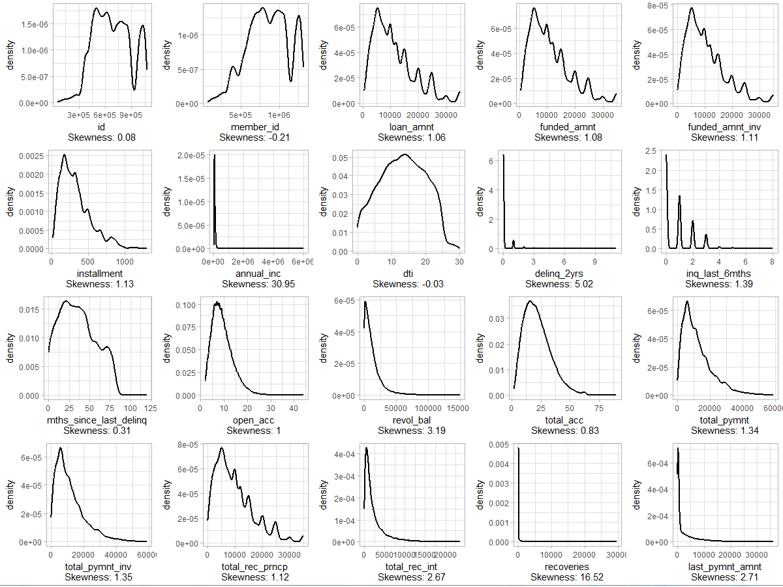
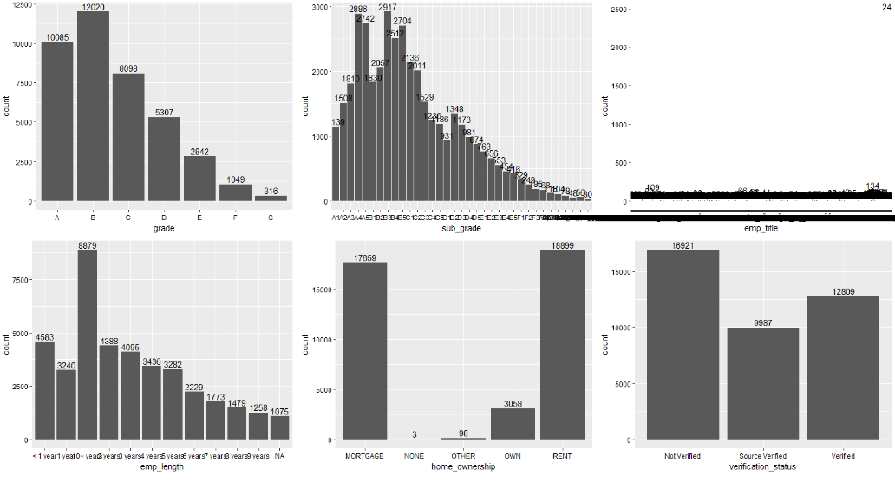
Data Density
Data density check on both numerical and categorical data for further analysis

Slide 7
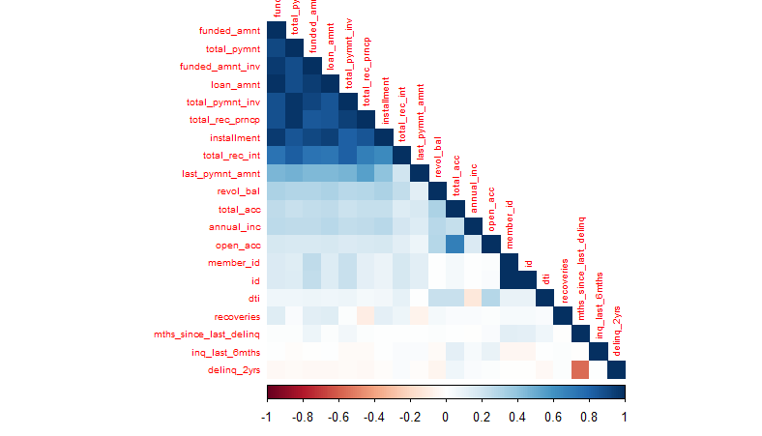
Data Correlation
Check the correlation between each numerical variable for further analysis

Slide 8
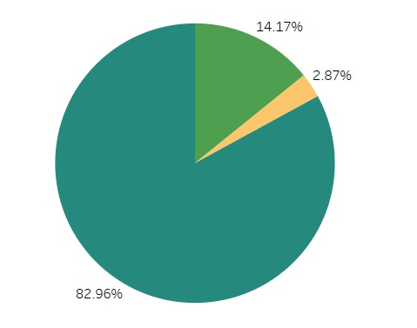
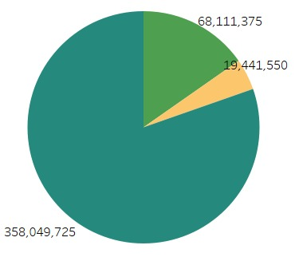
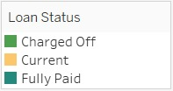
Univariate Analysis (Loan status)
charged off v/s fully paid
14.18% of Loans are charged off accounting to a loss of ~68M revenue

Slide 9
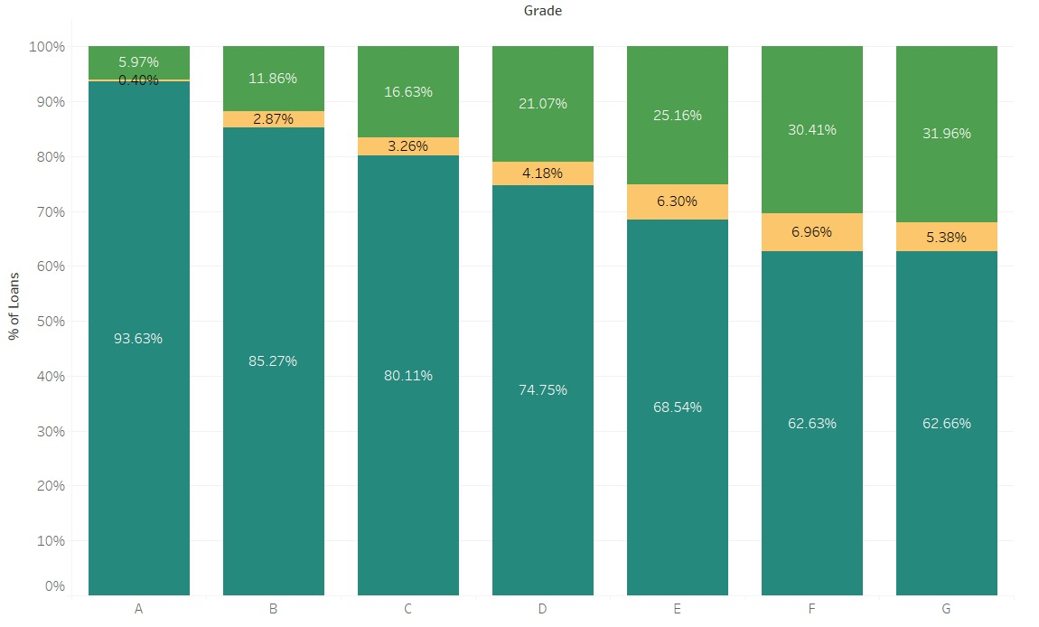
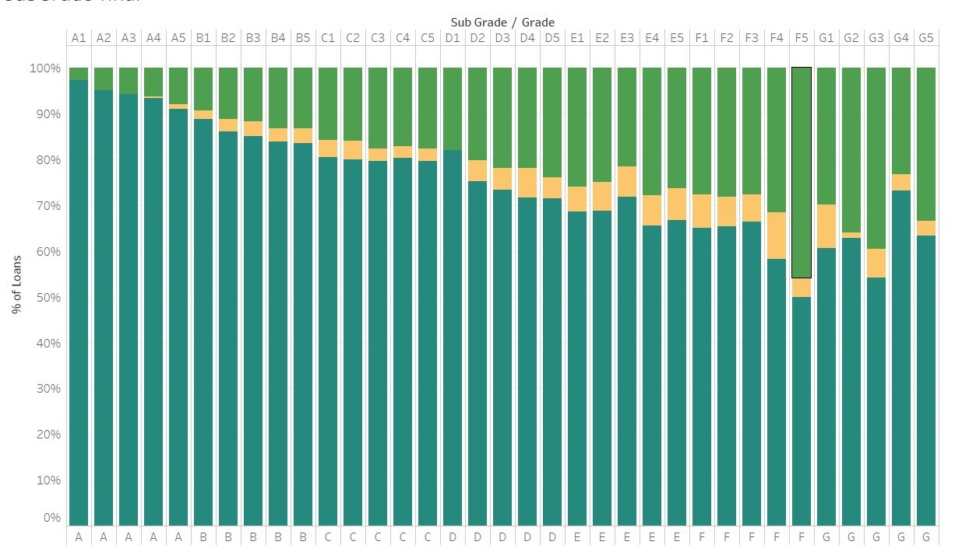
Bivariate Analysis (Grade)
Grade A to G shows an increasing trend to default with grade A showing 5.97% defaults and grade G showing 31.96% of defaults
Following Grade, Sub grade also shows a similar trend with number of defaulters increasing from A to G

Slide 10
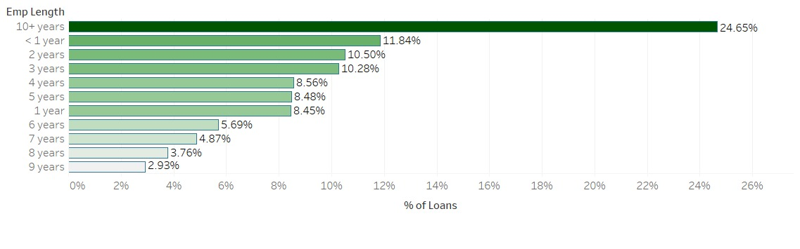
Bivariate Analysis (Employment length)
Out of all the defaulters, this is the contribution from each employment length. Ignoring 10+ as this is a far bigger bucket than the rest with possibly higher observations. Considering the rest, we observe that with longer employment length has less probability of defaulting

Slide 11
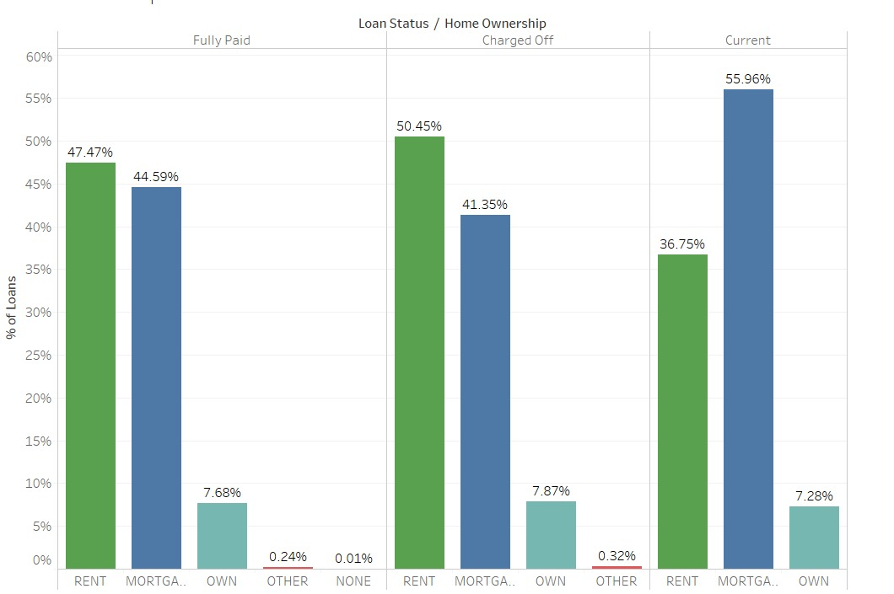
Bivariate Analysis (Applicants’ home ownership)
Home Ownership seems to have an impact on defaulting as ~50% of the defaulters have rented accommodation & ~41% have mortgage with lower share of ~7% as that of people with own accommodation

Slide 12
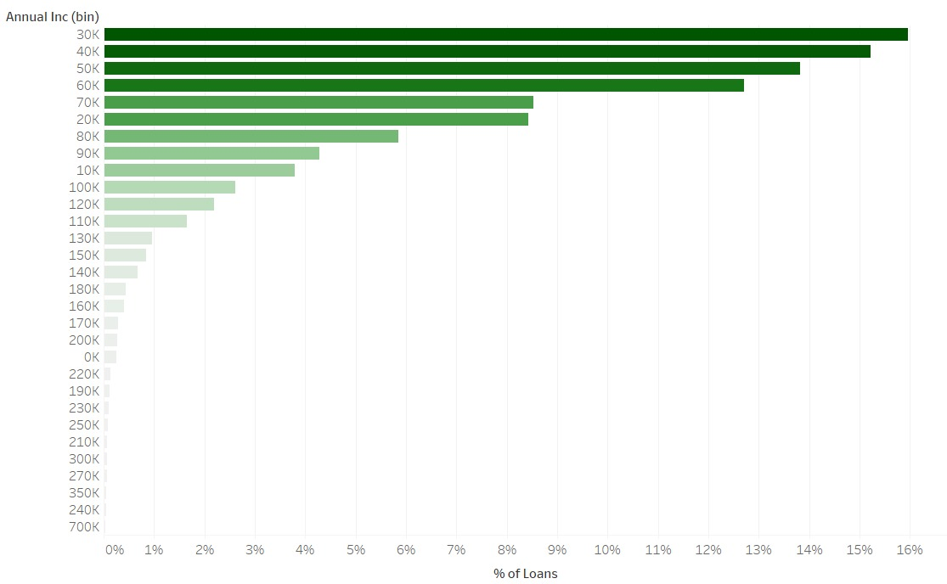
Bivariate Analysis (Annual income)
In terms of Annual Income, it looked like higher the annual income, lower the chances of defaulting

Slide 13
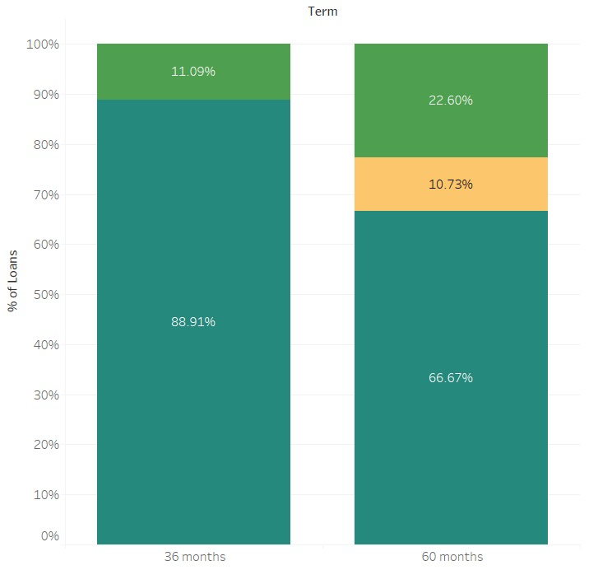
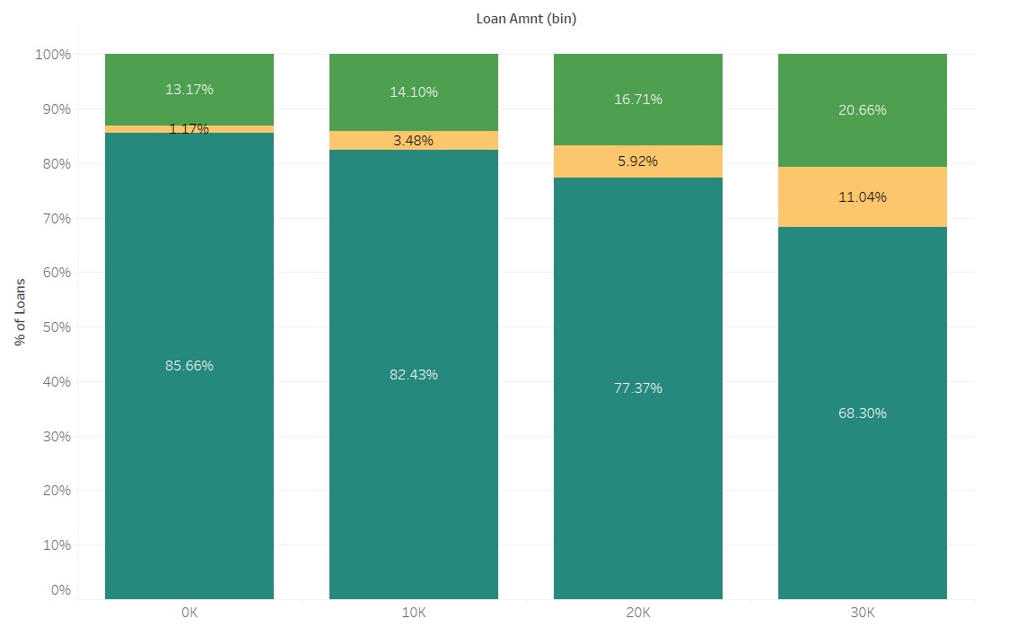
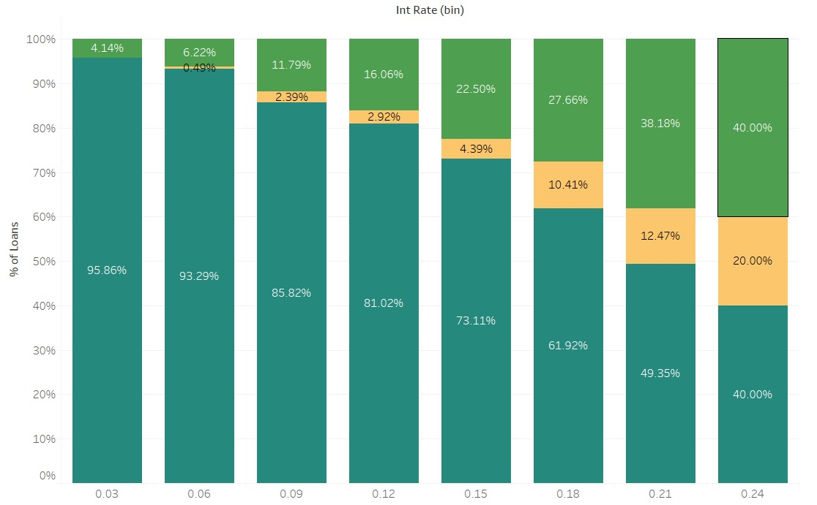
Bivariate Analysis (Terms, loan amount and interest rate)
Looks like people opting for longer loan terms have higher chances of defaulting
It looks like people opting for longer loan amount have higher chances of defaulting
Higher interest rate shows an increased number of people defaulting

Slide 14
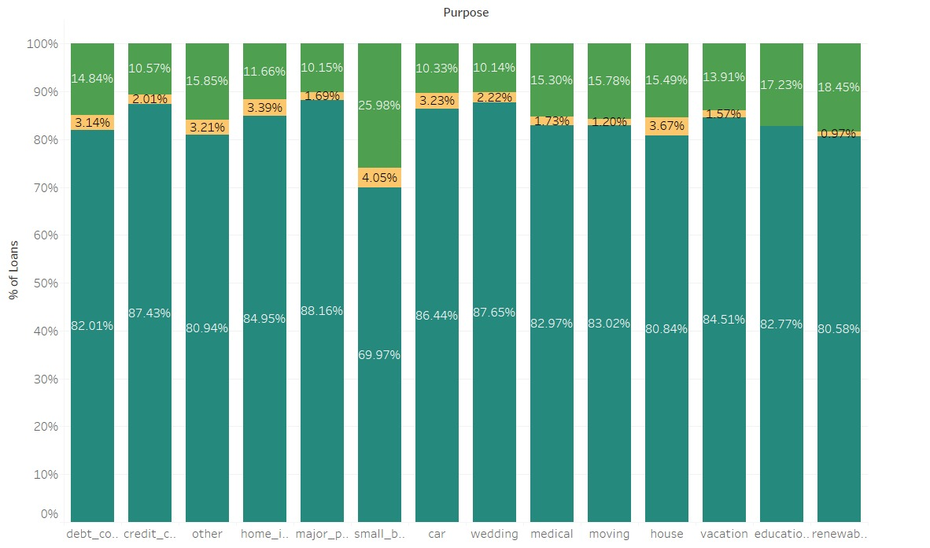
Bivariate Analysis (Purpose of loans)
Although, the purpose for which loans are availed did not show a trend in terms of defaulting. There was a remarkable ~25% case of default when the loan was being availed for 'small business'

Slide 15
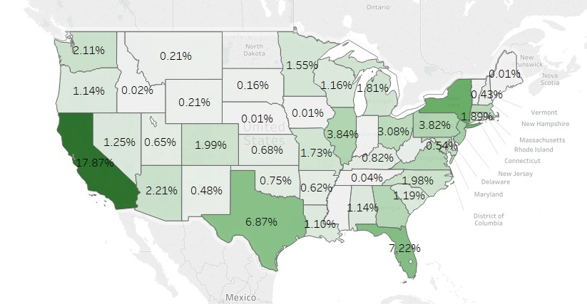
Bivariate Analysis (Demographic)
In terms of Country, California, Texas, Florida and New York seemed to have an higher ratio of defaulters compared to the rest of the states

Slide 16
Conclusion
From the analysis we have found the below variables should be considered while lending
Grade & Sub-Grade of the applicants
Applicants employment length
Applicants Home Ownership type
Loan terms, Amount, Interest Rates and Purpose
Applicants demographics
Annual Income

