Slide 1

PROJECT PRESENTATION
Submitted by- Paramvir Singh
Roll No.– 2021A1R173
Department– Computer Science and Engineering
Topic– Potato Disease Classification using Machine Learning
Submitted to - Sukhmeet Kour
Department of Computer Science & Engineering
Model Institute of Engineering & Technology (Autonomous), Jammu
10 – 12 – 2024
Roll No.- 2021A1R173

Slide 2
Contents
Introduction to Potato Diseases
Challenges in Manual Disease Identification
Overview of Conventional Neural Networks
Data Preparation and Preprocessing
CNN Architecture Design
Training the CNN Model
Evaluating Model Performance
Real-World Application and Deployment
Conclusion and Future Directions
Roll No.- 2021A1R173

Slide 3
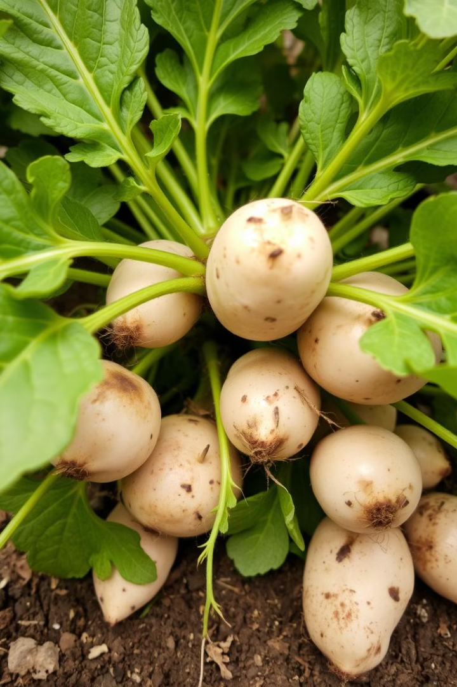
Introduction to Potato Diseases
Potato Blight
Potato blight is a common and destructive disease caused by the pathogen Phytophthora infestans. Symptoms include brown spots on leaves and stems, white mold on stems, and black rot on tubers.
Early Blight
Early blight is another common potato disease caused by the pathogen Alternaria solani. Symptoms include small, brown spots on leaves, which can eventually spread and cause wilting.
Roll No.- 2021A1R173

Slide 4
Challenges in Manual Disease Identification
Time-Consuming
Manual inspection of potato plants for diseases can be extremely time-consuming and labor-intensive, especially for large-scale farms.
Subjectivity
Disease identification can be subjective, leading to inconsistent diagnoses and potential misclassification.
Expertise Required
Accurate disease identification requires specialized knowledge and expertise, which may not be readily available in all agricultural settings.
Roll No.- 2021A1R173

Slide 5
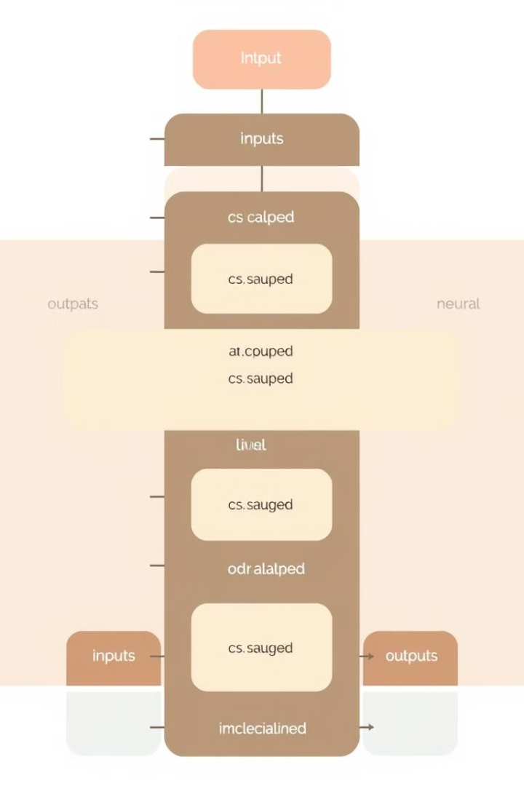
Overview of Conventional Neural Networks
Artificial Neurons
Neural networks are inspired by the structure and function of the human brain. They are composed of artificial neurons that process and transmit information.
Layered Architecture
Neural networks are typically organized into layers of interconnected neurons, allowing for complex data processing and pattern recognition.
Learning Through Data
Neural networks learn through training, where they are fed large amounts of data and adjust their internal parameters to improve their performance.
Roll No.- 2021A1R173

Slide 6
Data Preparation and Preprocessing
Image Collection
Gathering a large and diverse dataset of potato plant images, including both healthy and diseased plants, is crucial for training a reliable model.
Image Resizing
All images in the dataset are resized to a consistent size to ensure uniformity and efficient processing by the neural network.
Labeling
Each image in the dataset must be accurately labeled with the corresponding potato disease or healthy state for supervised learning.
Data Splitting
The dataset is divided into training, validation, and testing sets to evaluate the model's performance and avoid overfitting.
Roll No.- 2021A1R173

Slide 7
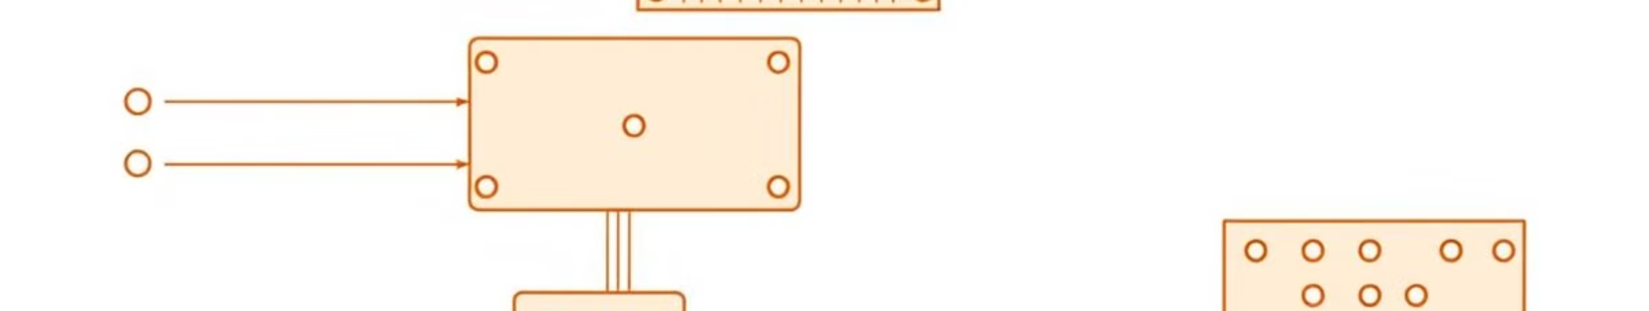
CNN Architecture Design
Convolutional Layers
Convolutional layers extract features from the input image by applying filters that detect patterns and edges.
Pooling Layers
Pooling layers reduce the spatial dimensions of the feature maps, reducing computational complexity and preventing overfitting.
Fully Connected Layers
Fully connected layers combine the extracted features and make predictions about the potato disease classification.
Roll No.- 2021A1R173

Slide 8

Training the CNN Model
Forward Propagation
Input images are passed through the CNN architecture, generating predictions based on the current model parameters.
Backpropagation
The difference between predicted and actual labels is calculated, and the model's weights are adjusted to minimize this error.
Epochs
The training process is repeated multiple times over the entire dataset, gradually improving the model's accuracy and performance.
Roll No.- 2021A1R173

Slide 9
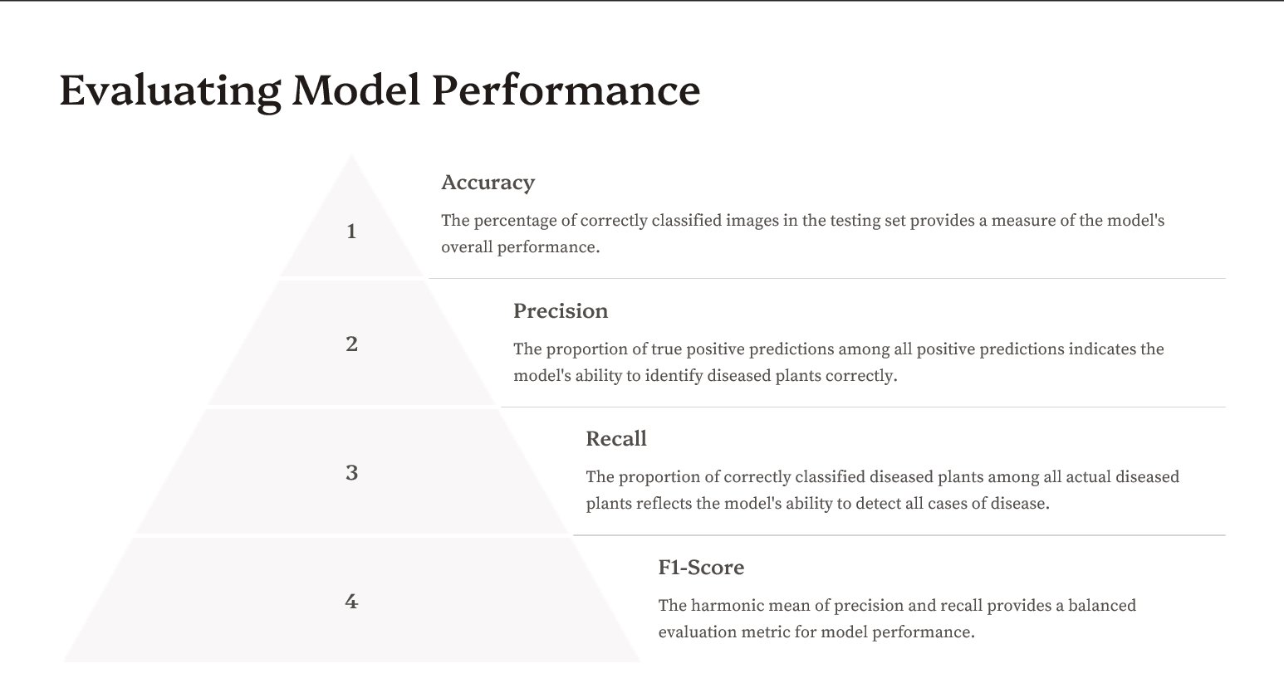
Evaluating Model Performance
Roll No.- 2021A1R173

Slide 10
Real-World Application and Deployment
App Development
A user-friendly mobile app can be developed to allow farmers to easily capture images of potato plants and receive real-time disease diagnoses.
Field Integration
The CNN model can be integrated into existing agricultural systems, providing early detection and timely interventions to prevent disease outbreaks.
Data Collection
Continued data collection from the field can be used to fine-tune the model and improve its accuracy over time.
Roll No.- 2021A1R173

Slide 11
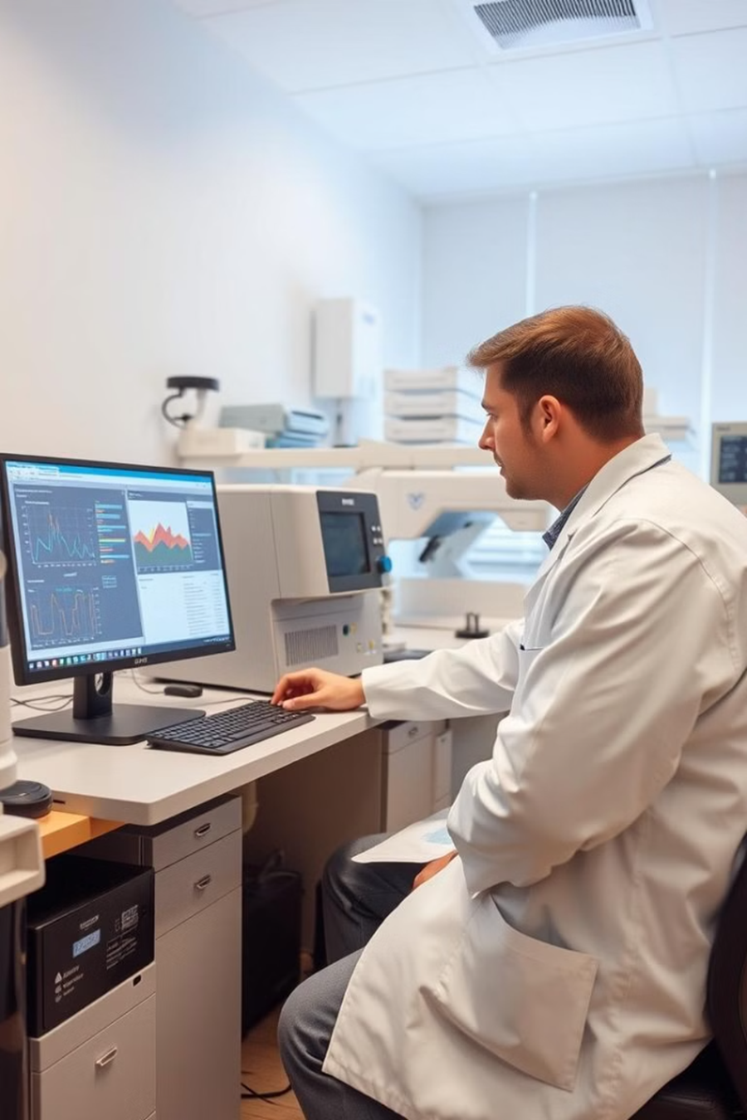
Conclusion and Future Directions
Conventional neural networks have proven to be effective in classifying potato diseases, offering a more accurate and efficient alternative to manual inspection. Further research and development can explore the use of more advanced deep learning architectures, such as recurrent neural networks (RNNs) and transformers, to enhance the model's capabilities and address the limitations of traditional CNNs. By leveraging these advancements, we can contribute to a more sustainable and efficient potato production system, benefiting farmers and consumers alike.
Roll No.- 2021A1R173

Slide 12
References
"Plant Village Dataset: An Open-Source Dataset for Plant Disease Classification" IEEE Access Paper
"Convolutional Neural Networks for Classification of Plant Disease Images" IJCA Paper
"Deep Learning for Plant Identification and Disease Detection" IEEE Access Paper
"A Survey of Deep Learning Techniques for Agriculture Crop Disease Detection" ScienceDirect Paper
"Automated Potato Disease Identification Using Deep Learning: A Survey" ScienceDirect Paper
"Deep Convolutional Neural Networks for Plant Disease Detection" ScienceDirect Paper
Roll No.- 2021A1R173

Slide 13
Thank You
Roll No.- 2021A1R173

