Slide 1

Tech Ring
We make the RIGHT choice for you….
ARTIFICIAL INTELLIGENCE BASED PERSONAL COMPUTER PARTS AND LAPTOPS RECOMMENDING ASSISTANT

Slide 2
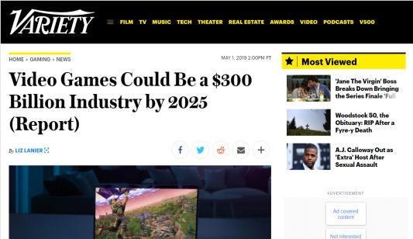
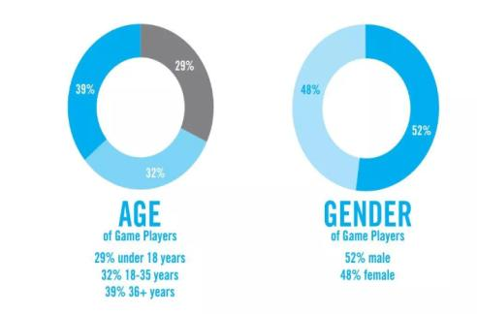
INTRODUCTION
Current Trend : Games demand specifications.
Gamers assemble their PC by themselves.
Source: https://variety.com/2019/gaming/news/video-games-300-billion-industry-2025-report-1203202672/

Slide 3
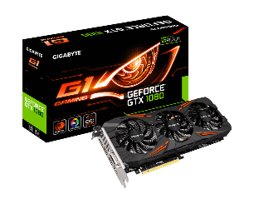

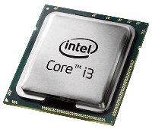
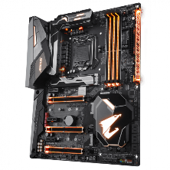
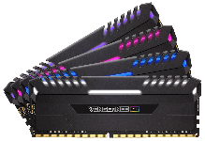




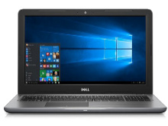
PROBLEM STATEMENT
How do I build a PC without having knowledge about Compatibility???
Consumers
Vendors
Why is it hard to find the BEST hardware ?
Spends 1.8+ Million for intermediary options.
Need to match the Requirement.
Compatibility issues.
Lacks Technical Knowledge.
Prefer Customer Experiences.
Budget limitations.
Vendor Options.
Confused due to numerous options.
Geographical boundaries.
Source: http://www.statistics.gov.lk/industry/ASI_2016_Report.pdf
3
Image source : http://www.pngmart.com/image/87246

Slide 4






Analyze customer’s Gaming Requirement.
Analyze customer feedback.
SOLUTION
Price Comparison & Optimization.
Laptops Comparison and recommendation.
Notes:
Our solution has four main sub research components
Helps User to identify compatible parts for gaming requirement
to get idea about product before purchasing
Compare local vendor price with global e commerce sites and choose the best price for a product
Compare computational power and choose the best one among them

Slide 5





FUNCTIONALITIES
Build Assembly Sequence plan customized according to the Game Specification.
Display multiple vendor options for each
Product.
Generate Assembly Plan according to the budget limitations
Capability to conduct Laptop comparison and Recommendation.
Display analyzed customer comments in
a Rating Format.
Notify Customer when there is a price drop

Slide 6
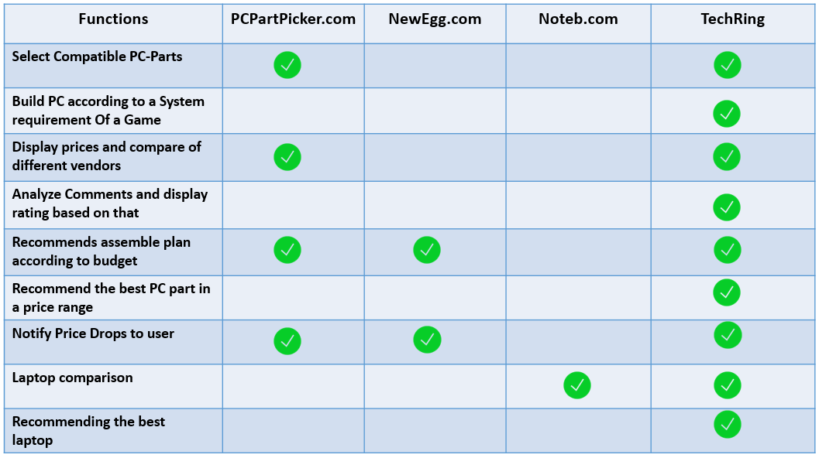
COMPETITION

Slide 7




BUSINESS PLAN.
Revenue on Sales.
5% Profit on each sale
Transaction Fee Revenue Model
QR Code Mechanism is used.
Membership
Subscription.
Annual membership subscription.
Subscription Revenue Model
Marketing Plan.
First Mover Advantage.
7

Slide 8
MARKET SIZE
Consumers
21.44 Million
Total Sri Lankan Population
4 Million
School Population (18%)
3.1 Million
Gaming Population in Sri Lanka (14%)
32% Web Sites users.
Local Vendors.
Placed 26th among the Industries in Sri Lanka.
32 establishments.
3226 People engaged.
This represent 0.15% of the total industries.
Source:http://www.statistics.gov.lk/industry/ASI_2016_Report.pdf

Slide 9
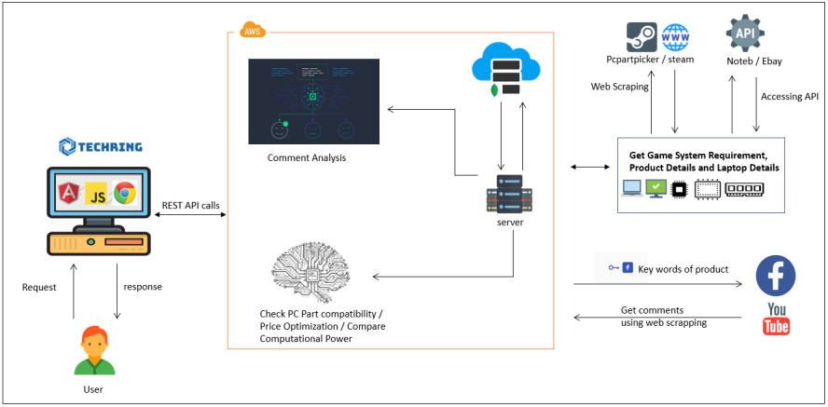
HIGH LEVEL SYSTEM DIAGRAM

Slide 10







USED TECHNOLOGIES
Technologies
Python 3.7.1
Java (spring boot framework)
Angular 6
NodeJS
Tools
Jupyter Notebook
Robo 3T
Microsoft Visual Studio Code
Spring Tool Suite
Database
MongoDB 4.0.0

Slide 11
DEMONSTRATION OF THE PRODUCT

Slide 13





OUR TEAM
Supervisor :
Prof. Koliya Pulasinghe
Team :
01
02
03
04
H.K.S.P. Gunadasa
Sewwandi E.D.D.
M.A.V.L. Gunathilaka
Tharaka K.K.S.
IT16010390
IT15146816
IT16055186
IT16054578

Slide 14

T H A N K YOU

