Slide 1
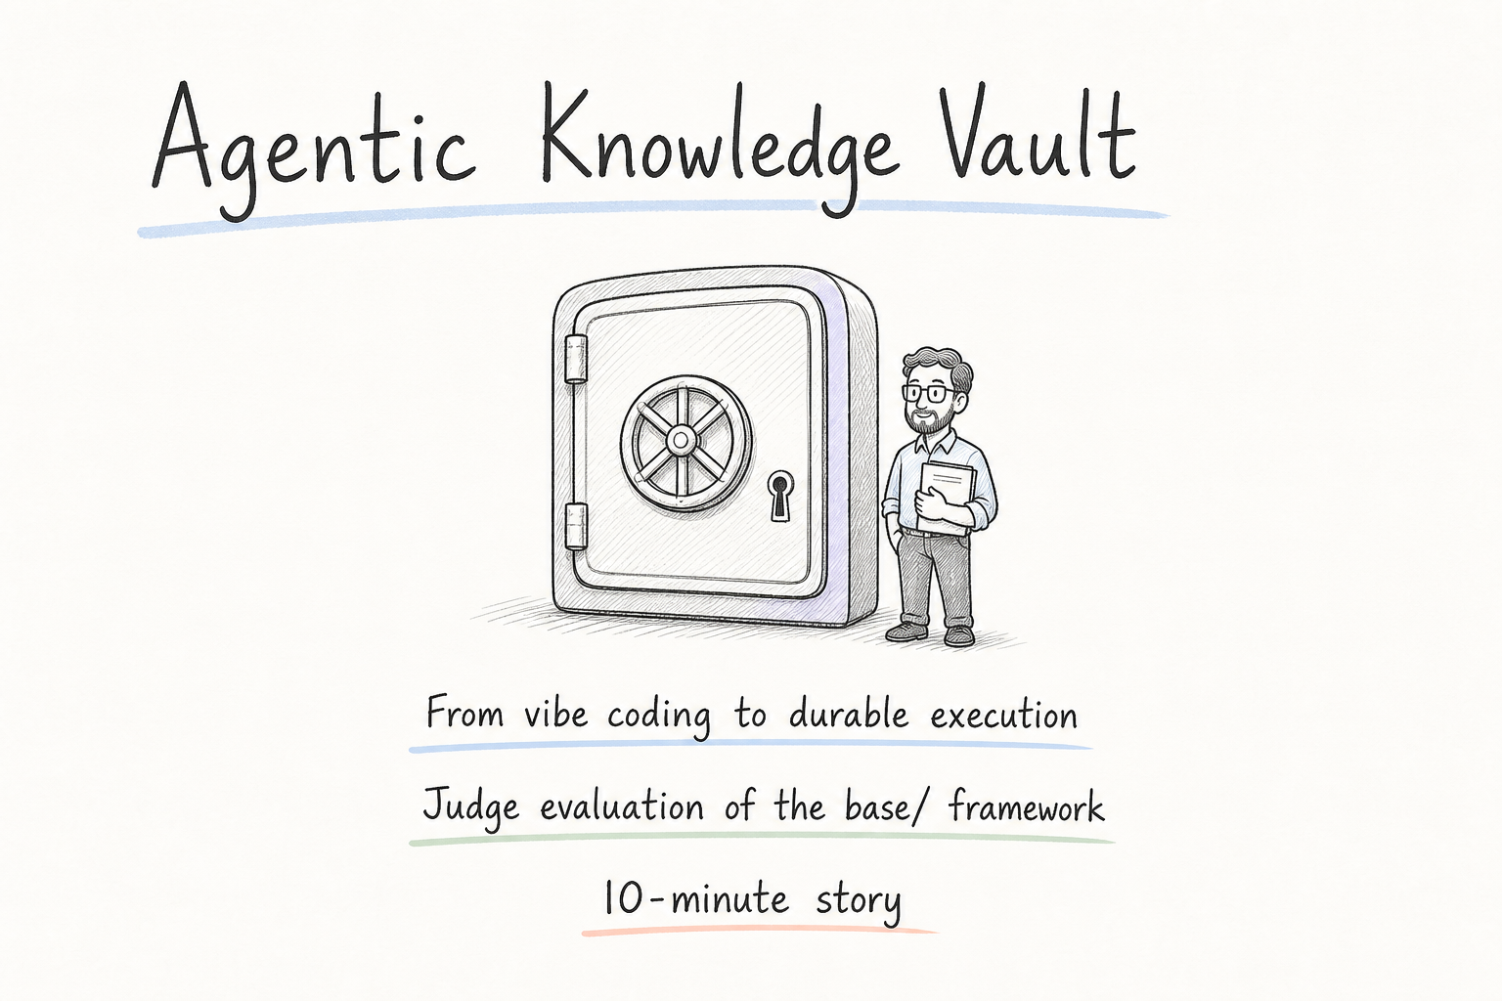
Notes:
Judges, thanks for the time. In the next ten minutes I want to show you why we moved beyond pure vibe coding, and what the Agentic Knowledge Vault framework actually changes. The short title on this page is the whole arc: from vibe coding to durable execution. The Service Bus work is our proof instance — the pattern itself is what we want you to evaluate.

Slide 2
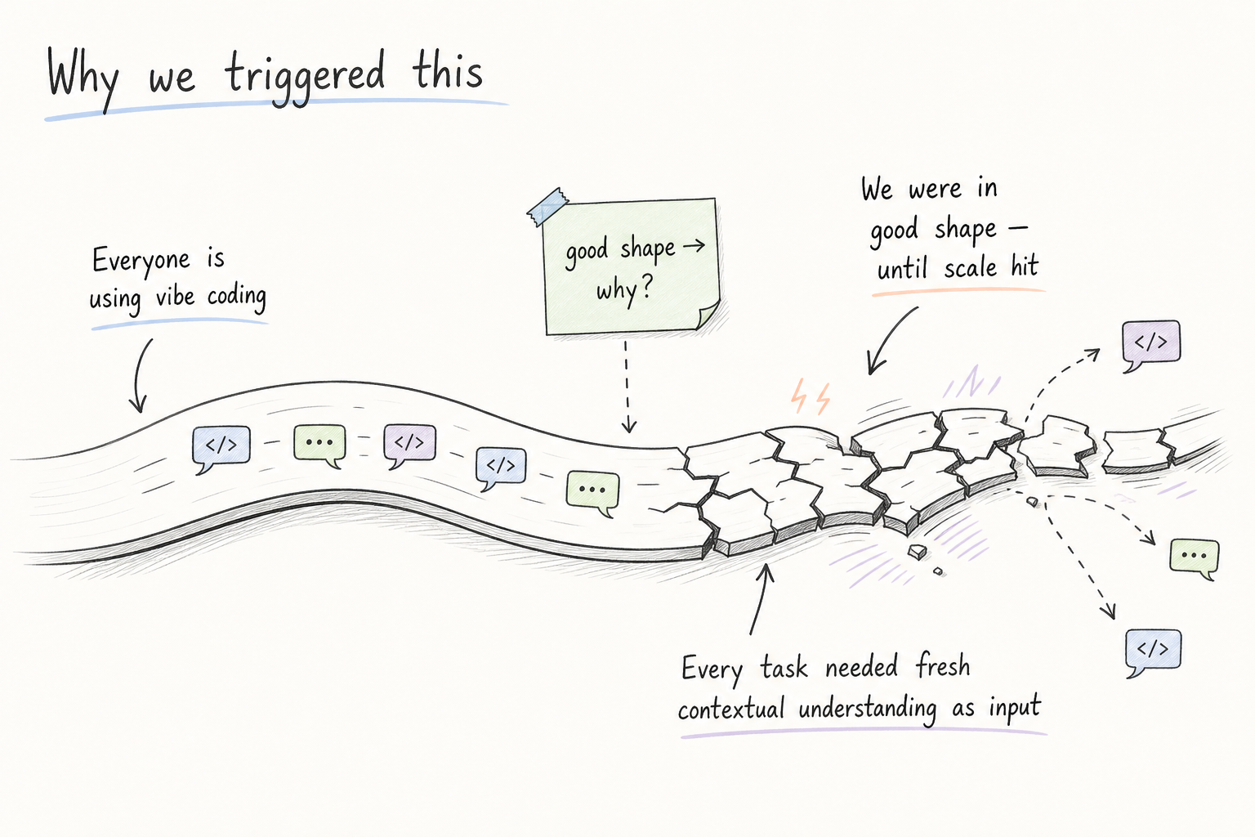
Notes:
Everyone is vibe coding now, and honestly we were in good shape with it. Velocity was high. The trigger was subtler: every new task still needed a fresh dump of contextual understanding as input. We were productive, but we were also re-teaching the system the same product reality over and over.

Slide 3
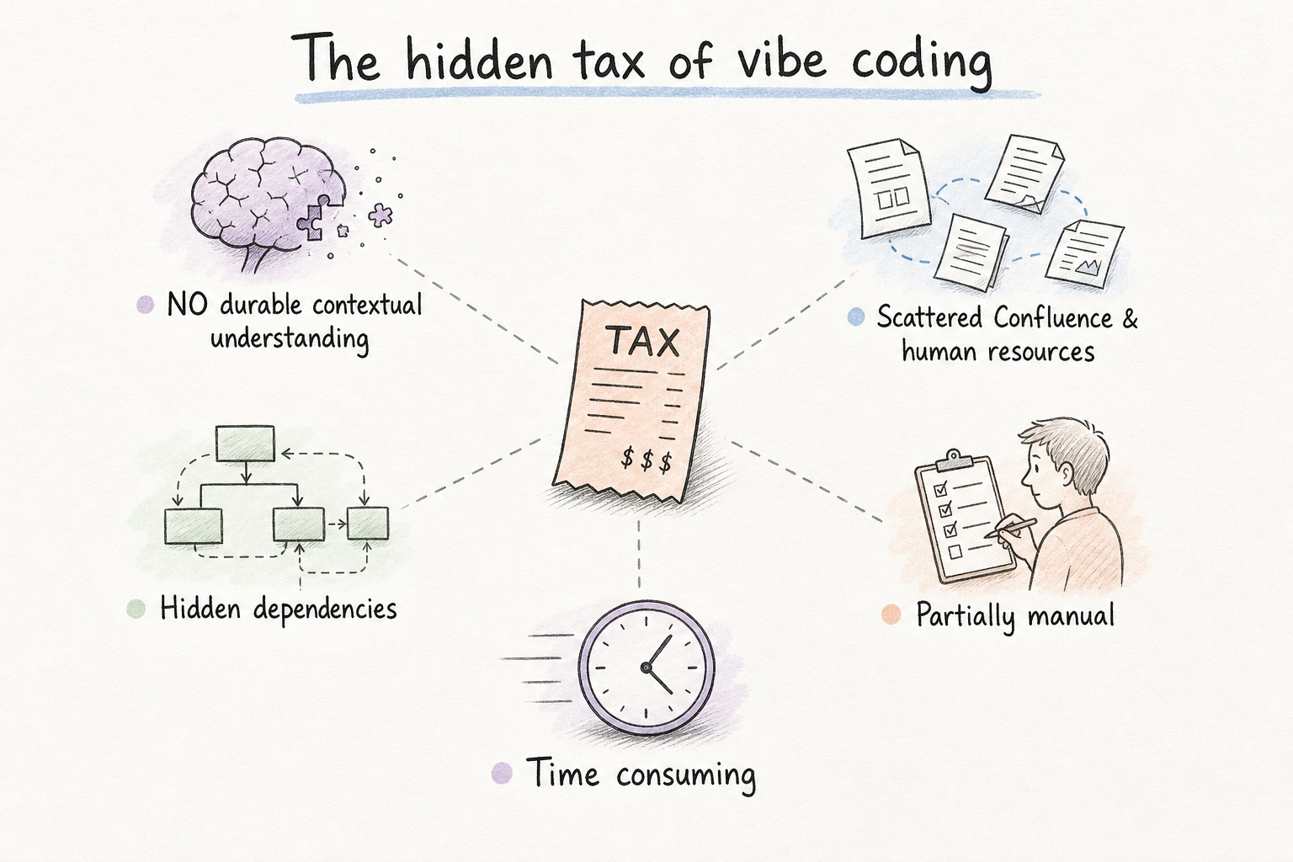
Notes:
That tax shows up in five places. There is no durable contextual understanding. Context is hard to grab — it lives in scattered Confluence pages and in people's heads. Dependencies are partial and hidden. Work stays partially manual. And rediscovery burns time. None of these is dramatic alone; together they slow every serious change.

Slide 4
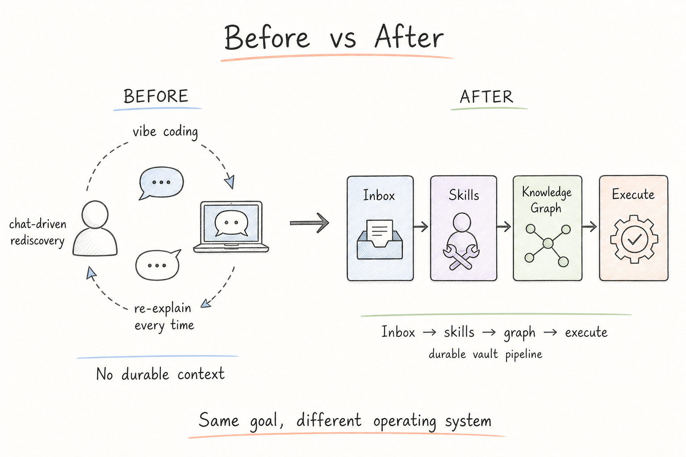
Notes:
So the operating model has to change. On the left, chat-driven rediscovery: re-explain, regenerate, hope the agent remembered. On the right, a durable pipeline: Inbox, skills and micro-workflows, knowledge graph, then execute. Same goal — get work done — different operating system.

Slide 5
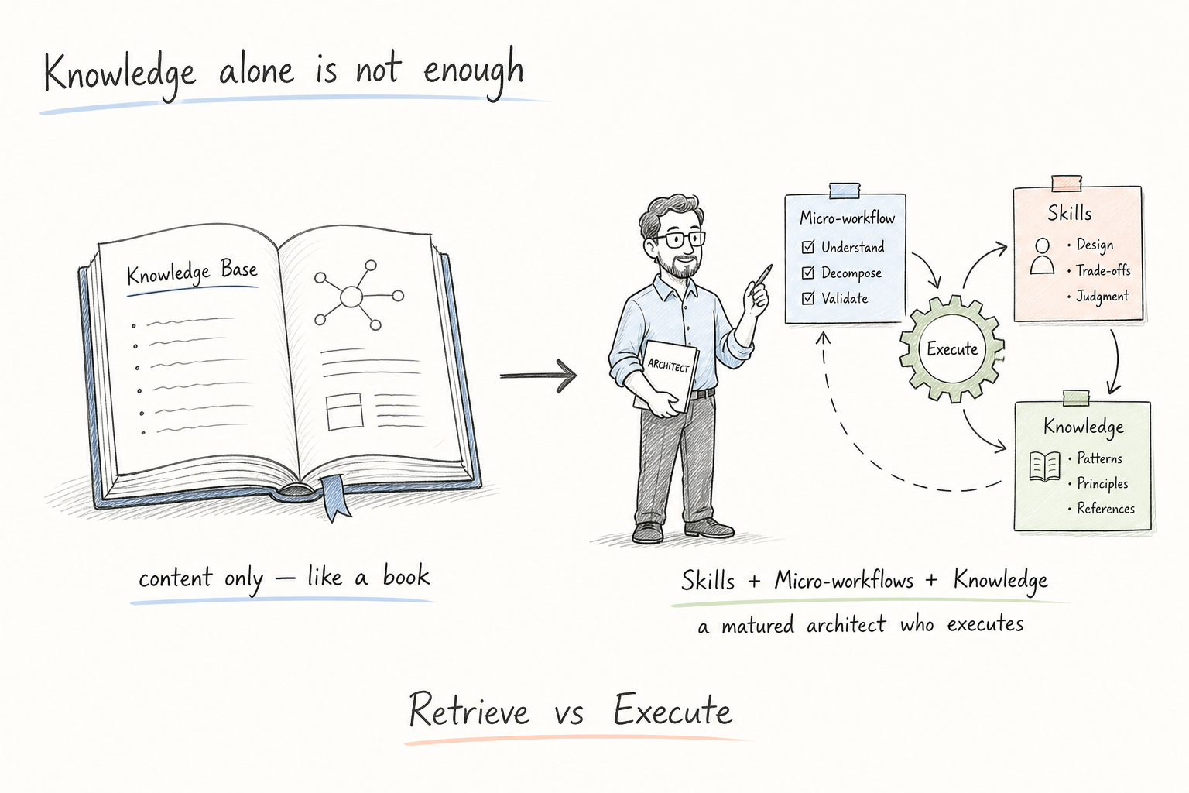
Notes:
Here is the core thesis. A knowledge base by itself is content — like a book. Useful, but passive. What we need is Skills plus Micro-workflows plus Knowledge: a matured architect that can execute. Retrieve is not enough. Execute is the point.

Slide 6
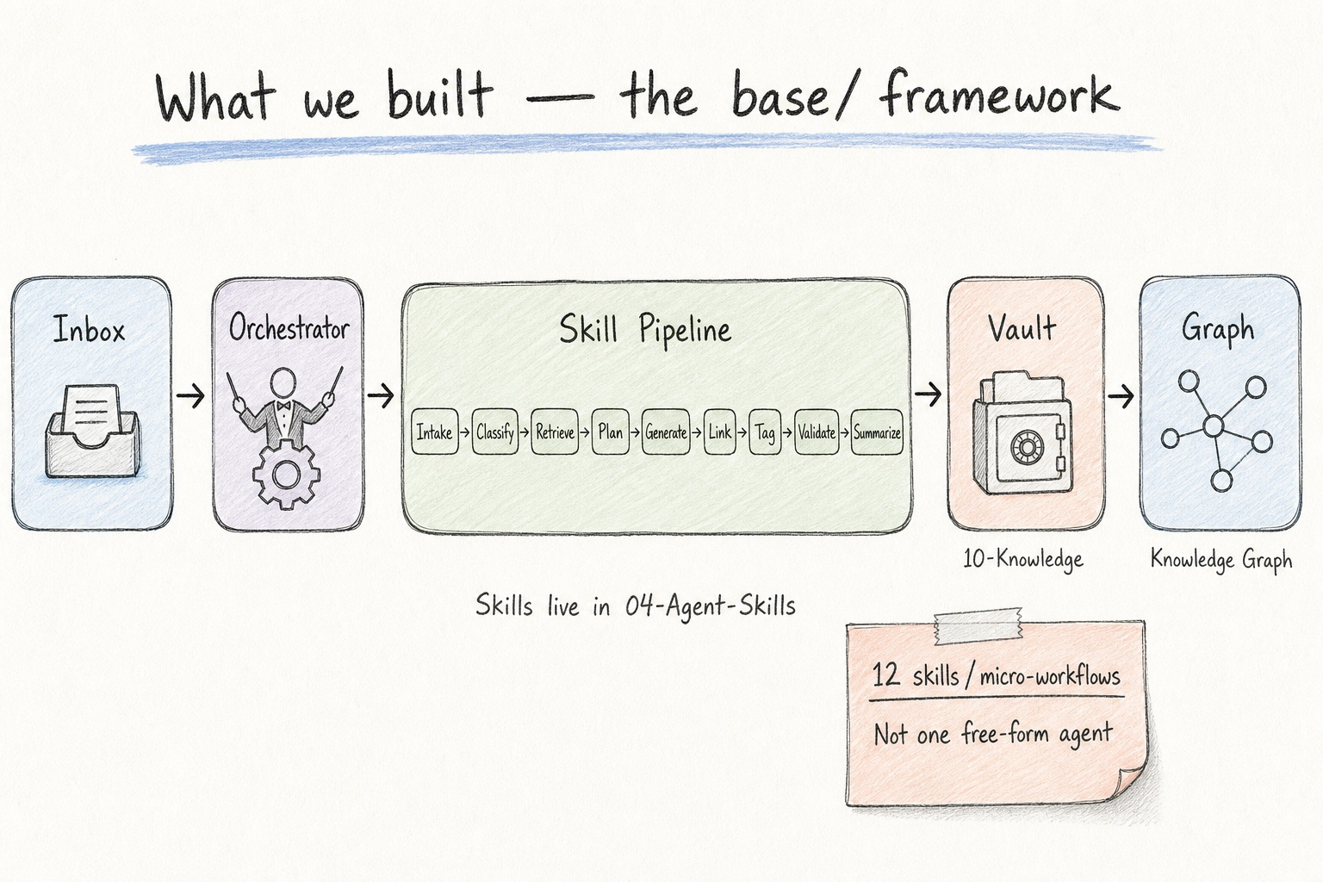
Notes:
This is the `base/` framework. Raw knowledge enters the Inbox. A Knowledge Orchestrator runs a skill pipeline — Intake, Classify, Retrieve, Plan, Generate, Link, Tag, Validate, Summarize — into a structured vault, then into a knowledge graph that both humans and agents can use. Twelve skills, each a governable micro-workflow. Not one free-form agent with unbounded authority.

Slide 7
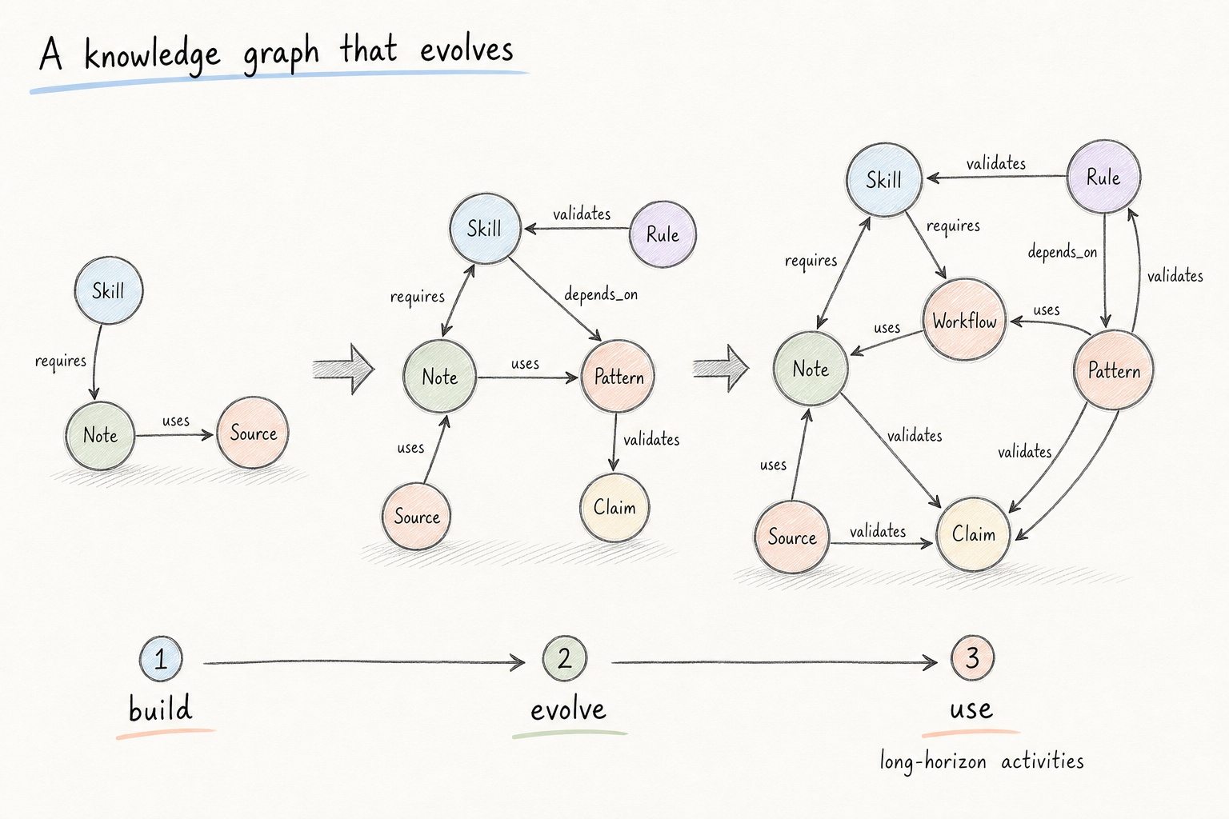
Notes:
The graph is typed: requires, depends_on, uses, validates. It builds up, evolves, and gets used inside long-horizon activities — not only one-shot Q&A. That is how context stops being a chat accident and becomes an asset.

Slide 8
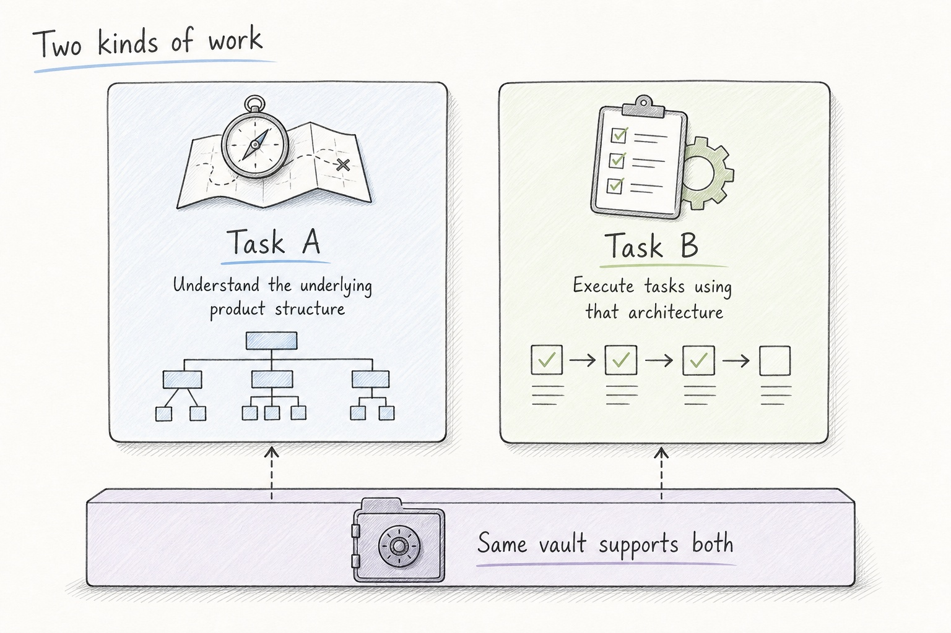
Notes:
With that in place, we support two kinds of work. Task A: understand the underlying structure of the existing product. Task B: knowing that structure, execute tasks against the given architecture. Same vault. Different verbs. Understanding and action share one durable substrate.

Slide 9
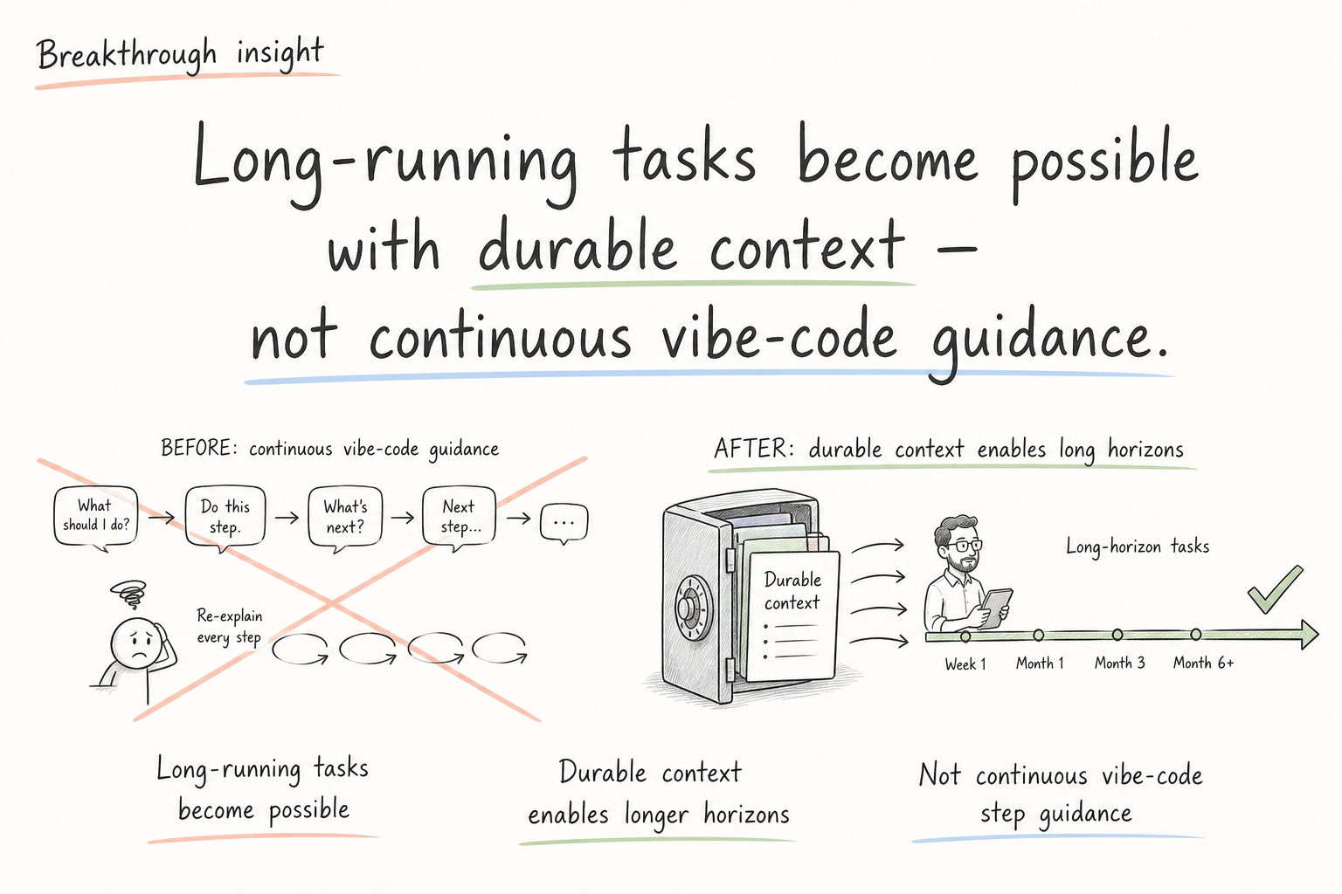
Notes:
The breakthrough for us was realizing long-running tasks are possible when context is durable. We do not need continuous vibe-code step guidance for every move. The vault lets agents work across longer horizons with less re-prompting.

Slide 10
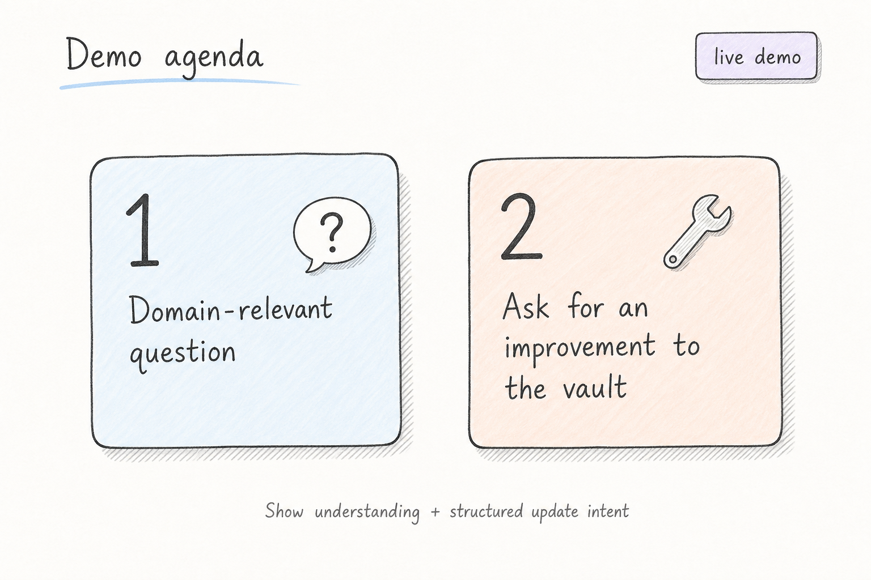
Notes:
I will show two live asks. First, a domain-relevant question against the vault — can it answer from structured knowledge, not from vibes. Second, ask for an improvement to the vault — can it propose a structured update through the skill path. Please watch for understanding plus governed action.

Slide 11
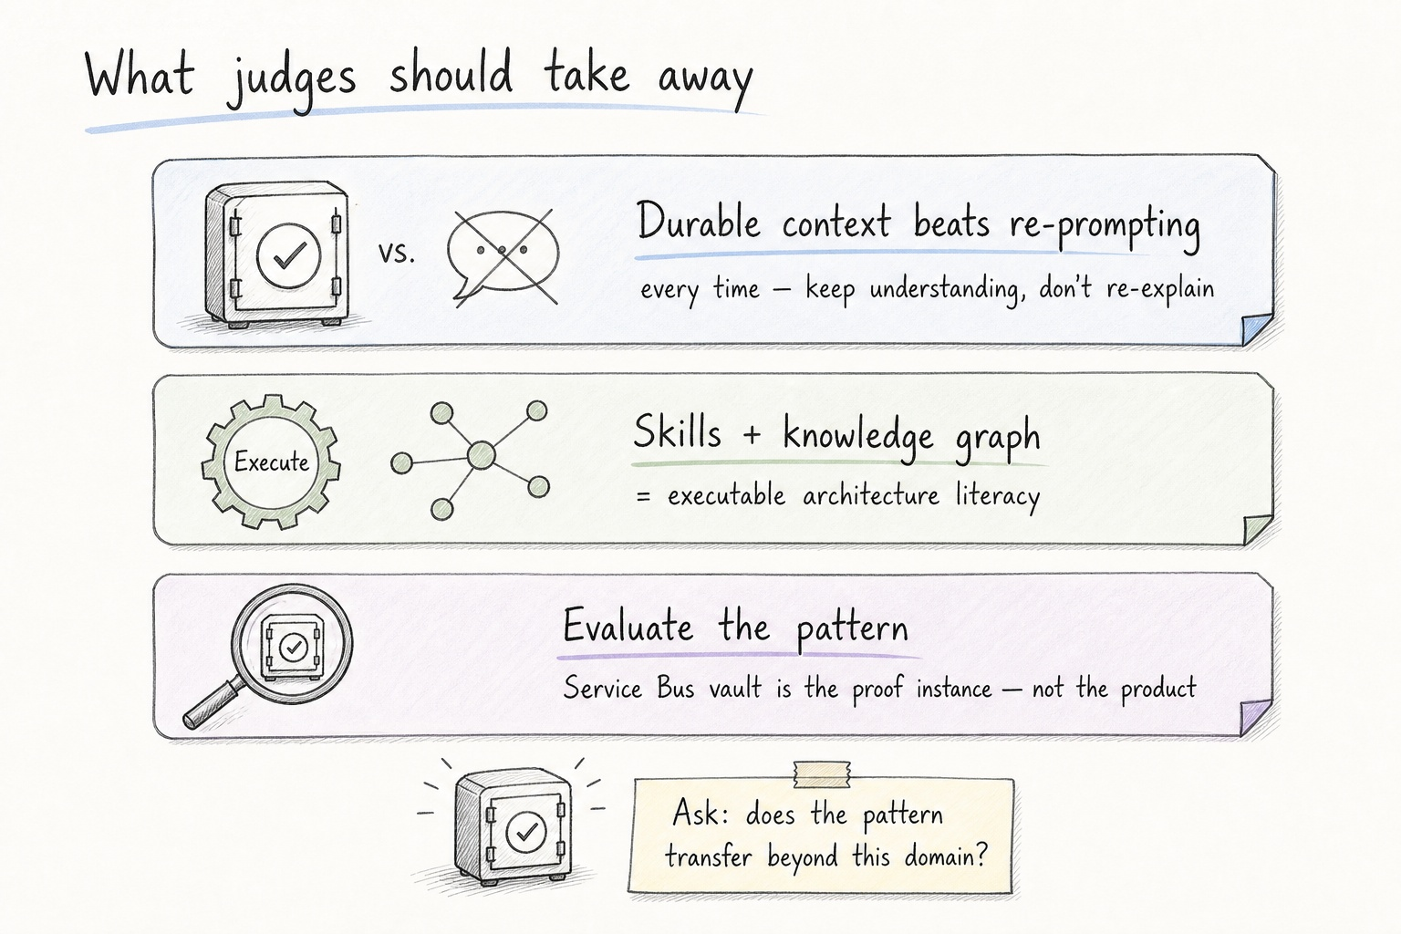
Notes:
Three takeaways. Durable context beats re-prompting every time. Skills plus a knowledge graph give you executable architecture literacy. Evaluate the pattern — the Service Bus vault is the proof instance, not the whole story. Happy to take questions.

