Slide 1
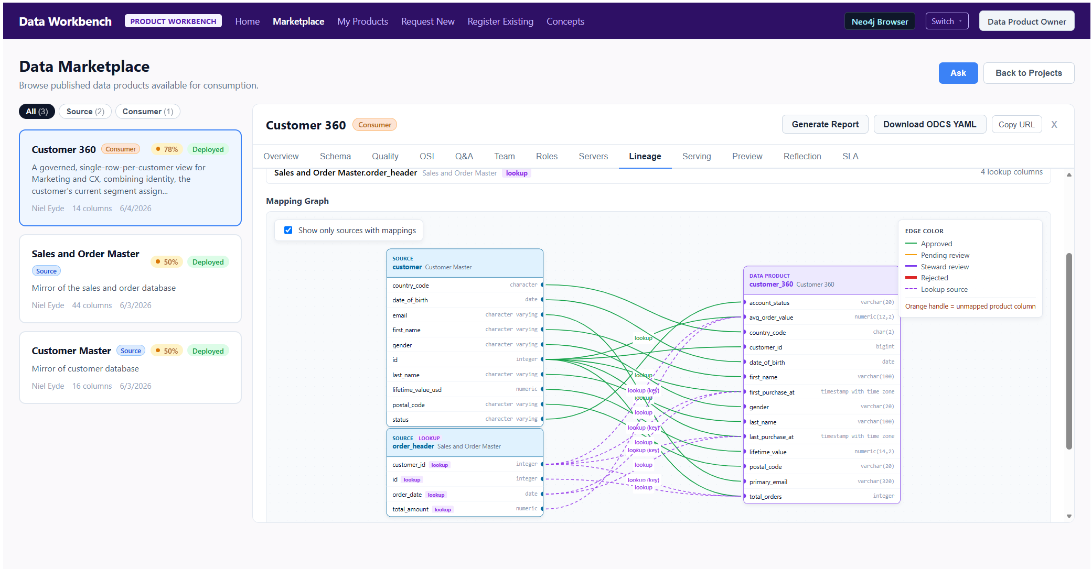
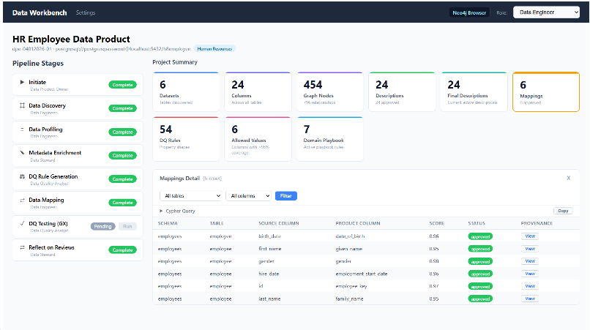
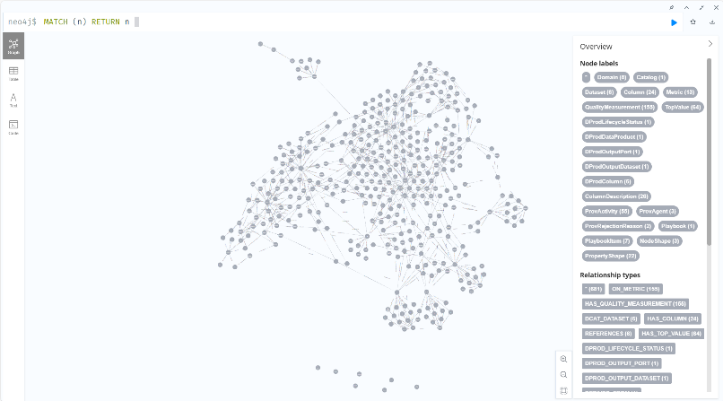
Data Workbench
An AI-powered platform for building, governing, and publishing enterprise data products
What is Data Workbench?
A workbench where AI agents and humans collaborate to build governed data products. Agent skills automate the heavy lifting — engineers and product owners review and approve at every step.
Engineering Workbench
AI pipeline: discover → profile → map → quality → publish
Product Workbench
Design products contract-first, validate and publish to marketplace
Knowledge Graph
Neo4j: all assets, semantics, lineage & provenance in one graph.
Key Features
Agent-Powered Pipeline
20+ AI agent skills built for data engineering — discovery, profiling, mapping, quality,
Human-in-the-Loop
Every AI output reviewed and approved before it persists. Provenance tracked at each step.
Data Contracts (ODCS)
Every product carries a machine-readable contract: schema, rules, lineage, and governance built in.
Two Product Types
Source-aligned: certify existing databases. Consumer-aligned: design for your AI use cases.
Marketplace & Discoverability
Published products searchable and consumable by AI agents and teams across the enterprise.

Slide 2
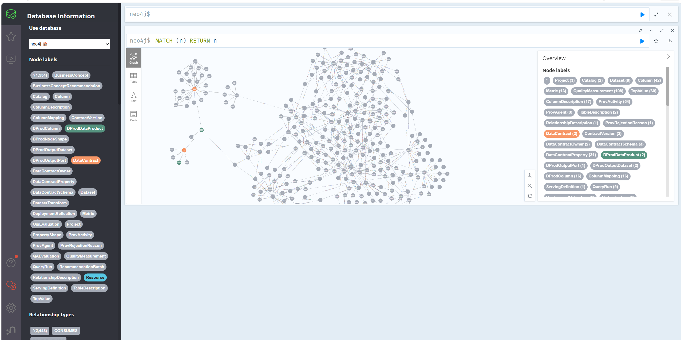
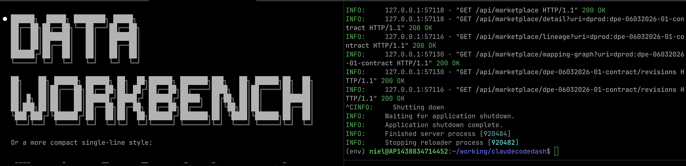
Data Workbench
A workbench where AI agents and humans collaborate to build governed data products. Data agent and skills automate the heavy lifting — engineers and product owners review and approve at every step.
Product Workbench
Design products contract-first, validate and publish to marketplace
Engineering Workbench
AI pipeline: discover → profile → map → quality → publish
Knowledge Graph
Neo4j: all assets, semantics, lineage & provenance in one graph.
Key Features
Agent-Powered Pipeline
30+ AI agent skills built for data engineering — discovery, profiling, mapping, quality,
Human-in-the-Loop
Every AI output reviewed and approved before it persists. Provenance tracked at each step.
Data Contracts (ODCS)
Every product carries a machine-readable contract: schema, rules, lineage, and governance built in.
Two Product Types
Source-aligned: certify existing databases. Consumer-aligned: design for your AI use cases.
Marketplace & Discoverability
Published products searchable and consumable by AI agents and teams across the enterprise.

Slide 3
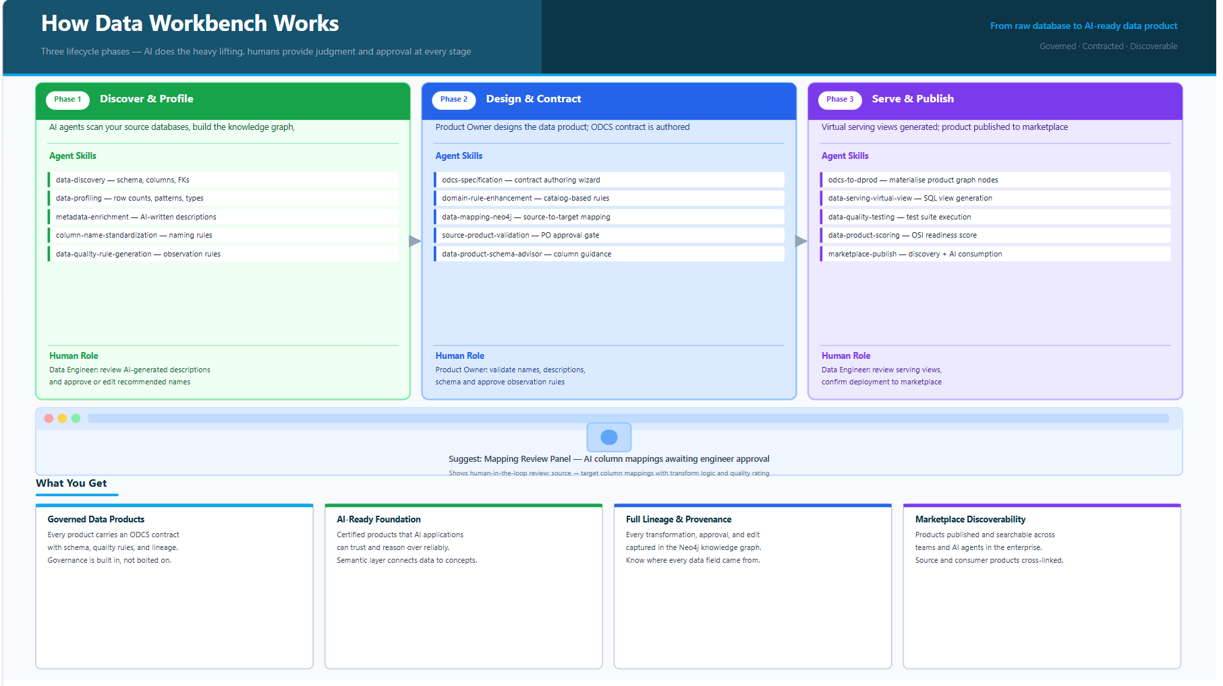

Slide 4
Data Workbench — System Architecture
Full layered stack · UI shells → Agent Harness → Skills Ecosystem → Data & Memory
Data Workbench
Data & Memory Layer
Data Product Owner Chat
Guides Product Owners through product definition, naming, schema authoring, domain rules & quality decisions
Data Engineer Chat
Assists with discovery, mapping, quality assessment, graph queries, lineage & pipeline decisions
Semantic Layer Chat Lite
Business concept queries powered by the Neo4j domain ontology · Not a full semantic layer
Knowledge Graph
System of Record
Discovery → Profiling → Enrichment → Products → Concepts
Context graph: understands all artifacts + interdependencies
Input to Agent Skills (read) · Output from Agent Skills (written)
Brain of the Workbench — all artifacts and their relationships live here
Ontologies
DCAT-2 (W3C Data Catalog Vocabulary) — Structures data products, datasets,
PROV-O (W3C Provenance Ontology) — Every review, approval, rejection, and edit recorded
SHACL (Shapes Constraint Language) — Data quality rules expressed constraints on columns
DProd (Data Product Graph — custom) — Core product ontology: :
ODCS (Open Data Contract Standard) — Spec-layer format for authoring contracts;
Custom Domain Ontology — Business concept graph powering the Semantic Layer Chat
WORKBENCH
Data Product Workbench
Data Product Owner Workbench UI
Import Data Product Contracts – Open Data Contract Standard (ODCS)
Create/Ingest Source-aligned Data Products
Create New Consumer-aligned Data Products
Data Product Marketplace
Data Engineer Workbench
Data Engineer Workbench UI and CLI
Step-by-step workflow execution; run, reset, or rerun individual stages
Approve, replace, or escalate AI-suggested mappings, descriptions, and quality rule proposals
Project health at a glance: dataset/column counts, mapping coverage, DQ scores, and serving readiness
End-to-end column lineage from source datasets through transformations to published data product views
Author and review column-level transform logic (cast, lookup, concat, window) with Steward escalation
Agent Harness
SDK
Compatible with any SDK supporting tool calling + multi-turn context
Execution Model
Goal definition → Model call
→ Loop until goal achieved
→ Repeat as many iterations as needed
LLM Provider
Configurable LLM backend
Selectable capability tier;
Swappable per harness or per workflow stage
Memory (Unstructured)
Agent SDK managed
Conversational + task state
Separate from SQLite structured memory
Agent Skills Ecosystem
Agent Tools
Structured Memory
Project data + scoping
Guide-me function history
Structured agent context + memory
Workflow + stage run records
Chat sessions + product requests
CLI reads from here to scope all commands
Data Discovery
Table + column metadata
FK + relationship discovery
Schema cataloguing
Multi-dialect SQL support
Data Profiling
Statistical column profiling
Null rates · cardinality
Value distributions + patterns
Row-level DQ signal detection
Data Quality
Rule generation (profiling-based)
GX / Pandera test execution
DQ scoring + OSI readiness
Failure analysis + remediation
Built-in Harness Tools
Read · Write · Edit · Bash
Grep · Glob · WebFetch
Native harness toolset
Data Enrichment
Column name standardization
LLM-generated descriptions
Table relationship classification
Domain rule enhancement
Data Materialization
ODCS spec → dprod graph
AI-assisted column mapping
Virtual view DDL generation
FK inference + bridge logic
Data Analysis
Question analysis + QA eval
SQL generation + execution
OSI readiness scoring
Marketplace enrichment
Model Context Protocol
Custom, enterprise and ecosystem tools
Harness Memory
Agent SDK managed
Conversational + task state
Unstructured context per session
Harness-level persistence
Distinct from SQLite project/session memory
★ What the Data Workbench uniquely brings — not provided by the agent harness out of the box

Slide 5

Data Workbench — System Architecture
Full layered stack · UI shells → Agent Harness → Skills Ecosystem → Data & Memory
Data Workbench
Data & Memory Layer
Data Product Owner Chat
Guides Product Owners through product definition, naming, schema authoring, domain rules & quality decisions
Data Engineer Chat
Assists with discovery, mapping, quality assessment, graph queries, lineage & pipeline decisions
Semantic Layer Chat Lite
Business concept queries powered by the Neo4j domain ontology · Not a full semantic layer
Knowledge Graph
System of Record
Discovery → Profiling → Enrichment → Products → Concepts
Context graph: understands all artifacts + interdependencies
Input to Agent Skills (read) · Output from Agent Skills (written)
Brain of the Workbench — all artifacts and their relationships live here
Ontologies
DCAT-2 (W3C Data Catalog Vocabulary) — Structures data products, datasets,
PROV-O (W3C Provenance Ontology) — Every review, approval, rejection, and edit recorded
SHACL (Shapes Constraint Language) — Data quality rules expressed constraints on columns
DProd (Data Product Graph — custom) — Core product ontology: :
ODCS (Open Data Contract Standard) — Spec-layer format for authoring contracts;
Custom Domain Ontology — Business concept graph powering the Semantic Layer Chat
WORKBENCH
React Frontend
Python backend
Neo4J
Data Product Workbench
Data Product Owner Workbench UI
Import Data Product Contracts – Open Data Contract Standard (ODCS)
Create/Ingest Source-aligned Data Products
Create New Consumer-aligned Data Products
Data Product Marketplace
Data Engineer Workbench
Data Engineer Workbench UI and CLI
Step-by-step workflow execution; run, reset, or rerun individual stages
Approve, replace, or escalate AI-suggested mappings, descriptions, and quality rule proposals
Project health at a glance: dataset/column counts, mapping coverage, DQ scores, and serving readiness
End-to-end column lineage from source datasets through transformations to published data product views
Author and review column-level transform logic (cast, lookup, concat, window) with Steward escalation
Agent Harness
SDK
Compatible with any SDK supporting tool calling + multi-turn context
Execution Model
Goal definition → Model call
→ Loop until goal achieved
→ Repeat as many iterations as needed
LLM Provider
Configurable LLM backend
Selectable capability tier;
Swappable per harness or per workflow stage
Memory (Unstructured)
Agent SDK managed
Conversational + task state
Separate from SQLite structured memory
Claude Code
Claude Agent SDK
Claude Agents
Anthropic Models
Agent Skills Ecosystem
Agent Tools
Structured Memory
Project data + scoping
Guide-me function history
Structured agent context + memory
Workflow + stage run records
Chat sessions + product requests
CLI reads from here to scope all commands
Custom Claude Agent Skills
sqllite
Data Discovery
Table + column metadata
FK + relationship discovery
Schema cataloguing
Multi-dialect SQL support
Data Profiling
Statistical column profiling
Null rates · cardinality
Value distributions + patterns
Row-level DQ signal detection
Data Quality
Rule generation (profiling-based)
GX / Pandera test execution
DQ scoring + OSI readiness
Failure analysis + remediation
Built-in Harness Tools
Read · Write · Edit · Bash
Grep · Glob · WebFetch
Native harness toolset
Claude tools
Harness Memory
Agent SDK managed
Conversational + task state
Unstructured context per session
Harness-level persistence
Distinct from SQLite project/session memory
Data Enrichment
Column name standardization
LLM-generated descriptions
Table relationship classification
Domain rule enhancement
Data Materialization
ODCS spec → dprod graph
AI-assisted column mapping
Virtual view DDL generation
FK inference + bridge logic
Data Analysis
Question analysis + QA eval
SQL generation + execution
OSI readiness scoring
Marketplace enrichment
Model Context Protocol
Custom, enterprise and ecosystem tools
Claude
★ What the Data Workbench uniquely brings — not provided by the agent harness out of the box

Slide 6
Data Workbench — System Architecture
Full layered stack · UI shells → Agent Harness → Skills Ecosystem → Data & Memory
Data Product Owner Chat
Data Engineer Chat
Semantic Layer Chat ⚡ Light
Guides POs through product definition, naming,
schema authoring, domain rules & quality decisions
Assists with discovery, mapping, quality assessment,
graph queries, lineage & pipeline decisions
Business concept queries powered by the Neo4j
domain ontology · Not a full semantic layer
INTERFACES
Role-Based Access
Python + React
ODCS Spec Standard
Project Scoping
WebSocket Streaming
Data Workbench
Data Product Owner UI (Product Workbench)
Contract-first 9-step wizard · Marketplace · My Products
Product validation gate · Ingest existing products
Source candidate requests · Chat assistant panel
Source-aligned (dpe-sa) · Consumer-aligned (dpe-cf)
Workbench UI
Pipeline · Reviews · Dashboard
Schema · Lineage · Chat panel
CLI Interface
Requires workbench services
+ project context from SQLite
WORKBENCH
Data Engineer UI (Engineering Workbench)
Delegates tasks
Agent Harness
Off-the-shelf · No bespoke build required · Skills + concepts portable to any compatible harness
SDK
Current: Claude Code SDK (interim)
Target: Anthropic Agent SDK
High similarity · Low migration friction
Execution Model
Goal definition → Model call
→ Loop until goal achieved
→ Repeat as many iterations as needed
Anthropic Models
Sonnet · Opus · Haiku
Configurable per harness
Default: Sonnet
Built-in Core Tools
Read · Write · Edit · Bash
Grep · Glob · WebFetch
Native harness toolset
Memory (Unstructured)
Agent SDK managed
Conversational + task state
Separate from SQLite structured memory
HARNESS
Agent Skills Ecosystem
★ What the Data Workbench uniquely brings — not provided by the agent harness out of the box
Discovery
Profiling
Data Quality
Metadata Enrichment
Materialization
Data Analysis
① skill.md — capability spec
② Scripts — tool executors
③ Tools — executable actions
④ Reference Content — knowledge
Table + column metadata
FK + relationship discovery
Schema cataloguing
Multi-dialect SQL support
Reads: Source DB
Writes: :Catalog
:Dataset · :Column
data-discovery
data-discovery-mysql
DCAT-2 Neo4j export
Statistical column profiling
Null rates · cardinality
Value distributions + patterns
Row-level DQ signal detection
Reads: :Dataset
Writes: :ProfilingRun
:ColumnProfile
data-profiling
data-profiling-to-dqv-neo4j
Rule generation (profiling-based)
GX / Pandera test execution
DQ scoring + OSI readiness
Failure analysis + remediation
Reads: :Column :Profile
Writes: :PropertyShape
:TestRun · :TestResult
data-quality-rule-generation
data-quality-testing-gx
data-scoring · data-remediation
DATA QUALITY
Column name standardization
LLM-generated descriptions
Table relationship classification
Domain rule enhancement
Reads: :Dataset :Column
Writes: :ColumnDescription
:TableDescription
metadata-enrichment
column-name-standardizer
domain-rule-enhancement
ENRICHMENT
ODCS spec → dprod graph
AI-assisted column mapping
Virtual view DDL generation
FK inference + bridge logic
Reads: :DataContract
Writes: :DProdDataProduct
:ColumnMapping · Views
data-mapping-neo4j
data-serving-virtual-view
odcs-to-graph
MATERIALIZATION
Question analysis + QA eval
SQL generation + execution
OSI readiness scoring
Marketplace enrichment
Reads: :DProdColumn views
Writes: :QAEvaluation
:OSIScore
data-product-question-analyzer
data-scoring
marketplace enrichment
DATA ANALYSIS
Every Skill Contains:
⊕ Domain Knowledge
⊕ Domain Knowledge
⊕ Domain Knowledge
⊕ Domain Knowledge (select skills)
SKILLS
DISCOVERY
PROFILING
Domain Knowledge Catalog: Customer ontology · Orders ontology · Growing catalog
Data & Memory Layer
read / write
Insight Extraction Engine — feedback loop
Neo4j is the system of record — captures everything from discovery through to data product publication
Neo4j Knowledge Graph · System of Record
SQLite · Structured Memory
Harness Memory · Unstructured
Discovery → Profiling → Enrichment → Products → Concepts
Light Domain Ontology · Explainability · Traceability · PROV-O provenance
Context graph: understands all artifacts + interdependencies
Ontologies: SHACL · PROV-O · DCAT-2 · W3C · Custom product graph
Input to Agent Skills (read) · Output from Agent Skills (written)
Brain of the Workbench — all artifacts and their relationships live here
Project data + scoping
Guide-me function history
Structured agent context + memory
Workflow + stage run records
Chat sessions + product requests
CLI reads from here to scope all commands
Agent SDK managed
Conversational + task state
Unstructured context per session
Harness-level persistence
Distinct from SQLite project/session memory
DATA
ODCS
Open Data Contract Standard
Data product spec foundation
Extensible to other spec standards
Portability
No bespoke agent harness required
Skills + ideas portable to any harness
that meets basic tool + loop requirements
Light Semantic Layer
Powered by Neo4j domain graph
Extracts business concepts from all ingested data
Light — not a full semantic layer implementation
Insight Extraction Engine
Neo4j artifacts → improved playbooks
Skill self-improvement feedback loop
Reflector → Curator → Updated skills
W3C PROV-O
Full provenance on all decisions
Who approved what, when + why
Engineer · PO · AI · Steward agents
Role-Based Access
PO · Engineer · Steward · DQA
Partial implementation (demo level)
Architectural concept is present
Cross-Cutting Concerns

Slide 7
Agent Skills Ecosystem
Skill anatomy, catalog depth, and harness orchestration model
Data Workbench — Agent Skills Ecosystem
v2 of 3 · Skills Anatomy Detail · What the Workbench Uniquely Brings
Data Workbench
PO UI (contract wizard · marketplace) + Engineer UI (pipeline · reviews · CLI)
Python + React · ODCS Spec · Project Scoping · Role-Based Access
Agent Harness
Claude Code SDK (interim) → Anthropic Agent SDK (target) · Anthropic Models
Goal → Loop until achieved · Built-in Core Tools · Unstructured Memory
Agent Skills Ecosystem
★ These skills are what the Data Workbench uniquely contributes — they are not provided by the agent harness out of the box
⊕ Domain Knowledge
⊕ Domain Knowledge
Discovery
Profiling
Data Quality
① skill.md — capability spec
Skill Anatomy
Every skill contains:
② Scripts — tool executors
③ Tools — executable actions
Purpose
Extracts table + column metadata from source
databases. Discovers FK relationships, infers
schema structure, writes to Neo4j catalog.
Anatomy
Neo4j I/O
data-discovery · data-discovery-mysql · DCAT-2 export
Purpose
Statistical profiling per column: null rates,
cardinality, value distributions, pattern detection.
Feeds downstream DQ rule generation.
Anatomy
Neo4j I/O
data-profiling · data-profiling-to-dqv-neo4j
④ Reference — domain knowledge
① skill.md
Scope, goals, DB dialects supported
② Scripts
extract_schema.py · write_catalog.py
① skill.md
Profile scope, sampling strategy, output
② Scripts
profile_columns.py · write_profiles.py
Purpose
Rule generation from profiling. GX/Pandera
test execution. Scoring, failure analysis,
remediation + OSI readiness assessment.
Anatomy
Neo4j I/O
data-quality-rule-generation · testing-gx · testing-python · data-scoring · data-remediation
① skill.md
Rule types, test framework, scoring
② Scripts
generate_rules.py · run_tests.py
③ Tools
Bash · run_cypher.py · DB connectors
④ Domain Reference
Column naming conventions
③ Tools
Bash · Pandas/SQL · run_cypher.py
④ Domain Reference
Profiling heuristics + thresholds
③ Tools
GX · Pandera · run_cypher.py
④ Reference
Rule templates by column type
Domain Knowledge Catalog
Customer ontology
Orders ontology
Growing catalog
READS: Source DB (JDBC)
Project config from SQLite
WRITES: :Catalog · :Dataset
:Column · :REFERENCES edges
READS: :Dataset · :Column
Connection from SQLite
WRITES: :ProfilingRun
:ColumnProfile · stats
READS: :Column :Profile
:DataContract (approved rules)
WRITES: :PropertyShape
:TestRun · :TestResult
⊕ Domain Knowledge
Metadata Enrichment
Materialization of Views
Data Analysis
Purpose
LLM-generated column + table descriptions.
Column name standardization. Table relationship
classification. Domain rule enhancement.
Anatomy
Neo4j I/O
metadata-enrichment · column-name-standardizer · domain-rule-enhancement
Purpose
Translates approved ODCS specs into the dprod
graph. AI-assisted column mapping (source → target).
Generates virtual SQL views with FK inference.
Anatomy
Neo4j I/O
data-mapping-neo4j · data-serving-virtual-view · odcs-to-graph · data-product-spec-to-dprod-neo4j
Purpose
Generates and executes questions against
data product views. OSI readiness scoring.
Playbook-driven self-improvement loop.
Anatomy
Neo4j I/O
data-product-question-analyzer · data-product-question-executor · data-scoring
① skill.md
Enrichment scope, naming rules
② Scripts
write_descriptions.py · name_std.py
① skill.md
Mapping strategy, DDL logic, transforms
② Scripts
write_mappings.py · generate_view_ddl.py
① skill.md
QA eval framework, scoring model
② Scripts
generate_questions.py · score.py
③ Tools
Bash · run_cypher.py · LLM calls
④ Domain Reference
Business glossary + naming catalog
③ Tools
Bash · run_cypher.py · Postgres
④ Reference
Transform DSL · FK bridge rules
③ Tools
Bash · SQL executor · run_cypher
④ Reference
OSI dimensions · scoring rubric
READS: :Dataset · :Column
:ProfilingRun (context)
WRITES: :ColumnDescription
:TableDescription
READS: :DataContract
:Column · :DProdColumn
WRITES: :DProdDataProduct
:ColumnMapping · Views DDL
READS: :DProdColumn views
:DataContract metadata
WRITES: :QAEvaluation
:OSIScore · :ServingDefinition
Insight Extraction → Skill Improvement
read / write
Data & Memory Layer
Neo4j Knowledge Graph · System of Record
Discovery → Profiling → Enrichment → Products → Concepts
Light Domain Ontology · PROV-O provenance · Explainability & traceability
SHACL · PROV-O · DCAT-2 · W3C · Custom product graph ontologies
Context graph — understands all artifacts and their interdependencies
SQLite · Structured Memory
Project data + scoping · Workflow state
Chat sessions · Stage run records
Guide-me history · Product requests
CLI reads from here to scope all commands
Harness Memory · Unstructured
Agent SDK managed conversational state
Per-session context + task memory
Distinct from SQLite structured memory
Managed transparently by the harness SDK

Slide 8
Data Product Journey
Six-phase lifecycle · PO ideation → Engineering → Marketplace deployment
Data Workbench — Data Product Journey
v3 of 3 · End-to-End Flow · How a Data Product Goes from Idea to Marketplace
Data Product Owner
① Ideate & Define
PO has a data product idea
Chat assistant guides naming,
schema, domain, quality rules
→ Contract-first ODCS spec drafted
9-step wizard · Chat panel
PO-driven
product-authoring-assistant
② Source Discovery
Engineer runs discovery on source DB
Tables, columns, FKs catalogued
Statistical profiling executed
→ Full catalog written to Neo4j
Pipeline · Workbench UI
Engineer-driven
data-discovery · data-profiling
③ Assess & Enrich
DQ rules generated from profiling
Column descriptions + names enriched
Table relationship types classified
→ Enriched catalog ready for PO review
Pipeline · Reviews tab
Engineer-driven
metadata-enrichment · data-quality-*
④ Shape & Validate
PO reviews: names + descriptions + rules
PO binds source products (consumer)
Gap analysis: can spec be satisfied?
→ Approved ODCS spec committed
Validation gate · Wizard step 8
gap-analyzer · archetype-classifier
⑤ Map & Serve
AI maps source → target columns
Engineer reviews + approves/replaces
Virtual SQL views generated + deployed
→ Deployable data product ready
MappingReviewPanel · Pipeline
Engineer-driven
data-mapping-neo4j · data-serving-virtual-view
⑥ Publish
PO deploys + publishes product
OSI readiness scored
Product visible in Marketplace
Consumers can discover + consume
Marketplace · Score OSI now
PO-driven
data-product-question-analyzer
Data Engineer
PO-driven
Engineer reviews
↓ Each phase is executed by Agent Skills via the Agent Harness ↓
Agent Skills Ecosystem + Agent Harness
Goal → Model call → Loop until achieved · SDK: Claude Code (now) → Anthropic Agent SDK (target) · Anthropic Models
Skills: Product Authoring
Skills: Discovery + Profiling
Skills: Enrichment + Quality
Skills: Validation + Ingest
Skills: Mapping + Serving
Skills: Analysis + Scoring
product-authoring-assistant
data-product-name-advisor
data-product-schema-advisor
data-product-spec-writer
What they do:
Guide PO through ODCS spec
authoring. Suggest names, schema
columns, quality rules. Preview
gap check vs available sources.
Neo4j: writes :DataContract
:DataContractSchema
:PropertyShape (rules)
data-discovery
data-discovery-mysql
data-profiling
data-profiling-to-dqv-neo4j
What they do:
Extract schema from source DB.
Statistical column profiling. FK
relationship discovery. Write full
catalog to Neo4j.
Neo4j: writes :Catalog
:Dataset · :Column
:ProfilingRun · :ColumnProfile
metadata-enrichment
column-name-standardizer
data-quality-rule-generation
domain-rule-enhancement
What they do:
LLM descriptions for columns +
tables. Standardize names. Generate
DQ rules from profiling + domain
catalog. Table classification.
Neo4j: writes :ColumnDescription
:TableDescription
:PropertyShape (DQ rules)
data-product-gap-analyzer
data-product-archetype-classifier
data-product-discovery-advisor
odcs-to-graph
What they do:
Gap analysis: can spec columns be
sourced? Classify product archetype.
Suggest source candidates. Persist
ODCS spec to Neo4j graph.
Neo4j: writes :DataContract v2
:CONSUMES edges
:DataContractSchema confirmed
data-mapping-neo4j
data-serving-virtual-view
data-product-spec-to-dprod-neo4j
data-mapping-rationale-summarizer
What they do:
AI maps source → target columns.
FK inference for join construction.
DDL view generation + deployment.
Mapping rationale report.
Neo4j: writes :ColumnMapping
:DProdDataProduct
:ServingDefinition
data-product-question-analyzer
data-product-question-executor
data-scoring (OSI readiness)
data-product-osi-advisor
What they do:
Generate + execute QA questions
against deployed views. OSI score.
Readiness assessment before publish.
Marketplace enrichment.
Neo4j: writes :QAEvaluation
:OSIScore
:DataContract {lifecycle: published}
Powered by Phase ① (Ideate & Define)
Powered by Phase ② (Source Discovery)
Powered by Phase ③ (Assess & Enrich)
Powered by Phase ④ (Shape & Validate)
Powered by Phase ⑤ (Map & Serve)
Powered by Phase ⑥ (Publish)
all skills read + write Neo4j
Insight Loop
Data & Memory Layer
All journey artifacts are persisted here — enabling explainability, traceability, and continuous improvement
Neo4j Knowledge Graph · System of Record · Brain of the Data Workbench
SQLite · Structured Memory
Harness Memory · Unstructured
Captures every step of the journey: Discovery → Profiling → Enrichment → Product spec → Mappings → Views → Publication
Context graph: all artifacts and their interdependencies in one queryable knowledge store
Light Domain Ontology (business concepts) · PROV-O provenance on every decision · Explainability & traceability
Ontologies: SHACL · PROV-O · DCAT-2 · W3C · Custom product graph
Insight Extraction Engine reads from here → improves agent playbooks + skills (feedback loop)
Project data + scoping
Workflow + stage run records
Guide-me history · Product requests
Chat sessions · Ingest drafts
CLI reads project context from here
Agent SDK managed
Conversational + task state
Per-session context
Harness-level persistence
Distinct from SQLite
Contract-First Design
PO defines the product contract
before binding to sources (dpe-cf)
ODCS as the spec standard
Bidirectional Feedback
PO ↔ Engineer loops for pushbacks,
source candidate requests, edits
Not a linear waterfall
Portability
Off-the-shelf harness — no bespoke build.
Skills + concepts portable to any
compatible agent harness
Self-Improving Skills
Insight Extraction Engine reads
Neo4j artifacts → improves playbooks
Reflector → Curator → Updated skills
Full Provenance
Every decision traced with W3C PROV-O
Who approved what, when, and why
Engineer · PO · AI · Steward agents
Light Semantic Layer
Neo4j domain graph exposes business
concepts extracted from all products
Not a full semantic layer implementation
Key Architecture Principles

Slide 9
Data Workbench
Intro — What is Data Workbench
AI-Powered · Human-Governed · AI-Ready
An AI-powered platform for building, governing, and publishing enterprise data products
Engineering Workbench + Product Workbench
What is Data Workbench?
A workbench where AI agents and humans
collaborate to build governed data products.
Agent skills automate the heavy lifting —
engineers and product owners review and
Engineering Workbench — Pipeline & Stages
Knowledge Graph Explorer
approve at every step.
Suggest: project list with pipeline stage progress chips
Suggest: Neo4j browser graph visualization
Two Workbench Shells
Engineering Workbench
AI pipeline: discover → profile →
map → quality → publish
Product Workbench
Design products contract-first,
validate and publish to marketplace
Product Workbench — Marketplace & Product Authoring
Knowledge Graph
Suggest: product wizard OR published marketplace product cards
Neo4j: all assets, semantics,
lineage & provenance in one graph
Key Features
Agent-Powered Pipeline
Human-in-the-Loop
Data Contracts (ODCS)
Two Product Types
Marketplace & Discoverability
20+ AI agent skills built for
Every AI output reviewed and
Every product carries a machine-
Source-aligned: certify existing
Published products searchable
data engineering — discovery,
approved before it persists.
readable contract: schema, rules,
databases. Consumer-aligned:
and consumable by AI agents
profiling, mapping, quality,
Provenance tracked at each step.
lineage, and governance built in.
design for your AI use cases.
and teams across the enterprise.

Slide 10
How Data Workbench Works
How It Works — Agent Lifecycle
From raw database to AI-ready data product
Three lifecycle phases — AI does the heavy lifting, humans provide judgment and approval at every stage
Governed · Contracted · Discoverable
Phase 1
Discover & Profile
Phase 2
Design & Contract
Phase 3
Serve & Publish
AI agents scan your source databases, build the knowledge graph,
Product Owner designs the data product; ODCS contract is authored
Virtual serving views generated; product published to marketplace
Agent Skills
Agent Skills
Agent Skills
data-discovery — schema, columns, FKs
odcs-specification — contract authoring wizard
odcs-to-dprod — materialise product graph nodes
data-profiling — row counts, patterns, types
domain-rule-enhancement — catalog-based rules
data-serving-virtual-view — SQL view generation
metadata-enrichment — AI-written descriptions
data-mapping-neo4j — source-to-target mapping
data-quality-testing — test suite execution
column-name-standardization — naming rules
source-product-validation — PO approval gate
data-product-scoring — OSI readiness score
data-quality-rule-generation — observation rules
data-product-schema-advisor — column guidance
marketplace-publish — discovery + AI consumption
Human Role
Human Role
Human Role
Data Engineer: review AI-generated descriptions
Product Owner: validate names, descriptions,
Data Engineer: review serving views,
and approve or edit recommended names
schema and approve observation rules
confirm deployment to marketplace
Suggest: Mapping Review Panel — AI column mappings awaiting engineer approval
What You Get
Shows human-in-the-loop review: source → target column mappings with transform logic and quality rating
Governed Data Products
AI-Ready Foundation
Full Lineage & Provenance
Marketplace Discoverability
Every product carries an ODCS contract
Certified products that AI applications
Every transformation, approval, and edit
Products published and searchable across
with schema, quality rules, and lineage.
can trust and reason over reliably.
captured in the Neo4j knowledge graph.
teams and AI agents in the enterprise.
Governance is built in, not bolted on.
Semantic layer connects data to concepts.
Know where every data field came from.
Source and consumer products cross-linked.

Slide 11
Algorithms are off the shelf. Differentiation is in the data.
Arc 1 v1 — AI Readiness Gap
77% of D&A leaders cite AI-ready data as a top-5 investment priority. Only 9% have a functioning data readiness assessment.
THE AI READINESS GAP
HOW DATA WORKBENCH CLOSES IT
"You have a database, not a data product."
DISCOVER & UNDERSTAND AUTOMATICALLY
— Tony Giordano, Data Workbench Practice Lead
Agent skills scan every schema, profile every column,
83%
and write business descriptions from data patterns.
Hours to a complete, governed semantic knowledge graph.
of organizations don't develop business-aligned data products
Most enterprise data exists as raw, undocumented tables — invisible to AI,
Skills: data-discovery · data-profiling · metadata-enrichment
lacking business context, and unfit for governed consumption.
9%
CONTRACT, GOVERN & QUALIFY
ODCS data contracts encode business rules, quality thresholds,
have a functioning AI data readiness assessment
and lineage for every data asset.
Organizations are planning AI initiatives without knowing which data assets
Domain knowledge catalogs pre-load governance rules per domain.
are ready to support them. The gap between ambition and readiness stalls AI.
Skills: domain-rule-enhancement · data-quality-rule-generation
Semantic fragmentation causes AI to reason incorrectly
"Customer", "Client", "Account" — conflicting definitions across
MAP, SERVE & PUBLISH
teams cause AI to hallucinate business answers in production.
AI maps source columns to target schemas with full lineage.
Virtual serving views generated, tested, and deployed.
Published to a searchable data marketplace — days, not months.
Skills: data-mapping-neo4j · data-serving-virtual-view · data-scoring
"By 2027, organizations prioritizing semantics in AI-ready data will achieve 80% higher agentic AI accuracy and 60% lower cost."
Gartner · Prioritize Semantics to Overcome the Agentic Contextualization Gap · May 2026 · ID G00852605
The question isn't whether to build data products. It's whether you can do it fast enough.

Slide 12
We use AI to build the data foundation. So AI can build on it.
Arc 1 v2 — AI Builds the Foundation
AI agent innovation applied to the domain of data engineering — building the certified foundation that enterprise AI depends on.
AI APPLIED TO DATA ENGINEERING
DATA PRODUCTS
AI THAT RUNS ON YOUR DATA
Data Workbench applies AI agent innovation to the domain of data.
Output of agent work on data.
Enterprise AI needs certified, governed, semantically-rich data
Purpose-built agent skills that do the data engineering work.
Foundation enterprise AI depends on.
to reason correctly and return trusted answers at scale.
Schema Discovery
SOURCE-ALIGNED
CONSUMER-ALIGNED
Natural Language Data Access
Agents scan every table, column, FK, index · hours not weeks
Certify what you have
Build what you need
Ask in business terms. Agent routes to the certified
· Existing databases
· Contract-first schema
data product. Returns a governed, trusted answer.
· Profiled & governed
· Agent-mapped
Data Profiling
· Contract synthesized
· Marketplace-published
Statistical patterns, nulls, cardinality, anomaly detection
Agentic Workflows
Contracted
Governed
AI-Ready
Multi-step AI processes grounded in certified data.
No hallucination — agents access governed sources.
Metadata Enrichment
Neo4j Knowledge Graph
AI writes business descriptions · human approves or corrects
builds
System of record for all data assets
enables
Automated Analytics & Insights
Agents reason directly over data products.
AI applied to every domain.
Consistent KPIs, no conflicting definitions.
Intelligent Mapping
Data Workbench applies it to
Source→target column mapping with full lineage · human reviews
the domain of data.
AI-Powered Business Applications
83%
Apps built on a foundation of certified data.
Quality Assurance
Semantic context baked in — not retrofitted.
Domain rules from catalogs · observation rules from profiling
of organizations don't build
data products aligned to
business objectives.
Serve & Publish
— Gartner 2024 Survey
Virtual views + ODCS contract + marketplace listing in days
"By 2027, organizations prioritizing semantics
Source Data
→
Data Products
→
AI Agents
will achieve 80% higher AI accuracy and
Human-in-the-loop at every step · Active Learning · PROV-O Provenance
60% lower cost."
Every approval improves future runs. Every rejection trains the system.
Gartner · May 2026 · ID G00852605
The agents building the foundation. The foundation enabling the agents.
AI innovation applied to the domain of data — so data can power everything else.
What would it look like if your data engineering practice moved at the speed of AI?

Slide 13
Every AI use case starts with a data product you haven't built yet.
Arc 2 v1 — DB vs Data Product Pipeline
Agent skills automate the heavy lifting. Engineers focus on judgment, quality, and business value.
Databases are not data products. Turning one into the other is where AI initiatives stall — and where Data Workbench starts.
THE DATABASE APPROACH — undocumented, ungoverned, no contract, no lineage
Schema Discovery
Data Documentation
Column Mapping
Quality Rules
Deploy & Document
3–5 weeks
2–4 weeks
2–3 weeks
1–3 weeks
1–2 weeks
Ungoverned
DBAs manually document
Analysts write descriptions
Engineers map source
Rules defined ad hoc,
View built manually.
database table
tables, columns, types,
— often incomplete
to target in spreadsheets
per-project, never
No contract, no
8–17
relationships
or out of date
— no lineage
reused or governed
marketplace entry
weeks
vs.
THE DATA PRODUCT APPROACH — contracted, governed, documented, AI-consumable
Auto-Discovery
Profile & Enrich
Intelligent Mapping
Quality & Rules
Serve & Publish
Governed
2–4 hrs
1–3 hrs
1–2 hrs
1–2 hrs
< 1 hr
Data Product
Agents scan every table,
AI writes descriptions
AI maps source to target
Domain rules from catalog.
Virtual view generated.
Days
column, and FK —
from profiling data.
with full lineage.
Observation rules from
ODCS contract attached.
fully documented to graph
Human approves or edits.
Human reviews, approves.
profiling. Auto-generated.
Published to marketplace.
✓ Contract
✓ Lineage
✓ Quality Rules
✓ Marketplace
data-discovery
data-profiling + metadata-enrichment
data-mapping-neo4j
data-quality-rule-generation
data-serving-virtual-view
20+ Agent Skills
Two Product Types
Human-in-the-Loop
Active Learning
Each with domain expertise
Source-aligned: certify what you have.
Engineers approve AI suggestions.
Rejections and edits train the system.
and provenance-tracked approvals
Consumer-aligned: build what you need.
Every decision improves future runs.
Accuracy improves with every project.
From source database to governed, marketplace-ready data product — measured in days, not months.
With full provenance, lineage, and human approval at every step.
How many AI-ready data products does your organization have today?

Slide 14
AI agents doing the data work. So AI agents can do the business work.
Arc 2 v2 — AI Doing the Data Work
We apply the same AI agent technology to data engineering that you'll use to run your business — building the foundation first.
AI can be applied to any domain. Data Workbench applies it to the domain of data engineering — building the foundation AI needs to work.
WITHOUT DATA WORKBENCH — manual, fragmented, ungoverned
Schema Discovery
Data Documentation
Column Mapping
Quality Rules
Deploy & Document
3–5 weeks
2–4 weeks
2–3 weeks
1–3 weeks
1–2 weeks
Ungoverned
DBAs document tables,
Analysts write descriptions
Engineers map source
Rules ad hoc per
View built manually.
database table
columns, relationships
— often incomplete,
to target in
project — never reused
No contract, no
8–17
manually
always stale
spreadsheets
or governed
marketplace entry
weeks
WITH DATA WORKBENCH AGENT SKILLS — AI doing the data engineering work
AI agent skills →
Auto-Discovery
Profile & Enrich
Intelligent Mapping
Quality & Rules
Serve & Publish
Governed
2–4 hrs
1–3 hrs
1–2 hrs
1–2 hrs
< 1 hr
Data Product
Scans every table,
AI writes descriptions
AI maps source→target
Domain rules from
Virtual view + ODCS
Days
column, FK — fully
from data patterns.
with full lineage.
catalog. Observation
contract. Published
documented to graph
Human approves.
Human reviews.
rules from profiling.
to marketplace.
✓ Contract
✓ Lineage
✓ Quality
data-discovery
data-profiling + metadata-enrichment
data-mapping-neo4j
data-quality-rule-generation
data-serving-virtual-view
✓ Marketplace
✓ AI-Ready
WHAT BECOMES POSSIBLE — enterprise AI with certified data products to reason over
Natural Language Queries
Agentic Workflows
Consistent KPIs
AI-Powered Apps
Ask in business terms.
Multi-step AI processes
Semantic layer routes agents
Applications built on
Get governed answers.
grounded in certified data.
to same governed products.
a trusted data foundation.
20+ Agent Skills
Two Product Types
Active Learning
Days to AI-Ready
Purpose-built for data engineering.
Source-aligned: certify what you have.
Every approval improves future runs.
From raw database to governed,
Each with domain expertise.
Consumer-aligned: build what you need.
Every rejection trains the system.
marketplace-ready data product.
AI builds the foundation. The foundation enables AI.
The same agent technology that will run your business — applied today to build the data it depends on.

Slide 15
The three layers every AI initiative needs. Start with the foundation.
Arc 3 v1 — Three-Layer Stack
AI agents are only as good as the data they reason over. Reliable AI begins with reliable, governed data products.
Natural Language Queries
Agentic Workflows
Automated Analytics
AI-Powered Applications
Layer 3
Ask in business terms.
Multi-step AI processes grounded
Agents reason over data directly.
Apps with semantic context.
AI AGENTS &
Get trusted, governed answers.
in certified data products.
No manual query engineering.
Consistent KPIs across tools.
APPLICATIONS
The Consumer
enables
Business Ontology (Top Layer)
Data Product Metadata (Bottom Layer)
Semantic Routing + Context
Maps business concepts and terms.
Maps ontology concepts
Routes AI queries to the right
Layer 2
Ensures consistent KPIs,
to certified data products.
data product automatically.
SEMANTIC LAYER
metrics, and definitions.
Bridges business to technical.
Injects semantic context into prompts.
The Router
Proof-of-concept dual-ontology semantic layer included in Data Workbench — demonstrates how governed data products directly power AI queries
powers
Data Workbench builds this layer — 20+ agent skills, full lifecycle from source database to marketplace-published data product
SOURCE-ALIGNED — certify what you have
CONSUMER-ALIGNED — build what you need
→ Discovered from existing databases and data warehouses
→ Contract-first: schema designed before engineering begins
Layer 1
→ Auto-profiled and AI-enriched with business descriptions
→ Product Owner shapes columns, rules, and grain in a wizard
DATA PRODUCTS
The Foundation
→ ODCS data contract synthesized from approved graph state
→ Bound to source-aligned products via governed CONSUMES edges
→ Quality rules generated from observed data patterns
→ Virtual serving views generated with FK-aware join logic
→ Published to marketplace with full schema lineage
→ AI-ready: certified, governed, and semantically grounded
Contracted (ODCS)
Governed
Quality-assured
Lineage-traced
Marketplace-discoverable
feeds
Relational Databases
Data Warehouses
Data Lakes
Source APIs
Legacy Systems
"Algorithms are off the shelf, including GenAI. Differentiation is in the readiness of the data for AI."
Gartner · D&A Leaders, Ready Your Data for AI · 2025
Layer 1. Built. Governed. Published. The foundation that makes the rest possible.

Slide 16
AI builds the foundation. The foundation powers AI.
Arc 3 v2 — AI Builder + AI Consumer
The same AI agent technology applied to the domain of data engineering — building what enterprise AI will run on.
AI AS THE BUILDER
Data Workbench
DATA PRODUCTS — THE BRIDGE
AI AS THE CONSUMER
Enterprise AI
Data Workbench applies AI agent
← built by AI agents
consumed by AI agents →
Enterprise AI that needs certified,
technology to data engineering:
governed data to reason correctly:
1
Schema Discovery
SOURCE-ALIGNED
CONSUMER-ALIGNED
Natural Language Queries
Agents scan databases, discover every table,
Certify what you have
Build what you need
Ask in business terms.
column, FK, and index — hours, not weeks
→ Existing databases & warehouses
→ Contract-first schema authoring
Agent routes to the right
→ Auto-discovered, profiled, enriched
→ PO defines before engineer builds
certified data product.
2
Data Profiling
→ ODCS contract synthesized from graph
→ Mapped to source products via graph
Statistical patterns, nulls, cardinality,
→ Published with quality rules + lineage
→ AI-ready: governed, semantically grounded
Agentic Workflows
anomalies — data quality baseline built fast
Multi-step AI processes
grounded in governed data.
3
Metadata Enrichment
Contracted (ODCS)
Governed
Lineage-traced
Quality-assured
Marketplace-discoverable
No hallucination at scale.
AI writes business descriptions from data
patterns — human approves or corrects each
AI applied to every domain.
Automated Analytics
builds →
→ enables
Agents reason directly over
4
Intelligent Mapping
Data Workbench applies it to the domain of DATA.
data products. Consistent
Source-to-target column mapping with full
Purpose-built agent skills for data engineering.
KPIs, no conflicting defs.
lineage — AI suggests, human approves
Semantic layer (between data products and AI consumers):
AI-Powered Applications
5
Quality Assurance
Routes AI queries to the right certified data product. Proof-of-concept included in Data Workbench.
Apps with semantic context
Domain rules from knowledge catalogs +
baked in — built on a
observation rules derived from profiling
The Virtuous Cycle
certified data foundation.
Serve & Publish
↺ Better data products → better AI outcomes
6
Virtual views + ODCS contract generated +
↺ Better AI outcomes → more enterprise confidence
marketplace listing in under a day
↺ More confidence → more data products → stronger foundation
80%
83% of orgs don't build business-aligned data products
higher agentic AI accuracy
Only 9% have a functioning AI data readiness assessment
60% lower cost
Human-in-the-loop at every decision
Gartner 2024 Survey — D&A Leaders, Ready Your Data for AI
when organizations prioritize
Active Learning · PROV-O Provenance · Neo4j Graph
Source DB
→
Agent Skills
→
Data Product
→
Semantic
→
AI Agents
semantics in AI-ready data.
Gartner · May 2026
The agents building the foundation. The foundation enabling the agents.
AI innovation applied to the domain of data — so data can power everything else.
What would your enterprise AI look like with a certified, governed data foundation ready on day one?

