Slide 1




XSLT - Extensible Stylesheet Language Transformations
Try it out
  Make an XML file
  Make an XSLT file
  Run the transform and view the transformed data
<xml />
input
<xsl:… />
transform
<xml />
(or text)
output

Slide 2
Extensible Stylesheet Language Transformations
XSLT is an XML-related technology that is used to manipulate and transform XML documents. The acronym XSLT stands for Extensible Stylesheet Language Transformations, which is a mouthful to say, but it sounds more complicated than it is.
With XSLT, you can take an XML document and choose the elements and values you want, then generate a new file with your choices. Because of XSLT's ability to change the content of an XML document, XSLT is referred to as the stylesheet for XML.
If you have already heard about HTML and CSS, you know that CSS is a way of styling HTML. In a similar relationship, XSLT is used to style and transform XML.

Slide 3
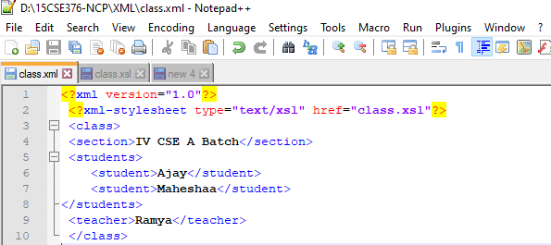
XML Code

Slide 4
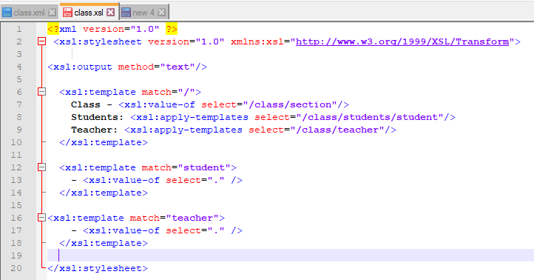
XSLT Code- class.xsl

Slide 5
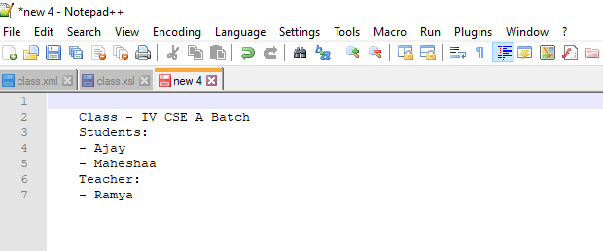

Slide 6
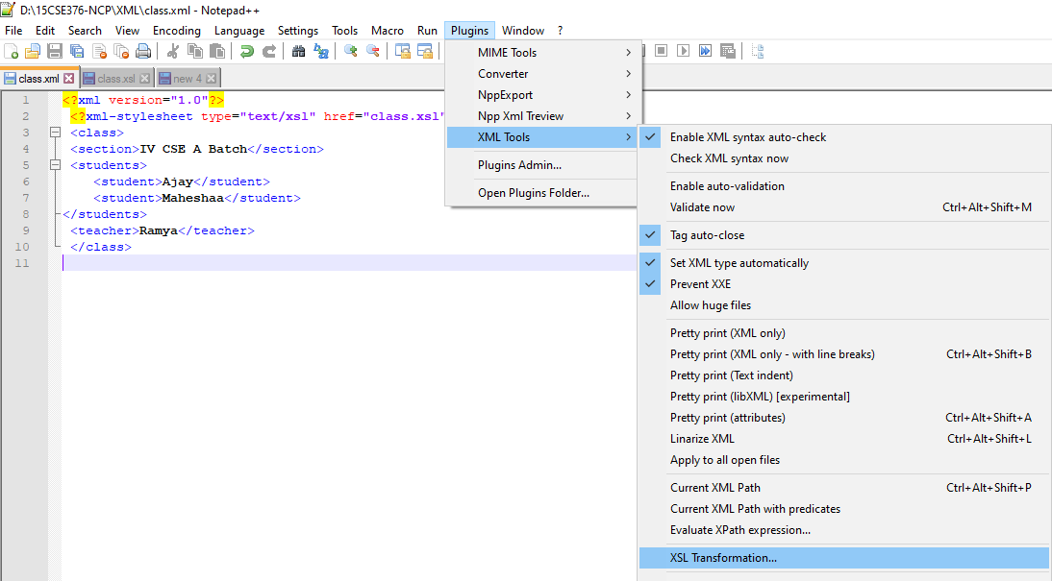

Slide 7
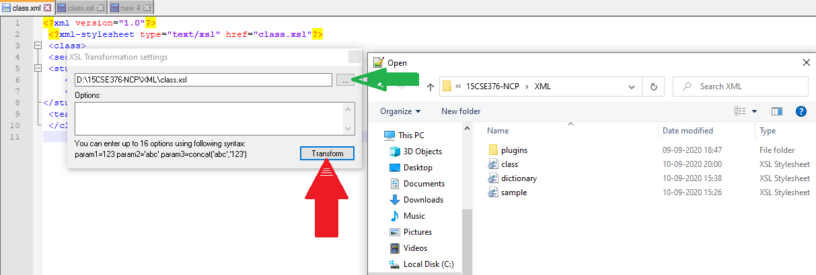

Slide 8
CSS = Style Sheets for HTML
HTML uses predefined tags, and the meaning of each tag is well understood.
The <table> tag in HTML defines a table - and a browser knows how to display it.
Adding styles to HTML elements are simple. Telling a browser to display an element in a special font or color, is easy with CSS.

Slide 9
XSL = Style Sheets for XML
XML does not use predefined tags (we can use any tag-names we like), and therefore the meaning of each tag is not well understood.
A <table> tag could mean an HTML table, a piece of furniture, or something else - and a browser does not know how to display it.
XSL describes how the XML document should be displayed!

Slide 10
XSL - More Than a Style Sheet Language
XSL consists of three parts:
XSLT - a language for transforming XML documents
XPath - a language for navigating in XML documents
XSL-FO - a language for formatting XML documents

Slide 11
XSLT Introduction
XSLT is a language for transforming XML documents into XHTML documents or to other XML documents.
XPath is a language for navigating in XML documents.
What You Should Already Know
Before you continue you should have a basic understanding of the following:
HTML / XHTML
XML / XML Namespaces
XPath

Slide 12
XSLT = XSL Transformations
XSLT is the most important part of XSL.
XSLT is used to transform an XML document into another XML document, or another type of document that is recognized by a browser, like HTML and XHTML. Normally XSLT does this by transforming each XML element into an (X)HTML element.
With XSLT you can add/remove elements and attributes to or from the output file. You can also rearrange and sort elements, perform tests and make decisions about which elements to hide and display, and a lot more.
A common way to describe the transformation process is to say that XSLT transforms an XML source-tree into an XML result-tree.

Slide 13
XSLT Uses XPath
XSLT uses XPath to find information in an XML document.
XPath is used to navigate through elements and attributes in XML documents.

Slide 14
How Does it Work?
In the transformation process, XSLT uses XPath to define parts of the source document that should match one or more predefined templates.
When a match is found, XSLT will transform the matching part of the source document into the result document.

Slide 15
XSLT Browser Support
All major browsers have support for XML and XSLT.
Internet Explorer supports XML, XSLT, and XPath from version 6.
Chrome supports XML, XSLT, and XPath from version 1.
Firefox supports XML, XSLT, and XPath from version 3.
Safari supports XML and XSLT from version 3.
Opera supports XML, XSLT, and XPath from version 9.

Slide 16
XSLT - Transformation
Correct Style Sheet Declaration
The root element that declares the document to be an XSL style sheet is <xsl:stylesheet> or <xsl:transform>.
Note: <xsl:stylesheet> and <xsl:transform> are completely synonymous and either can be used!
The correct way to declare an XSL style sheet according to the W3C XSLT Recommendation is:
<xsl:stylesheet version="1.0"
xmlns:xsl="http://www.w3.org/1999/XSL/Transform">
or:
<xsl:transform version="1.0"
xmlns:xsl="http://www.w3.org/1999/XSL/Transform">
To get access to the XSLT elements, attributes and features we must declare the XSLT namespace at the top of the document.
The xmlns:xsl="http://www.w3.org/1999/XSL/Transform" points to the official W3C XSLT namespace.

Slide 17
Start with a Raw XML Document-"cdcatalog.xml"
<?xml version="1.0”?>
<catalog>
<cd>
<title>Empire Burlesque</title>
<artist>Bob Dylan</artist>
<country>USA</country>
<company>Columbia</company>
<price>10.90</price>
<year>2010</year>
</cd>
.
.
</catalog>

Slide 18
Create an XSL Style Sheet
"cdcatalog.xsl"
<?xml version="1.0”?>
<xsl:stylesheet version="1.0"
xmlns:xsl="http://www.w3.org/1999/XSL/Transform">
<xsl:template match="/">
<html>
<body>
<h2>My CD Collection</h2>
<table border="1">
<tr bgcolor="#9acd32">
<th>Title</th>
<th>Artist</th>
</tr>

Slide 19
<xsl:for-each select="catalog/cd">
<tr>
<td><xsl:value-of select="title"/></td>
<td><xsl:value-of select="artist"/></td>
</tr>
</xsl:for-each>
</table>
</body>
</html>
</xsl:template>
</xsl:stylesheet>

Slide 20
Link the XSL Style Sheet to the XML Document
"cdcatalog.xml"
<?xml version="1.0”?>
<?xml-stylesheet type="text/xsl" href="cdcatalog.xsl"?>
<catalog>
<cd>
<title>Empire Burlesque</title>
<artist>Bob Dylan</artist>
<country>USA</country>
<company>Columbia</company>
<price>10.90</price>
<year>2010</year>
</cd>
.
.
</catalog>

Slide 21
XSLT <xsl:template> Element
An XSL style sheet consists of one or more set of rules that are called templates.
A template contains rules to apply when a specified node is matched.
The <xsl:template> Element
The <xsl:template> element is used to build templates.
The match attribute is used to associate a template with an XML element. The match attribute can also be used to define a template for the entire XML document. The value of the match attribute is an XPath expression (i.e. match="/" defines the whole document).

Slide 22
Example
<?xml version="1.0”?>
<xsl:stylesheet version="1.0"
xmlns:xsl="http://www.w3.org/1999/XSL/Transform">
<xsl:template match="/">
<html>
<body>
<h2>My CD Collection</h2>
<table border="1">
<tr bgcolor="#9acd32">
<th>Title</th>
<th>Artist</th>
</tr>
<tr>
<td>.</td>
<td>.</td>
</tr>
</table>
</body>
</html>
</xsl:template>
</xsl:stylesheet>

Slide 23
Example Explained
Since an XSL style sheet is an XML document, it always begins with the XML declaration: <?xml version="1.0”?>.
The next element, <xsl:stylesheet>, defines that this document is an XSLT style sheet document (along with the version number and XSLT namespace attributes).
The <xsl:template> element defines a template. The match="/" attribute associates the template with the root of the XML source document.
The content inside the <xsl:template> element defines some HTML to write to the output.
The last two lines define the end of the template and the end of the style sheet.
The result from this example was a little disappointing, because no data was copied from the XML document to the output. In the next chapter you will learn how to use the <xsl:value-of> element to select values from the XML elements.

Slide 24
XSLT <xsl:value-of> Element
The <xsl:value-of> element is used to extract the value of a selected node.
The <xsl:value-of> element can be used to extract the value of an XML element and add it to the output stream of the transformation:
Example
<?xml version="1.0”?>
<xsl:stylesheet version="1.0"
xmlns:xsl="http://www.w3.org/1999/XSL/Transform">
<xsl:template match="/">
<html>
<body>
<h2>My CD Collection</h2>
<table border="1">
<tr bgcolor="#9acd32">
<th>Title</th>
<th>Artist</th>
</tr>
<tr>
<td><xsl:value-of select="catalog/cd/title"/></td>
<td><xsl:value-of select="catalog/cd/artist"/></td>
</tr>
</table>
</body> </html>
</xsl:template>
</xsl:stylesheet>

Slide 25
Note: The select attribute, in the example above, contains an XPath expression. An XPath expression works like navigating a file system; a forward slash (/) selects subdirectories.
The result from the example above was a little disappointing; only one line of data was copied from the XML document to the output. In the next chapter you will learn how to use the <xsl:for-each> element to loop through the XML elements, and display all of the records.

Slide 26
XSLT <xsl:for-each> Element
The <xsl:for-each> element allows you to do looping in XSLT.
The XSL <xsl:for-each> element can be used to select every XML element of a specified node-set:
Example
<?xml version="1.0" encoding="UTF-8"?>
<xsl:stylesheet version="1.0"
xmlns:xsl="http://www.w3.org/1999/XSL/Transform">
<xsl:template match="/">
<html>
<body>
<h2>My CD Collection</h2>
<table border="1">
<tr bgcolor="#9acd32">
<th>Title</th>
<th>Artist</th>
</tr>
<xsl:for-each select="catalog/cd">
<tr>
<td><xsl:value-of select="title"/></td>
<td><xsl:value-of select="artist"/></td>
</tr>
</xsl:for-each>
</table>
</body>
</html>
</xsl:template>
</xsl:stylesheet>

Slide 27
Note: The value of the select attribute is an XPath expression. An XPath expression works like navigating a file system; where a forward slash (/) selects subdirectories.

Slide 28
Filtering the Output
We can also filter the output from the XML file by adding a criterion to the select attribute in the <xsl:for-each> element.
<xsl:for-each select="catalog/cd[artist='Bob Dylan']">
Legal filter operators are:
= (equal)
!= (not equal)
&lt; less than
&gt; greater than

Slide 29
<?xml version="1.0”?>
<xsl:stylesheet version="1.0"
xmlns:xsl="http://www.w3.org/1999/XSL/Transform">
<xsl:template match="/">
<html>
<body>
<h2>My CD Collection</h2>
<table border="1">
<tr bgcolor="#9acd32">
<th>Title</th>
<th>Artist</th>
</tr>
<xsl:for-each select="catalog/cd[artist='Bob Dylan']">
<tr>
<td><xsl:value-of select="title"/></td>
<td><xsl:value-of select="artist"/></td>
</tr>
</xsl:for-each>
</table>
</body>
</html>
</xsl:template>
</xsl:stylesheet>

Slide 30
XSLT <xsl:sort> Element
The <xsl:sort> element is used to sort the output.
Where to put the Sort Information
To sort the output, simply add an <xsl:sort> element inside the <xsl:for-each> element in the XSL file:
Example
<?xml version="1.0" encoding="UTF-8"?>
<xsl:stylesheet version="1.0"
xmlns:xsl="http://www.w3.org/1999/XSL/Transform">
<xsl:template match="/">
<html>
<body>
<h2>My CD Collection</h2>
<table border="1">
<tr bgcolor="#9acd32">
<th>Title</th>
<th>Artist</th>
</tr>

Slide 31
<xsl:for-each select="catalog/cd">
<xsl:sort select="artist"/>
<tr>
<td><xsl:value-of select="title"/></td>
<td><xsl:value-of select="artist"/></td>
</tr>
</xsl:for-each>
</table>
</body>
</html>
</xsl:template>
</xsl:stylesheet>
Note: The select attribute indicates what XML element to sort on.

Slide 32
XSLT <xsl:if> Element
The <xsl:if> element is used to put a conditional test against the content of the XML file.
The <xsl:if> Element
To put a conditional if test against the content of the XML file, add an <xsl:if> element to the XSL document.
Syntax
<xsl:if test="expression">
...some output if the expression is true...
</xsl:if>

Slide 33
Where to Put the <xsl:if> Element
To add a conditional test, add the <xsl:if> element inside the <xsl:for-each> element in the XSL file:
Example
<?xml version="1.0”?>
<xsl:stylesheet version="1.0"
xmlns:xsl="http://www.w3.org/1999/XSL/Transform">
<xsl:template match="/">
<html>
<body>
<h2>My CD Collection</h2>
<table border="1">
<tr bgcolor="#9acd32">
<th>Title</th>
<th>Artist</th>
<th>Price</th>
</tr>
<xsl:for-each select="catalog/cd">
<xsl:if test="price &gt; 10">
<tr>
<td><xsl:value-of select="title"/></td>
<td><xsl:value-of select="artist"/></td>
<td><xsl:value-of select="price"/></td>
</tr>
</xsl:if>
</xsl:for-each>
</table>
</body>
</html>
</xsl:template>
</xsl:stylesheet>

Slide 34
Note:
The value of the required test attribute contains the expression to be evaluated.
The code above will only output the title and artist elements of the CDs that has a price that is higher than 10.

Slide 35
XSLT <xsl:choose> Element
The <xsl:choose> element is used in conjunction with <xsl:when> and <xsl:otherwise> to express multiple conditional tests.
The <xsl:choose> Element
Syntax
<xsl:choose>
<xsl:when test="expression">
... some output ...
</xsl:when>
<xsl:otherwise>
... some output ....
</xsl:otherwise>
</xsl:choose>

Slide 36
Where to put the Choose Condition
  To insert a multiple conditional test against the XML file, add the <xsl:choose>, <xsl:when>, and <xsl:otherwise> elements to the XSL file:
Example
<?xml version="1.0" encoding="UTF-8"?>
<xsl:stylesheet version="1.0"
xmlns:xsl="http://www.w3.org/1999/XSL/Transform">
<xsl:template match="/">
<html>
<body>
<h2>My CD Collection</h2>
<table border="1">
<tr bgcolor="#9acd32">
<th>Title</th>
<th>Artist</th>
</tr>

Slide 37
<xsl:for-each select="catalog/cd">
<tr>
<td><xsl:value-of select="title"/></td>
<xsl:choose>
<xsl:when test="price &gt; 10">
<td bgcolor="#ff00ff">
<xsl:value-of select="artist"/></td>
</xsl:when>
<xsl:otherwise>
<td><xsl:value-of select="artist"/></td>
</xsl:otherwise>
</xsl:choose>
</tr>
</xsl:for-each>
</table>
</body>
</html>
</xsl:template>
</xsl:stylesheet>

Slide 38
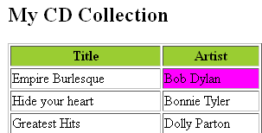
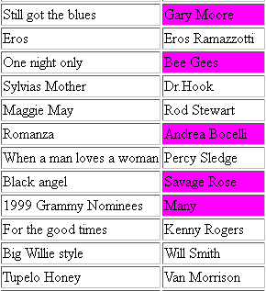
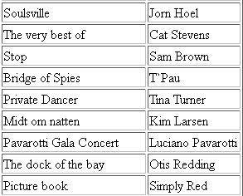
The code above will add a pink background-color to the "Artist" column WHEN the price of the CD is higher than 10.

Slide 39
Example
<?xml version="1.0" encoding="UTF-8"?>
<xsl:stylesheet version="1.0"
xmlns:xsl="http://www.w3.org/1999/XSL/Transform">
<xsl:template match="/">
<html>
<body>
<h2>My CD Collection</h2>
<table border="1">
<tr bgcolor="#9acd32">
<th>Title</th>
<th>Artist</th>
</tr>

Slide 40
<xsl:for-each select="catalog/cd">
<tr>
<td><xsl:value-of select="title"/></td>
<xsl:choose>
<xsl:when test="price &gt; 10">
<td bgcolor="#ff00ff">
<xsl:value-of select="artist"/></td>
</xsl:when>
<xsl:when test="price &gt; 9">
<td bgcolor="#cccccc">
<xsl:value-of select="artist"/></td>
</xsl:when>
<xsl:otherwise>
<td><xsl:value-of select="artist"/></td>
</xsl:otherwise>
</xsl:choose>
</tr>
</xsl:for-each>
</table>
</body>
</html>
</xsl:template>
</xsl:stylesheet>

Slide 41
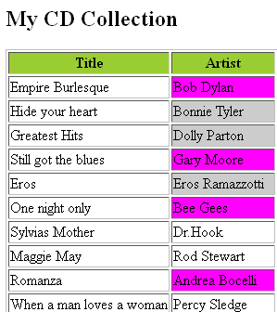

Slide 42
XSLT <xsl:apply-templates> Element
The <xsl:apply-templates> element applies a template to the current element or to the current element's child nodes.
The <xsl:apply-templates> Element
The <xsl:apply-templates> element applies a template to the current element or to the current element's child nodes.
If we add a select attribute to the <xsl:apply-templates> element it will process only the child element that matches the value of the attribute. We can use the select attribute to specify the order in which the child nodes are processed.

Slide 43
<?xml version="1.0" encoding="UTF-8"?>
<xsl:stylesheet version="1.0"
xmlns:xsl="http://www.w3.org/1999/XSL/Transform">
<xsl:template match="/">
<html>
<body>
<h2>My CD Collection</h2>
<xsl:apply-templates/>
</body>
</html>
</xsl:template>
<xsl:template match="cd">
<p>
<xsl:apply-templates select="title"/>
<xsl:apply-templates select="artist"/>
</p>
</xsl:template>
<xsl:template match="title">
Title: <span style="color:#ff0000">
<xsl:value-of select="."/></span>
<br />
</xsl:template>
<xsl:template match="artist">
Artist: <span style="color:#00ff00">
<xsl:value-of select="."/></span>
<br />
</xsl:template>
</xsl:stylesheet>

Slide 44
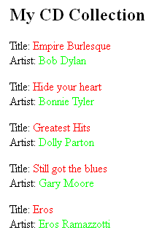

Slide 45
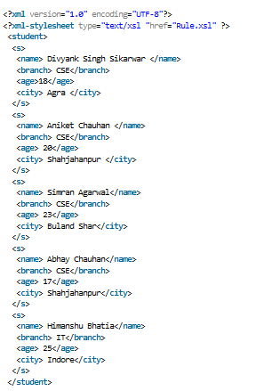
Students.xml

Slide 46
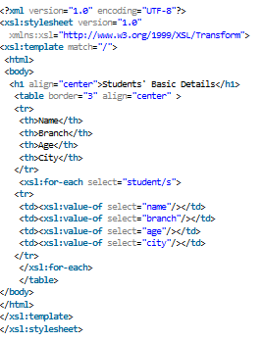
Rule.xsl

Slide 47
