Slide 1
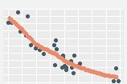


render
manipulate
: describe interactive figure using clear, unifying grammar

