Slide 1
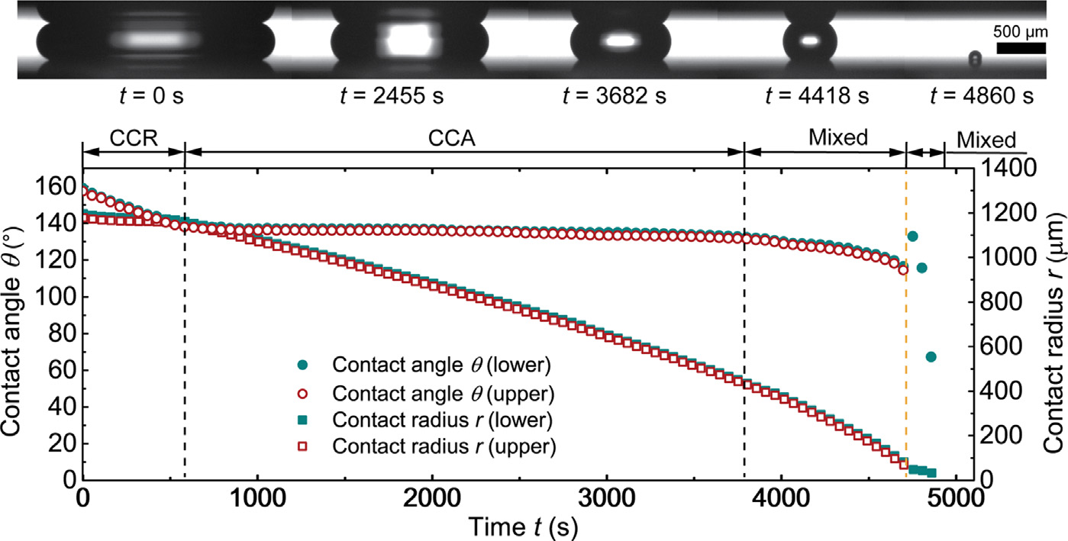
Droplet Confined in parallel plate
Fig:Evaporation of squeezed water droplets between two parallel hydrophobic/superhydrophobic surfaces,Xukun He

Slide 2

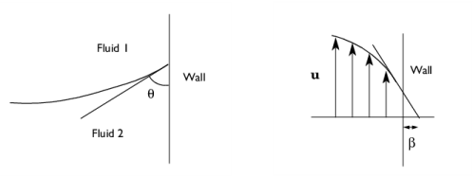
Physics Modules used
Laminar Flow
  The Laminar Flow (spf) interface is used to compute the velocity and pressure fields for the flow of a single-phase fluid in the laminar flow regime
  Wetted wall to pin the droplet at desirable CA
Level Set
  The level set method is a technique to represent moving interfaces or boundaries using a fixed mesh.
  Allows for incorporation of mass flux at interface

Slide 3
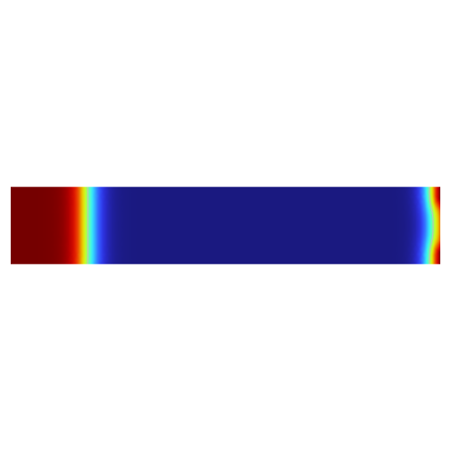
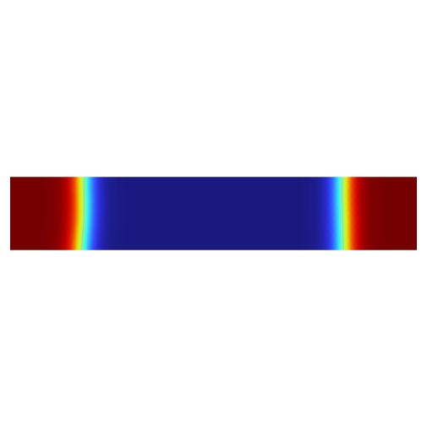
Results
Studing the system at constant contact angle regime at various contact angles
At pi/6:
t=0
t=10

Slide 4
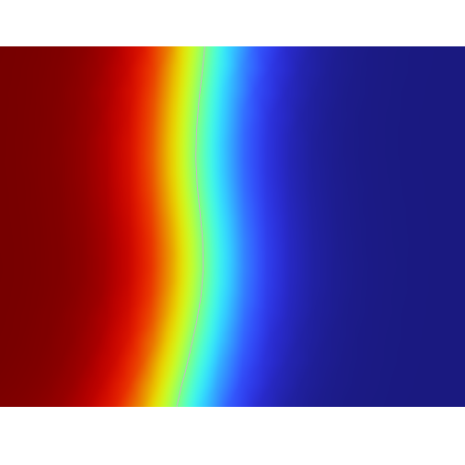
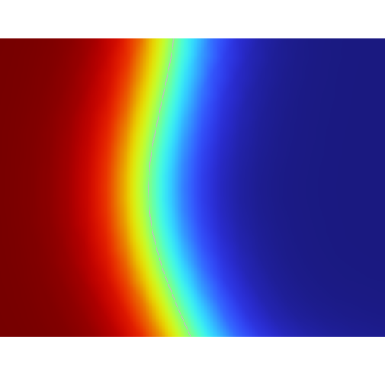

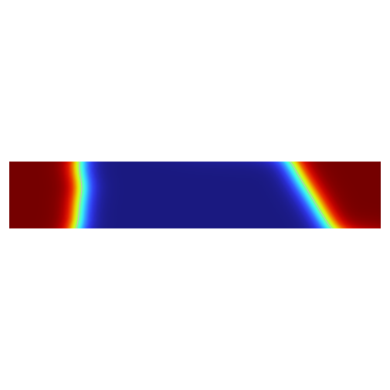
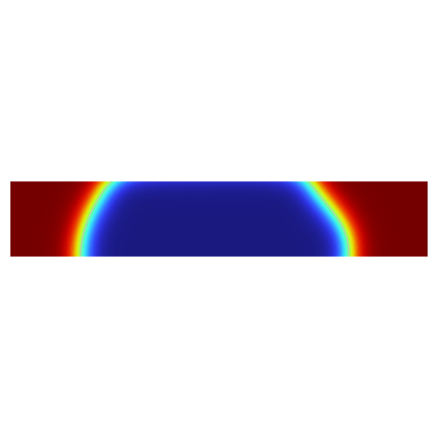
At pi/3:
t=0
t=10
At 3pi/2:
t=0
t=10
t=20

Slide 5
Results
Splitting of droplet at exterme contact angle, using finer mesh might prevent this
Droplet settle at expected position in the nominal cases
Gravity is neglected in the study, so the assymetry in the 3pi/2 case is unexpected

Slide 6
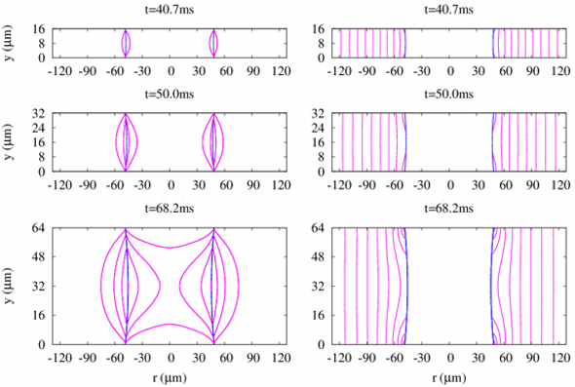
To do
Work on droplet splitting
Velocity flow inside the droplet, could be tracked precisely using Particle tracking method
Incorporate the mass flux at the interface and study the evolution of the droplet at various volume
Fig 9:Numerical simulation of droplet evaporation between two
circular plates† Hangjin Ban and Gihun Son*

