Slide 1
DATE4/10/25
Presentation
Impact of social media
😨😨

Slide 2

Name:Zacith iprahim
Name:muztaph dahir
Name:Nazra hebel
Slide 1:
TitleThe Benefits and Drawbacks of Social Media By: [Your Name] Date: [Insert Date]--Slide
Introduction Social media plays a major role in modern life.
It connects people globally through platforms like Facebook, TikTok,
and Instagram. Youth are the biggest users, relying on it for entertainment, news, and communication.
This presentation explores both the positive and negative side

Slide 3
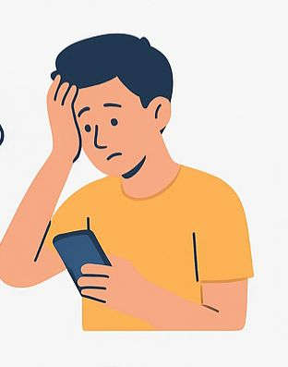
DATE: 4/10/25
Slide 2
It breaks communication barriers and helps maintain relationships. It’s useful for both personal and professional networking.---
Educational OpportunitiesPlatforms like YouTube and LinkedIn offer free learning content. Students can join study groups and follow educational pages.
Live sessions and webinars are easily accessible. It promotes knowledge
sharing across the globe.---

Slide 4
DATE:4/10/25
SLIDE 3
Awareness and ActivismSocial media spreads awareness on social and health issues.
Movements like #BlackLivesMatter gained strength through it. Youth are more engaged in social change.
It empowers people to speak out and mobilize others.
Time Consumption Social media can become addictive and waste time. Many spend hours scrolling without purpose.
It reduces productivity and focus. Leads to neglect of studies or responsibilities.

Slide 5
DATE:4/10/25
SLIDE 4
Slide 8: Mental Health EffectsExcessive use causes stress, anxiety, and depression. People compare their lives to unrealistic online images. Cyberbullying is common and harmful. Sleep issues arise from night-time screen use.---
Slide 9: Misinformation & PrivacyFalse information spreads fast on social media. Users may fall for scams or fake news. Personal data is often at risk. Oversharing can lead to identity theft or harassment.---
Slide 10: ConclusionSocial media has clear benefits and serious risks. The key is balanced, mindful usage. Education and awareness can reduce harm.

Slide 6
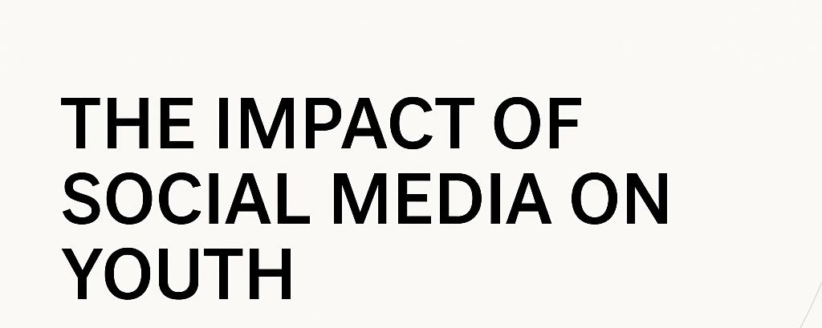
END

