Slide 1
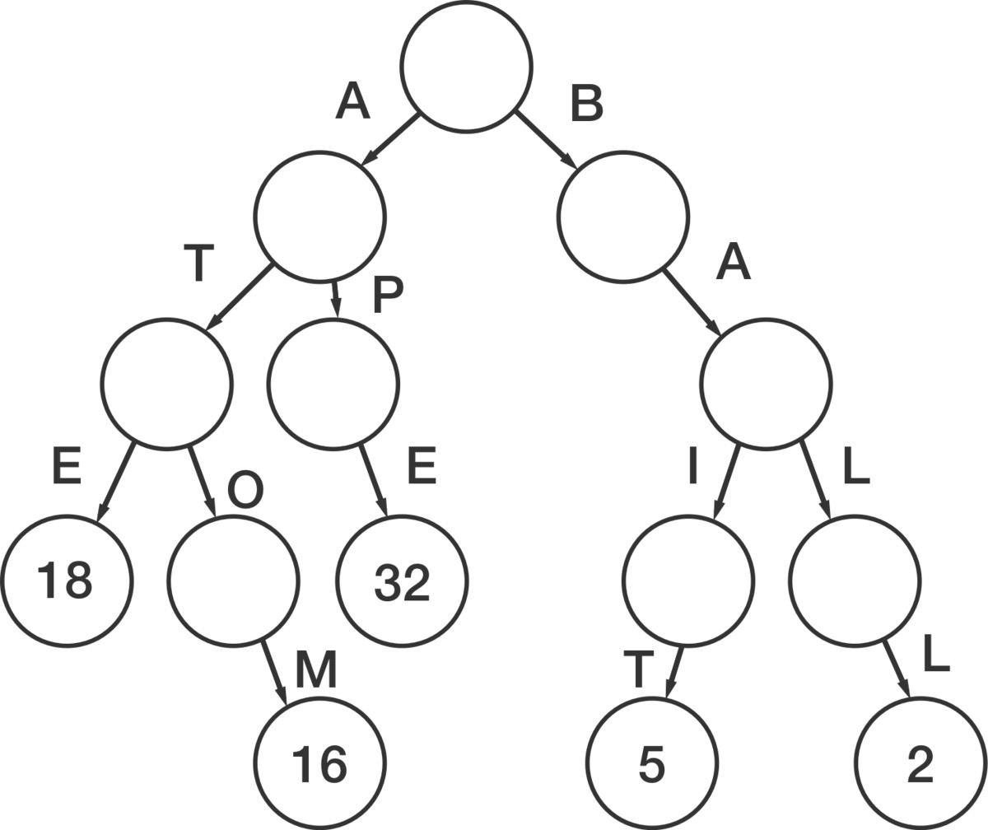
Tries
By Adri Wessels
IOI Training Camp 2 (8-9 February 2019)

Slide 2
Tries
A “tree”-type structure used to store key-value pairs or optionally just existence of keys.
Also known as retrieval trees, radix trees or prefix trees.
Made to be a compromise between time and memory.
Each node stores only a single character of the key, with the final node of the key also storing the value inserted with the key.
Creates an implicit ordering of the keys through it’s implementation.
Pronounced “try”.

Slide 3
Tries – Example:
We start with the empty root node

Slide 4
Tries – Example:
We start with the empty root node
We then begin adding the nodes for the first key: “atom”
a

Slide 5
Tries – Example:
We start with the empty root node
We then begin adding the nodes for the first key: “atom”
a
t

Slide 6
Tries – Example:
We start with the empty root node
We then begin adding the nodes for the first key: “atom”
a
t
o

Slide 7
Tries – Example:
We start with the empty root node
We then begin adding the nodes for the first key: “atom”
a
t
o
m

Slide 8
Tries – Example:
We start with the empty root node
We then begin adding the nodes for the first key: “atom”
Then the associated value: 16
a
t
o
m
16

Slide 9
Tries – Example:
We start with the empty root node
We then begin adding the nodes for the first key: “atom”
Then the associated value: 16
We can then add another key: “ate”
a
t
o
m
16

Slide 10
Tries – Example:
We start with the empty root node
We then begin adding the nodes for the first key: “atom”
Then the associated value: 16
We can then add another key: “ate”
a
t
o
m
16

Slide 11
Tries – Example:
We start with the empty root node
We then begin adding the nodes for the first key: “atom”
Then the associated value: 16
We can then add another key: “ate”
a
t
e
o
m
16

Slide 12
Tries – Example:
We start with the empty root node
We then begin adding the nodes for the first key: “atom”
Then the associated value: 16
We can then add another key: “ate”
Then the value again: 18
a
t
e
o
18
m
16

Slide 13
Tries – Example:
We start with the empty root node
We then begin adding the nodes for the first key: “atom”
Then the associated value: 16
We can then add another key: “ate”
Then the value again: 18
Maybe we want to add the key: “at”
a
t
e
o
18
m
16

Slide 14
Tries – Example:
We start with the empty root node
We then begin adding the nodes for the first key: “atom”
Then the associated value: 16
We can then add another key: “ate”
Then the value again: 18
Maybe we want to add the key: “at”
a
t
e
o
18
m
16

Slide 15
Tries – Example:
We start with the empty root node
We then begin adding the nodes for the first key: “atom”
Then the associated value: 16
We can then add another key: “ate”
Then the value again: 18
Maybe we want to add the key: “at”
a
t
e
o
18
m
16

Slide 16
Tries – Example:
We start with the empty root node
We then begin adding the nodes for the first key: “atom”
Then the associated value: 16
We can then add another key: “ate”
Then the value again: 18
Maybe we want to add the key: “at”
Then the value: 20
a
t
20
e
o
18
m
16

Slide 17
Tries – Example:
We start with the empty root node
We then begin adding the nodes for the first key: “atom”
Then the associated value: 16
We can then add another key: “ate”
Then the value again: 18
Maybe we want to add the key: “at”
Then the value: 20
Finally we have our completed trie with our 3 keys ordered: at, ate, atom.
a
t
20
e
o
18
m
16

Slide 18
Tries – Example:
From our example we can see that insertion is O(L) where L is the length of the key since we just traverse the tree down and go through L nodes along the way.
Similarly checking if a key exists or getting the value of a key is also O(L) since we essentially do the same thing, but then just retrieve the value at the end.
The example also shows that a prefix of another key can also be its own key (Note: This is dependant on the implementation).
It should also be noted that the keys do not have to be strings and can be any type that can be represented as an array of a smaller type where the smaller type is the equivalent “character” type.

Slide 19
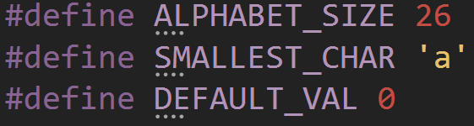
Tries – Implementation:
First we need some defines
ALPHABET_SIZE is the amount of different values each character can take.
SMALLEST_CHAR is the smallest value that each character can take so that the characters can be offset to start at 0.
DEFAULT_VAL is the default value that a node stores when it doesn’t store an inserted value. Another implementation is to have nodes store pointers to values and then use nullptr as the default value.

Slide 20

Tries – Implementation:
The implementation of the tree itself amounts to a single Node pointer.
The implementation shown uses strings as keys and ints as values, but you can change this if you need to without too much trouble.

Slide 21
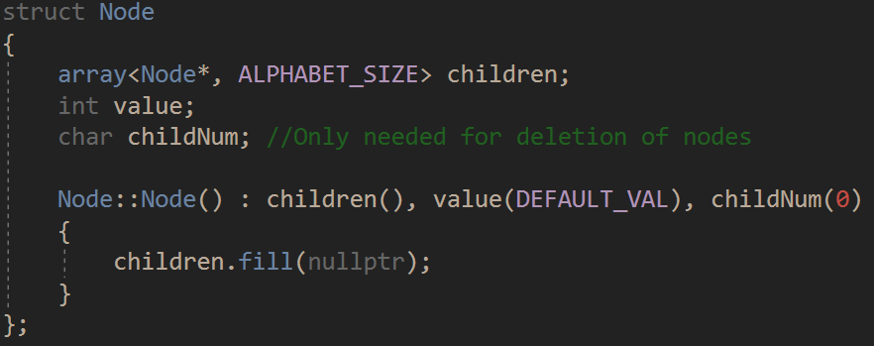
Tries – Implementation:
Next we have the Nodes which store all the data and connect to each other by storing pointers to their children.
Note: std::array is used here, but it can be replaced with a normal array. This does require you to include <array>.

Slide 22
Tries – Implementation:
To insert we traverse down the tree until we reach the end of the key and then add the value in.
At each step you check if the node already exists.
If the node exists, traverse to it.
If it doesn’t, create it and traverse to it.
When you traversed down to the last node of the key, give that node the value.
Note: The new keyword is used to create new Nodes because it’s easier (and probably faster) than having a global vector to store them all in. You can also create the root note with new if you want to.

Slide 23
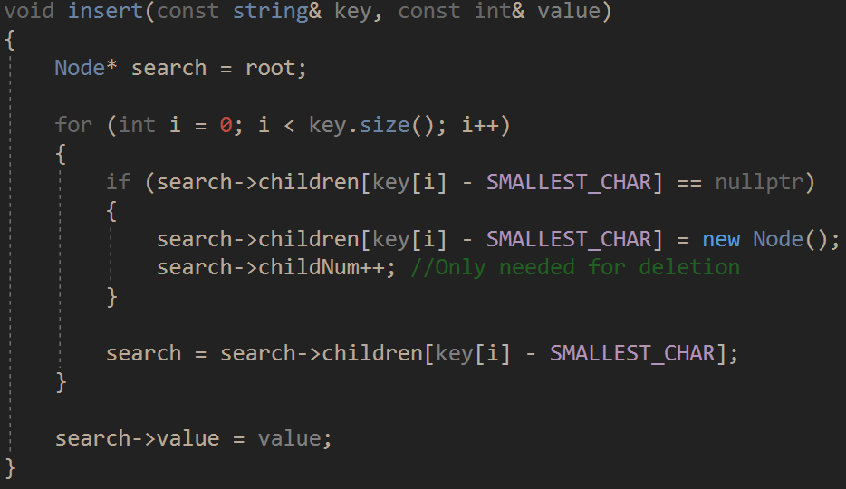
Tries – Implementation:

Slide 24
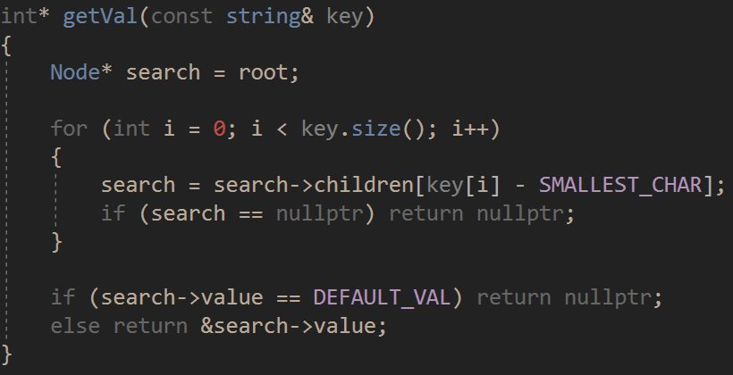
Tries – Implementation:
The method to get the value for the key returns a pointer to the value.
We also traverse the tree, but if a node doesn’t exist we just return nullptr.
If we get to the end we return the address of the value.

Slide 25
Tries – Implementation:
To delete we need to traverse down the tree and then traverse back up while deleting nodes that don’t correspond to any other keys along the way.
The easiest way to do this is with recursion.
We traverse down to the bottom and then remove the value from the last node of the key.
On the way back up the key we check if the node has any children, and if it is storing a value. If neither of these are true we can delete it.
We then return whether we deleted the node so that the next node up knows to remove the deleted node from it’s children.
Not as easy as the rest of the implementation, but also not always necessary.

Slide 26
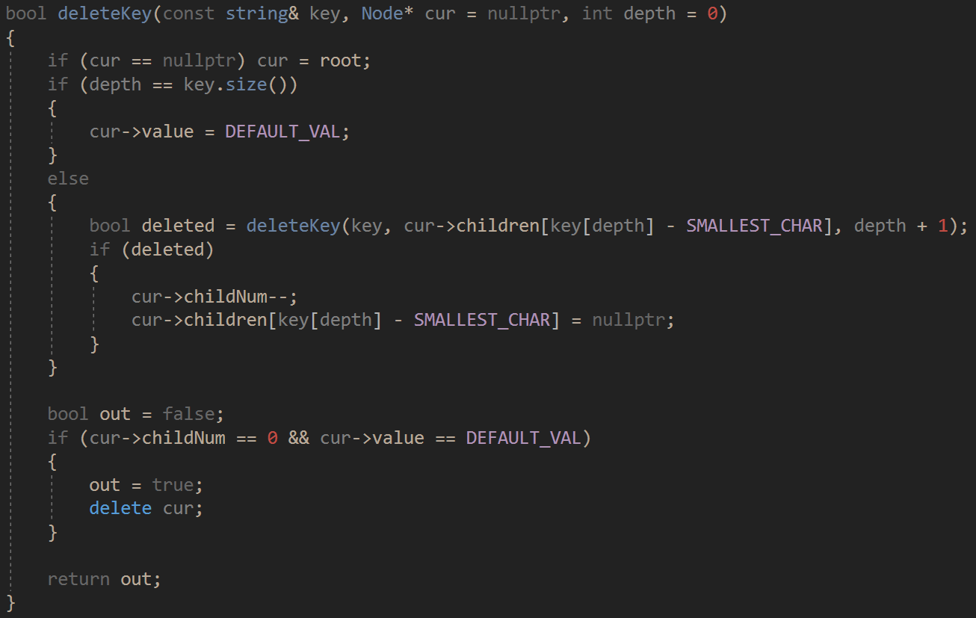
Tries – Implementation:

Slide 27
Tries – Analysis:
Inserting, retrieving and deleting values is O(L) because the dominating term is the traversal of the trie along the key.
Space complexity is O(NL) where N is the number of keys and L is the length of the longest key.

