Slide 1
Dynamic Programming

Slide 2
What is dynamic programming?
‘Programming’ - a mathematical term
Break problem into subproblems
Work backwards
Can use ‘recursion’
1
1 1
1 2 1
1 3 3 1
1 4 6 4 1
1 5 10 10 5 1
Pascal’s DP Triangle

Slide 3
Comparison to normal recursion
Explicitly solve subproblems first
Avoid recalculation
Not as flexible

Slide 4
Eg: Fibonacci numbers
f(1) = f(2) = 1
f(n) = f(n – 1) + f(n – 2)
1 1 2 3 5 8 13 21 35…

Slide 5
Recursive Fibonacci
int fibonacci(int n)
{
if (n <= 2)
return 1;
return fibonacci(n - 1) + fibonacci(n - 2);
}

Slide 6
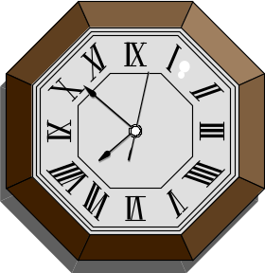
The problem
Recursion:
time vs memory
f(7)
f(6)
f(5)
f(5)
f(4)
f(4)
f(3)
f(4)
f(3)
f(3)
f(2)
f(3)
f(2)
f(2)
f(1)
f(3)
f(2)
f(2)
f(1)
f(2)
f(1)
f(2)
f(1)
f(2)
f(1)

Slide 7
The solution: variables instead of functions
f(7)
int fibonacci(int n)
{
int f[...];
f[1] = f[2] = 1;
for (int i = 3; i <= n; i++)
f[i] = f[n - 1] + f[n - 2];
return f[n];
}
f(6)
f(5)
f(4)
f(3)
f(2)
f(1)
DP: Arrays and ‘for’ loops

Slide 8
Golden Ratio Fibonacci
Is the DP solution always the most efficient
?

Slide 9
Drawbacks | Advantages
Space – the ‘curse of dimensionality’
Can be conceptually difficult
Speed – polynomial (unlike recursion)
Coding complexity (compared to full searches)
Problems can often be considered from different angles

Slide 10
Different angles – eg. knapsack problem

Slide 11

Reducing dimensions
f(7)
Not all examples are as obvious as this one…
f(6)
f(5)
f(4)
last two required
f(3)
f(2)
can reduce to constant amount of space instead of linear – removes necessity for dynamic array
f(1)

Slide 12
Typical applications
Find maximum/minimum possible…
Calculate the number of ways in which…
Consider DP instead of recursion or a full search when:
The time required is exponential and is not severely limited
Working forwards yields too many complexities … (Guji paths…)

Slide 13
Eg: Subset Sums [Spring 98 USACO]
Summary: in how many ways can the set of numbers 1 to n be divided into two subsets with identical sums?
Eg with the set {1, 2, 3} there is one way: {1, 2} and {3} since
(1 + 2) = (3)
Note: {3} and {1, 2} is not counted as another way…

Slide 14

The underlying DP problem:

Slide 15
The recursion
Let P[T, N] be the number of possible ways in which a total of T can be reached by adding together numbers up to and including N. (Numbers cannot be used more than once)
Thus P[T, N] = P[T, N – 1] + P[T – N, N - 1]
More specifically: if there are 2 ways of making 3 using numbers up to 4, then with the use of 5 you know there are 2 ways of making 8, and you can add this to the original 1 way you had of making 8 using numbers up to 4.

Slide 16
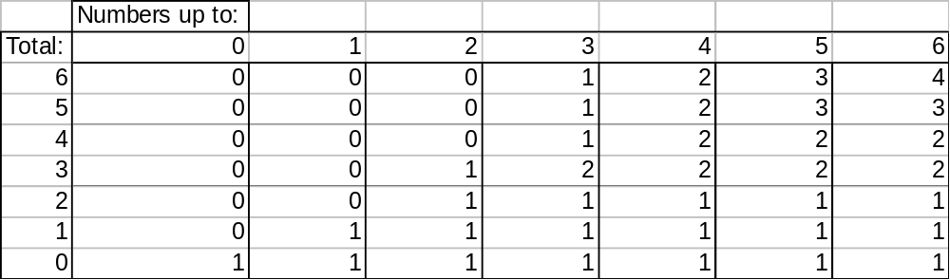
The process

Slide 17
The process

Slide 18
The process

Slide 19
The process
You can remove a dimension by keeping a spare; but you can remove the spare if you order is correct

Slide 20
Missing unnecessary information
In the previous example we have no idea which combinations could produce those sums; only the number of possible combinations.
The fact that the details of the combinations were not specified as necessary for the solution is another clue pointing towards DP.
If we were required to calculate the combinations, either a full search or much more complicated DP would be necessary which kept track of all sub-possibilities…

Slide 21
IOI example: number game
6 46 17 31 22 41 21 43 27 8 20 26 3 16 45

Slide 22
Too many possibilities?
Work backwards…
21

Slide 23
Too many possibilities?
Work backwards…
21 43

Slide 24
Too many possibilities?
Work backwards…
21 43 27

Slide 25
Too many possibilities?
Work backwards…
First: A; Second: B
6 46 17 31 22 41 21 43 27 8 20 26 3 16 45
First: C; Second: D
6 46 17 31 22 41 21 43 27 8 20 26 3 16 45

Slide 26

So…
You only need a 2D array which gives the optimum first and second player score for subsequences of different length. But this can be compressed into a 1D array and a spare, and with care the spare can be removed.
All thanks to DP!

Slide 27
Why not chess?

Slide 28
The End

