Slide 1
Mathematical Proofs
And how they are applied to Computer Olympiads

Slide 2
Counter Example
Can ONLY be used to DISPROVE a proposition, NEVER to PROVE it, by not being able to find one!
You have to prove there is no counter example, for it to prove the proposition.

Slide 3
Proof by contradiction
Basic idea:
You want to prove a proposition true.
Assume that the given proposition is untrue.
Based on that assumption reach a statement that is impossible.
Thus the assumption is false.
Hence the proposition must be true.

Slide 4
Example 1
Prove there is no largest prime, i.e. there are an infinite amount of them.
Proof by contradiction:
Assume there are not infinitely many primes
Call them: p₁, p₂ , p₃, p₄…p_{n}
Consider the number x = p₁*p₂*p₃*p₄…*p_{n} + 1
x is clearly not prime because since it does not equal p₁, p₂ , p₃, p₄…p_{n}
Known Fact: Any number has a prime devisor

Slide 5
Thus x has a prime devisor p_{k}
But we have that p₁, p₂ , p₃, p₄…p_{n} do not divide x
Thus we have another prime p_{k} not equal to p₁, p₂ , p₃, p₄…p_{n}
But we assumed p₁, p₂ , p₃, p₄…p_{n} are all the primes
Thus a contradiction and we have proved there are infinitely many primes and hence no largest prime.

Slide 6
Example 2
Grand Central Taxi Rank (2008 Camp 2 day 2)
You are given a weighted spanning tree.
Find the node that minimises the maximum distance to
any other node.

Slide 7
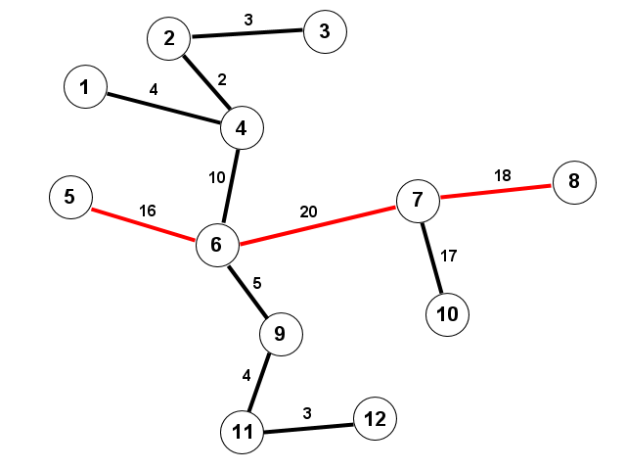

Slide 8
Example 3
Making Change (Online Camp 2008)
You are given a coin system: c₁, c₂ , c₃, c₄…c_{n}
There is a “Greedy” method to make any amount.
Find if greedy algorithm is optimal i.e. do you use the minimal amount of coins.
If not, give the smallest amount for witch it is not optimal.
Small Example: coins 1, 2, 4, 5 and you want to make 8
Greedy: 5+ 2 +1 = 8
Optimal: 4 + 4 = 8
Thus greedy is not optimal

Slide 9
Solution to Making Change
We need to find the smallest value for which the greedy
solution is not optimal or prove that the greedy solution
is always optimal.
Thus test all amounts up to a certain point x.

Slide 10
Greedy method:
For any given amount A, take the largest coin, C, that is
smaller than that amount. Repeat for A = A-C until A=0.
This method is guaranteed to work if you have a coin
with value 1.

Slide 11
DP Method:
for i from 1 to x: //x is the point where we stop testing num[i] = 0
for i from 1 to x:
for j from 0 to n-1: //m is amount of coins
if coin[j] > i:
break
num[i] = min(num[i], num[i – coins[j]] + 1)

Slide 12
Suppose we have a coin system where a greedy
solution is not optimal.
The smallest value for this coin system for which the
greedy method is non optimal is x.
Assume x > 2m, where m is the biggest coin.

Slide 13
minCoin[x] = k and greed[x] = g where k < g.
We use a certain coin, call it d, in the optimal method to make x
Consider amount x-d, we have minCoin[x-d] = k-1
Since x > 2m we have x-d > m.
Since x-d < x the greedy method for x-d is optimal.
The greedy method to make value x-d will use coin m
Since we obtain value x from (x-d) +d we have the optimal solution for x contains coin m
Thus we use coin m in the optimal strategy to make x-d and we will use m in the optimal strategy to make value x.

Slide 14
Proof by contradiction continued
Thus minCoin[x-m] = k-1
The greedy solution for x also contains m.
Thus greed[x-m] = g -1
Then we have k-1 = g-1
Thus contradiction
Thus x <= 2m

