Slide 1
Methods in Combinatorics

Slide 2
Finite, Countable, Discrete.
  Enumerating objects which satisfy a condition.
In short: Counting Stuff
→ Balls & Urns

Slide 3
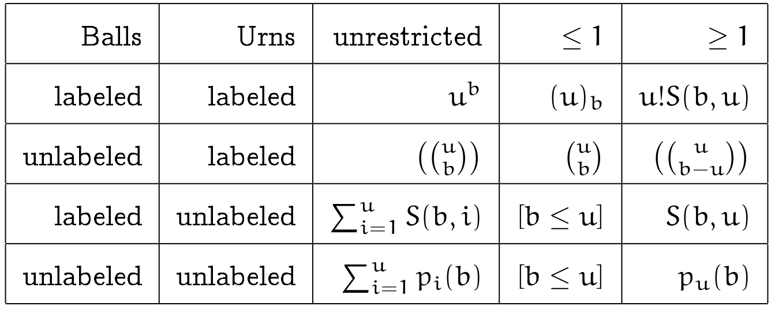
12-fold Way
Let u represent the number of available urns and b the number of balls.
≤ 1 : No more than one ball per urn
≥ 1 : At least one ball per urn

Slide 4
12-fold Way
Labeled balls, labeled urns, unrestricted:
  Total of possibilities.
Labeled balls, labeled urns, ≤ 1:
  Total of possibilities.
Unlabeled balls, labeled urns, ≤ 1:
  Total of possibilities.
  Pascal's Triangle
  Binomial Coefficients

Slide 5
12-fold Way
Unlabeled balls, labeled urns, unrestricted:
  Notation:
  Stars-and-Bars Method:
  Imagine the u urns as spaces between the u-1 bars.
  Example: (4 balls assigned to 3 urns)
  ★ | ★ ★ ★ |
  Among b+u-1 symbols we choose b to be stars...

Slide 6
12-fold Way
Unlabeled balls, labeled urns, ≥ 1
  Put one ball in each urn. Now there are b − u balls that can be distributed without restriction and so this is the previous case.
  Total:

Slide 7
12-fold Way [Stirling Numbers]
Labeled balls, unlabeled urns, ≥ 1
  Stirling numbers of the second kind.
  →
      Example: S(4, 2) = 7
(since {1,2,3,4} can be partitioned into 2 sets in 7 ways as follows:)
{1} ∪ {2, 3, 4}, {2} ∪ {1, 3, 4}, {3} ∪ {1, 2, 4}, {4} ∪ {1, 2, 3},
{1, 2} ∪ {3, 4}, {1, 3} ∪ {2, 4}, {1, 4} ∪ {2, 3}
  Bell numbers are the total partitions for b (i.e. u goes from 0 to b)
How to calculate? No explicit formula. Recurrence relation:
S(n, k) = k S(n − 1, k) + S(n − 1, k − 1)
S(n, k) is defined to be the number of ways to
partition n objects into k non-empty, unordered sets.

Slide 8
12-fold Way [Stirling Numbers]
Labeled balls, unlabeled urns, ≥ 1
  Stirling numbers of the second kind.
How to calculate? No explicit formula. Recurrence relation:
S(n, k) = k S(n − 1, k) + S(n − 1, k − 1) where S(n,n) = S(n,1) = 1

Slide 9
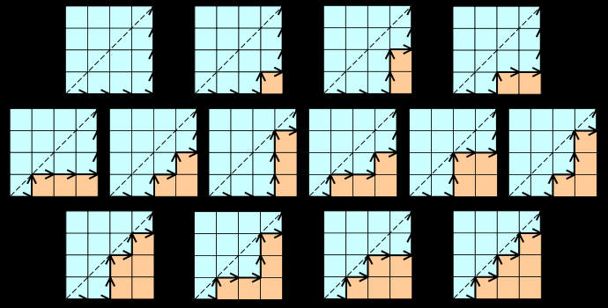
Catalan Numbers
Many applications.
  # sequences with correctly matched parenthesis for n pairs:
  ((())) ()(()) ()()() (())() (()())
  # monotonic paths not crossing the diagonal of an nxn grid:

Slide 10
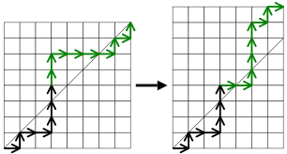
Catalan Numbers
Many applications.

Slide 11
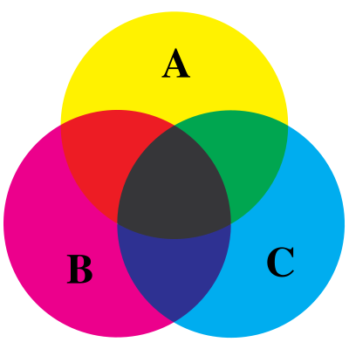
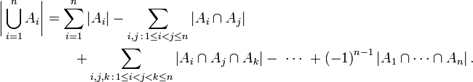
Inclusion Exclusion Principle
~ Common Sense
Compensate for over counting
when evaluating the cardinality of
the union of finite sets.

Slide 12
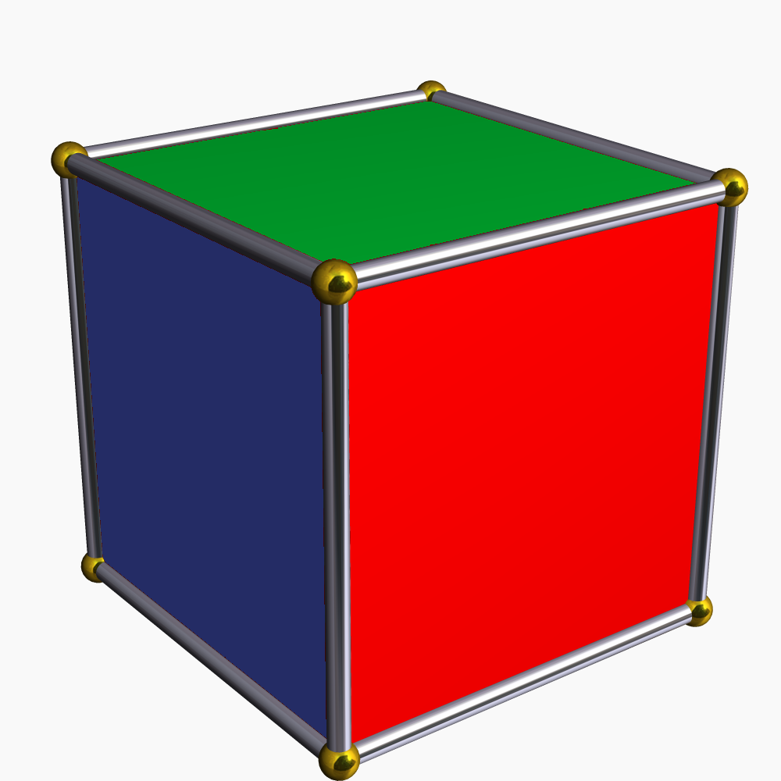
Burnside's Lemma
Colourings which are invarient under transformation.
  E.g. colouring the faces of a cube with 3 colours:
  one identity element
  six 90-degree face rotations
  three 180-degree face rotations
  eight 120-degree vertex rotations
  six 180-degree edge rotations
  How many faces remain unchanged after each transformation?
Total # of possibilites:

