Slide 1
Computational Geometry
Convex Hulls
Robust Geometric Primitives
Degeneracy and Stability
Nick Pilkington

Slide 2
Convex Hull

Slide 3
Convex Hull

Slide 4
Identifying
Two points furthest distance from each other.
Minimum set of points enclosing…
Ideas of fencing, encompassing or enclosing
Diameter, furthest pair, longest distance between…

Slide 5
Algorithms
Jarvis March
  O(n.h)
Graham Scan
  O(n.log n)

Slide 6
Jarvis March
Pick a point that you know to be on the convex hull.
To determine the next point on the hull, loop through all points and find the one that forms the minimum sized anticlockwise angle off the horizontal axis from the previous point.
Continue until you encounter the first point

Slide 7
Pros and Cons
Pros
  Easy to program
Cons
  Slow! Possibly O(n²)

Slide 8
Graham Scan
Find a point you know to be on the convex hull. (Lower y coordinate)
Sort all other points angularly around this point (anti clockwise), by calculating the angle that each point makes with the x axis (within the range 0 to 360 degrees)
Add the first two points to the hull.
For every other point except the last point
Make it the next point in the convex hull
Check to see if the angle it forms with the previous two points is greater than 180 degrees
  As long as the angle formed with the last two points is greater than 180 degrees, remove the previous point
To add the last point
  Perform the deletion above,
  Check to see if the angle the last point forms with the previous point and the first point is greater than 180 degrees or if the angle formed with the last point and the first two points is greater than 180 degrees.
  If the first case is true, remove the last point, and continue checking with the next-to-last point.
  If the second case is true, remove the first point and continue checking.
  Stop when neither case is true.

Slide 9
Graham Scan
8
9
6
10
7
4
11
3
5
2
1

Slide 10
Pros and Cons
Pros
  Fast
  Relatively Easy to Program
Cons
  Bit fiddly to program

Slide 11
Robust Geometric Primitives
Area of a Triangle
Line / Line Segment Intersection
Point in Polygon
Area of a Polygon
Pitfalls, Arithmetic Accuracies, Exceptions.

Slide 12
Area of a Triangle
Heron’s Formula
Area = Sqrt(s(s-a)(s-b)(s-c)), where s = (a+b+c)/2
Determinant / Cross Product

Slide 13
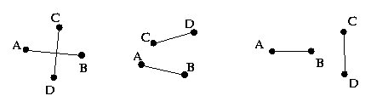
Line/Line Segment
Line / Line Segment
Above and Below Test
Use the signed area of the triangle
Line Segment / Line Segment
Same a s above, however TWO checks are necessary!

Slide 14
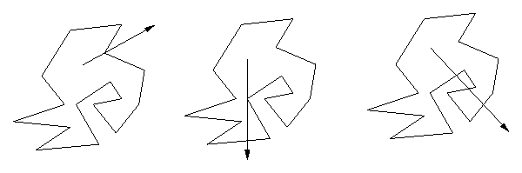
Point in Polygon
Extend the point in a random direction forming a ray.
Find the number of times the ray intersects an edge of the polygon.
Even number of intersections = outside
Odd number of intersection = inside
Algorithm generalizes to 3 dimensions!

Slide 15
Area of Polygon
Area of polygon
The area of a polygon with vertices (x 1, y 1), ..., (x n, y n) is equal to the determinant:
1 | x1 x2 . . . xn |
--- | |
2 | y1 y2 . . . yn |
This formula generalizes to compute d! times the volume of a simplex in d dimensions.
Areas and volumes are signed!

Slide 16
Area of a Polygon
Triangulation
Monte Carlo Methods

Slide 17
Pitfalls
  Degeneracy
    Ignore It !
    Deal with It!
  Numerical Stability
    Precision!
    Rounding Errors!

Slide 18
Questions
IOI 2003 Day 2 :: Boundary
Given a rectangular field with fence posts 1 meter apart along its perimeter. An number of rocks represented by polygons in the field. A viewers position. Calculate the number of fence posts that a person at the viewers position can see, unobstructed by rocks in the field.
O(N.R) 72~80%
O(R log R + N Log d) 100%
***Looking at the top 20 places from IOI 2003 only 6 of them scored more than 72% in this problem. ***

