Slide 1
The Travelling Salesman
Marietjie Venter
Notes:
Selling your ideas is challenging. First, you must get your listeners to agree with you in principle. Then, you must move them to action. Use the Dale Carnegie Training® Evidence – Action – Benefit formula, and you will deliver a motivational, action-oriented presentation.

Slide 2
The Setting
A salesman wants to sell his product in a number of cities.
He wants to visit each city exactly once and then return to the city where he started off.
The cities can be visited in any order.
Notes:
Open your presentation with an attention-getting incident. Choose an incident your audience relates to. The incidence is the evidence that supports the action and proves the benefit. Beginning with a motivational incident prepares your audience for the action step that follows.

Slide 3
The Problem
Find the order in which the salesman has to visit the cities so that the total travelling distance is a minimum, called the optimal tour.
Very simple ☺
Notes:
Next, state the action step. Make your action step specific, clear and brief. Be sure you can visualize your audience taking the action. If you can’t, they can’t either. Be confident when you state the action step, and you will be more likely to motivate the audience to action.

Slide 4
The Solution
Not so simple ☹
Optimal solution is of O(n^x)
Optimization problem:
  Find the best solution you can in the given time, even though it might not be the optimal solution.
Notes:
Next, state the action step. Make your action step specific, clear and brief. Be sure you can visualize your audience taking the action. If you can’t, they can’t either. Be confident when you state the action step, and you will be more likely to motivate the audience to action.

Slide 5
Always Remember
Keep track of the best solution so far.
Keep track runtime so far (if there is a time limit)
Give the best solution so far when time runs out.
Notes:
Next, state the action step. Make your action step specific, clear and brief. Be sure you can visualize your audience taking the action. If you can’t, they can’t either. Be confident when you state the action step, and you will be more likely to motivate the audience to action.

Slide 6
Possible Approaches
Good old random!
  Generate random solutions.
  Keep track of the best solution so far.
  Give the best solution so far when time runs out.
Techniques can be used to improve the solution (discussed later).
Notes:
Next, state the action step. Make your action step specific, clear and brief. Be sure you can visualize your audience taking the action. If you can’t, they can’t either. Be confident when you state the action step, and you will be more likely to motivate the audience to action.

Slide 7
Nearest Neighbour
Construct the tour by going from each city to the closest unvisited city until all the cities have been visited.
Some cities can be “forgotten” only to have to be inserted later at high cost to the solution.
(Greedy algorithm)
Notes:
To complete the Dale Carnegie Training® Evidence – Action – Benefit formula, follow the action step with the benefits to the audience. Consider their interests, needs, and preferences. Support the benefits with evidence; i.e., statistics, demonstrations, testimonials, incidents, analogies, and exhibits and you will build credibility.

Slide 8
Insertion Heuristics
Start with a subtour.
Keep adding cities until all the cities are included.
Things to consider:
  Choice of starting subtour.
  How to choose the next node (city) to insert in the tour.
  Where to insert it.
Notes:
Next, state the action step. Make your action step specific, clear and brief. Be sure you can visualize your audience taking the action. If you can’t, they can’t either. Be confident when you state the action step, and you will be more likely to motivate the audience to action.

Slide 9
Choice of Subtour
Typically 3 cities, e.g. the 3 cities that form the largest triangle.
Very good option: the tour that forms the convex hull of all the nodes (cities).
Notes:
To complete the Dale Carnegie Training® Evidence – Action – Benefit formula, follow the action step with the benefits to the audience. Consider their interests, needs, and preferences. Support the benefits with evidence; i.e., statistics, demonstrations, testimonials, incidents, analogies, and exhibits and you will build credibility.

Slide 10
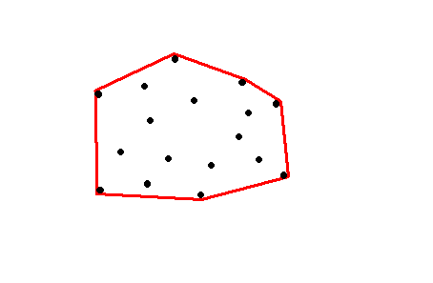
Convex Hull
  Each dot represents a city.
  Red “ring” illustrates the convex hull.
Tour is convex.
All the cities fall inside the ring.
As if you wrap an elastic band around all the cities.
Notes:
To complete the Dale Carnegie Training® Evidence – Action – Benefit formula, follow the action step with the benefits to the audience. Consider their interests, needs, and preferences. Support the benefits with evidence; i.e., statistics, demonstrations, testimonials, incidents, analogies, and exhibits and you will build credibility.

Slide 11
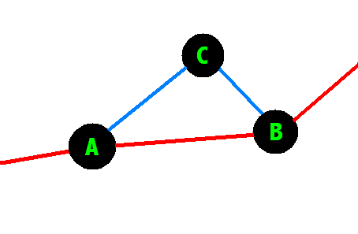
Cheapest Insertion
Each time insert the city which causes the lowest increase in total distance.
((dist AC + dist CB) – dist AB) is a minimum.
(Greedy algorithm)
Notes:
To complete the Dale Carnegie Training® Evidence – Action – Benefit formula, follow the action step with the benefits to the audience. Consider their interests, needs, and preferences. Support the benefits with evidence; i.e., statistics, demonstrations, testimonials, incidents, analogies, and exhibits and you will build credibility.

Slide 12
Farthest Insertion
Insert the city of which its closest distance to the existing tour is a maximum.
The idea is to fix the overall layout of the tour as soon as possible.
Notes:
To complete the Dale Carnegie Training® Evidence – Action – Benefit formula, follow the action step with the benefits to the audience. Consider their interests, needs, and preferences. Support the benefits with evidence; i.e., statistics, demonstrations, testimonials, incidents, analogies, and exhibits and you will build credibility.

Slide 13
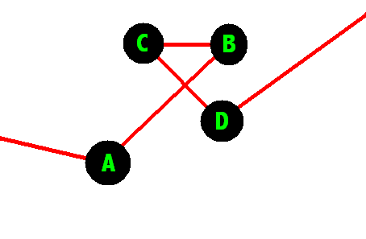
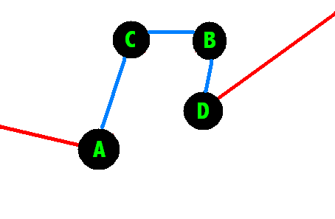
Improving Solutions
Exchange: change the order in which 2 cities occur in the tour and check if this decreases the total distance.
Notes:
To complete the Dale Carnegie Training® Evidence – Action – Benefit formula, follow the action step with the benefits to the audience. Consider their interests, needs, and preferences. Support the benefits with evidence; i.e., statistics, demonstrations, testimonials, incidents, analogies, and exhibits and you will build credibility.

Slide 14
Improving Solutions
Genetic Programming:
  Mutation
    Randomly alter the tour to see if a better one can be found.
  Selective “breeding”
    Take two good solutions and combine them to see if a better one can be constructed.
Notes:
To complete the Dale Carnegie Training® Evidence – Action – Benefit formula, follow the action step with the benefits to the audience. Consider their interests, needs, and preferences. Support the benefits with evidence; i.e., statistics, demonstrations, testimonials, incidents, analogies, and exhibits and you will build credibility.

Slide 15
The Travelling Salesman
Nearest Neighbour
Insertion Heuristics
  Convex hull
  Cheapest insertion
  Farthest insertion
Improving solutions
Notes:
To close, restate the action step followed by the benefits. Speak with conviction and confidence, and you will sell your ideas.

