Slide 1
Network Flow
By Migael Strydom

Slide 2
The Problem
Maximum flow = ?
A
0/6
0/8
B
C
0/3
0/3
0/3
0/6
D
E
0/8
0/6
F

Slide 3
Some Terminology
Source
A
0/6
0/8
B
C
0/3
0/3
0/3
0/6
D
E
0/8
0/6
F
Sink

Slide 4
Flow and Capacity
Capacity
A
0/6
0/8
B
C
0/3
0/3
0/3
0/6
Flow
D
E
0/8
0/6
F

Slide 5
Find a path
Maximum flow = 6
Limiting edges
A
6/6
0/8
B
C
0/3
0/3
0/3
6/6
D
E
6/8
0/6
F

Slide 6
Find a path
Maximum flow = 9
A
6/6
3/8
B
C
0/3
Limiting edge
0/3
3/3
6/6
D
E
6/8
3/6
F

Slide 7
Find a path
Maximum flow = 11
A
6/6
5/8
B
C
2/3
0/3
3/3
6/6
D
E
8/8
3/6
Limiting edge
F

Slide 8
Any more?
A
6/6
5/8
B
C
2/3
0/3
3/3
6/6
D
E
8/8
3/6
F

Slide 9
An interesting twist
Maximum flow = 12
A
6/6
6/8
B
C
3/3
Backward Edge
1/3
3/3
5/6
D
E
8/8
4/6
F
Forward Edge

Slide 10
Voila!
A
6/6
6/8
B
C
3/3
1/3
3/3
5/6
D
E
8/8
4/6
F
Notes:
Notice: Nothing flowing backwards!

Slide 11
The Ford-Fulkerson Method
Start with zero flow through all edges.

Slide 12
The Ford-Fulkerson Method
Find a path from source to sink with no full forward edges or empty backwards edges.

Slide 13
The Ford-Fulkerson Method
Increase the flow by the maximum allowable capacity for the given path. (Recall the Limiting Edge)‏

Slide 14
Constraints
No forward edges may have more flow than their capacity allows.
Nothing may flow backwards.

Slide 15
Constraints –
Programmer-Speak
(edge.flow <= edge.capacity)‏
(edge.flow >= 0)‏
AND (&&)
(edge.residual >= 0)‏
(edge.residual <= edge.capacity)‏

Slide 16
The Crux of the Matter
If every path in a graph from the source to the sink has a full forward edge or an empty backward edge, then the flow is at a maximum.
(An intelligent observation that came as a result of the joint efforts of Mr L. R. Ford and Mr D. R. Fulkerson)‏

Slide 17
Path? What path?

Slide 18
Longest Path
A
0/1000
0/1000
B
0/1
C
0/1000
0/1000
D

Slide 19
Longest Path
A
0/1000
1/1000
B
1/1
C
1/1000
0/1000
D

Slide 20
Longest Path – Not Good
A
1/1000
1/1000
B
0/1
C
1/1000
1/1000
D

Slide 21
Not good at all
A
1/1000
2/1000
B
1/1
C
2/1000
1/1000
D

Slide 22
Again
A
2/1000
2/1000
B
0/1
C
2/1000
2/1000
D

Slide 23
And again
A
2/1000
3/1000
B
1/1
C
3/1000
2/1000
D

Slide 24
And again
A
3/1000
3/1000
B
0/1
C
3/1000
3/1000
D

Slide 25
The Best Path Choice…
Take the shortest path.
If the shortest path from source to sink is used, then the number of paths used before maximum flow is found is less than VE.

Slide 26
Another option
Take the path that increases the flow the most.

Slide 27
The lazy way…
Use breadth-first search.
It will work. The choice of path-finding only affects speed of algorithm, not the answer.

Slide 28
Mincut? What’s that?
Start from source.
Follow every path until first full forward or empty backward edge is found.

Slide 29
It cuts the graph in two!
A
6/6
6/8
B
C
3/3
1/3
3/3
5/6
D
E
8/8
4/6
F

Slide 30
Maxflow-Mincut Theorem
Maximum flow 6+3+3=12
= Minimum Cut
A
6/6
6/8
B
C
3/3
1/3
3/3
5/6
D
E
8/8
4/6
F

Slide 31
Variation
What if the nodes have maximum capacities as well?

Slide 32
A simple modification
Node capacity
2
1
5
3
3
1
2
1
5
3
3
1

Slide 33
Another variation
What about undirected graphs?

Slide 34
Another simple modification
=

Slide 35
Matching
1
2
3
4
5
6
A
B
C
D
E
F

Slide 36
Matching… Or network flow?
Source
1
2
3
4
5
6
A
B
C
D
E
F
Sink

Slide 37
What about edge capacities?
Set the capacities of all edges equal to 1.

Slide 38
Find a path
Source
1
2
3
4
5
6
A
B
C
D
E
F
Sink

Slide 39
Find a path
Source
1
2
3
4
5
6
A
B
C
D
E
F
Sink

Slide 40
Find a path
Source
1
2
3
4
5
6
A
B
C
D
E
F
Sink

Slide 41
Find a path
Source
1
2
3
4
5
6
A
B
C
D
E
F
Sink

Slide 42
Find a path
Source
1
2
3
4
5
6
A
B
C
D
E
F
Sink

Slide 43
That twist again
Source
1
2
3
4
5
6
A
B
C
D
E
F
Sink

Slide 44
A match!
Source
1
2
3
4
5
6
A
B
C
D
E
F
Sink

Slide 45
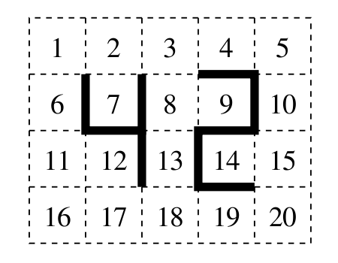
IOI 2005 Practise Round

Slide 46
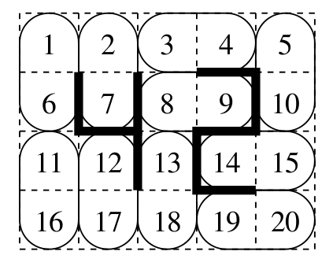
Solution

Slide 47
Thank you for listening

