Slide 1
Minimum Spanning Trees
What is a MST (Minimum Spanning Tree) and how to find it with Prim’s algorithm and Kruskal’s algorithm

Slide 2
Tree
What is a tree?
Root
Children of root node
Notes:
What is a tree?
A tree is a graph which is connected but which has no circuits.
Each of the nodes has:
- 1 parent
- Any number of children

Slide 3
Spanning Tree
Find a subgraph with minimum amount of edges.
There must be a path between every pair of vertices.
Notes:
Given the following graph, find a subgraph with a minimum amount of edges so that there will be a path between every pair of vertices

Slide 4
Spanning Tree
Answer:
This is called a spanning tree

Slide 5
Spanning Tree
What is a spanning tree?
Contains all the vertices of the graph and some or all of the edges
Path from any node to any other node
Notes:
A spanning tree of a graph is a subgraph that contains all the vertices of the graph and some or all of the edges
A spanning tree has a path from any node to any other node
A graph can have lots of spanning trees

Slide 6
Spanning Tree
A graph can have lots of spanning trees
This graph has
3 different spanning trees

Slide 7
Spanning Tree
Graph
T₁
T₂
T₃

Slide 8
Spanning Tree
How many spanning trees does this graph have?
Answer: 8

Slide 9
Minimum spanning tree
Suppose we add weights to the graph
Find the spanning tree with the minimum sum cost
1
5
2
3

Slide 10
Minimum spanning Tree
1
5
2
3
Graph
1
1
1
2
5
5
2
3
3
w(T₁)=6
w(T₁)=9
w(T₁)=8

Slide 11
Minimum spanning Tree
2
3
Graph
w(T₁)=6
This is the minimum spanning tree of the graph
Notes:
A MST is a minimum-weight tree in a weighted graph which contains all of the graph’s vertices.

Slide 12
MST applications
MST’s can be applied to problems like phone networks, computer networks and trail networks

Slide 13
Sample problem
Farmer John has ordered a high speed internet connection and is going to share his connectivity with the other farmers.
To minimize cost, he wants to minimize the length of optical fiber to connect his farm to all the other farms
Notes:
Problem from http://acm.fzu.edu.cn/reference/Minimum%20Spanning%20Tree.htm
Minimum Spanning Tree (MST)
Sample Problem: Agri-Net [Russ Cox, Winter 1999 USACO Open]
Farmer John is bringing internet connectivity to all farms in the area. He has ordered a high speed connection for his farm and is going to share his connectivity with the other farmers. To minimize cost, he wants to minimize the length of optical fiber to connect his farm to all the other farms.
Given a list of how much fiber it takes to connect each pair of farms, find the minimum amount of fiber needed to connect them all together. Each farm must connect to some other farm such that a path exists from any farm to any other farm. Some farms might have 1, 2, 3, or more connections to them.
The Abstraction
Given: an undirected, connected graph with weighted edges
A spanning tree of a graph is any sub-graph which is a connected tree (i.e., there exists a path between any nodes of the original graph which lies entirely in the sub-graph).
A minimal spanning tree is a spanning tree which has minimal `cost' (where cost is the sum of the weights of the edges in the tree).
Prim's algorithm to construct a Minimal Spanning Tree
Given: lists of nodes, edges, and edge costs
The algorithm (greedily) builds the minimal spanning tree by iteratively adding nodes into a working tree.
* Start with a tree which contains only one node. Iteratively find the closest node to that one and add the edge between them.
* Let the distance from each node not in the tree to the tree be the edge (connection) of minimal weight between that node and some node in the tree. If there is no such edge, then assume the distance is infinity (this shouldn't happen).
* At each step, identify a node (outside the tree) which is closest to the tree and add the minimum weight edge from that node to some node in the tree and incorporate the additional node as a part of the tree.
For analysis of why this works, consult Chapter 24 of [Cormen, Leiserson, Rivest].
Here is pseudocode for the algorithm:
# distance(j) is distance from tree to node j
# source(j) is which node of so-far connected MST
# is closest to node j
1 For all nodes i
2 distance(i) = infinity # no connections
3 intree(i) = False # no nodes in tree
4 source(i) = nil
5 treesize = 1 # add node 1 to tree
6 treecost = 0
7 intree(1) = True
8 For all neighbors j of node 1 # update distances
9 distance(j) = weight(1,j)
10 source(j) = 1
11 while (treesize < graphsize)
12 find node with minimum distance to tree; call it node i
13 assert (distance(i) != infinity, "Graph Is Not Connected")
# add edge source(i),i to MST
14 treesize = treesize + 1
15 treecost = treecost + distance(i)
16 intree(i) = True # mark node i as in tree
# update distance after node i added
17 for all neighbors j of node i
18 if (distance(j) > weight(i,j))
19 distance(j) = weight(i,j)
20 source(j) = i
Running time of this formulation is O(N2). You can obtain O(N log N) for sparse graphs, but it normally isn't worth the extra programming time.
Execution Example
Consider the following graph with weighted edges:
The goal is to find the minimal spanning tree. The algorithm will start at node 1 which connects to nodes 2, 6, and 3 with the weights shown on the edges:
Node distance intree source
1 infinity True nil
2 30 False 1
3 20 False 1
6 25 False 1
All nodes not shown have infinite distance, intree=False, and source=nil.
The smallest distance for a node not in the tree is 20, so the listed edge to node 3 is added to the tree:
Node distance intree source
1 infinity True nil
2 9 False 3
3 20 True 1
6 25 False 1
7 7 False 3
Note that node 3 is now `in the tree'. Node 2's distance changed to 9 while the source changed to 3.
The smallest distance is 7, so the edge from node 3 to node 7 (coincidental name!) is connected:
Node distance intree source
1 infinity True nil
2 9 False 3
3 20 True 1
6 10 False 7
7 7 True 3
Node 2's distance is 9, the smallest of any node not in the tree. Adding the edge from node 3 to node 2 results in a graph that looks like this:
Node distance intree source
1 infinity True nil
2 9 True 3
3 20 True 1
4 21 False 2
5 9 False 2
6 10 False 7
7 7 True 3
Add the edge from node 2 to node 5:
Node distance intree source
1 infinity True nil
2 9 True 3
3 20 True 1
4 8 False 5
5 9 True 2
6 10 False 7
7 7 True 3
8 12 False 5
Adding the edge from node 5 to node 4 is the next step:
Node distance intree source
1 infinity True nil
2 9 True 3
3 20 True 1
4 8 True 5
5 9 True 2
6 10 False 7
7 7 True 3
8 12 False 5
Next up: edge connecting nodes 6 and 7:
Node distance intree source
1 infinity True nil
2 9 True 3
3 20 True 1
4 8 True 5
5 9 True 2
6 10 True 7
7 7 True 3
8 11 False 6
Finally, add the edge from node 6 to node 8:
Node distance intree source
1 infinity True nil
2 9 True 3
3 20 True 1
4 8 True 5
5 9 True 2
6 10 True 7
7 7 True 3
8 11 True 6
And the minimal spanning tree is easily seen here.
Dangerous Curve
Understand that changing any element in a tree requires complete recalculation - incremental recalculation of a spanning tree when changing isolated nodes, for example, is not generally possible.
Problem Cues
If the problem mentions wanting an optimal, connected sub-graph, a minimum cost way to connect a system together, or a path between any two parts of the system, it is very likely to be a minimum spanning tree problem.
Extensions
If you subject the tree to any other constraints (no two nodes may be very far away or the average distance must be low), this algorithm breaks down and altering the program to handle such constraints is very difficult.
There is obviously no problem with multiple edges between two nodes (you ignore all but the smallest weight).
Prim's algorithm does not extend to directed graphs (where you want strong connectedness), either.
Sample Problems
Package Routing
Given: a set of locations of cities and the cost of connecting each pair of cities for a shipping company. Find the cheapest set of pairs of cities such that a package can be routed from any city to any other city.
Highway Building
Lower Slobbovia has made the plunge and has decided to connect all their cities with roads. Of course, being cheap, they want to spend as little money as possible. The cost of a highway is linearly proportional to its length. Given the x,y coordinates of the cities in L.S., find the cheapest way to interconnect the cities.
Bovile Phones (abridged) [USACO Training Camp 1998, Contest 2]
Given: a collection of stationary cows and haystacks in the field along with a cost function for connecting two (arbitrary) locations. Using only the haystacks and cows, calculate which haystacks one should include in a network to minimize the total cost.
Analysis: For each possible set of haystacks (i.e., about 2 n sets), calculate the cost of the minimal spanning tree of the haystacks in that set along with all the cows. Find the combination of haystacks that minimizes the cost.

Slide 14
How to solve a MST
One way to solve a MST, is to find all the spanning trees of the graph and find the minimum one, but
  the number of spanning trees grows exponentially with the graph size
  Generating all spanning trees for a weighted graph is not easy

Slide 15
Prim’s algorithm
One way to solve a MST is with Prim’s algorithm
Prim’s algorithm builds a tree one vertex at a time
Start by selecting a vertex randomly
On each iteration, simply add the nearest vertex not in the tree connected to a vertex in the tree
The algorithm stops when all the graph’s vertices has been included in the tree being constructed
This is a greedy algorithm

Slide 16
Prim’s algorithm
The algorithm
let T be a single vertex
while (T has fewer than n vertices)
{
find the smallest edge connecting a vertex
not in the tree to a vertex in the tree
add it to T
}

Slide 17
Prim’s algorithm
The algorithm with more detail:
Initialize MST to vertex 0.
priority[0] = 0
For all other vertices, set priority[i] = infinity
Initialize prioritySet to all vertices;
while prioritySet.notEmpty()
v = remove minimal-priority vertex from
prioritySet;
for each neighbor u of v
// Explore the edge.
w = weight of edge (v, u)
if w < priority[u]
priority[u] = w
endif
endfor
endwhile
Running time: O(n²)

Slide 18
Prim’s algorithm
O(V²) is too slow when finding the MST of a very large graph
Some data structures can be used to speed it up
Use a heap to remember, for each vertex, the smallest edge connecting T with that vertex.

Slide 19
Prim’s algorithm (heap)
Prim’s algorithm with a heap:
make a heap of values (vertex,edge,weight(edge))
initially (v,-,infinity) for each vertex
let T be a single vertex x
for each edge f=(u,v)
add (u,f,weight(f)) to heap
while (T has fewer than n vertices)
let (v,e,weight(e)) be the edge with the
smallest weight on the heap
remove (v,e,weight(e)) from the heap
add v and e to T
for each edge f=(u,v)
if u is not already in T
find value (u,g,weight(g)) in heap
if weight(f) < weight(g)
replace (u,g,weight(g)) with
(u,f,weight(f))
Running time: O(m + n log n)

Slide 20
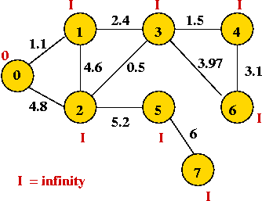
Prim’s algorithm demonstration
Initially, place vertex 0 in the MST and set the "priority" of each vertex to infinity.
∞
∞
∞
∞
∞
∞
∞

Slide 21
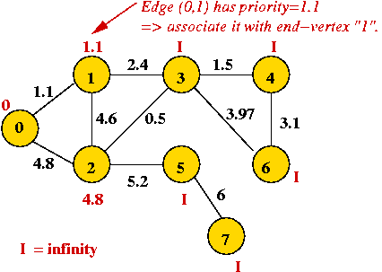
Prim’s algorithm demonstration
Explore edges from current MST: (0, 1) and (0, 2)
∞
∞
∞
∞
∞

Slide 22
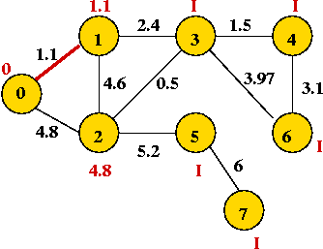
Prim’s algorithm demonstration
Pick lowest-weight edge (0, 1) to add => same as selecting lowest-priority vertex (vertex 1)
∞
∞
∞
∞
∞

Slide 23
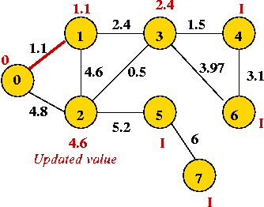
Prim’s algorithm demonstration
Explore edges from newly-added vertex: (1,3), (1,2)
∞
∞
∞
∞

Slide 24
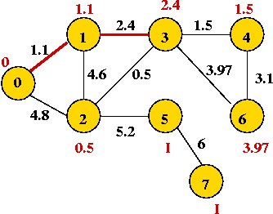
Prim’s algorithm demonstration
Pick vertex with lowest priority (vertex 3) and explore its edges:
∞
∞

Slide 25
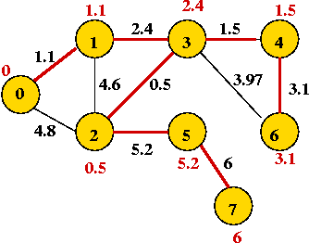
Prim’s algorithm demonstration
Continuing, we add vertices 2, 4, 6, 5 and 7:

Slide 26
Kruskal’s algorithm
Another way to solve a MST is with Kruskal’s algorithm
Kruskal is easier to code and easier to understand
This is a greedy algorithm
Basics of algorithm:
  Sort edges in order of increasing weight.
  Process edges in sort-order.
  For each edge, add it to the MST if it does not cause a cycle.

Slide 27
Kruskal’s algorithm
More advanched algorithm:
Initialize MST to be empty;
Place each vertex in its own set;
Sort edges of G in increasing-order;
for each edge e = (u,v) in order
if u and v are not in the same set
Add e to MST;
Compute the union of the two sets;
endif
endfor
return MST
Running time: O(m log m)

Slide 28
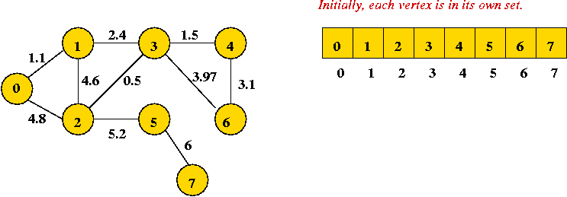
Kruskal’s algorithm example
Initially:
Sort order of edges: (2, 3), (0, 1), (3, 4), (1, 3), (4, 6), (3, 6), (1, 2), (0, 2), (2, 5), (5, 7)

Slide 29
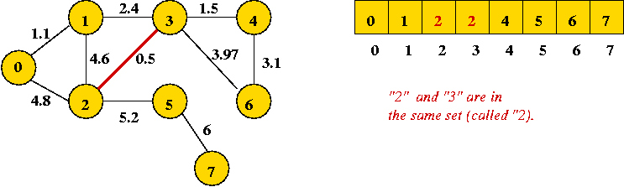
Kruskal’s algorithm example
First edge to add joins "2" and "3" (no cycle):
Sort order of edges: (2, 3), (0, 1), (3, 4), (1, 3), (4, 6), (3, 6), (1, 2), (0, 2), (2, 5), (5, 7)

Slide 30
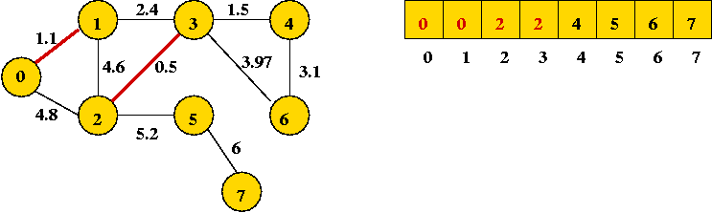
Kruskal’s algorithm example
Next edge in sort order: (0, 1):
Sort order of edges: (2, 3), (0, 1), (3, 4), (1, 3), (4, 6), (3, 6), (1, 2), (0, 2), (2, 5), (5, 7)

Slide 31
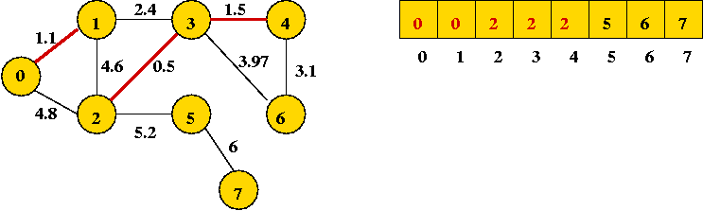
Kruskal’s algorithm example
Next edge in sort order: (3, 4):
Sort order of edges: (2, 3), (0, 1), (3, 4), (1, 3), (4, 6), (3, 6), (1, 2), (0, 2), (2, 5), (5, 7)

Slide 32
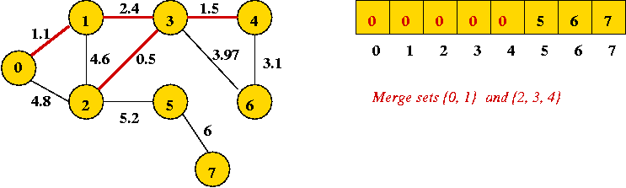
Kruskal’s algorithm example
Next edge in sort order: (1, 3): merges two sets (union)
Sort order of edges: (2, 3), (0, 1), (3, 4), (1, 3), (4, 6), (3, 6), (1, 2), (0, 2), (2, 5), (5, 7)

Slide 33

Kruskal’s algorithm example
Next edge in sort order: (4, 6):
Sort order of edges: (2, 3), (0, 1), (3, 4), (1, 3), (4, 6), (3, 6), (1, 2), (0, 2), (2, 5), (5, 7)

Slide 34
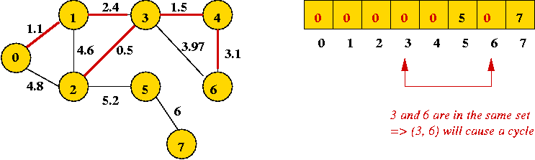
Kruskal’s algorithm example
Next edge in sort order: (3, 6): cannot be added
Next two edges also cannot be added: (0, 2) and (1, 2).
Sort order of edges: (2, 3), (0, 1), (3, 4), (1, 3), (4, 6), (3, 6), (1, 2), (0, 2), (2, 5), (5, 7)

Slide 35
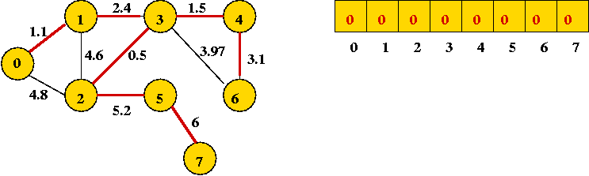
Kruskal’s algorithm example
Finally, add (2, 5) and (5, 7):
Sort order of edges: (2, 3), (0, 1), (3, 4), (1, 3), (4, 6), (3, 6), (1, 2), (0, 2), (2, 5), (5, 7)

Slide 36
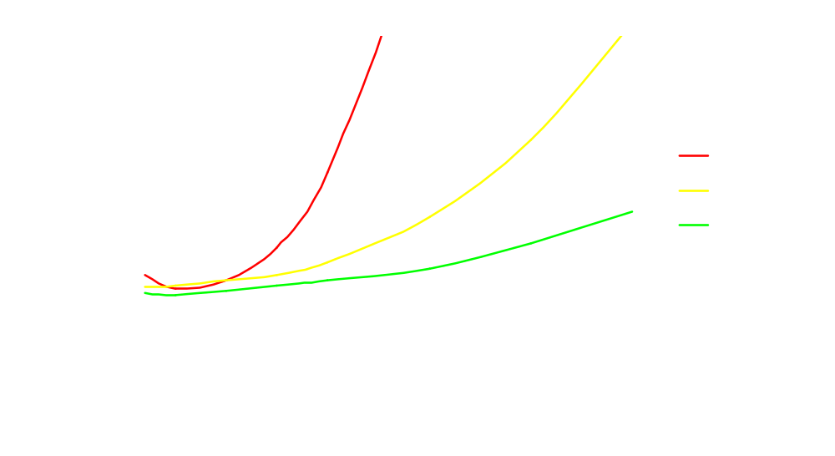
Time comparison

Slide 37
Comparison
Prim with a heap is faster than Kruskal, but Kruskal is easier to code.
Code both and choose the one you prefer.

Slide 38
Building Roads
(USACO Silver Dec. ’07 competition)
Building Roads
Farmer John had acquired several new farms!
He wants to connect the farms with roads so that he can travel from any farm to any other farm via a sequence of roads
Roads already connect some of the farms.
Notes:
Problem 7: Building Roads [Richard Ho, 2007]
Farmer John had just acquired several new farms! He wants to connect
the farms with roads so that he can travel from any farm to any
other farm via a sequence of roads; roads already connect some of
the farms.
Each of the N (1 <= N <= 1,000) farms (conveniently numbered 1..N)
is represented by a position (X_i, Y_i) on the plane (0 <= X_i <=
1,000,000; 0 <= Y_i <= 1,000,000). Given the preexisting M roads
(1 <= M <= 1,000) as pairs of connected farms, help Farmer John
determine the smallest length of additional roads he must build to
connect all his farms.
PROBLEM NAME: roads
INPUT FORMAT:
* Line 1: Two space-separated integers: N and M
* Lines 2..N+1: Two space-separated integers: X_i and Y_i
* Lines N+2..N+M+2: Two space-separated integers: i and j, indicating
that there is already a road connecting the farm i and farm j.
SAMPLE INPUT (file roads.in):
4 1
1 1
3 1
2 3
4 3
1 4
INPUT DETAILS:
Four farms at locations (1,1), (3,1), (2,3), and (4,3). Farms 1 and 4 are
connected by a road.
OUTPUT FORMAT:
* Line 1: Smallest length of additional roads required to connect all
farms, printed without rounding to two decimal places. Be sure
to calculate distances as 64-bit floating point numbers.
SAMPLE OUTPUT (file roads.out):
4.00
OUTPUT DETAILS:
Connect farms 1 and 2 with a road that is 2.00 units long, then connect
farms 3 and 4 with a road that is 2.00 units long. This is the best we can
do, and gives us a total of 4.00 unit lengths.

Slide 39
Building Roads
(USACO Silver Dec. ’07 competition)
This can be done by using any algorithm to find a MST.
The edge weights are the Euclidean distances between the farms
The easiest option is to use the O(n²) version of Prim’s algorithm.
Notes:
We note that since all edges have non-negative weights, there will not be a cycle in the final version of the graph. Thus, this problem is equivalent to finding the minimum spanning tree in a graph where the edge weights are the Euclidean distances (with the exception of a few whose distances are set to zero).
Several minimum spanning tree algorithms can be use here. Since we're finding the MST of a dense graph, the best option is probably the O(n^2) version of the Prim algorithm:
* Start with the tree being a single vertex
* Keep a list of distances of every other vertex to the tree
* At each iteration
o Add the closest vertex to the tree
o Update the distances accordingly.
This runs in O(n^2) time, which suffices for this problem.
By the way: This problem can actually be done in O(nlogn+m) time. The idea is basically the edges that could potentially be in the minimum spanning tree must belong to what's known as the Delaunay triangulation, which has O(n) edges. We can find the Delaunary triangulation in O(nlogn) time and apply a fast version of Kruskal's algorithm for sparse graphs to get the desired runtime.

