Slide 1

Brute force
“Obvious” solution
Enumerate all possibilities
Reliable way to score 30-50%

Slide 2
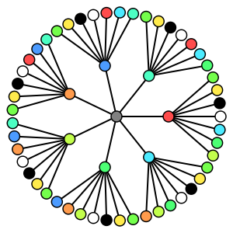
Depth-first search
Recursively enumerate all possibilities
Takes n^m time, where n is the depth and m is the branching factor
Backtracking can speed this up

Slide 3
permutations/combinations
Permutations: possible orderings of the elements of a set
For each element, generate the permutations for the remaining elements and prepend that element
Combinations: ways of selecting subsets of size K
For each element from 1 to N-K-1, recursively generate combinations of size K-1 for elements after that one
{1, 2, 3}
{1, 3, 2}
{2, 1, 3}
{2, 3, 1}
{3, 1, 2}
{3, 2, 1}
{1, 2, 3}
{1, 2}
{1, 3}
{2, 3}

Slide 4
Generating all subsets
Solution 1:
Use bits of integer as flags for membership
Increment
x & (1<<n) is non-zero if (n+1)th bit is set
Solution 2:
Depth-first search
000
001
010
011
100
101
110
111

Slide 5
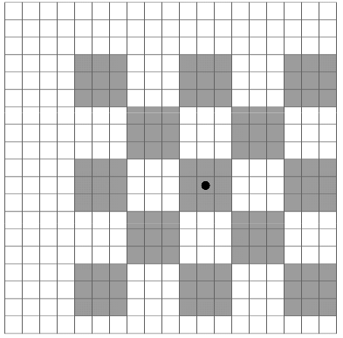
Problem example 1 - aliens
Brute force: O(n)
Brute force marks: 40
Linear search

Slide 6
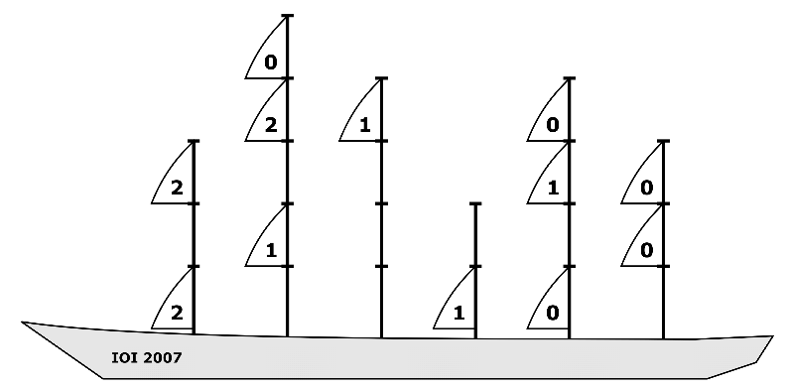
Problem example 2 - sails
“In test cases worth a total of 25 points, the total number of ways to arrange the sails will be at most 1000000”
Generate all combinations for each mast
Other suboptimal solutions may be easier

Slide 7
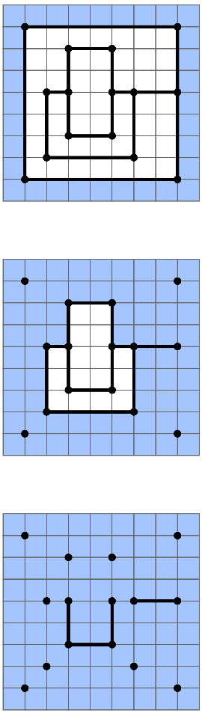
Problem example 3 - flood
Walls flooded on one side only collapse in 1 hour
Determine which walls will not collapse
Brute force: O(W.H)
Brute force marks: 40
0-1 BFS

